Slide 1
Day-3

Slide 2
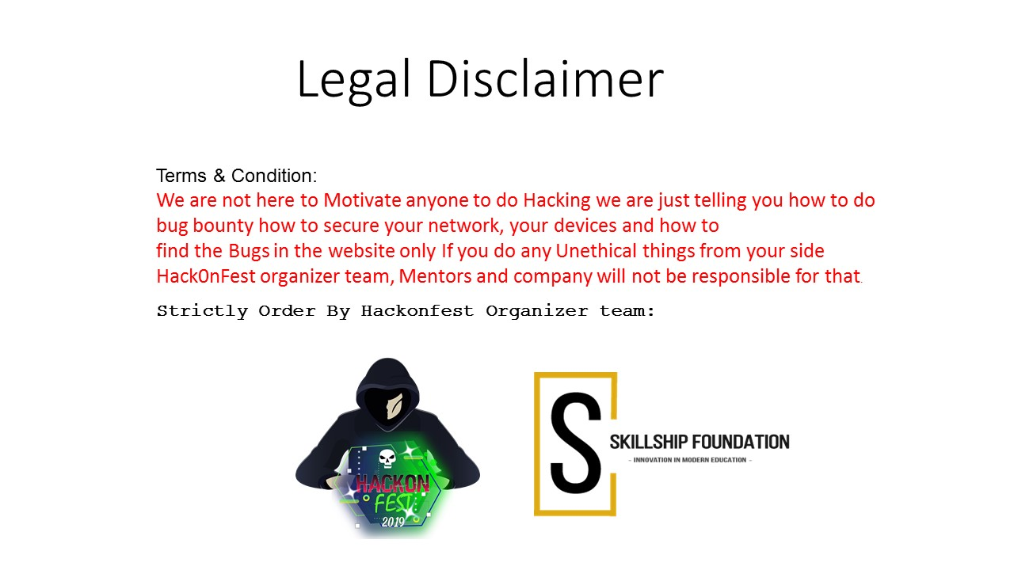

Slide 3
Exposed Source Code Control System
A lot of people will simple copy down a git directory and throw it on there website without realizing they might have just exposed their sites source code to the world. Git and Subversion are two of the most popular revision control systems and they contain a hidden file that can cause a lot of harm if uploaded to your website.

Slide 4
Tools
GitTool - gitdumper :
Command - . / gitdumper.sh target-website.com/.git /output-dir/
SvnTool - svn-extrator:
Command - svn-extractor.py --url <target-website-url>

Slide 5
Long Password DOS Attack
By sending a very long password (1.000.000 characters) it's possible to cause a denial a service attack on the server. This may lead to the website becoming unavailable or unresponsive. Usually this problem is caused by a vulnerable password hashing implementation. When a long password is sent, the password hashing process will result in CPU and memory exhaustion.

Slide 6
Password Reset Poisoning
Password Reset Poisoning is one such vulnerability, that leverages commonly unthought of headers, such as the Host header seen in an HTTP request.

Slide 7
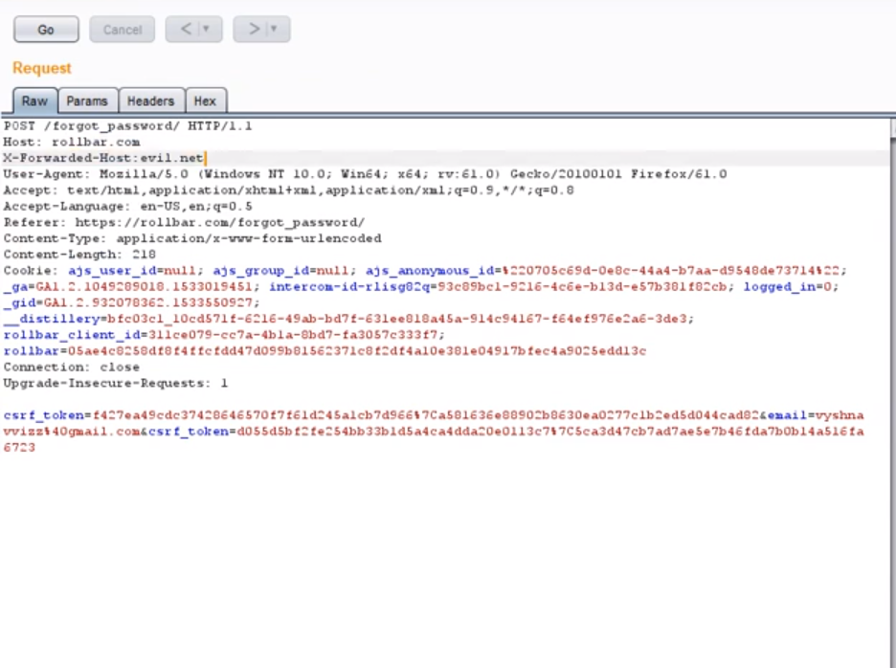

Slide 8
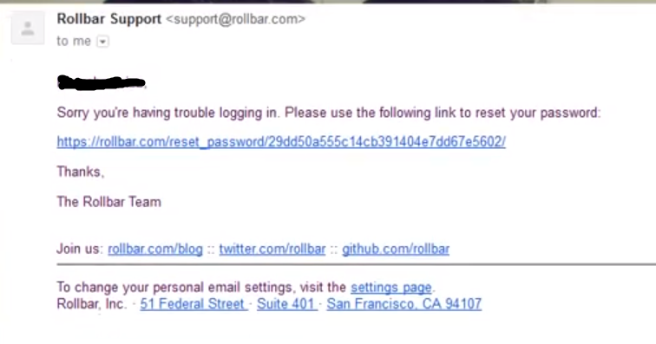

Slide 9
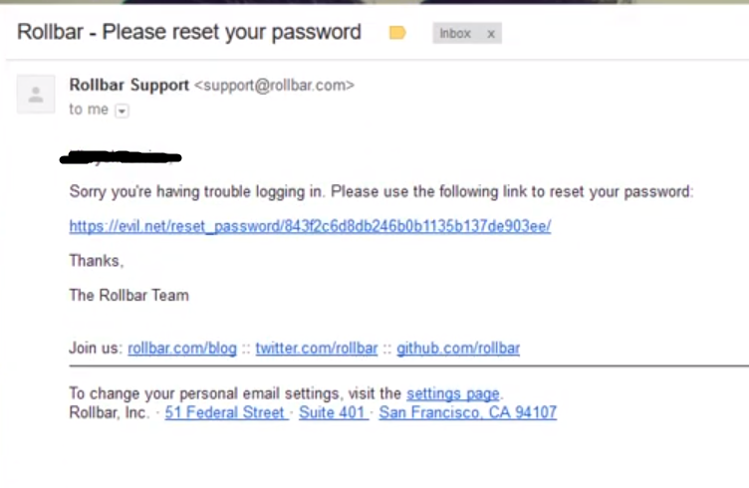

Slide 10
