Slide 1
PIP4004: UNIVERSITY PROJECT Final Presentation E-Waste Facility Locator
Batch Number:
Roll No Student Name
20221lcs0012 Padma sanjana
20221lcs0006 Yakesh Krishan D
20221lcs0021 Akash M P
20221lcs0019 Ashok K
20211cse0482 Jaykrishna L
Under the Supervision of,
Dr. Sivaramakrishnan S
Associate Professor
School of Computer Science and Engineering
Presidency University
Name of the Program: CSE
Name of the HoD: Asif Mohammed H.B
Name of the Program Project Coordinator: Mr. Amarnath J.L & Dr. Jayanthi. K.
Name of the School Project Coordinators: Dr. Sampath A K / Dr. Abdul Khadar A / Mr. Md Ziaur Rahman

Slide 2
Content
Introduction
Literature Review
Drawbacks of Existing Methods
Proposed Method
Objectives
Methodology / Modules
Architecture
Hardware / Software Components
Timeline of Project
Expected Outcomes
Conclusion
Git hub link

Slide 3
Introduction
Rapid urban growth has led to a surge in waste production, making manual waste sorting inefficient and error-prone.
Inconsistent segregation increases landfill pressure and reduces recycling efficiency.
This project introduces an AI-based solution using ResNet50 and PyTorch to automate waste classification.
Trained on the TrashNet dataset, the model identifies six waste types: plastic, metal, glass, cardboard, paper, and general trash.
With data augmentation techniques, the model adapts well to real-world scenarios with varied lighting and angles.
Achieved a validation accuracy of 97.86%, demonstrating potential for real-world deployment in smart cities.

Slide 4
Literature Review
Deep Learning in Waste Sorting: Recent studies show Convolutional Neural Networks (CNNs) achieve high accuracy in image-based waste classification.
ResNet50 Superiority: Models like ResNet50 outperform basic CNNs by leveraging residual connections, improving gradient flow and learning efficiency .
Real-time Implementation: Research highlights successful deployment of lightweight CNNs on embedded systems for real-time classification .
Dataset Utilization: TrashNet and similar datasets have been widely used, proving effective for training robust waste classifiers .
Transfer Learning Benefits: Using pretrained models like ResNet50 with fine-tuning reduces training time and enhances performance .

Slide 5
Existing method Drawback
Manual Sorting Limitations: Time-consuming, labor-intensive, and prone to human error, leading to inefficient recycling.
Low Generalization: Traditional models often fail in real-world conditions with poor lighting, varied angles, or noisy backgrounds.
Resource Dependency: Many methods rely on high-end hardware, limiting deployment in resource-constrained areas.
Limited Class Coverage: Some systems classify only a few types of waste, reducing practical applicability.
Inconsistent Accuracy: Without proper data augmentation and preprocessing, existing models struggle to maintain high accuracy in diverse environments.

Slide 6
Proposed Method
Architecture Used: ResNet50 deep CNN model known for its residual connections and robust feature extraction capabilities.
Dataset: Trained on the TrashNet dataset, covering 6 waste categories — plastic, metal, glass, cardboard, paper, and trash.
Data Augmentation: Techniques like flipping, rotation, grayscale conversion, and brightness adjustment simulate real-world variations.
Training Framework: Implemented using PyTorch, trained for 25 epochs on GPU-supported systems.
Output Layer: Modified to classify six categories using a softmax activation function.
Optimization: Used Adam optimizer and cross-entropy loss for better learning performance.

Slide 7
Objectives
Develop an AI-based waste classification system using the ResNet50 architecture.
Automate the identification of six common waste categories from real-world images.
Improve classification performance under varied lighting, angles, and image quality through data augmentation.
Ensure the model can run on low-resource setups with basic GPU support.
Design a scalable and practical solution suitable for integration into smart bins, recycling units, and municipal systems.

Slide 8
Methodology / Modules
Dataset Preparation
Used TrashNet dataset with 2,500 labeled images across 6 waste categories.
Images resized to 224×224 and normalized using ImageNet standards.
Data Augmentation
Applied flipping, rotation, grayscale conversion, and brightness adjustments.
Enhances robustness to real-world variations in lighting and angles.
Model Architecture
Used ResNet50, a deep CNN with residual connections to prevent vanishing gradients.
Final layer modified to classify six waste types using a softmax activation function.
Training Setup
Framework: PyTorch, trained over 25 epochs using Adam optimizer and cross-entropy loss.
Data split: 80% training, 20% validation.
Metrics recorded per epoch for performance monitoring.

Slide 9
Architecture
Input Layer Accepts 224×224 pixel images with 3 channels (RGB).
Convolutional Layers Initial 7×7 convolution with stride 2 and padding, followed by batch normalization, ReLU activation, and max pooling.
Residual Blocks Includes multiple bottleneck blocks with skip (residual) connections to improve gradient flow and deepen the network without degradation.
Adaptive Average Pooling Reduces spatial dimensions before the fully connected layer.
Fully Connected Layer Final layer modified to output 6 waste categories, followed by softmax activation for classification.
Highlights
Efficient gradient propagation using residual connections.
Deep feature extraction for high accuracy.
Robust to variations in image quality and angles.

Slide 10
Hardware/software components
Hardware
System: GPU-enabled PC or laptop
GPU: NVIDIA-supported GPU for faster training
Minimum Setup: Can run on low-end hardware for deployment
Software
Framework: PyTorch
Language: Python
Libraries:
torchvision for data augmentation and model handling
matplotlib / seaborn for result visualization
PIL, NumPy for image and data processing
Dataset
TrashNet Dataset
6 categories: Plastic, Metal, Glass, Cardboard, Paper, Trash
2,500 labeled images
Environment
OS: Windows/Linux
IDE: Jupyter Notebook / VS Code

Slide 11
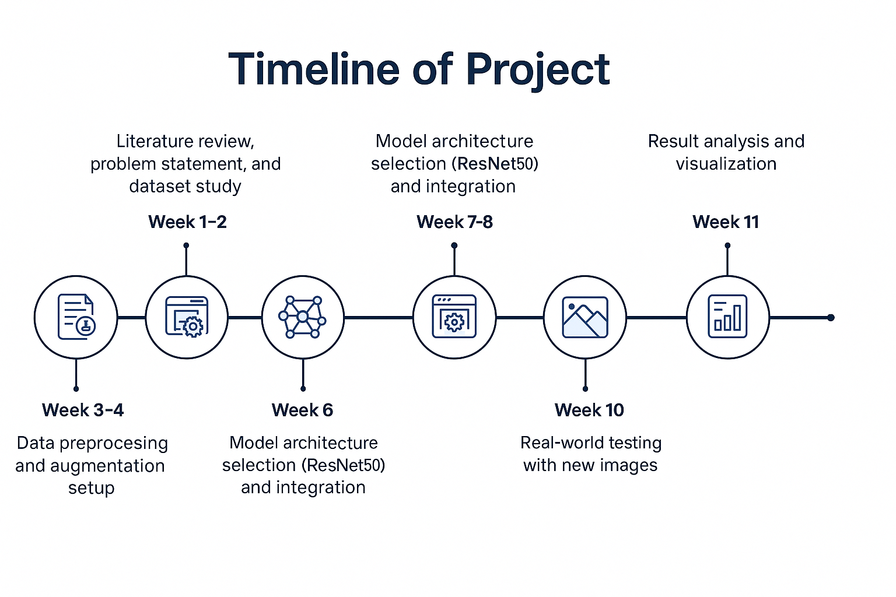
Timeline of Project

Slide 12
Expected Outcomes
A working AI model capable of accurately classifying six types of waste with 97.86% validation accuracy.
Demonstrated ability to handle real-world image variations such as lighting, angle, and noise.
A lightweight, resource-efficient system deployable on basic GPU setups or embedded devices.
Practical potential for integration into smart bins, municipal recycling centers, or real-time waste sorting systems.
A reusable and scalable AI pipeline that can be extended to other environmental classification tasks.

Slide 13
Conclusion
The project successfully developed a deep learning-based waste classification system using ResNet50 and the TrashNet dataset.
Through effective data preprocessing, augmentation, and model tuning, the system achieved high accuracy in real-world scenarios.
The model proved to be efficient, scalable, and capable of running on low-resource hardware, making it suitable for practical deployment.
This work demonstrates that AI-powered waste management is both feasible and impactful, offering a cost-effective solution for smarter, cleaner cities.

Slide 14
Analysis of Problem Statement
Technology Stack Components:
Frontend
HTML5, CSS3, JavaScript: For structuring and styling the web pages.
React.js (or Vanilla JavaScript): For building a dynamic and responsive user interface.
Bootstrap/Tailwind CSS: For a responsive and modern design.
Backend
Node.js with Express.js: For server-side logic and handling API requests.
RESTful API: To fetch and serve e-waste facility data.
Database
MongoDB: To store facility data (locations, contact info, services).
Firebase Realtime Database (Alternative): For cloud-based storage and real-time updates.
Mapping and Location Services
Google Maps API: For displaying facility locations on the map.
Geolocation API: To identify the user’s current location.
Hosting
Netlify/Vercel: For hosting the frontend.
Render/Heroku: For backend deployment.

Slide 15
Analysis of Problem Statement (contd...)
Software Requirements:
Operating System: Windows 10, macOS, or Linux.
IDE/Text Editor: Visual Studio Code, Sublime Text, or Atom.
Browser: Google Chrome, Mozilla Firefox, or Edge (for testing and development).
Node.js: For backend development.
MongoDB Atlas: Cloud-based database for easy deployment.
Google Maps API Key: For location services.
Libraries/Frameworks:
React.js for the frontend.
Express.js for the backend.
Bootstrap/Tailwind for styling.

Slide 16
Analysis of Problem Statement (contd...)
Hardware Requirements :
Development Machine:
Processor: Intel i5 or equivalent.
RAM: 8GB or higher.
Storage: 100GB free space.
Testing Devices:
Desktop/Laptop: For website testing.
Smartphone: To test mobile responsiveness.
Internet Connection: Stable connection for API integrations and hosting.

Slide 17
Conclusion
E-waste is a growing environmental challenge, and responsible disposal is essential for a sustainable future. Our E-Waste Collection and Recycling Website provides a convenient and rewarding solution for individuals to dispose of their electronic waste safely. By combining location-based services, educational resources, and an incentive-based recycling model, our platform aims to create a more responsible and eco-conscious society. Together, we can make a positive impact and contribute to a cleaner, healthier environment.

Slide 18
Github Link
The Github link provided should have public access permission.
Github Link
https://github.com/AkashManohar/E-Waste_Facility_Locator

Slide 19
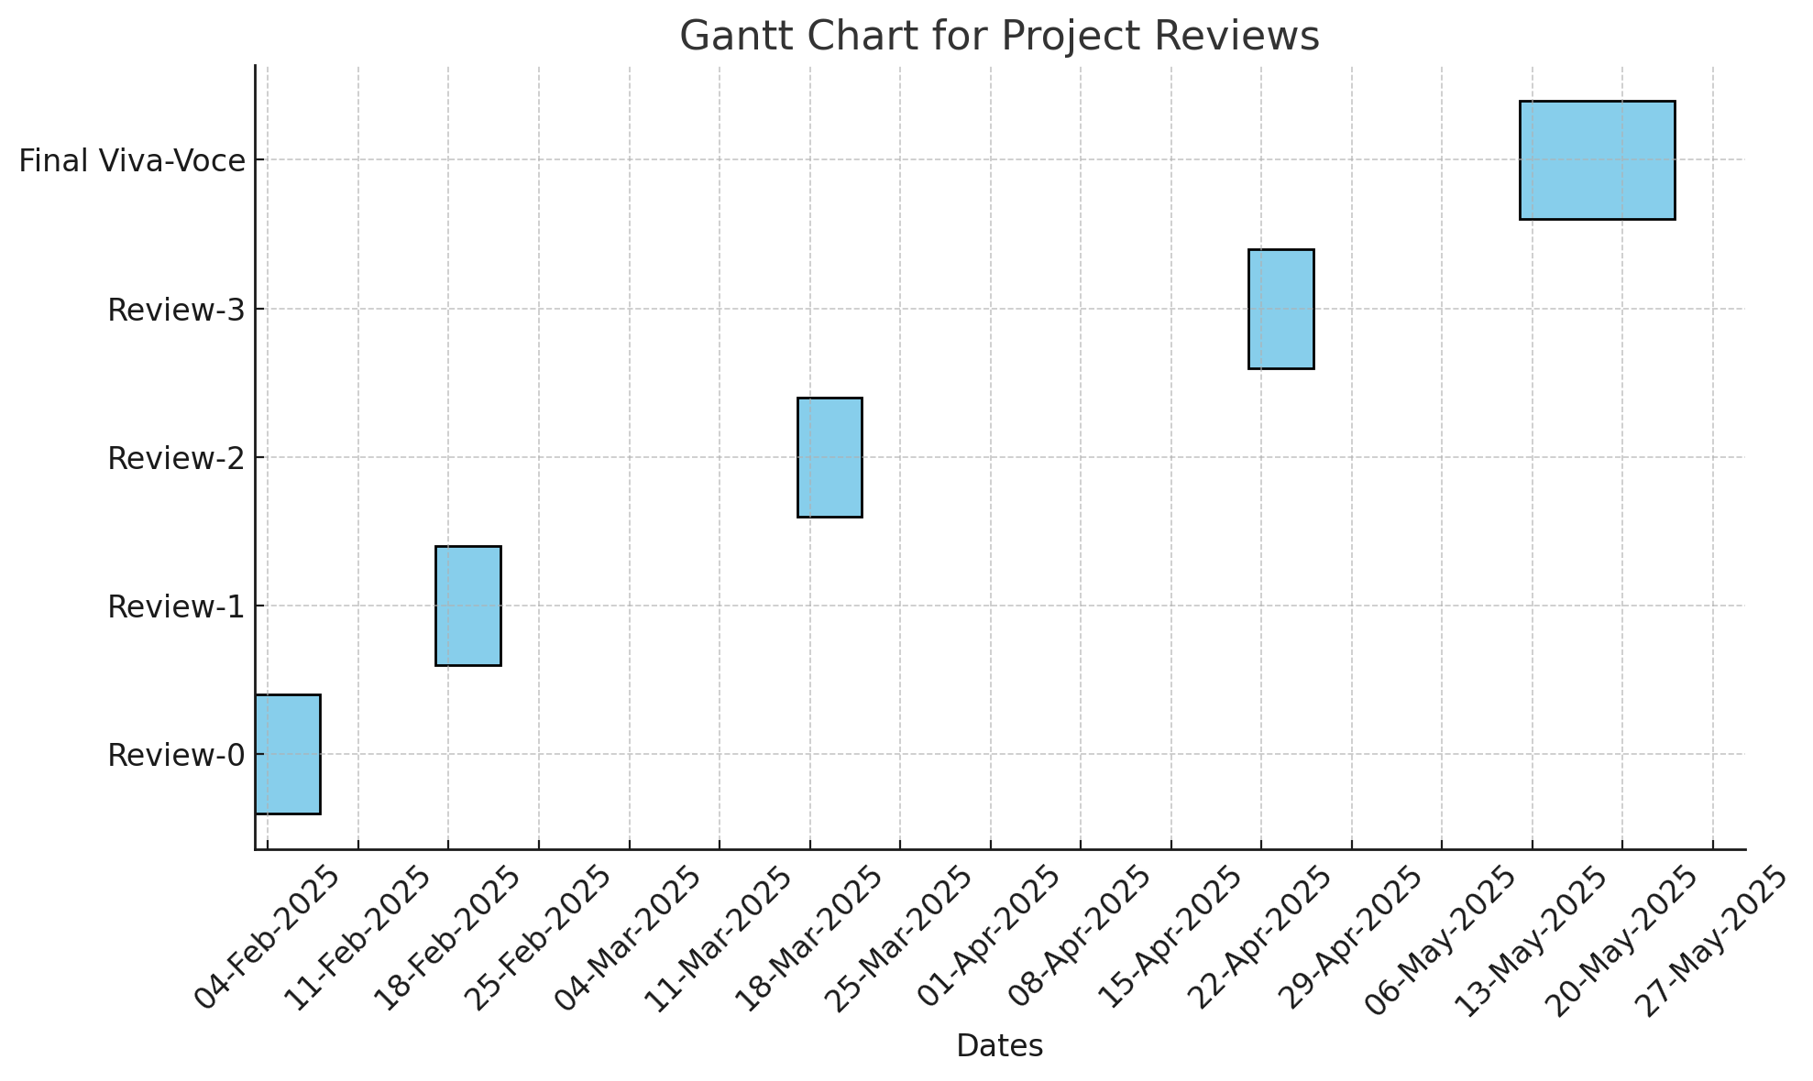
Timeline of the Project (Gantt Chart)

Slide 20
References (IEEE Paper format)
S. M. Al-Sabbagh, M. A. Al-Shawaqfeh, and A. A. Al-Hajjaj, "E-Waste Management and Recycling System: A Framework for Developing Countries," IEEE Access, vol. 7, pp. 100-110, 2019.DOI: 10.1109/ACCESS.2019.2894509
A. Sharma, K. Kumar, and R. Singh, "Effective Disposal and Recycling Techniques for E-Waste Management: A Case Study," in Proceedings of the 2018 IEEE International Conference on Environment and Electrical Engineering (EEEIC), pp. 1-6.DOI: 10.1109/EEEIC.2018.8494045

Slide 21


