Slide 1
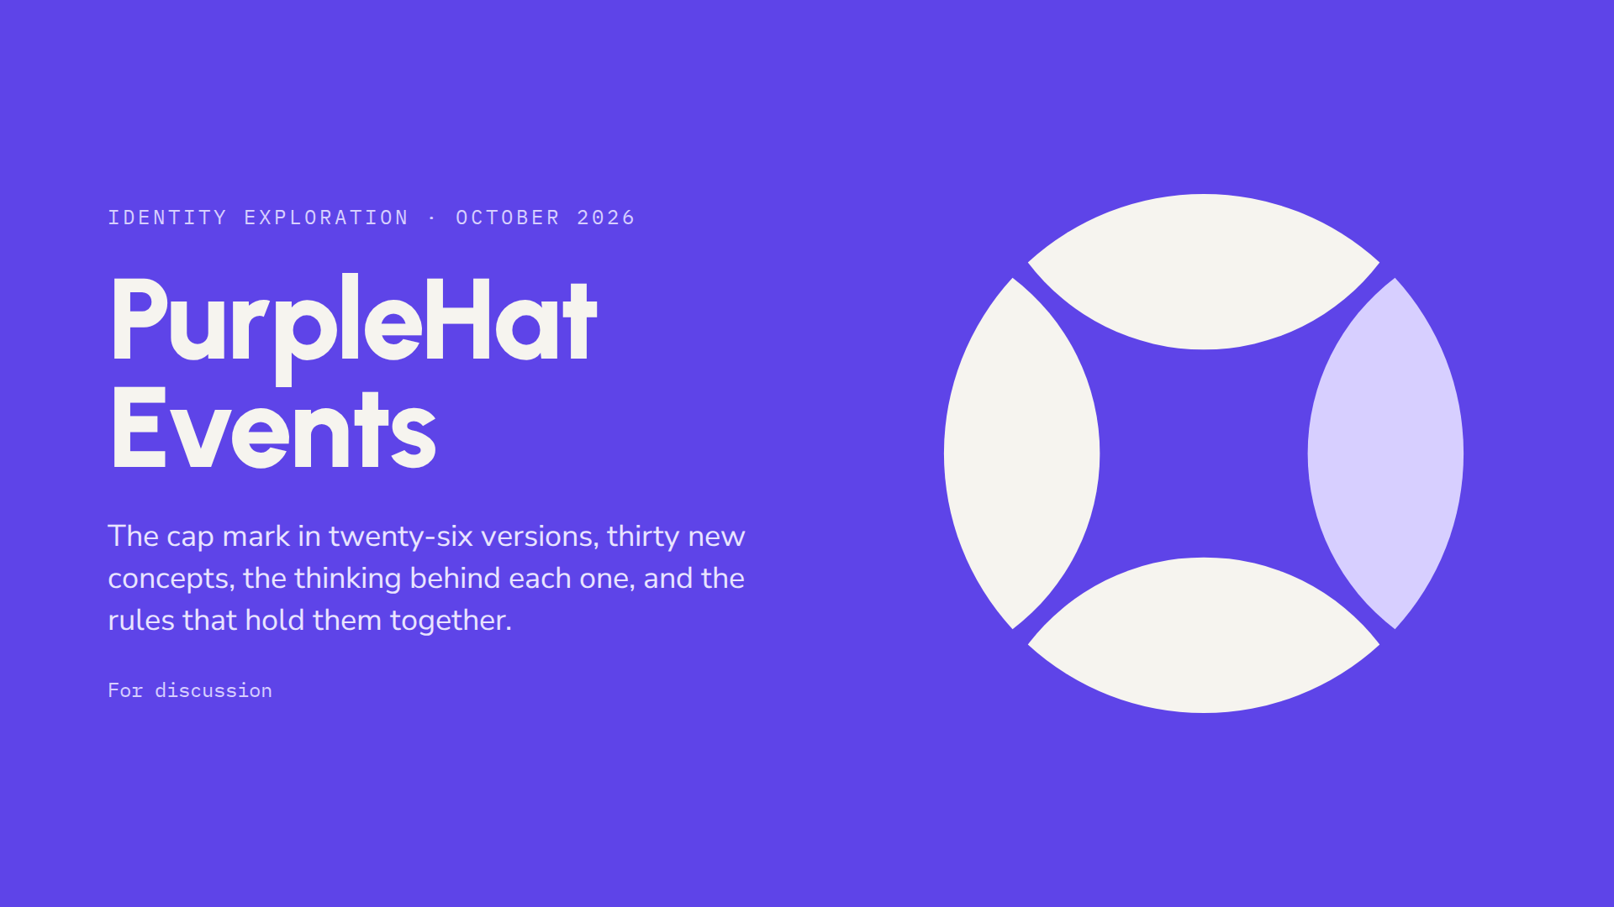
Notes:
This deck walks through the whole logo process: the brief, your original cap concept, the routes we tried and dropped, the rules we kept, and 26 versions grouped into six families. It ends with a recommendation and a short list of decisions for this meeting.

Slide 2
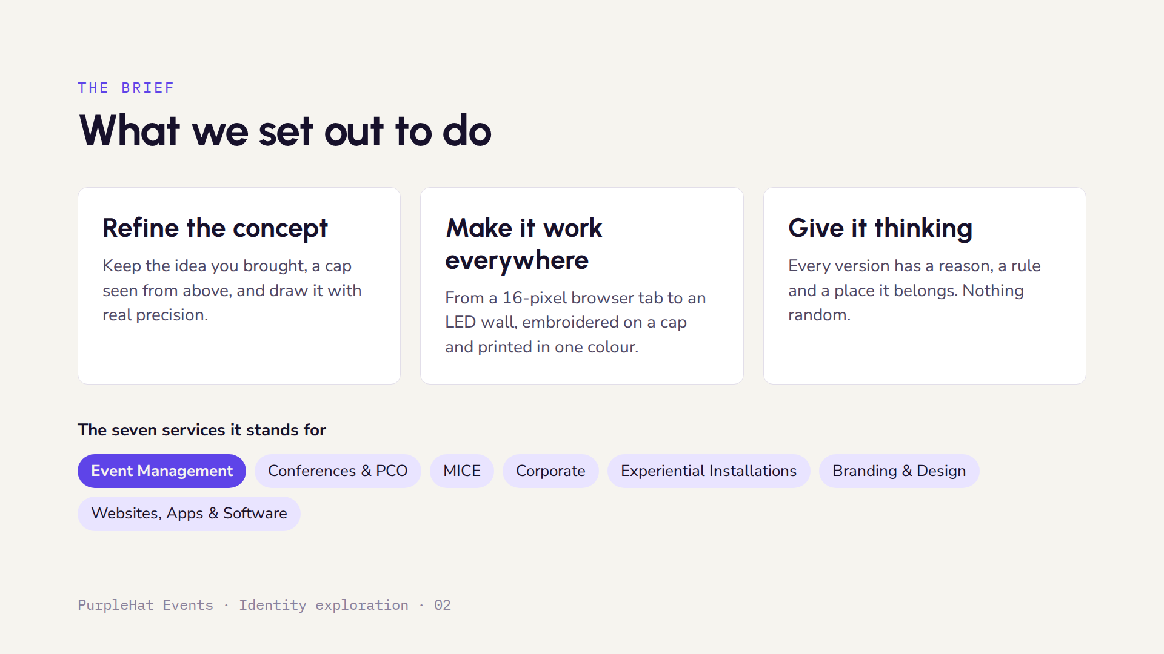
Notes:
Three goals guided everything: keep your concept and draw it precisely, make it work at every size and on every surface, and give each version a clear reason. Event Management is highlighted because it becomes the visor, the piece at the front.

Slide 3
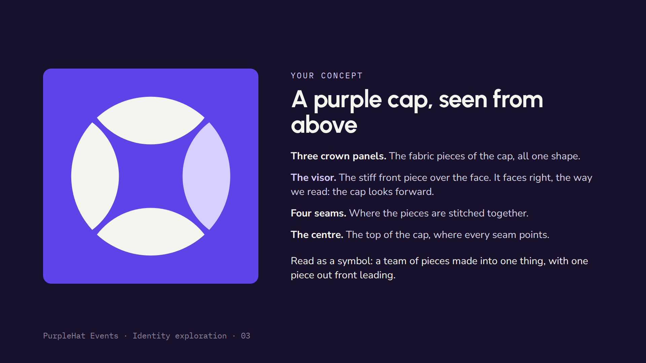
Notes:
This is the concept as you brought it. The key insight is that the lighter piece is the visor, so the cap has a front and a direction. The four seams are the stitching between the pieces. Everything after this keeps that idea.

Slide 4
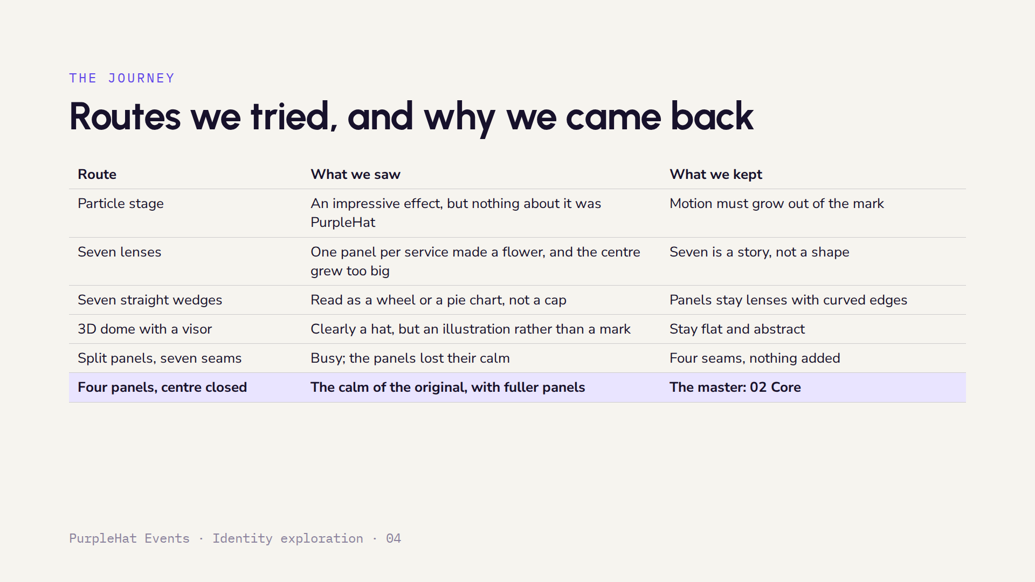
Notes:
Every route taught us something. The seven-service ideas were meaningful but made the mark busy or literal, so the services now live in the story and in the visor's role rather than in the drawing. The final row is where we landed: your original four panels with the centre slightly closed.

Slide 5
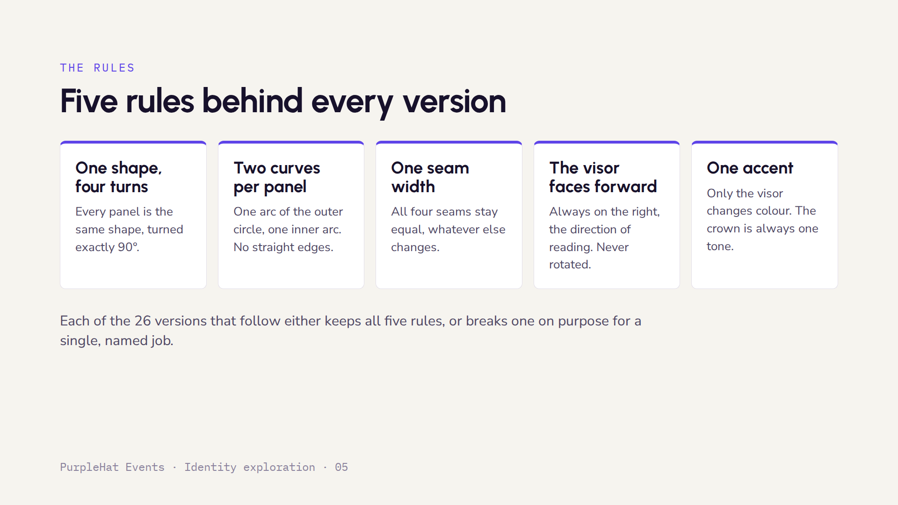
Notes:
These five rules are what make the mark feel calm and correct. When a version breaks one, for example the Tip of the hat breaks the symmetry, it is labelled as a special-purpose version, not a replacement for the master.

Slide 6
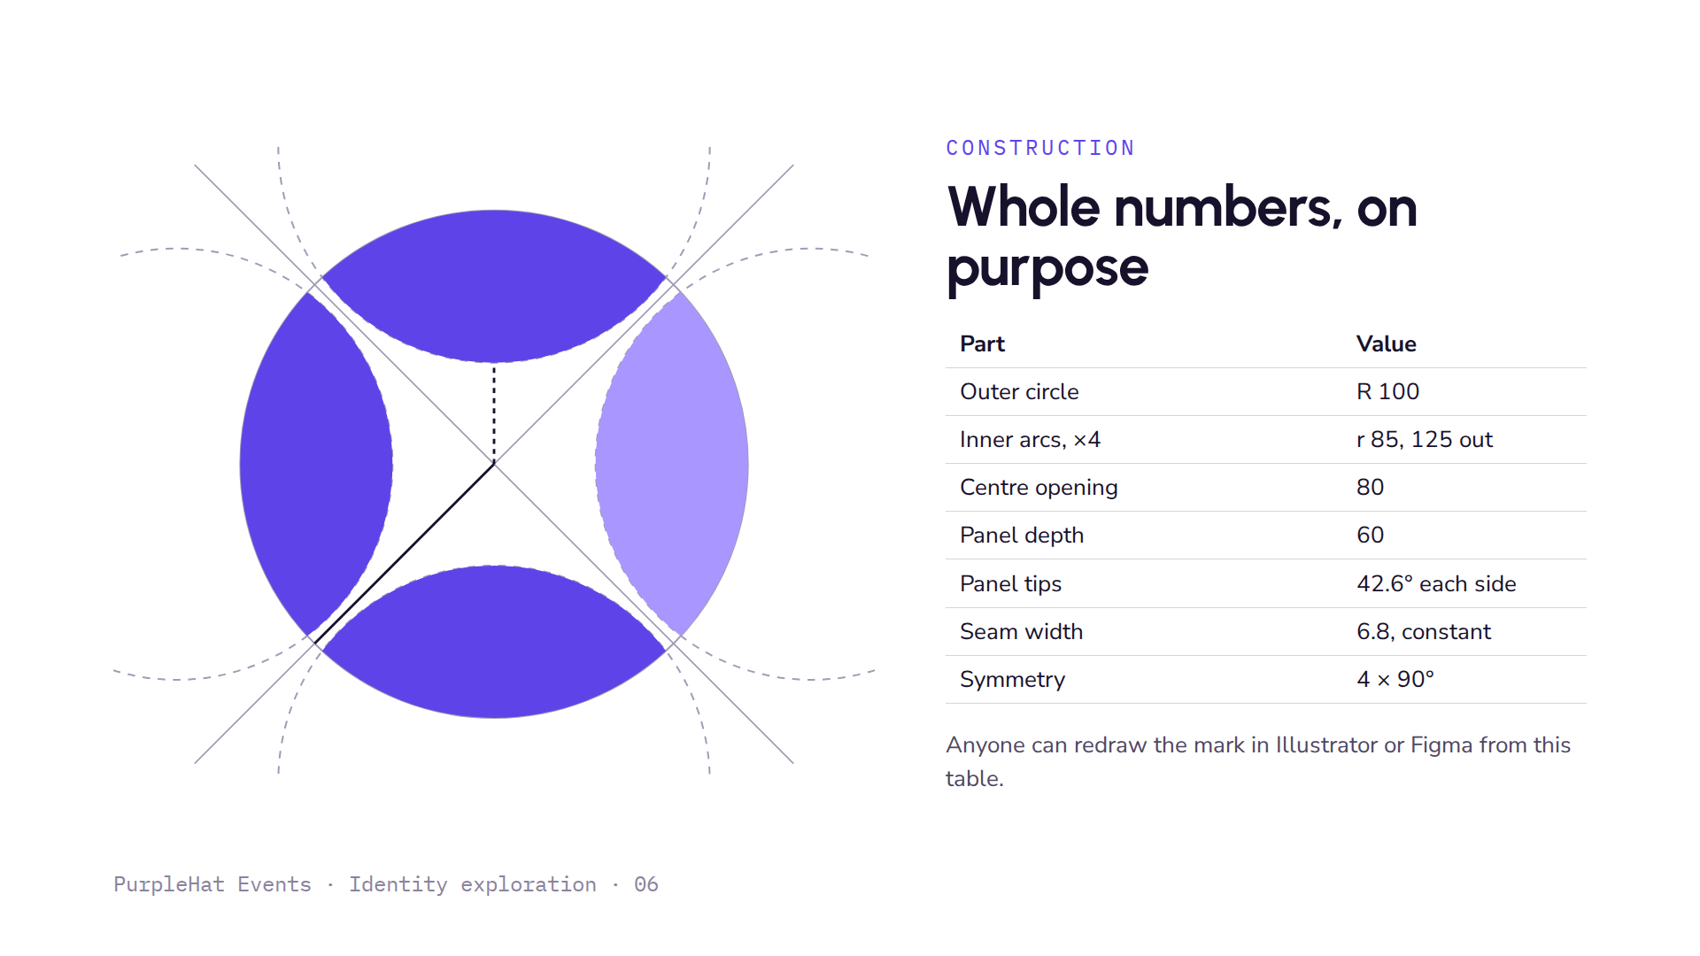
Notes:
The dashed circles are the four inner arcs. Each has a radius of 85 and sits 125 units from the centre, which makes the inner edge 40 from the centre and the opening 80 across. The solid line is the outer radius, drawn along a seam. The tips are set so each seam is exactly 6.8 units wide, the same as in the original concept.

Slide 7
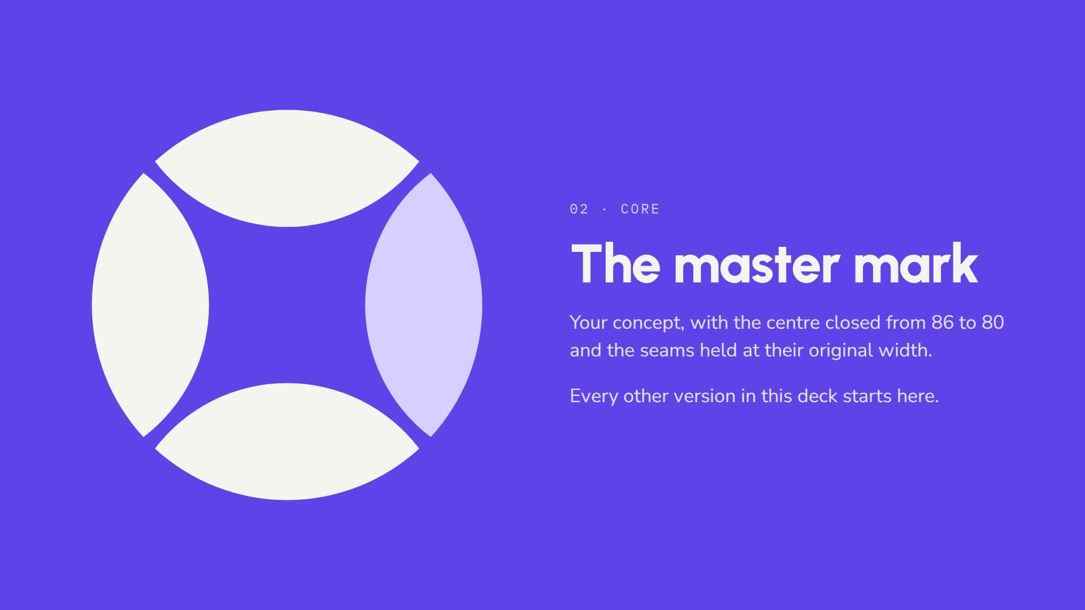
Notes:
This is the master. It is your original idea with one refinement: the centre opening is 7 percent smaller, so the panels feel fuller, while the seams stay exactly as wide as before. All 26 versions are built from this drawing.

Slide 8
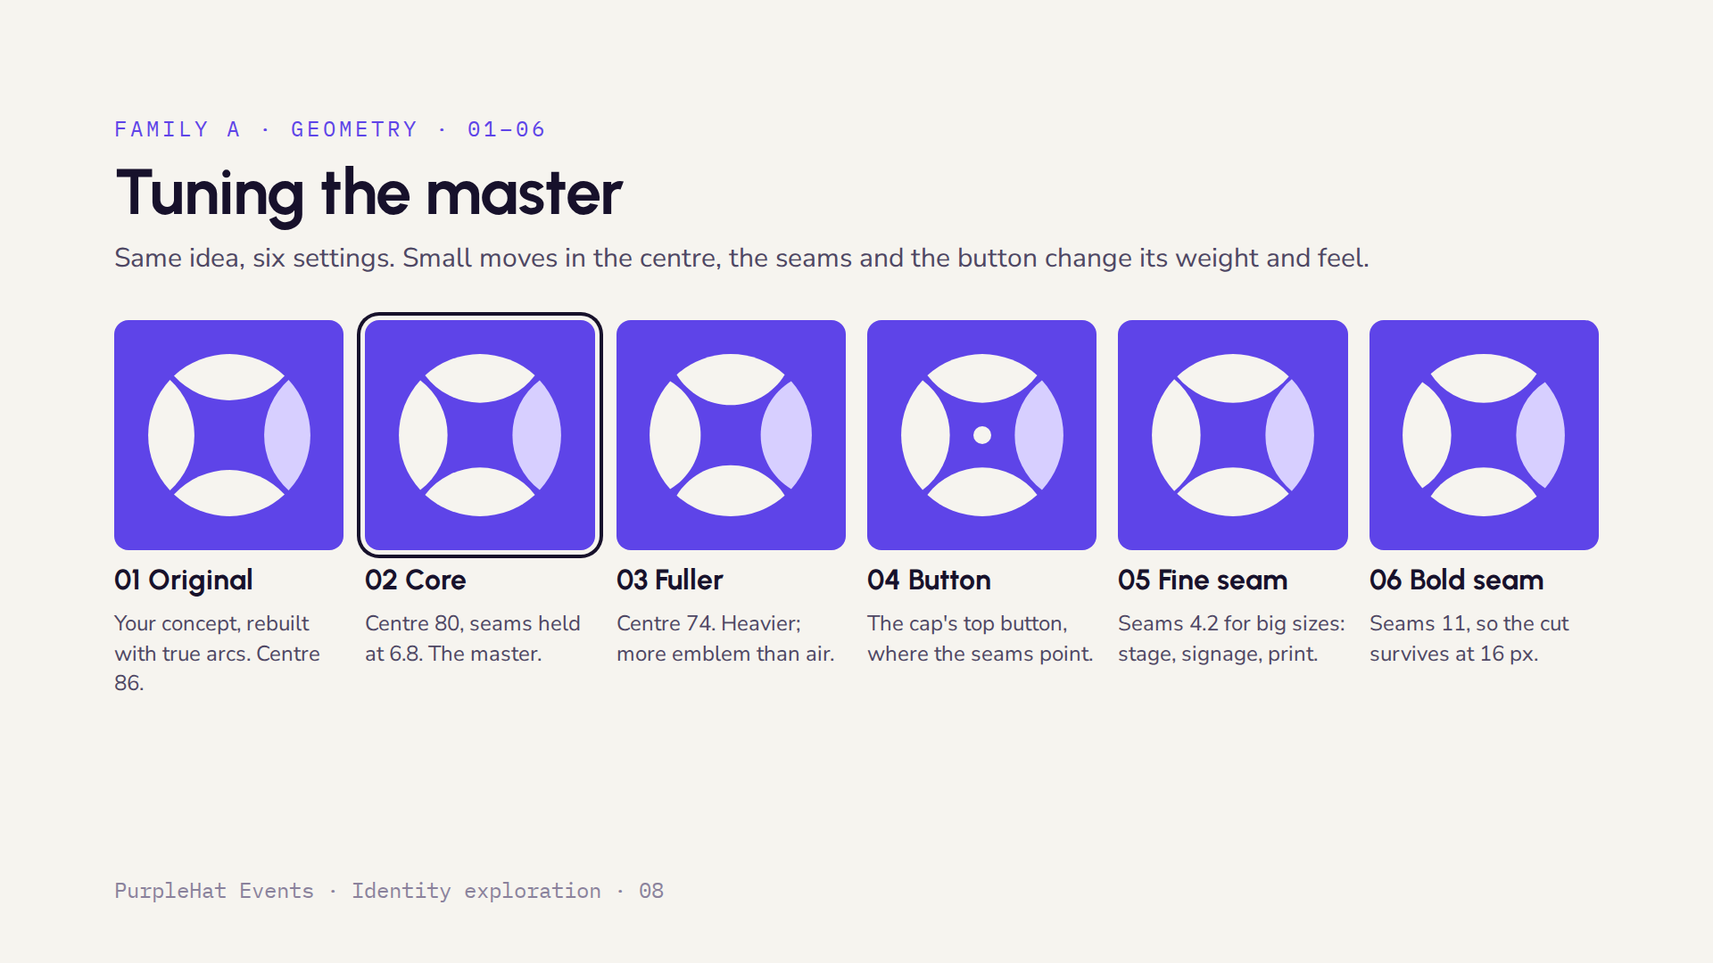
Notes:
All six keep the five rules. 01 is your concept as drawn; 02 is the master; 03 closes the centre further. 04 adds the button found on top of every real cap. 05 and 06 are size masters: the fine seam is for large surfaces where a thin cut looks elegant, the bold seam is the one to use for favicons and tiny icons.

Slide 9
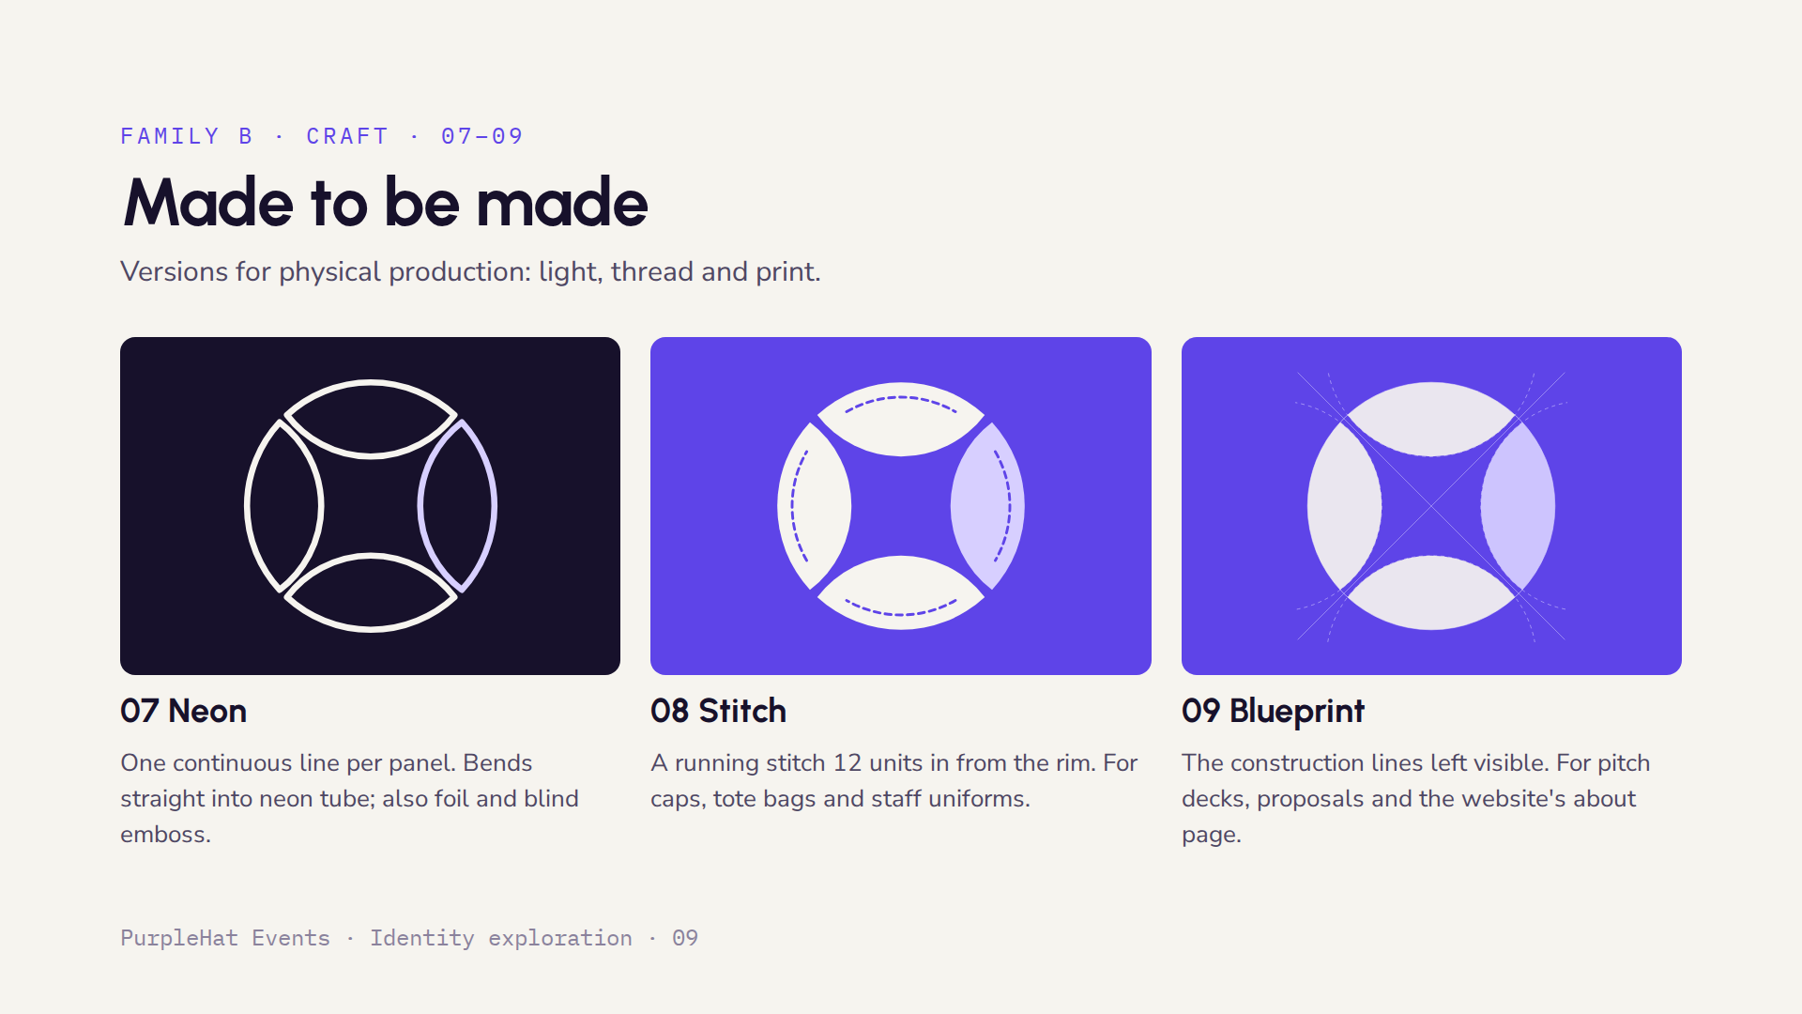
Notes:
These three are about making the mark physical. Neon works because each panel is one closed line with no crossings, so a sign maker can bend it. Stitch is the embroidery version, best on the crown of a real cap. Blueprint shows the geometry and tells clients that the identity was designed with care, which suits proposals.

Slide 10
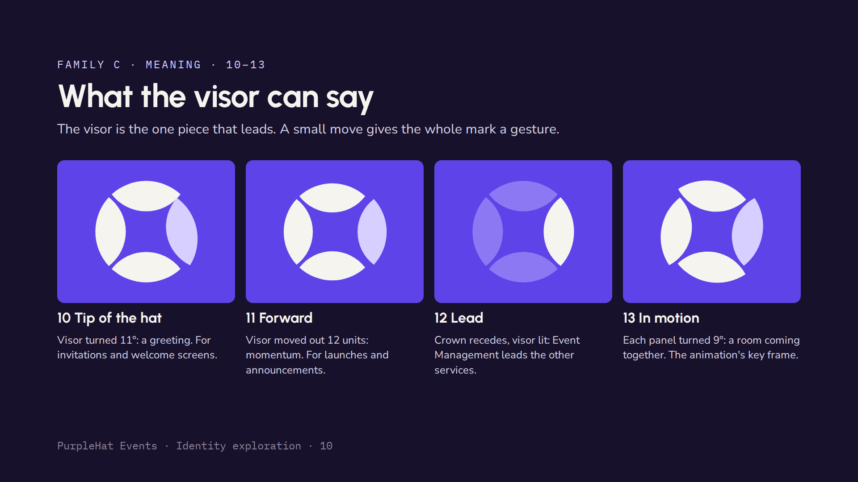
Notes:
These four break a rule on purpose to say something. Tip of the hat breaks symmetry to greet people, which suits invitations. Forward breaks the circle to suggest momentum. Lead dims the crown so the visor, Event Management, stands out. In motion turns each panel slightly; it is not a logo on its own but the starting frame of a logo animation where the panels settle into place.

Slide 11
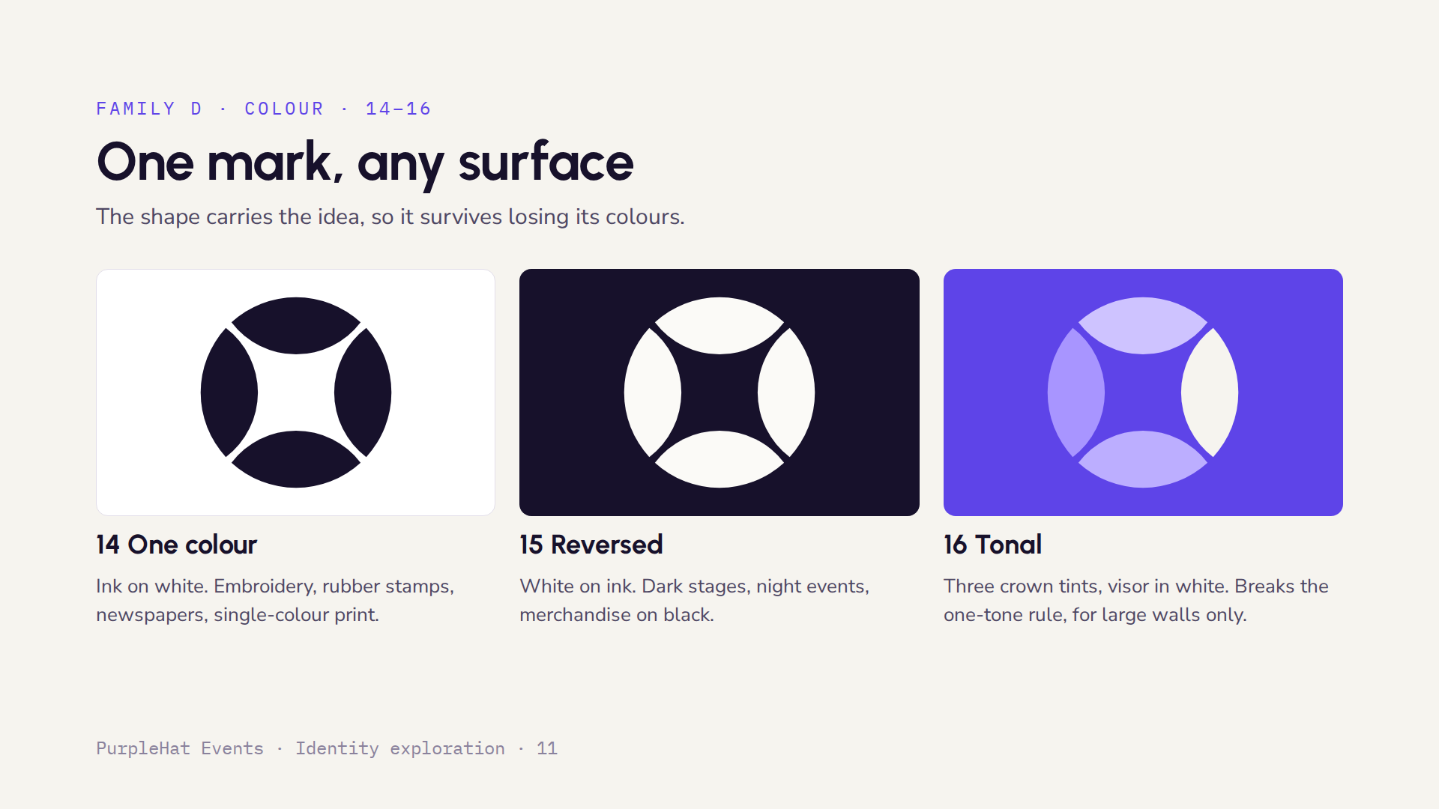
Notes:
A strong mark has to work without its colours. In one colour the visor is no longer highlighted, and the mark still reads because of its shape. Tonal is a decorative version for big surfaces such as a stage backdrop; the three tints can stand for the three pairs of services, with the visor in white for Event Management.

Slide 12
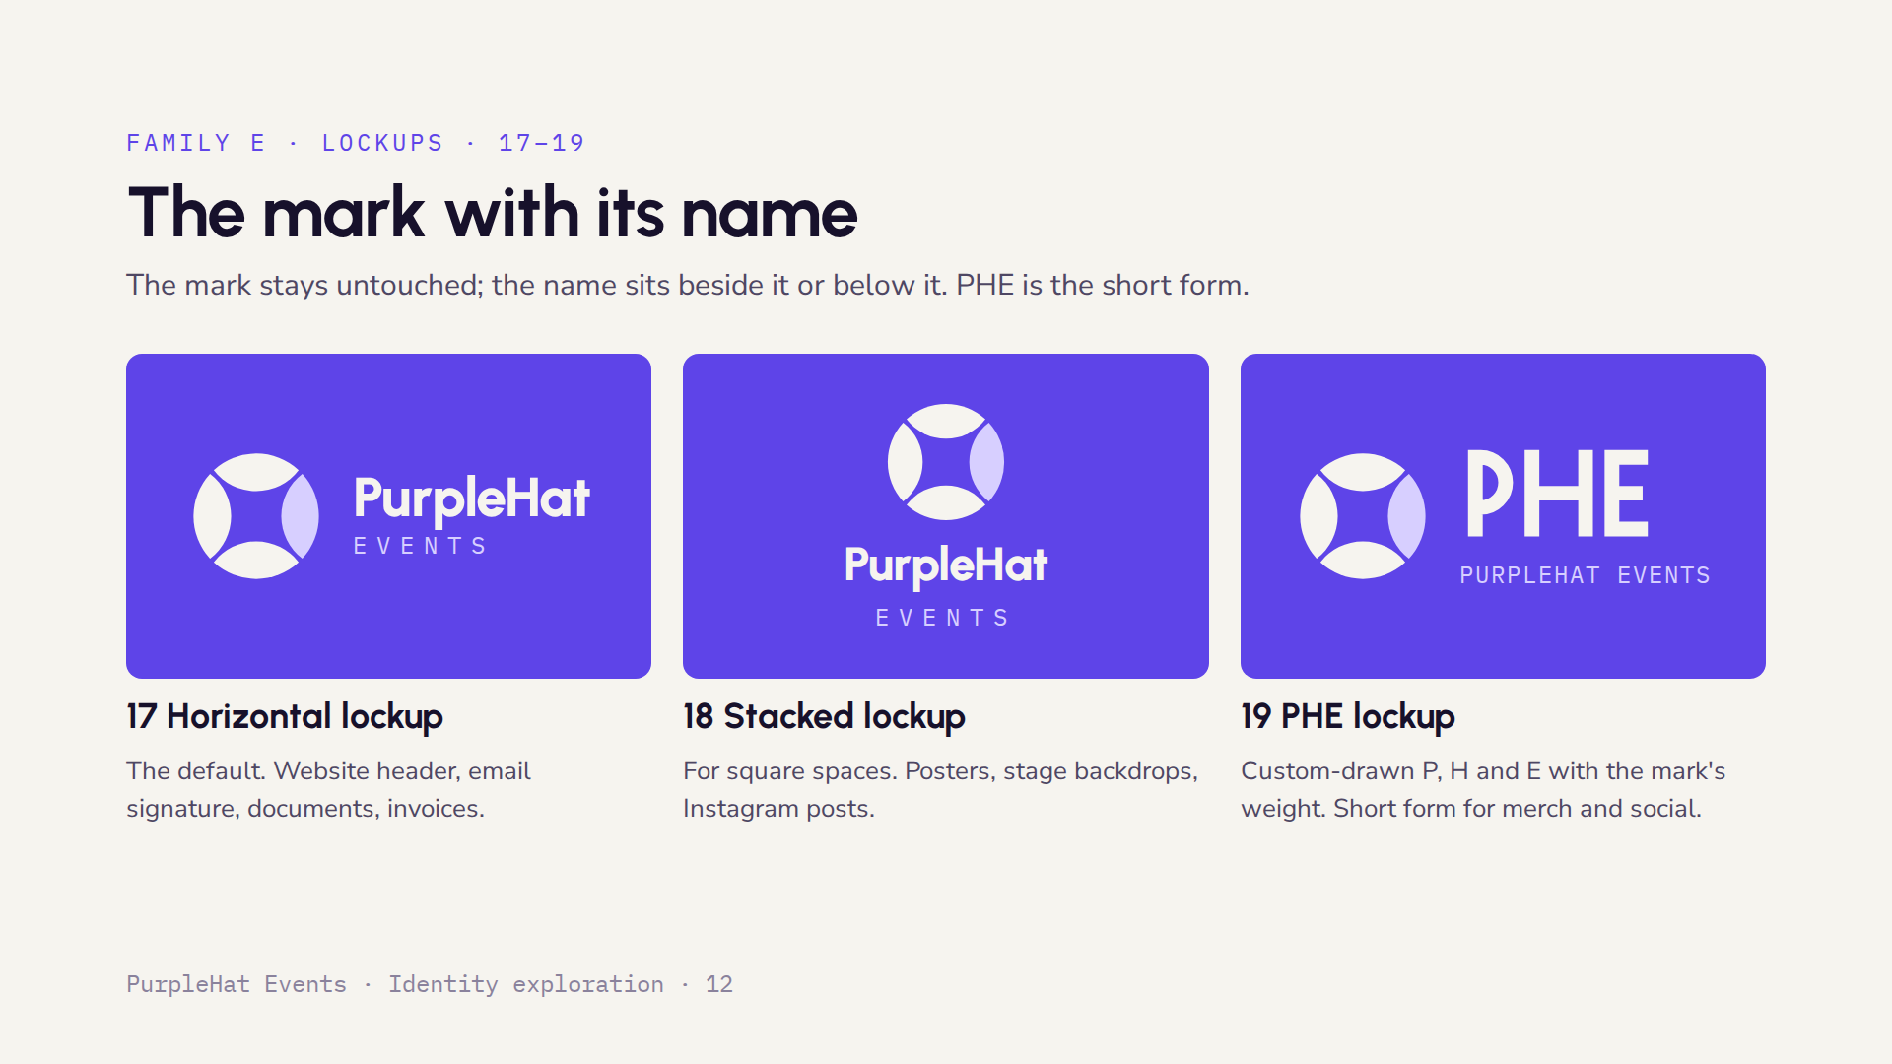
Notes:
The wordmark here is set in Urbanist as a stand-in; once a direction is chosen we would draw a custom wordmark based on it, so the round letters echo the circle of the mark. The PHE letters are already custom: drawn on a grid with square ends and a stroke that matches the weight of the panels.

Slide 13
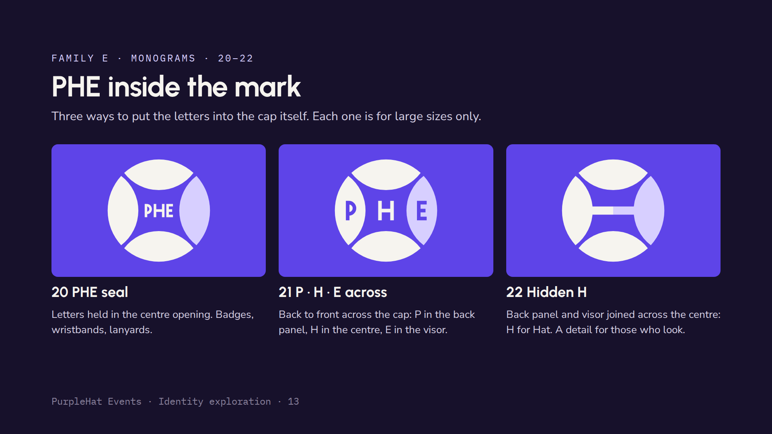
Notes:
These put the initials into the mark. They look strong large, on a lanyard or a stage, but the letters disappear below about 48 pixels, so none of them can replace the plain mark. The Hidden H is the most subtle: it reads as a bar until someone points out the H, which can be a nice story to tell clients.

Slide 14
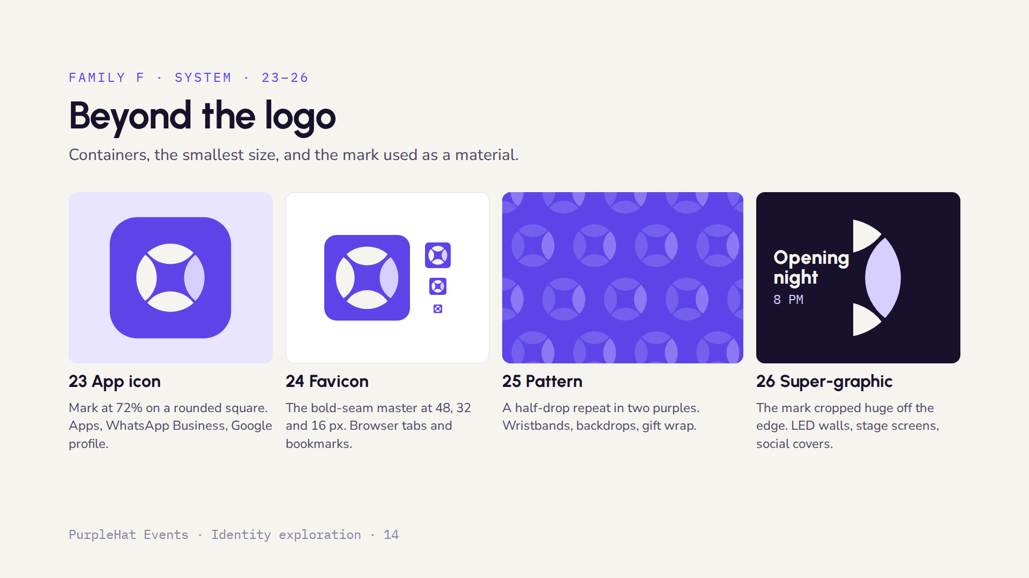
Notes:
These turn the mark into a system. The app icon and favicon cover the smallest uses; the favicon uses the bold-seam master so the seams stay open at 16 pixels. The pattern and the super-graphic use the mark as a material, so event screens and printed materials feel like PurpleHat even when the full logo is not shown.

Slide 15
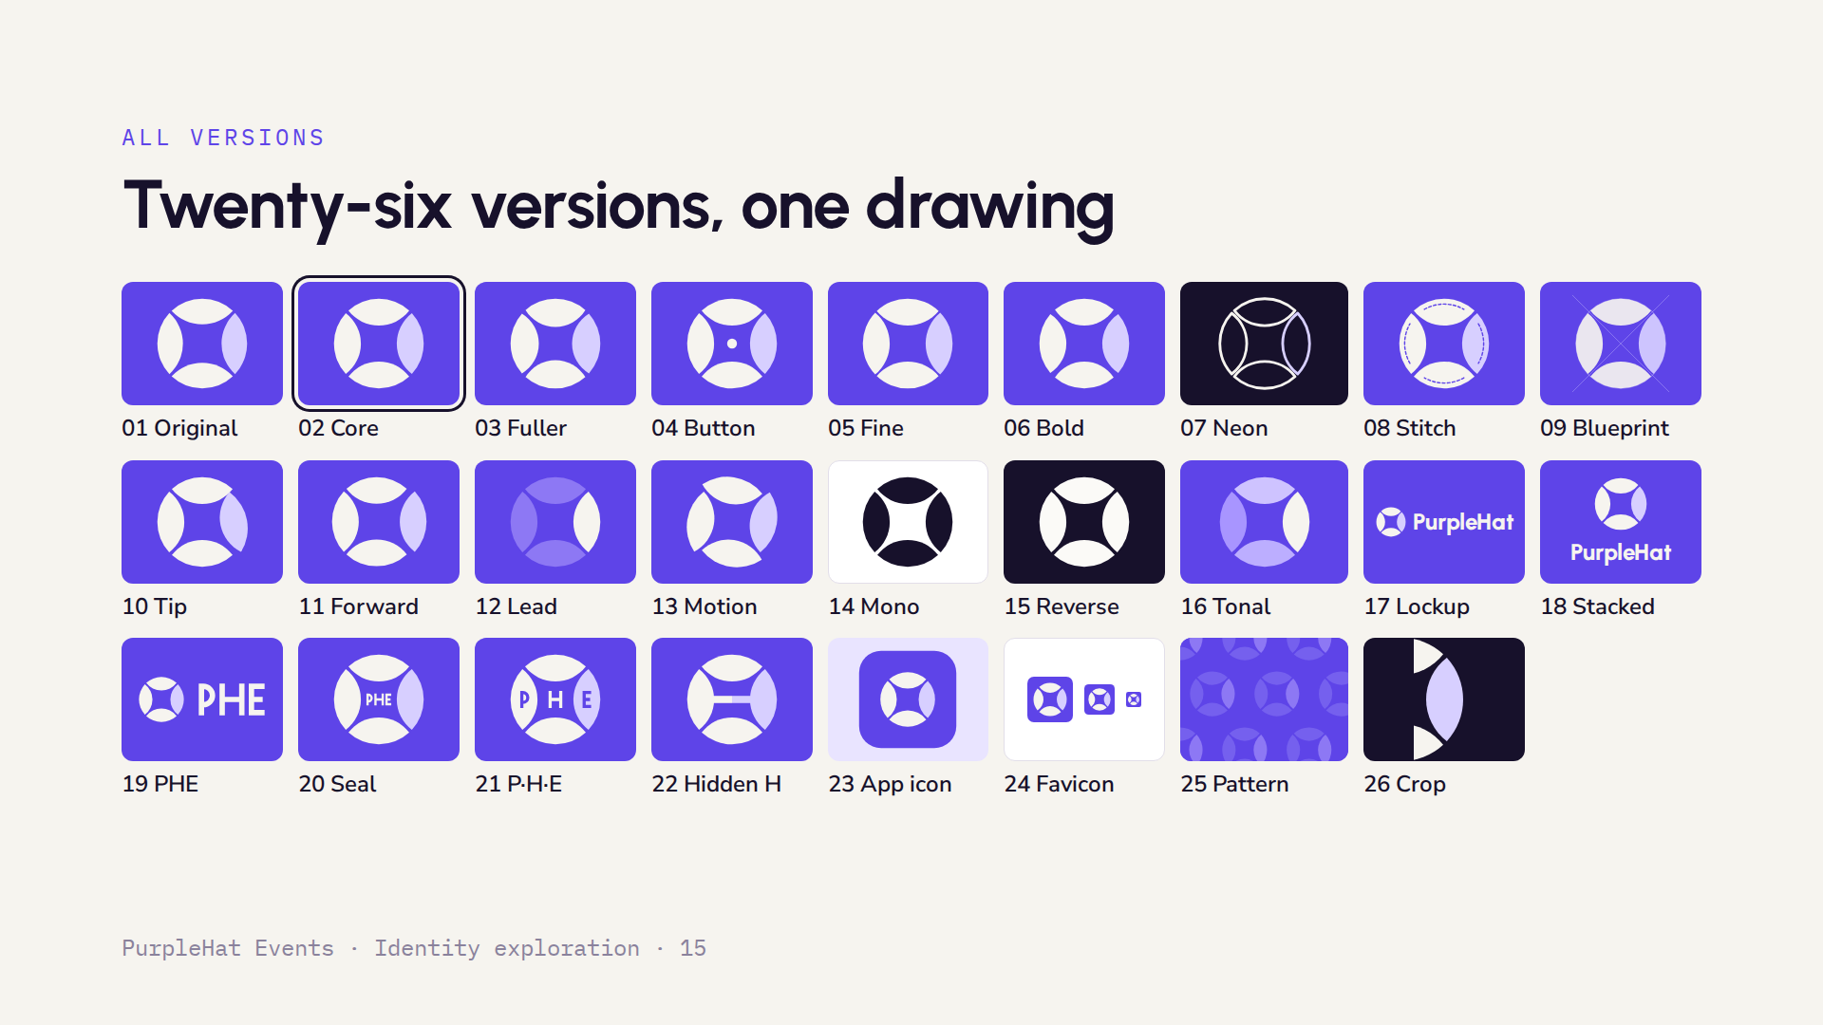
Notes:
All 26 versions on one page, numbered as in the family slides. The outlined tile, 02 Core, is the master; every other version is drawn from it. This is a good slide to leave up while the team discusses favourites.

Slide 16
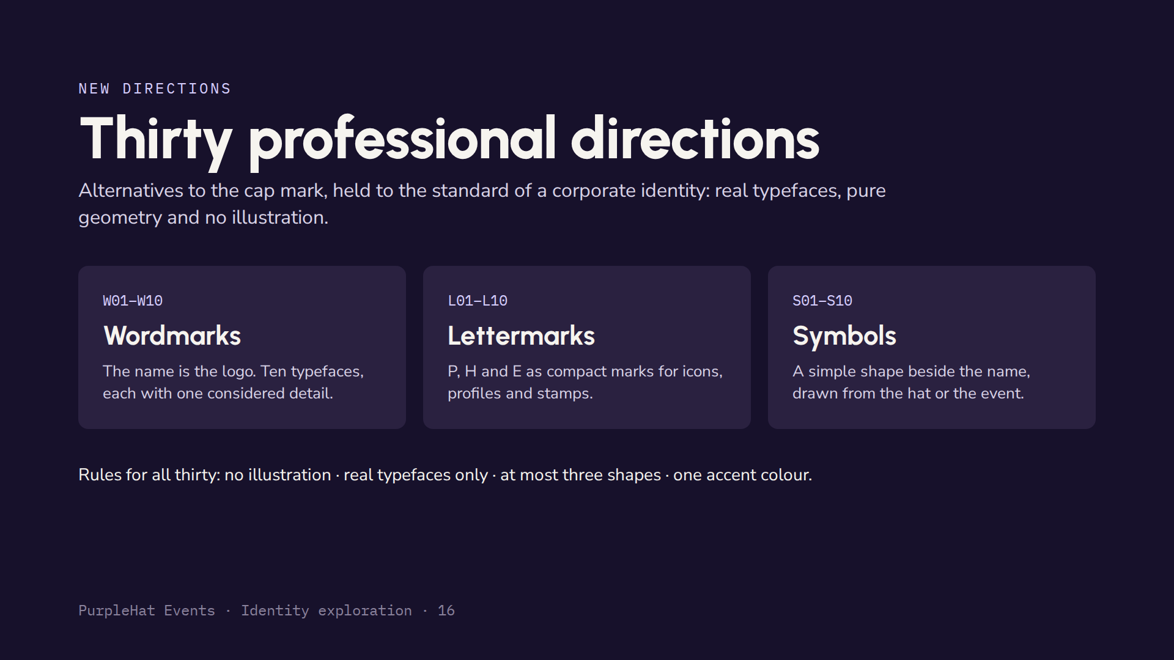
Notes:
These thirty directions sit alongside the cap mark as alternatives. They are deliberately restrained: a professional events, MICE and corporate firm needs an identity that looks established and trustworthy. Every letter here is drawn from a real typeface, converted to outlines, and every symbol uses no more than three simple shapes.

Slide 17
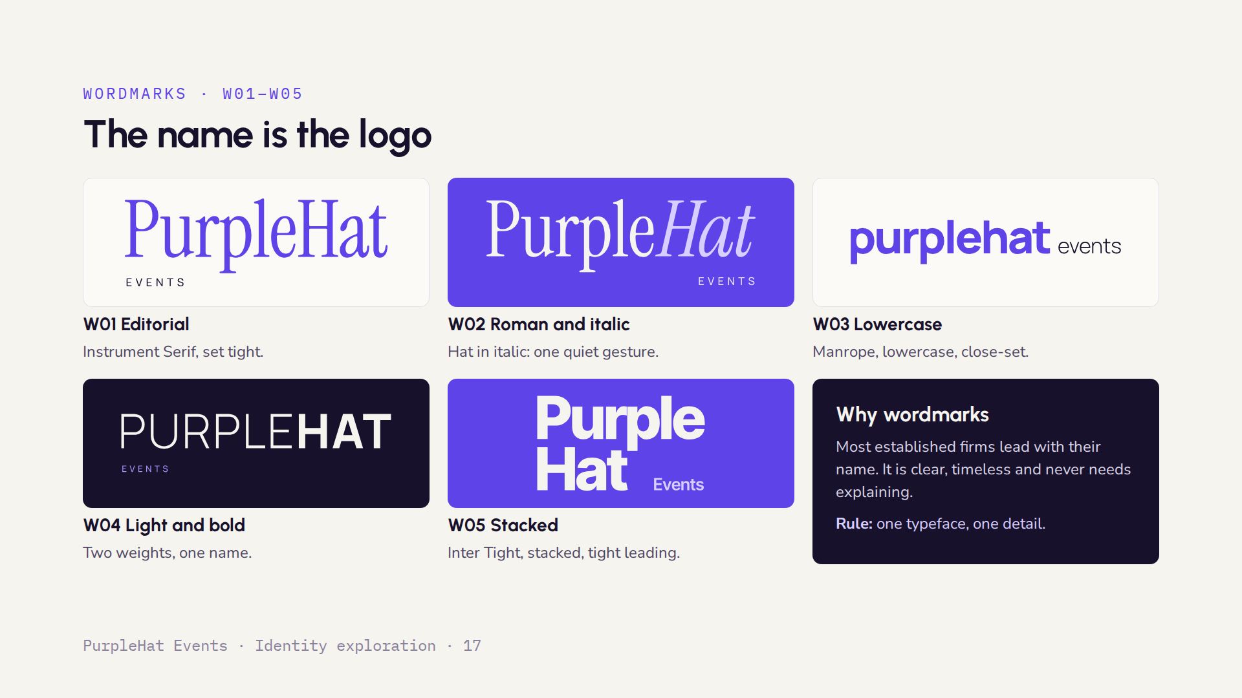
Notes:
Five wordmarks. W01 is editorial and refined, W02 adds a single italic gesture on Hat, W03 is modern and approachable, W04 contrasts a light and a heavy weight, and W05 is a bold stacked block that works well in square formats. EVENTS is always set in spaced capitals as a quiet second line.

Slide 18
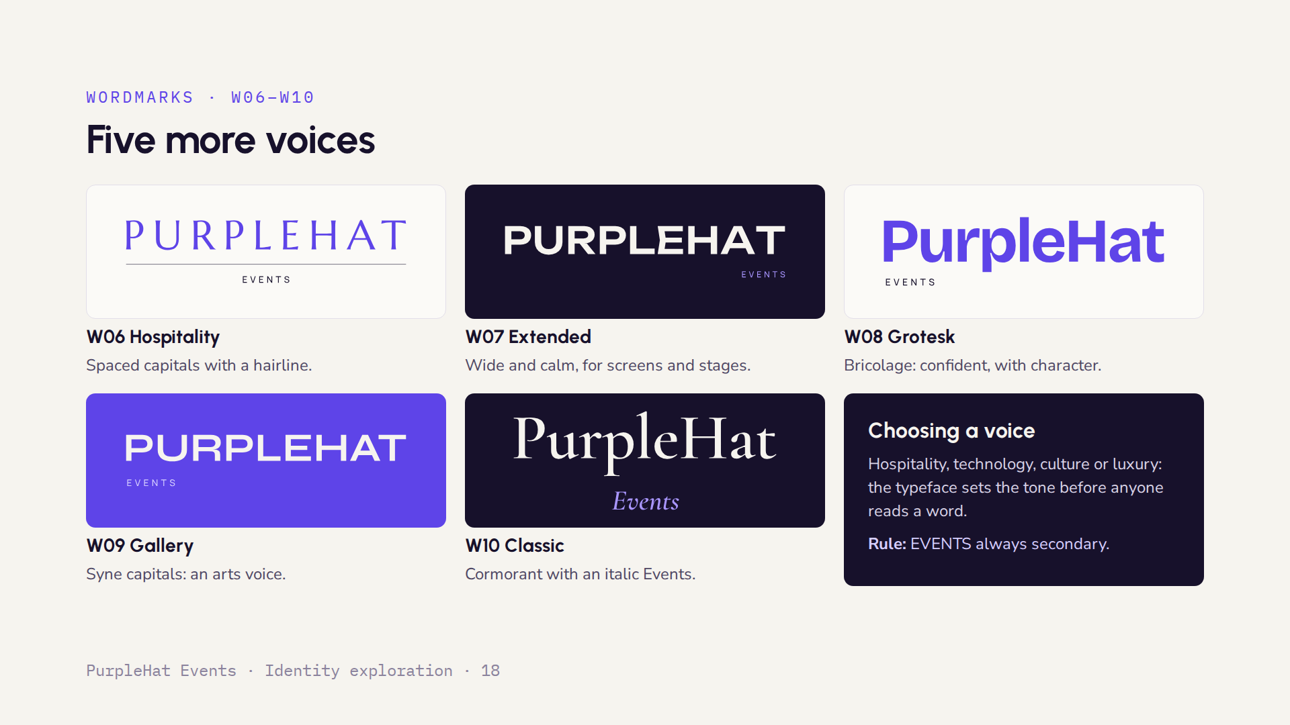
Notes:
W06 suits luxury hospitality and corporate dinners. W07 is the most technical and works best on screens and LED walls. W08 is contemporary and friendly without being casual. W09 leans towards arts and culture. W10 is the most traditional and premium, suited to weddings, galas and high-end corporate work.

Slide 19
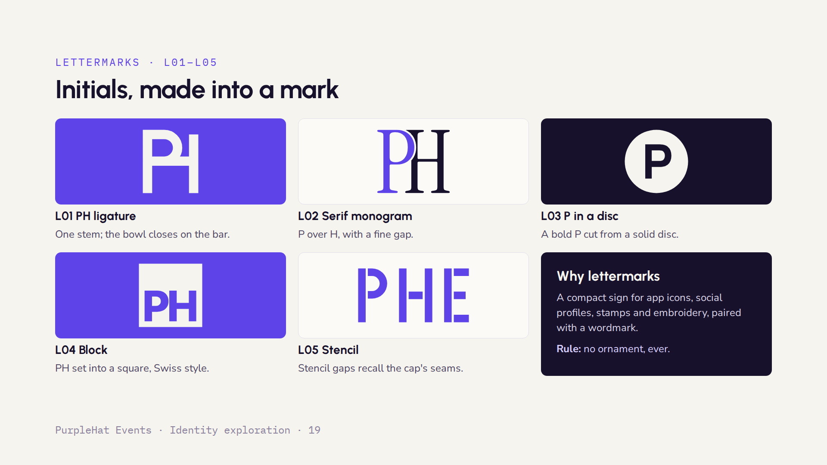
Notes:
Lettermarks give the brand a compact sign. L01 is the strongest geometric option and scales down well. L02 is a classic serif monogram, suited to premium print. L03 and L04 are bold and direct, ideal for app icons. L05 links back to the seams of the original cap concept.

Slide 20
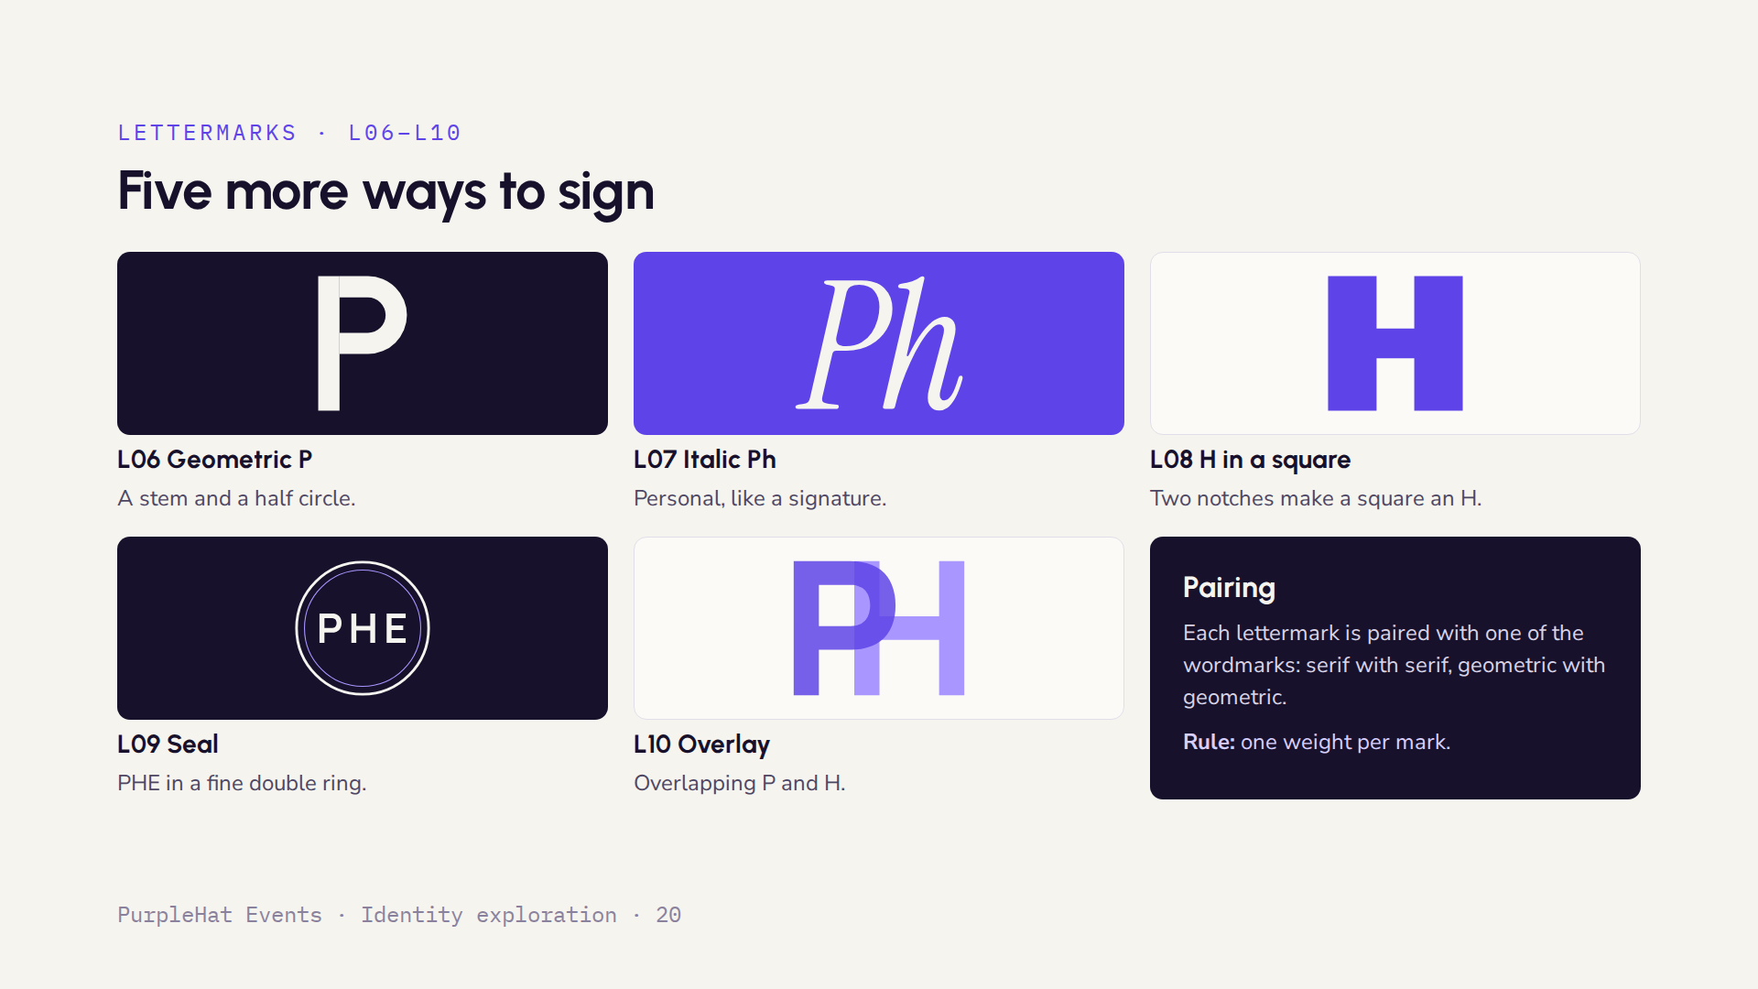
Notes:
L06 is the purest geometric form. L07 is the most personal and works for a founder-led, boutique feel. L08 is a strong modernist block, very legible small. L09 suits contracts, certificates and invitations. L10 uses transparency and works best on screens.

Slide 21
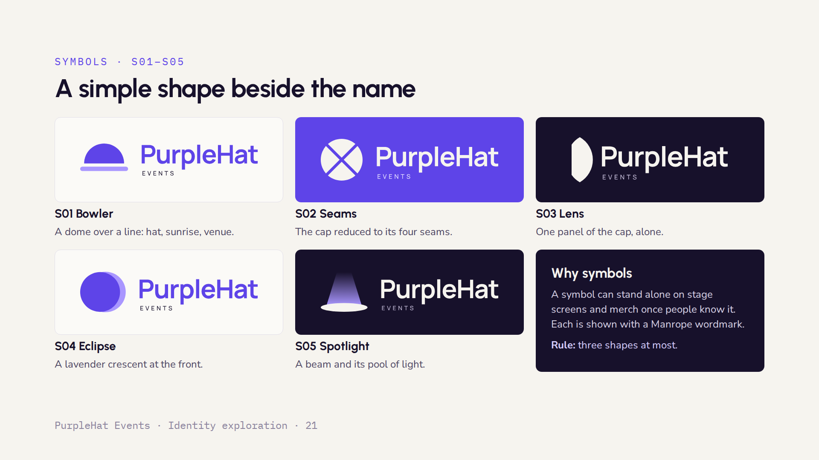
Notes:
S01 Bowler is the simplest and most flexible of all the symbols. S02 Seams and S03 Lens are reductions of the original cap concept, so they keep its story. S04 Eclipse echoes the visor as a crescent. S05 Spotlight is the most event-specific.

Slide 22
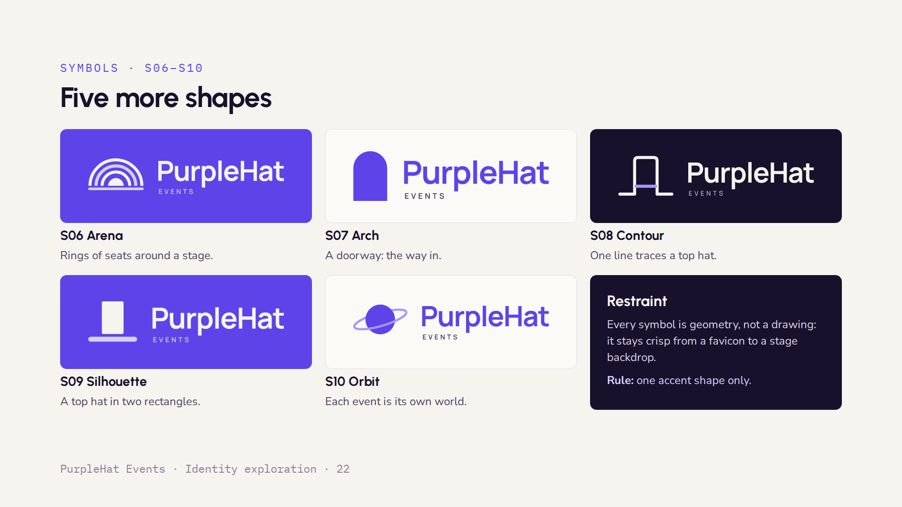
Notes:
S06 Arena speaks to conferences and large audiences. S07 Arch is the calmest, an invitation in one shape. S08 Contour is a single continuous line, elegant on embossed or foiled print. S09 Silhouette is the most direct hat reference kept to pure geometry. S10 Orbit is the most imaginative of the set.

Slide 23
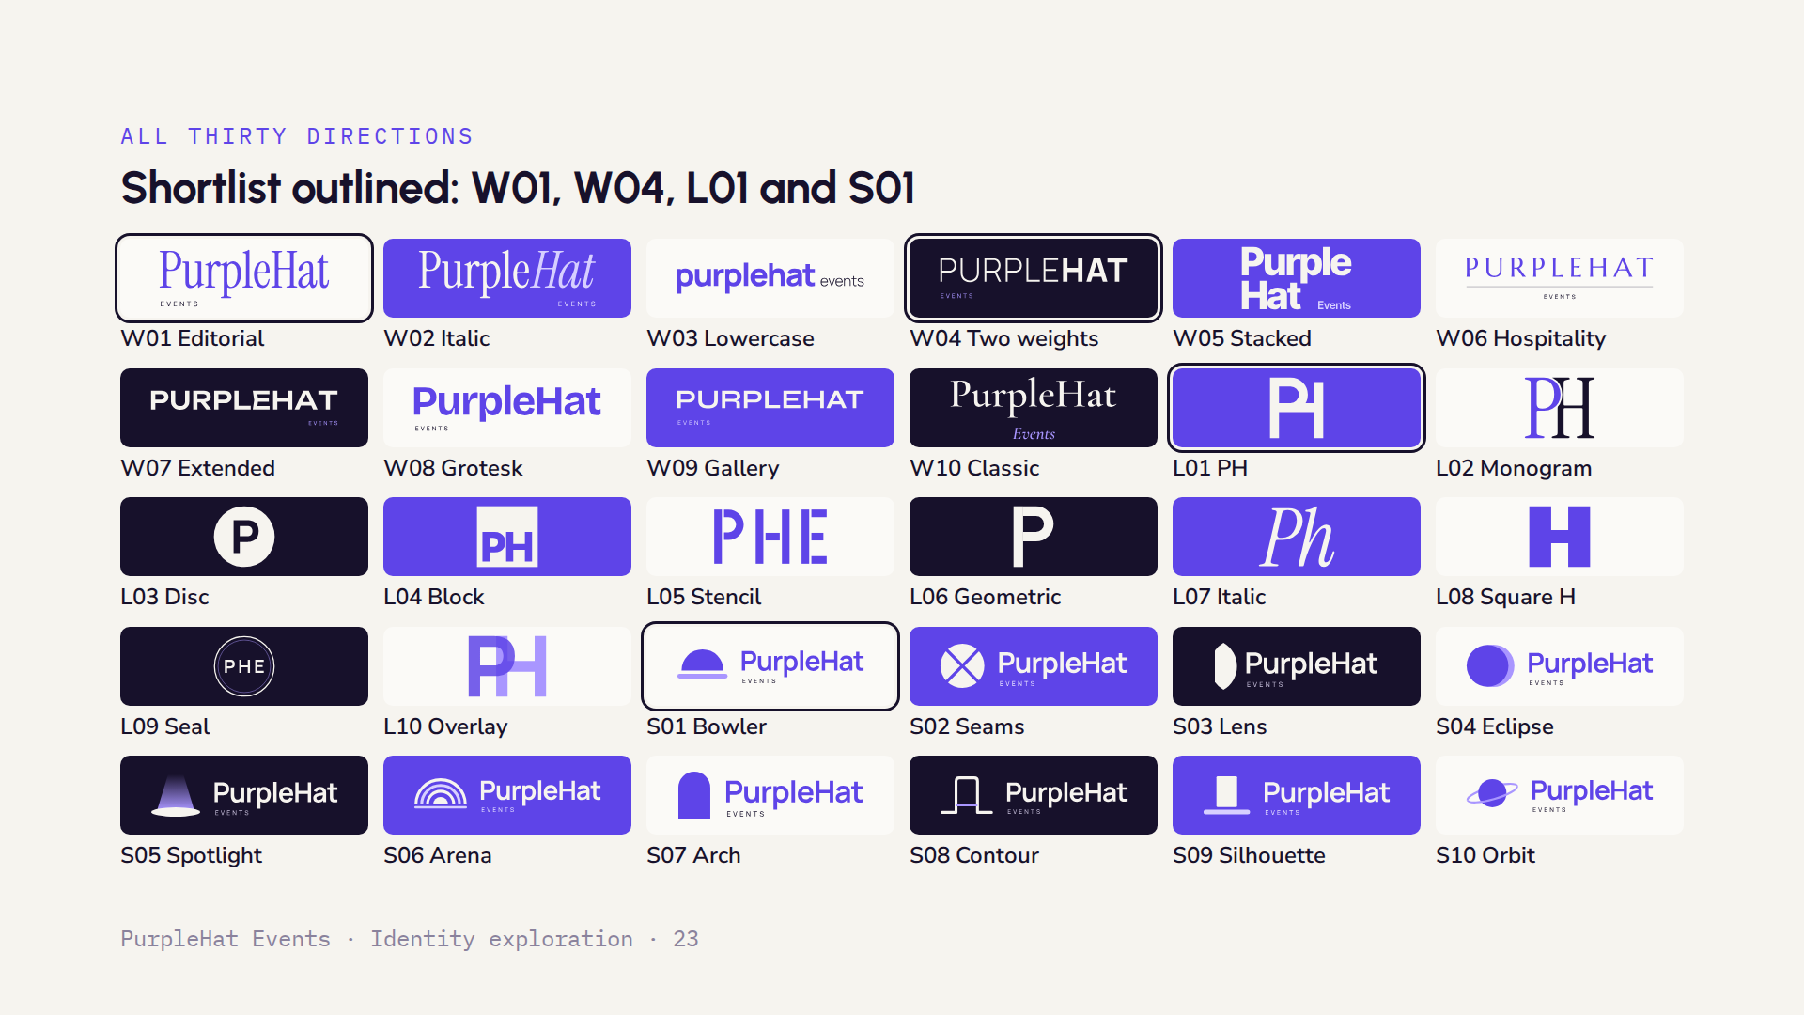
Notes:
All thirty directions on one page, with four outlined as our shortlist. W01 Editorial is the most refined serif option; W04 is the strongest modern sans. L01 is a compact sign that scales from favicon to signage. S01 Bowler is the simplest symbol and carries the hat idea without becoming a drawing. A likely system pairs one wordmark with one mark.

Slide 24
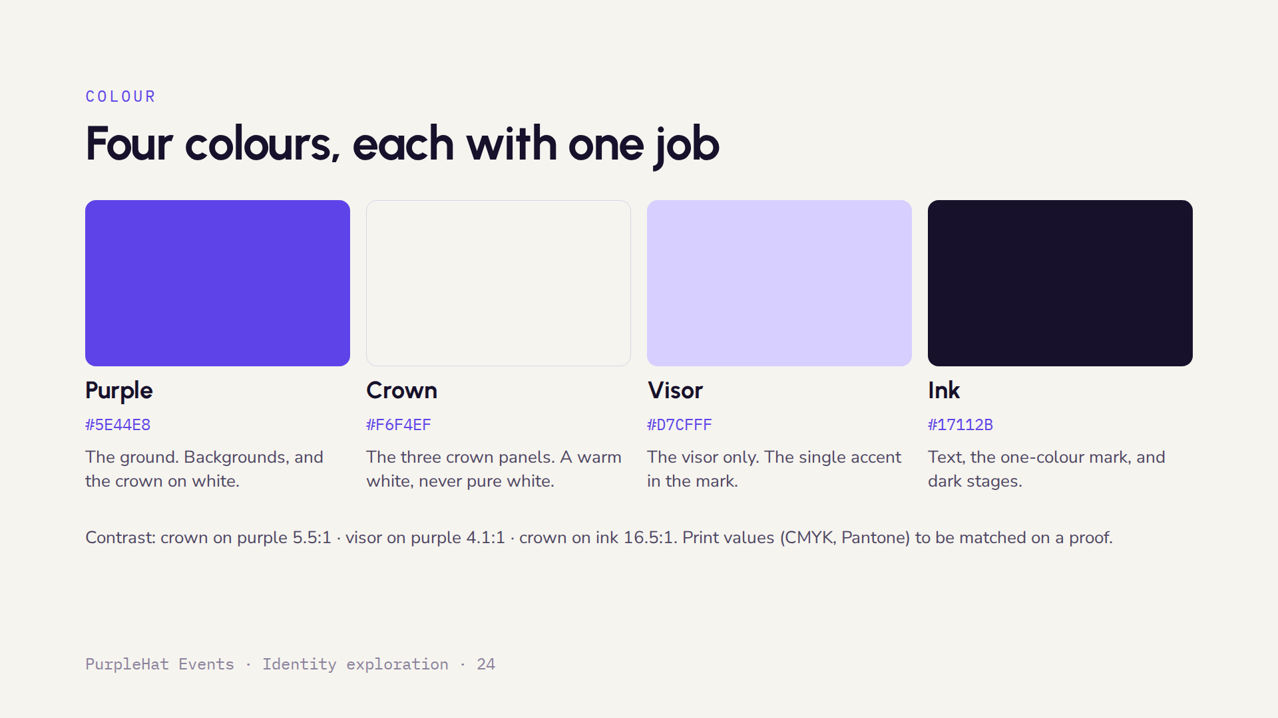
Notes:
The palette is deliberately small. Purple is the brand ground, the warm white keeps the crown from looking cold, lavender belongs only to the visor, and ink handles text and single-colour use. The contrast ratios are calculated from the screen colours. Printed colours need to be matched on a physical proof before the guidelines are final.

Slide 25
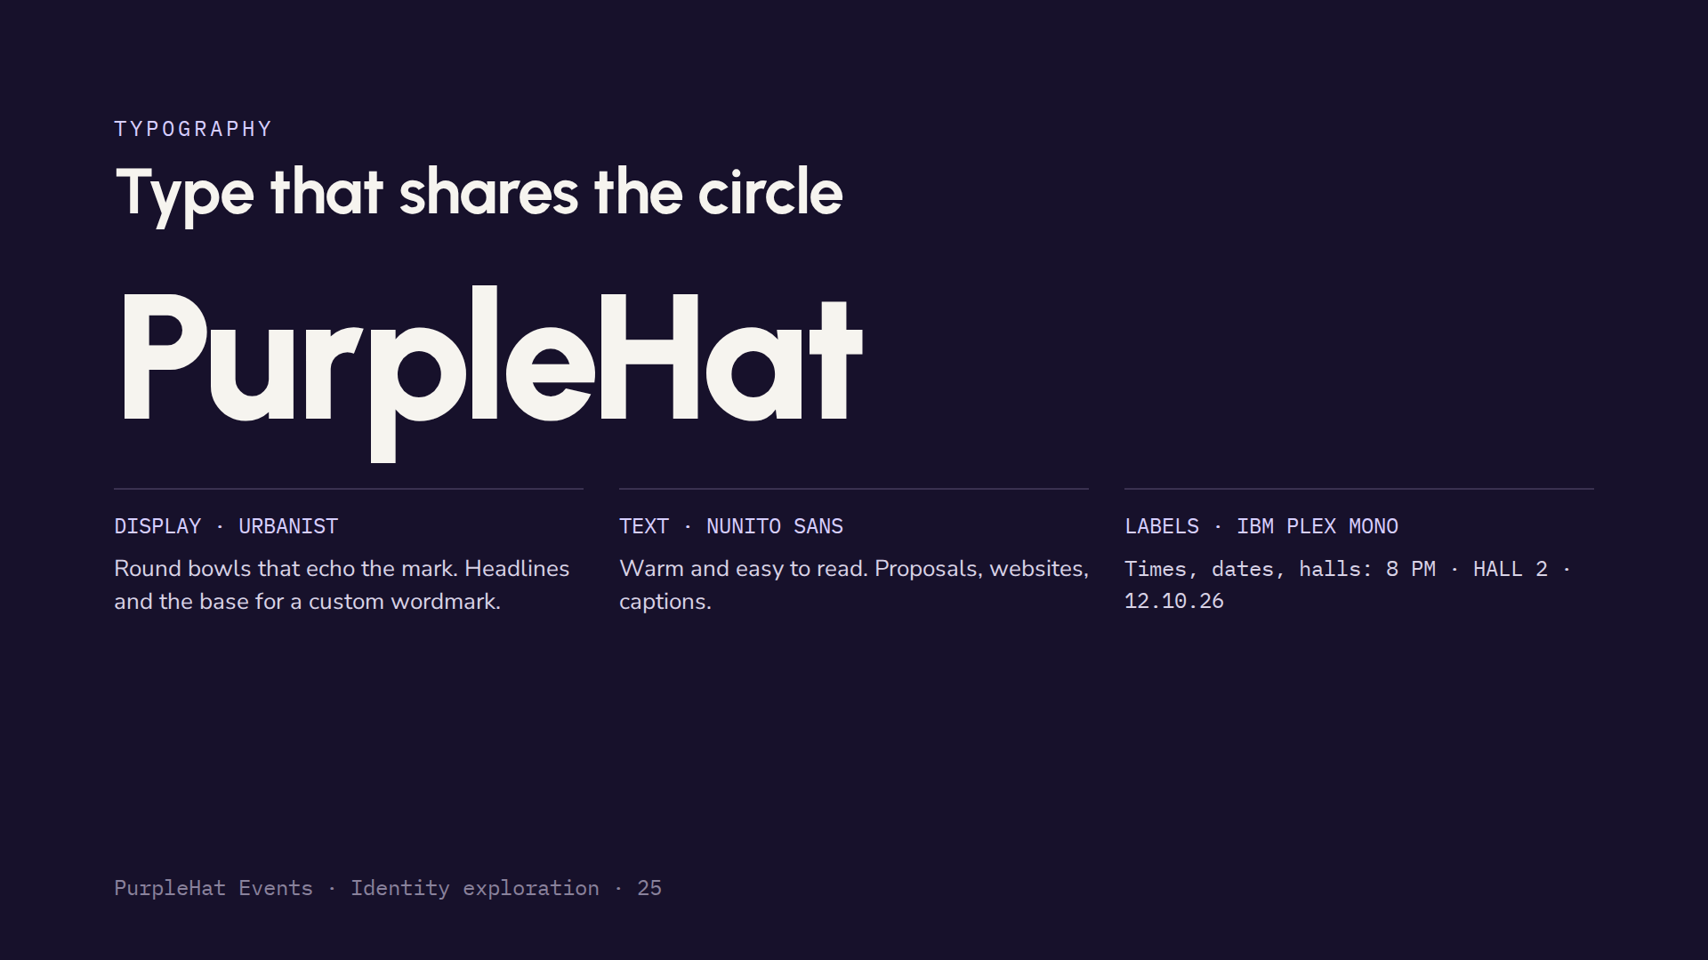
Notes:
All three fonts are free Google Fonts, so they work everywhere at no cost. The wordmark shown here is typeset in Urbanist. For the final logo we would redraw it by hand: tune the spacing, join the P and H rhythm, and match the stroke weight to the panels so the name and the mark feel like one piece.

Slide 26
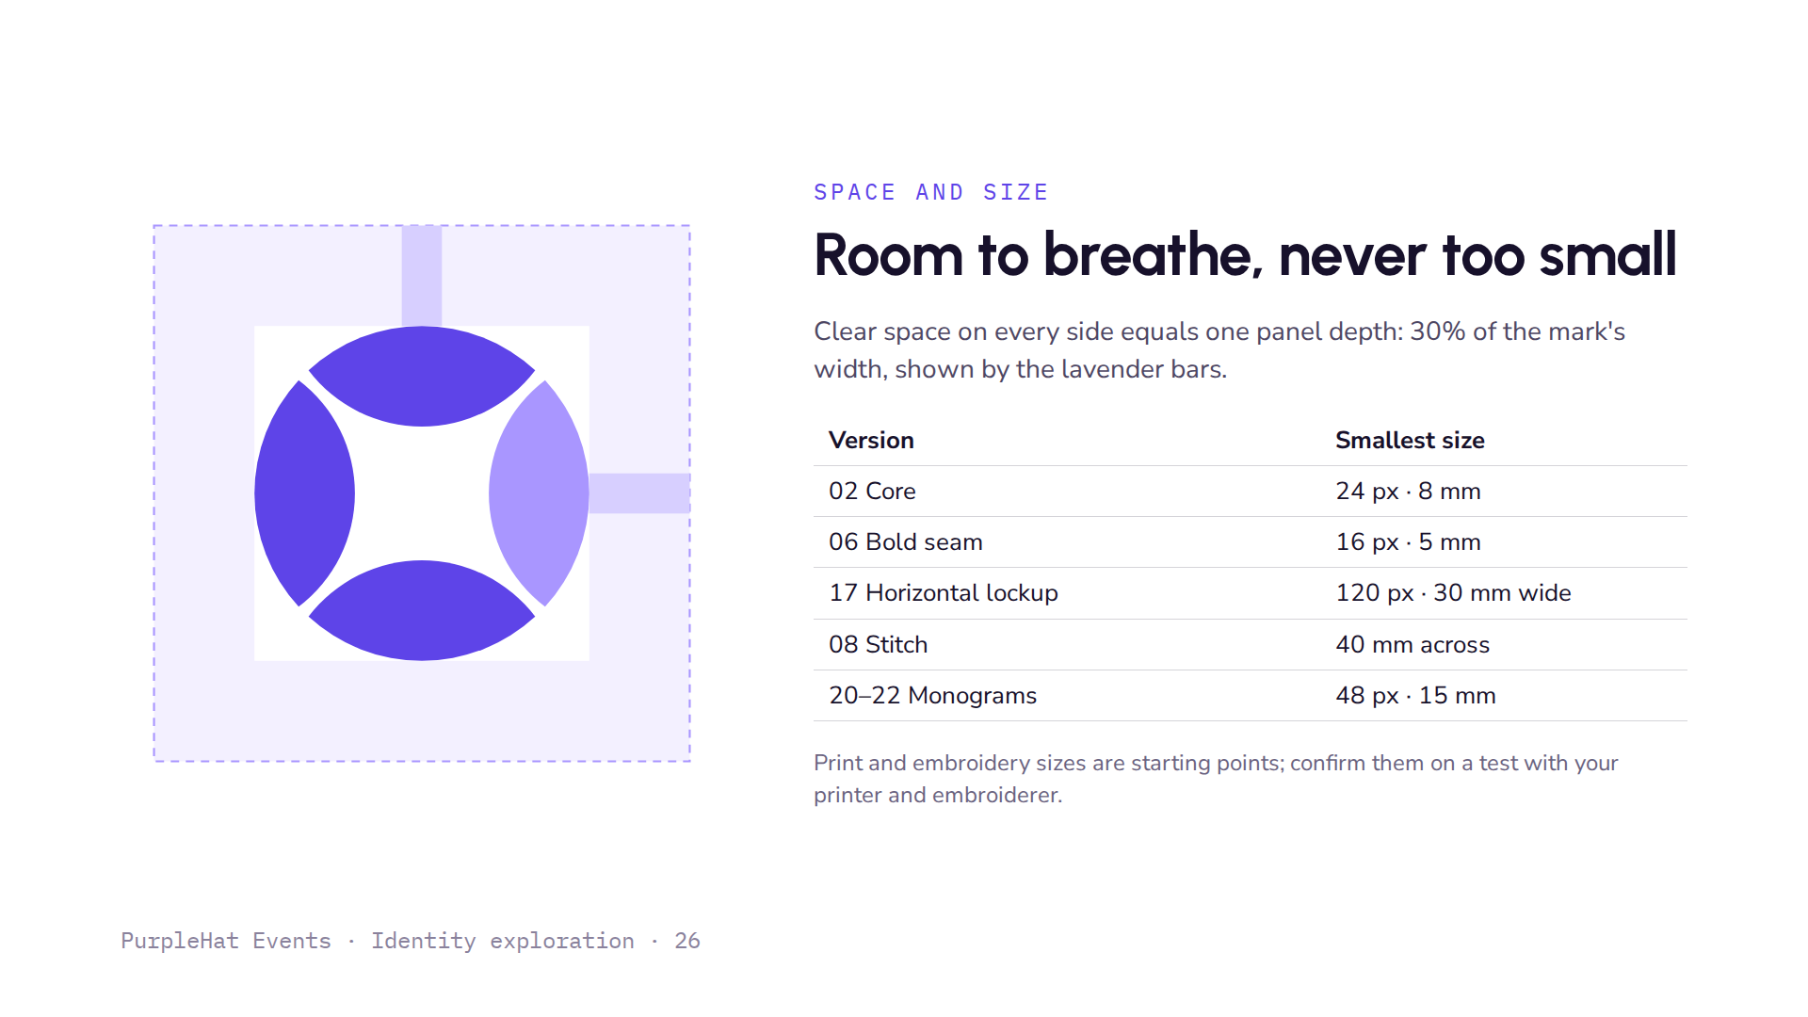
Notes:
Clear space is measured with the mark itself, so it scales with any size: one panel depth on every side. The minimum sizes come from the size tests: the core mark's seams start to close below 24 pixels, which is why the bold-seam version exists for favicons. The physical sizes need checking on real samples.

Slide 27
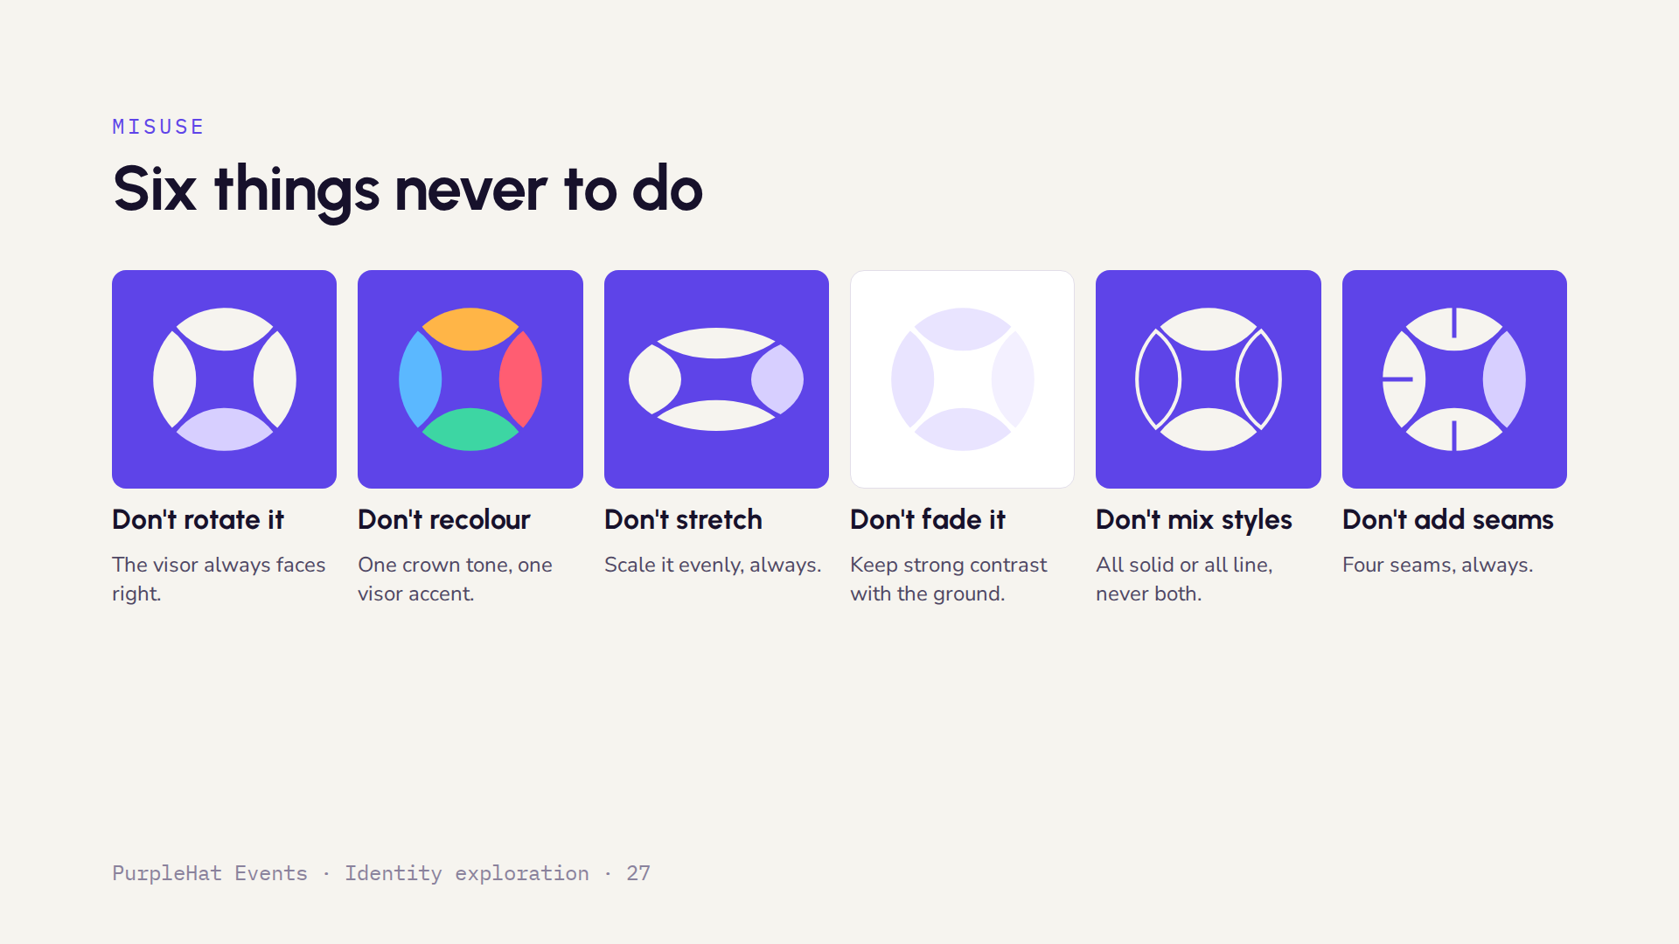
Notes:
Each of these breaks one of the five rules without a reason. Rotating moves the visor away from the front. Recolouring turns the crown into four separate things. Stretching breaks the circle. Low contrast makes it disappear. Mixing outline and solid confuses two styles. Extra seams were tested and dropped earlier, so they are listed here to stop them coming back.

Slide 28
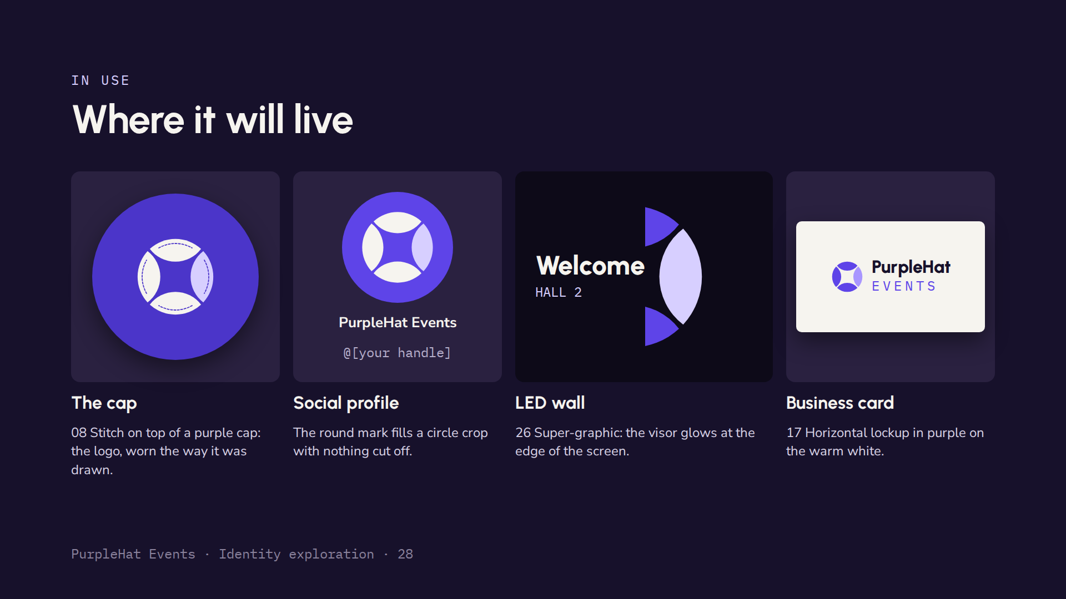
Notes:
Four quick sketches of real uses. The cap is the strongest story: the logo is literally the top of a cap, so embroidering it on our own caps closes the loop. These are simple mock-ups to show scale and feel; proper photographic mock-ups would come with the final guidelines.

Slide 29
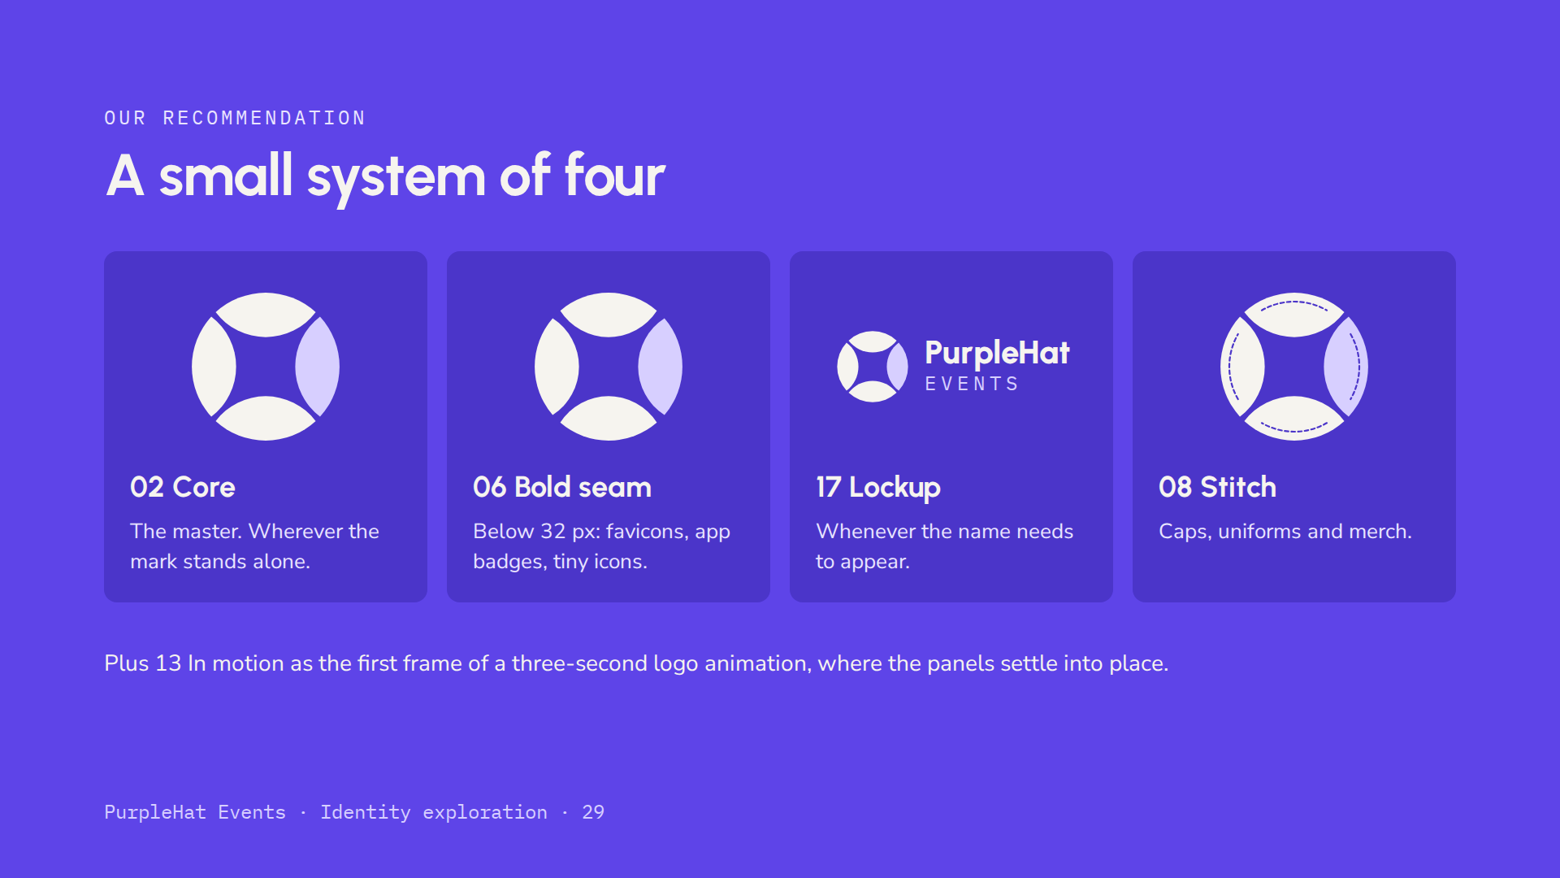
Notes:
Our recommendation is to adopt a small, disciplined system rather than many logos. The core mark everywhere, the bold-seam version only at small sizes, the horizontal lockup when the name is needed, and the stitched version for merchandise. The other versions stay in the toolkit for specific jobs, as described in the families.

Slide 30
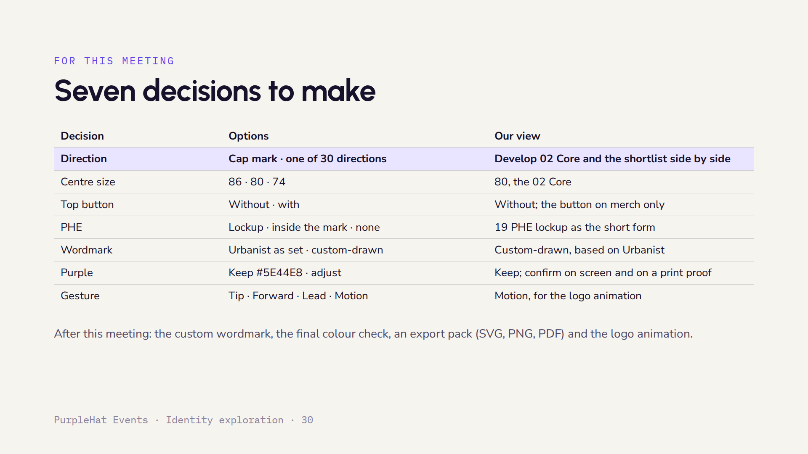
Notes:
These seven choices are all we need to finish the identity. The first one decides the direction: keep developing the cap mark, or take some of the thirty concepts to the same level of finish and compare. For each one we have given our view, but they are open for discussion. Once they are settled, the next round is the custom wordmark, colour proofs, the full export pack and a short logo animation.

