Slide 1


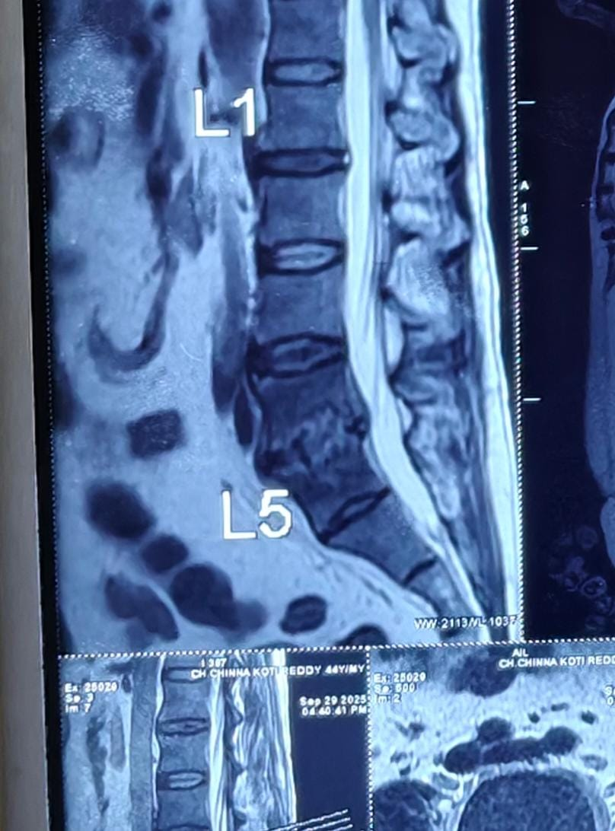
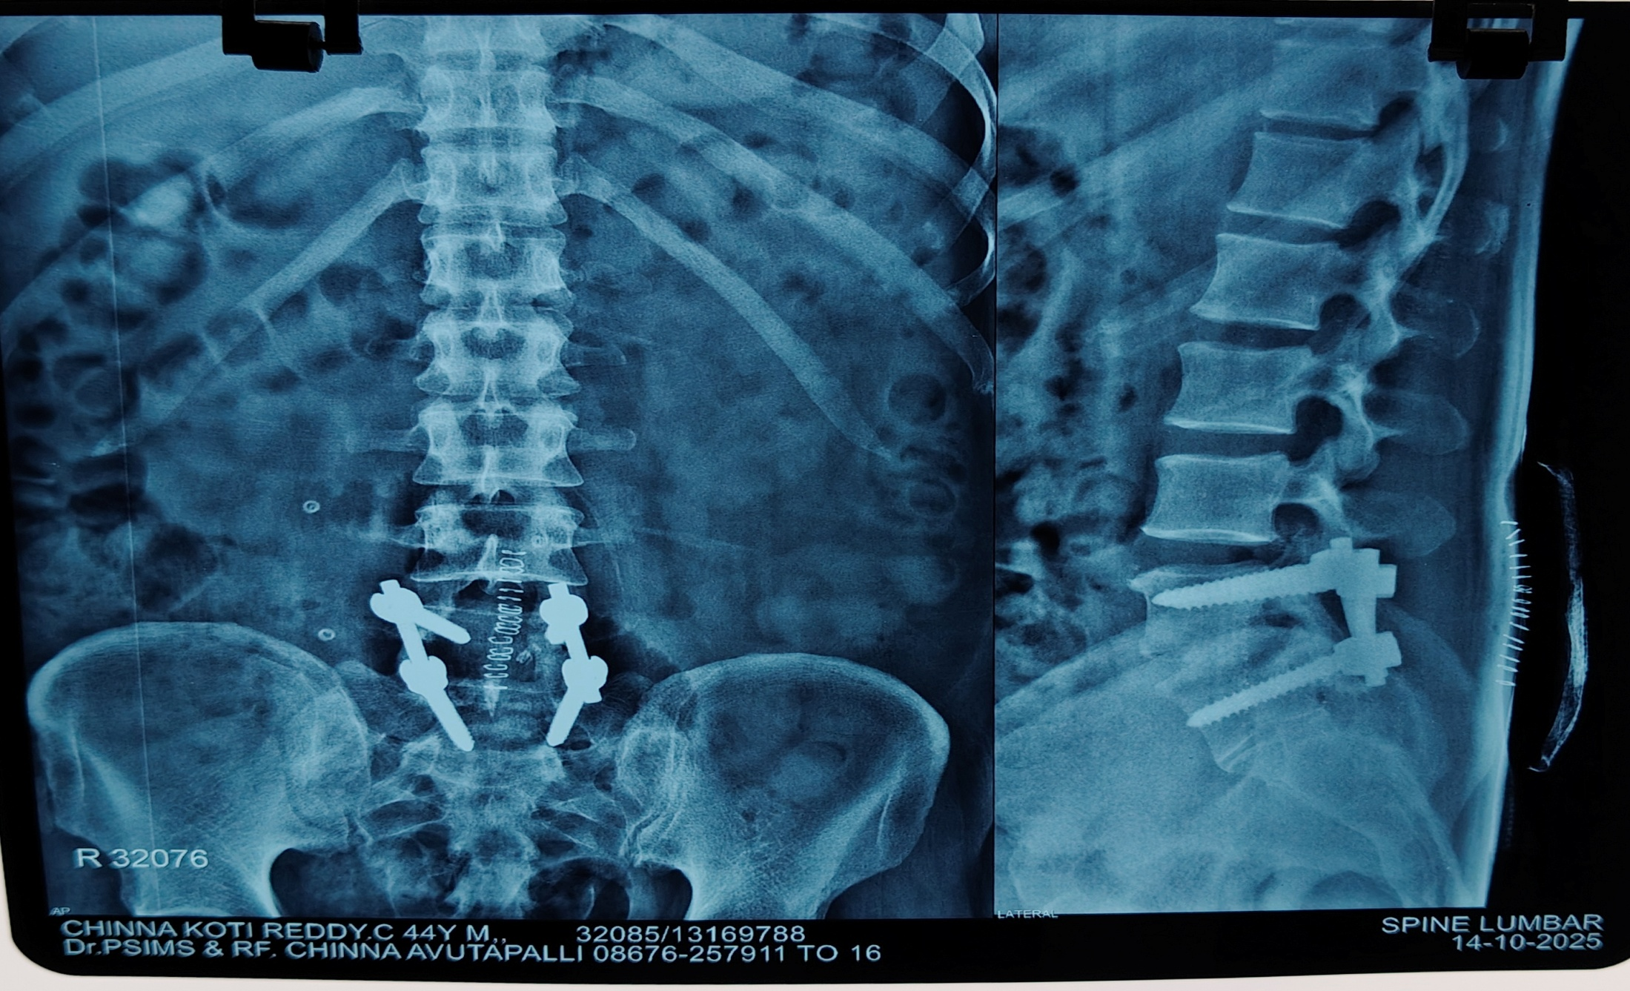
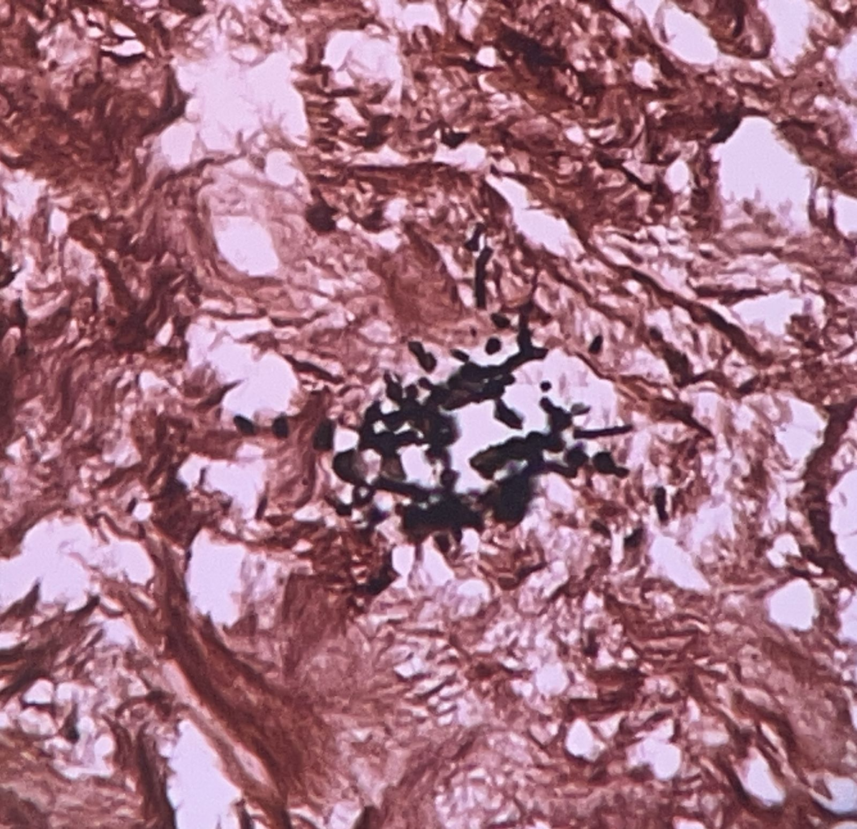
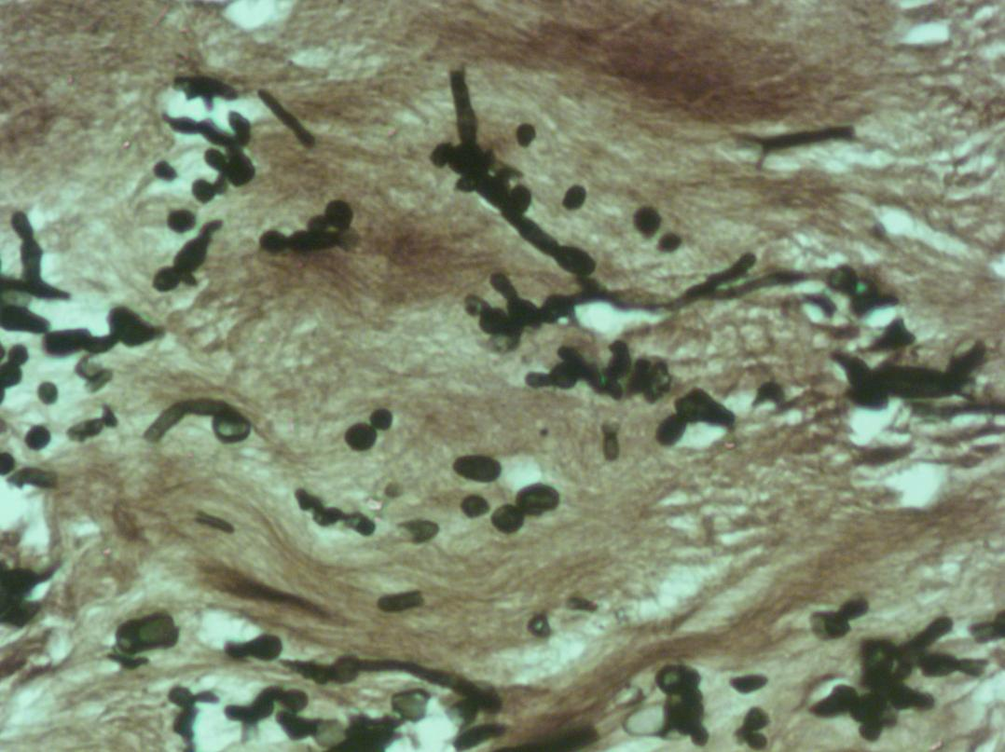
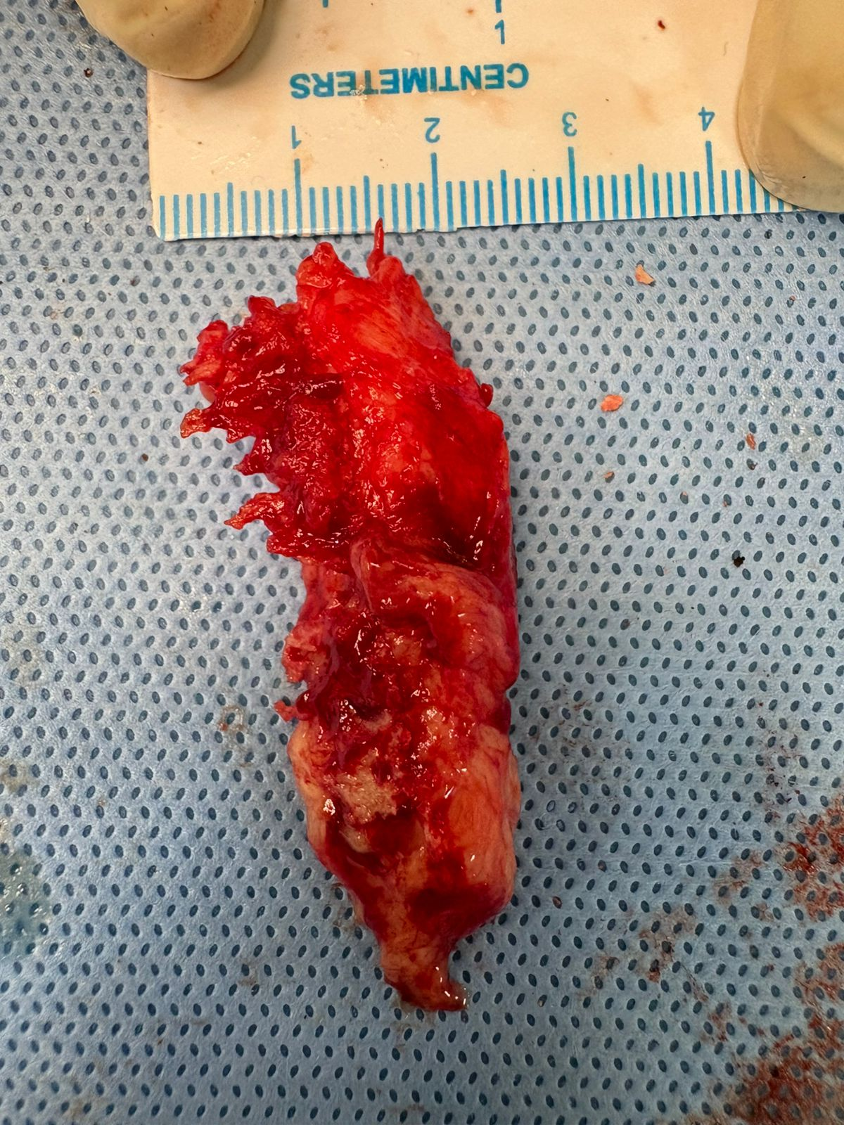
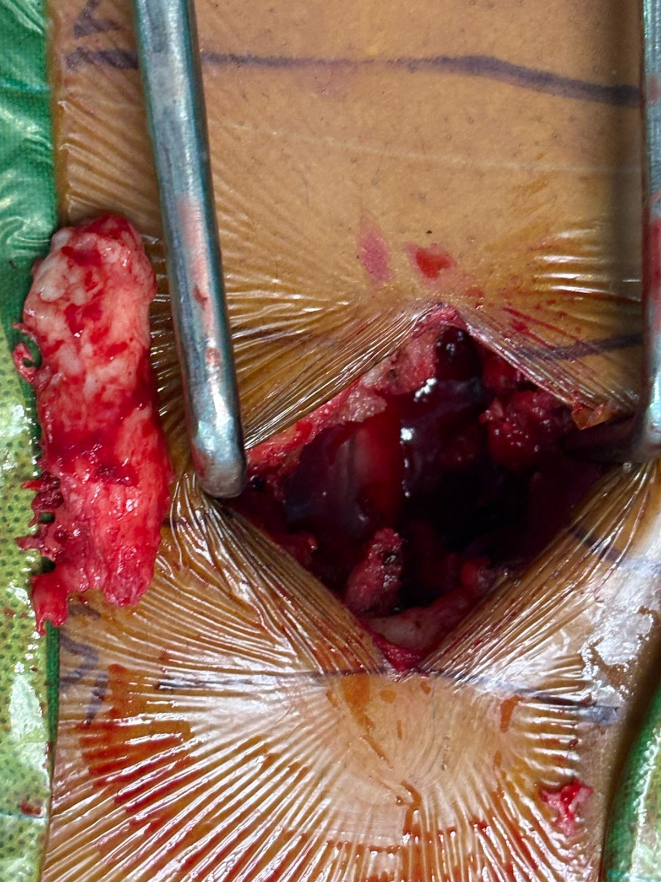
BEYOND BACTERIA - FUNGAL INVADERS OF SPINE
Presented by - Dr.P.TIRUMALA SRINIVAS 3rd yr postgraduate
Guide - Dr.B.B.JOGINATH Asst professor MS Ortho,DNB Ortho,MRCS,Fellow in spine surgery
INTRODUCTION
OPERATIVE FINDINGS
DISCUSSION
Patient underwent Posterior spinal decompression with instrumental fusion and Transpedicular biopsy at L4- L5.A large infected intervertebral disc material of size 5*2cm was excised
Aspergillus spondylodiscitis is a rare but serious form of invasive fungal infection, most commonly affecting the spine. It presents withnonspecific symptoms such as persistent back or neck pain and may show vertebral destruction with epidural collections on imaging. Although typically seen in immunocompromised patients, it can also occur in immunocompetent individuals. Early diagnosis using histopathology or culture and prompt antifungal therapy with or without surgery are essential to prevent neurological complications.
Blood, urine, and sputum cultures were negative for Aspergillus, Candida, and Mycobacterium tuberculosis. The patient had a history of bilateral ureteroscopic lithotripsy with bilateral DJ stenting, followed by stent removal due to infection. MRI of the lumbar spine revealed chronic spondylodiscitis at the L4–L5 level. Surgical intervention was performed, and the infected disc material was sent for histopath and microbiological evaluation i.e1)culture and sensitivity2)Gram staining, 3)AFB staining 4)KOH mount 5)biopsy 6)CBNAAT.Histopath revealed fungal spores and septate hyphae consistent with Aspergillus species with GMS positivity. Postoperatively, antifungal therapy with Amphotericin B (25 mg) and Voriconazole (200 mg) was initiated.
a) Preop MRI. b) Postop xray
CASE REPORT
d) Histopathology slides
A 44 year-old male patient presented with Lower back ache since 40days and unable to walk since 2 weeks. Laboratory tests showed elevated ESR and CRP with normal WBC count.
CONCLUSION
Lumbar Aspergillus spondylodiscitis is rare but should be considered in culture-negative or persistent spinal infections. Early imaging, histopathology, targeted antifungal therapy, and timely surgical intervention are essential for successful outcomes.
c) Intraop pics

