Slide 1




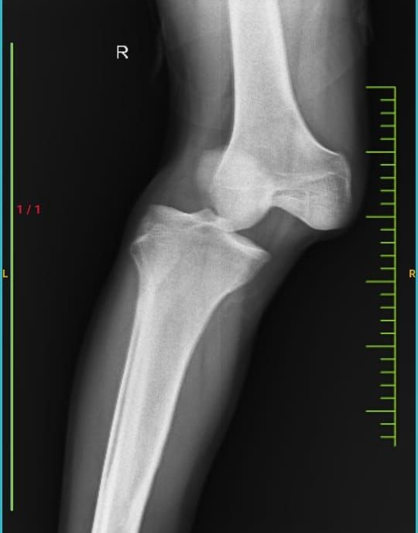
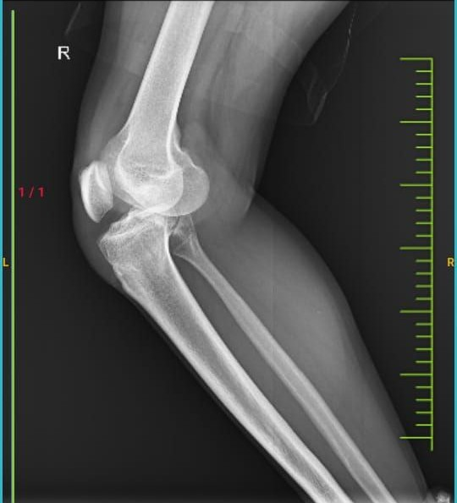
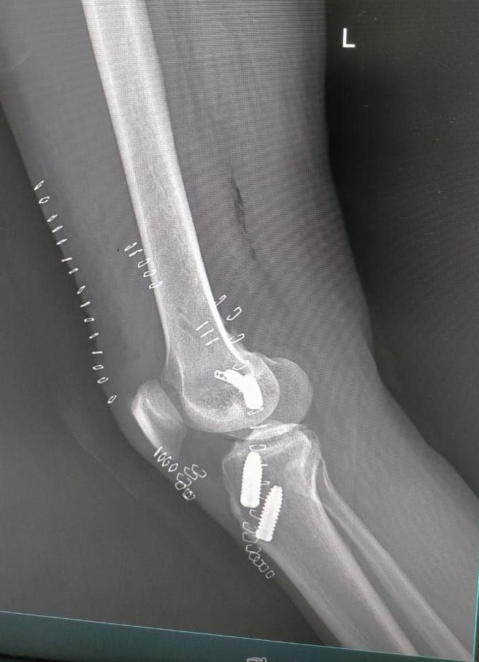
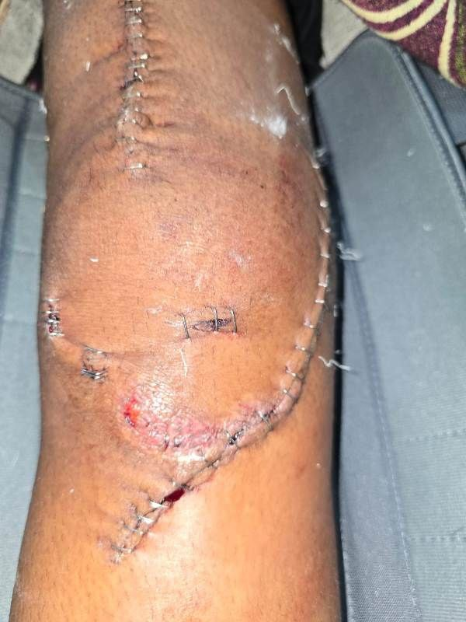
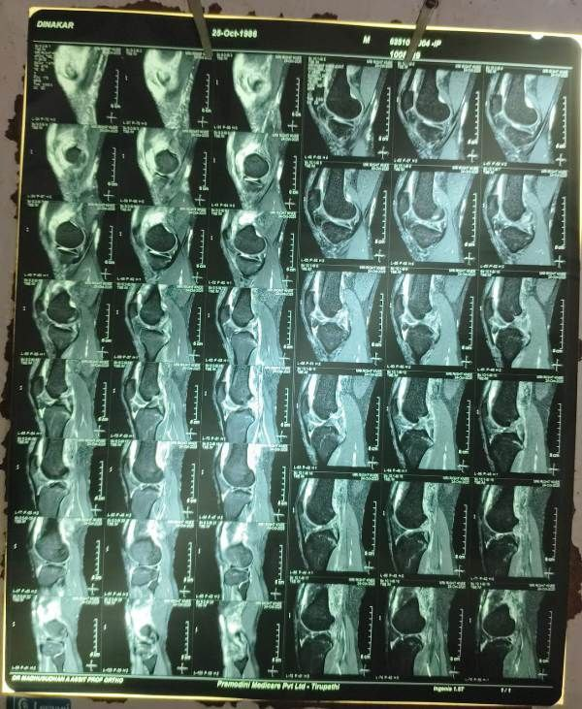
Comprehensive Management of Multiligamentous Knee Injury with knee dislocation
Presenter :DR B RAJ KUMAR NAIK
GUIDE: DR A MADHUSUDHANA (HOD)
DR D L VENKATESH ( Associate professor)
Sri Venkateswara Ramnarayan Ruia Government General Hospital , Tirupati OSSAP - 024 -ABS-55
INTRODUCTION
OPERATIVE FINDINGS
DISCUSSION
Multiligamentous knee injury with knee dislocation is a rare but limb threatening complex trauma following high velocity injury ,
Although incidence is low but carries significant risk of vascular compromise and neurological deficit, demanding prompt diagnosis and management .
●Immediate stabilization and monitoring done
●After 3 weeks Intraoperatively ,under diagnostic arthroscopy
●Bicruciate ligament and mcl ligament tear with normal meniscus noted
●Arthroscopic cruciate ligament reconstruction with open mcl reconstruction done with autograft
▪︎Addressing all injured structures in one setting helped re-establish normal biomechanics and reduce the risk of chronic instability or graft overload. ▪︎Early controlled rehabilitation was initiated to prevent stiffness while protecting the reconstructions
CASE REPORT
CONCLUSION
A 28 year old male patient presented to casualty
following motor vehicle accident with severe pain ,deformity and instability of knee with feeble distal pulses
Acute single-stage reconstruction for multiligament knee injury with dislocation is a safe and effective strategy when soft tissue conditions permits.
▪︎A structured, comprehensive approach leads to improved stability, functional recovery, and reduced long-term morbidity.

