Slide 1




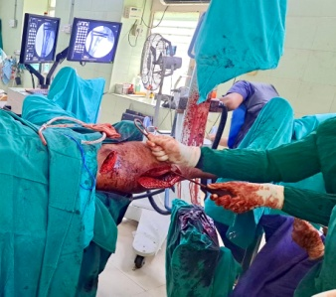
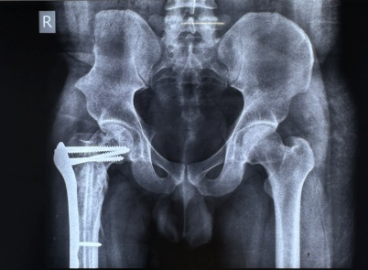
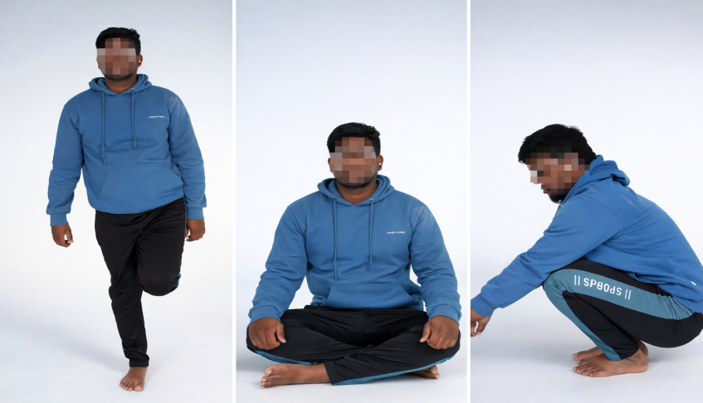
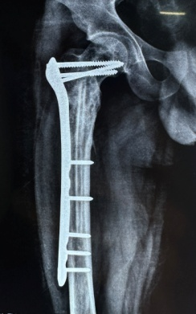
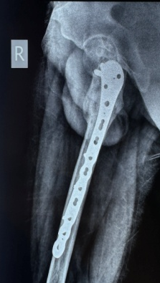
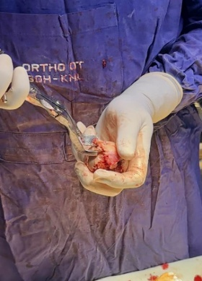
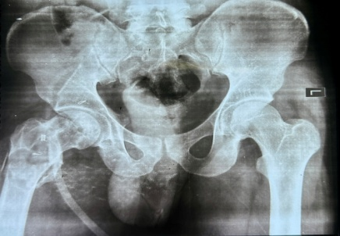
BIOLOGICAL RECONSTRUCTION OF SUBTROCHANTERIC FRACTURE IN PROXIMAL FEMORAL FIBROUS DYSPLASIA – A CASE REPORT
AUTHOR- DR MOHAMED MANSOOR ALI K
GUIDE -DR A.M ILIAS BASHA (ASS0CIATE PROFESSOR)
KURNOOL MEDICAL COLLAGE
ID:OSSAP 061
INTRODUCTION
OPERATIVE FINDINGS
DISCUSSION
Fibrous dysplasia is a benign fibro-osseous disorder in which normal bone is replaced by fibrous tissue and immature woven bone, resulting in structural weakness and increased risk of pathological fractures. The proximal femur is commonly affected due to high mechanical stress, making management challenging. Subtrochanteric fractures require both stable mechanical fixation and biological augmentation because of poor bone quality and impairaed healing. Biological reconstruction using fibular strut graft and cancellous graft provides structural support and promotes fracture union.
Intraoperatively, the proximal femur showed abnormal fibrous tissue replacing normal cancellous bone with cortical thinning, consistent with fibrous dysplasia. The fracture site was exposed and curetted. Reconstruction was performed using a fibular strut graft to provide structural support. Additional biological augmentation was achieved using iliac crest cancellous graft and cancellous allograft harvested from a compatible donor femoral head.
Fracture stabilization was achieved using a distal femoral locking plate to provide rigid fixation and maintain alignment. Adequate stability and graft placement were confirmed intraoperatively.
Management of pathological fractures in fibrous dysplasia is challenging due to poor bone quality, delayed healing, and risk of implant failure. Mechanical stabilization alone may not be sufficient; therefore, biological augmentation is essential. Fibular strut graft provides strong structural support and improves mechanical stability, while cancellous autograft and allograft enhance osteoconduction and promote fracture healing.
Locking plate fixation offers angular stability and is particularly useful in osteoporotic and pathological bone. Combined use of structural and cancellous grafts with locking plate fixation improves outcomes by addressing both mechanical and biological factors. This approach reduces the risk of nonunion, deformity, and implant failure.
CONCLUSION
Combined biological reconstruction using fibular strut graft, iliac crest cancellous graft, and cancellous allograft along with stable locking plate fixation provides effective management of subtrochanteric pathological fractures in fibrous dysplasia. This technique provides structural support, enhances biological healing, and ensures stable fixation in compromised bone.
CASE REPORT
A 24-year-old male presented with pain, inability to bear weight, and deformity of the right thigh following trivial trauma. Radiographic evaluation revealed a subtrochanteric pathological fracture of the left proximal femur with features suggestive of fibrous dysplasia. MRI confirmed the diagnosis, and histopathological examination demonstrated fibro-osseous tissue consistent with fibrous dysplasia.
Clinical images after one and half year

