Slide 1




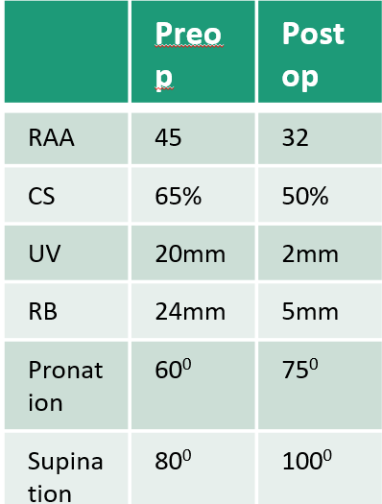
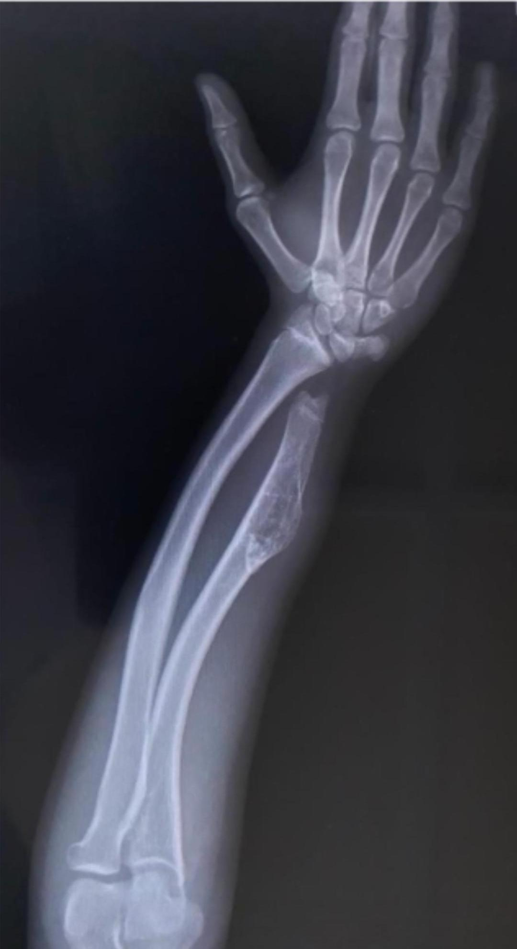
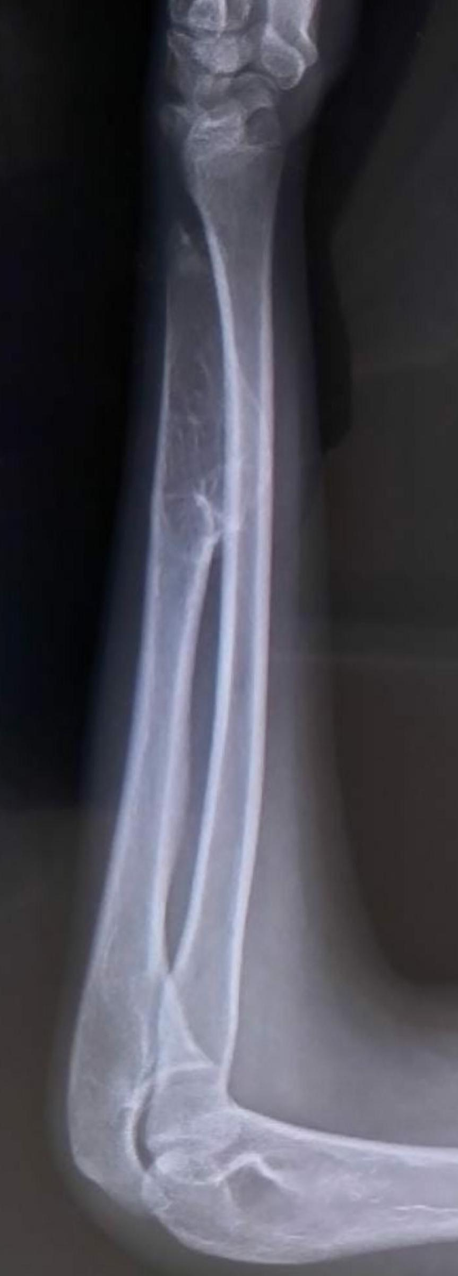
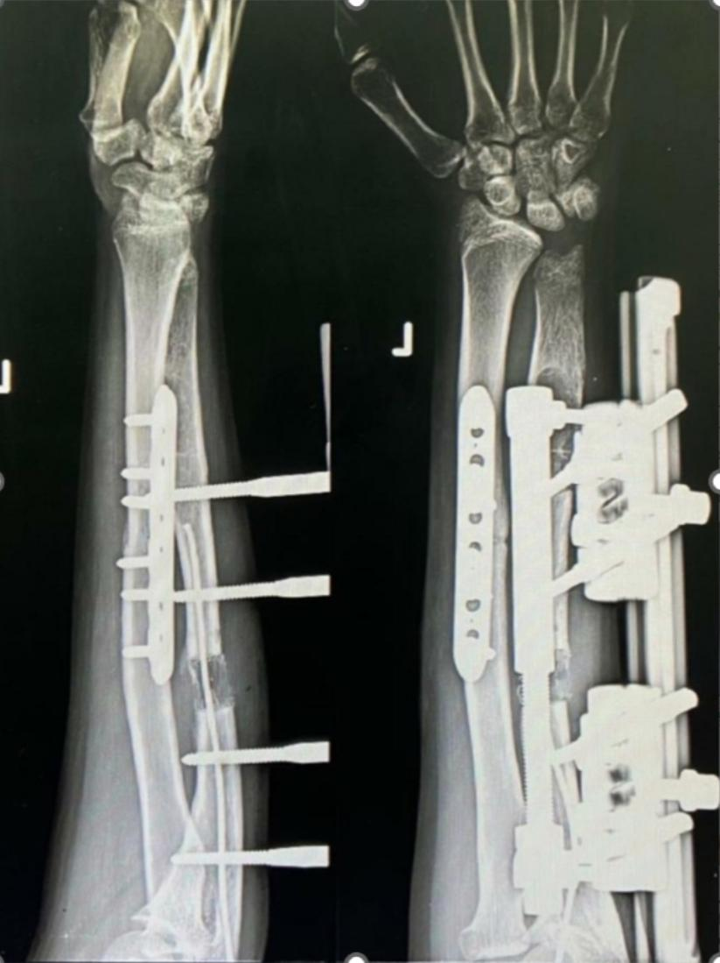
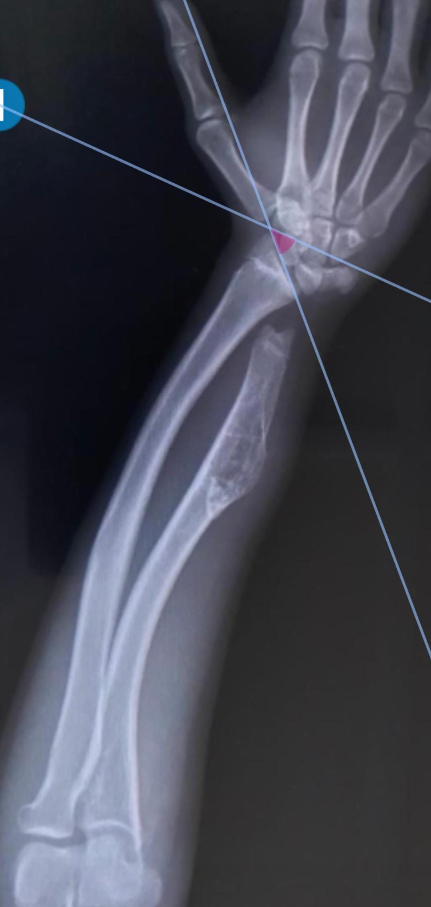
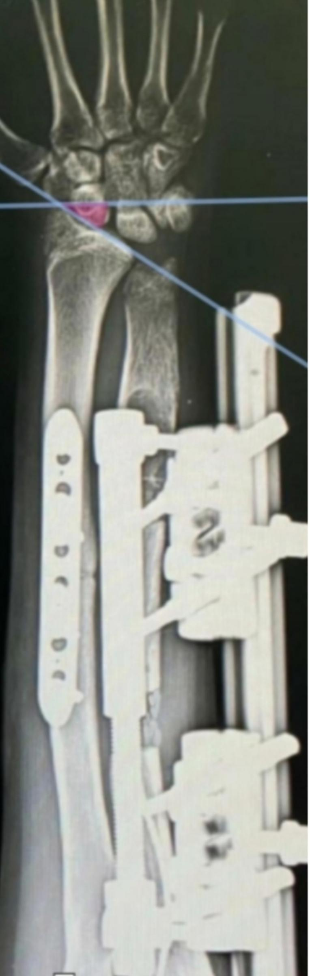
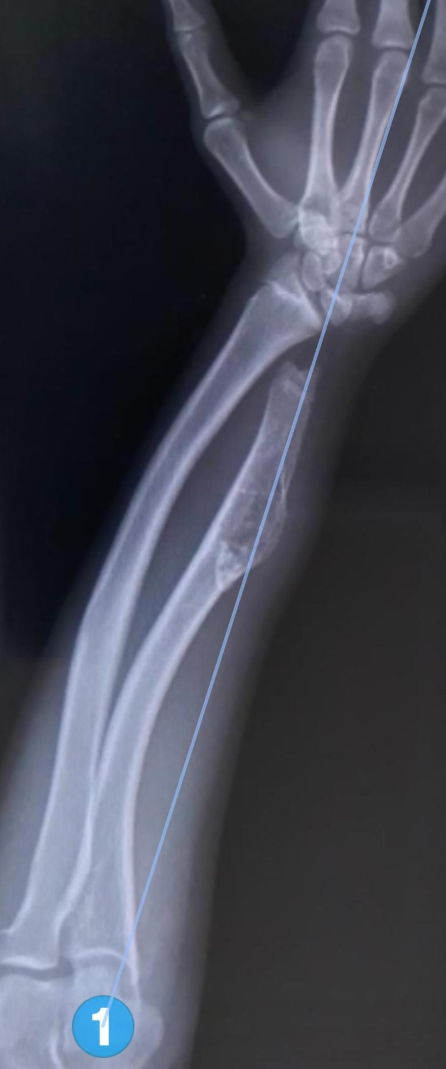
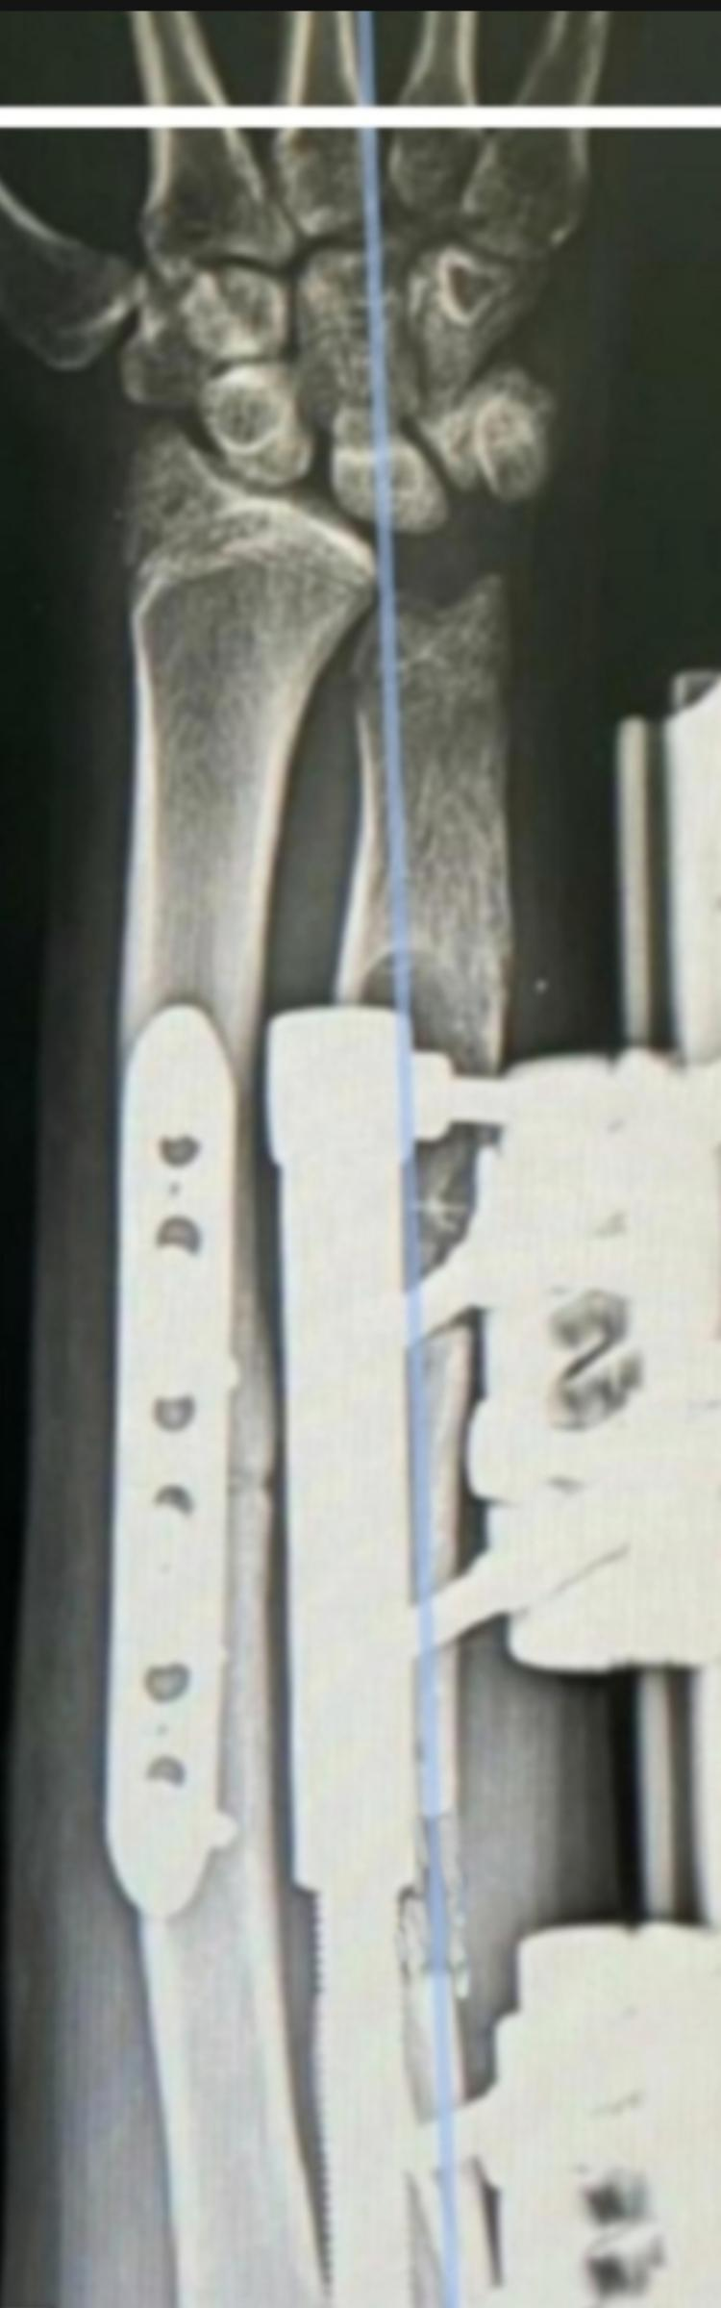
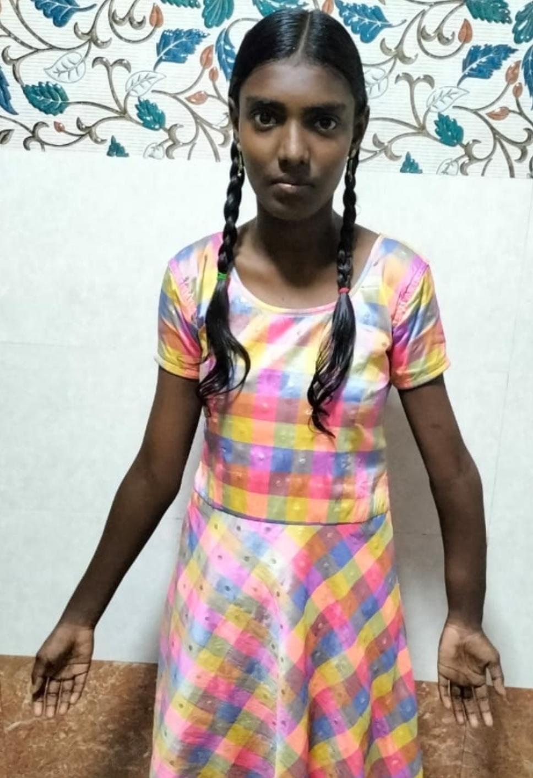
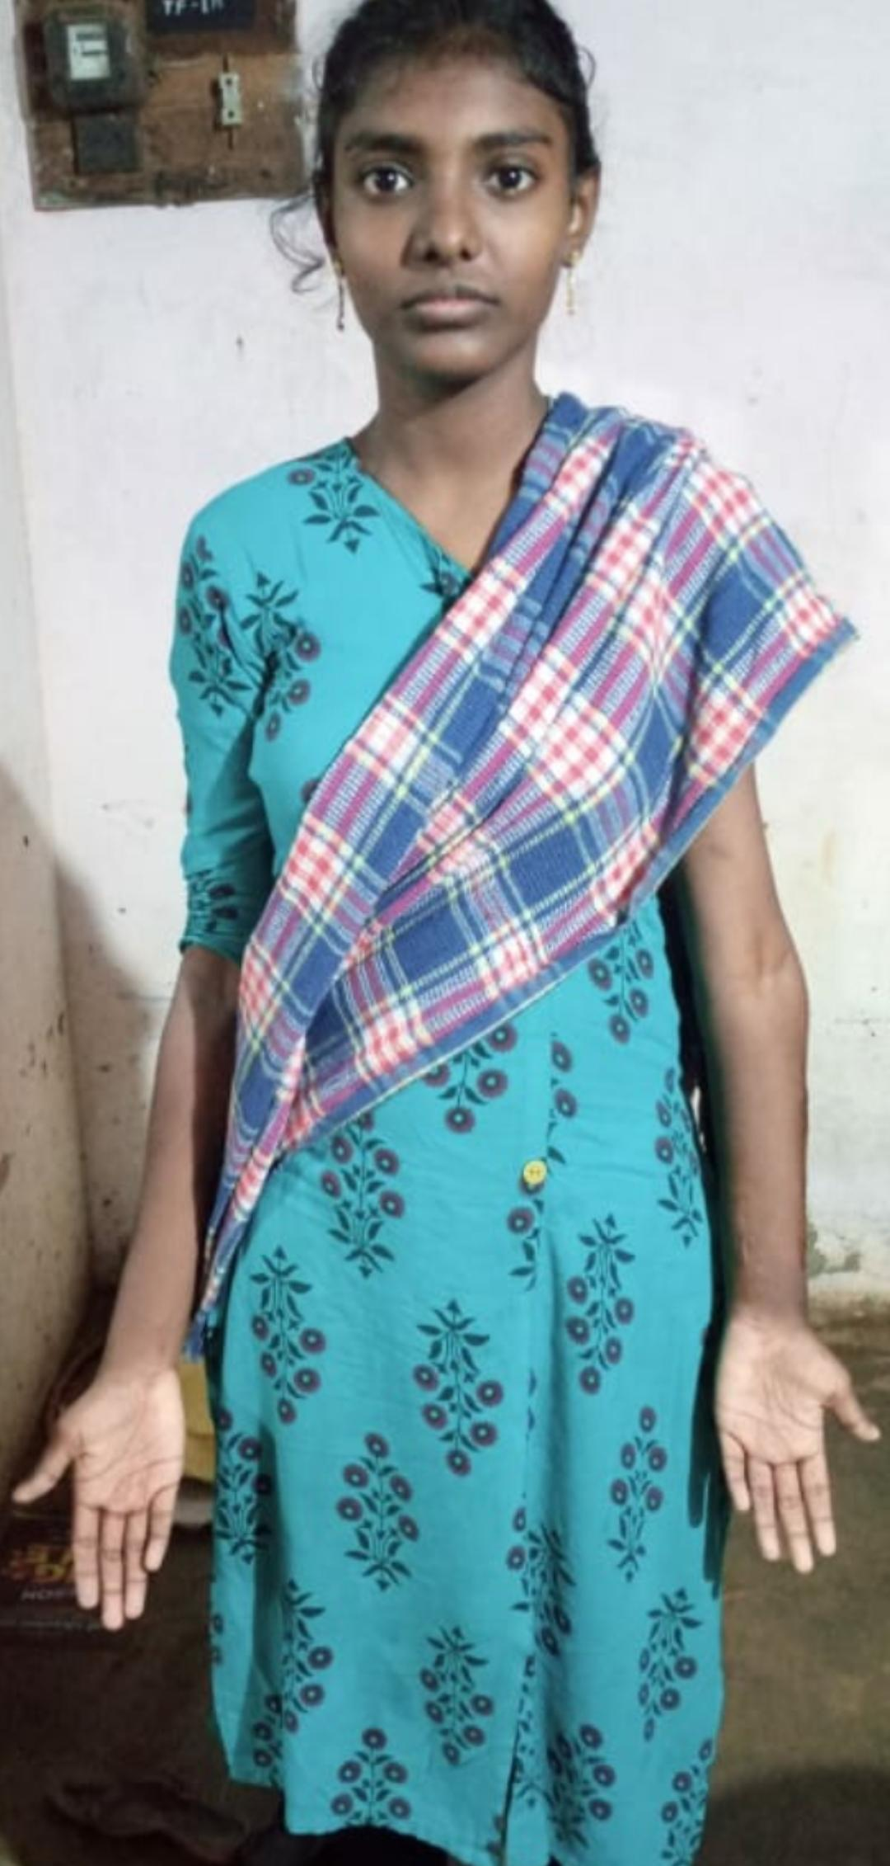
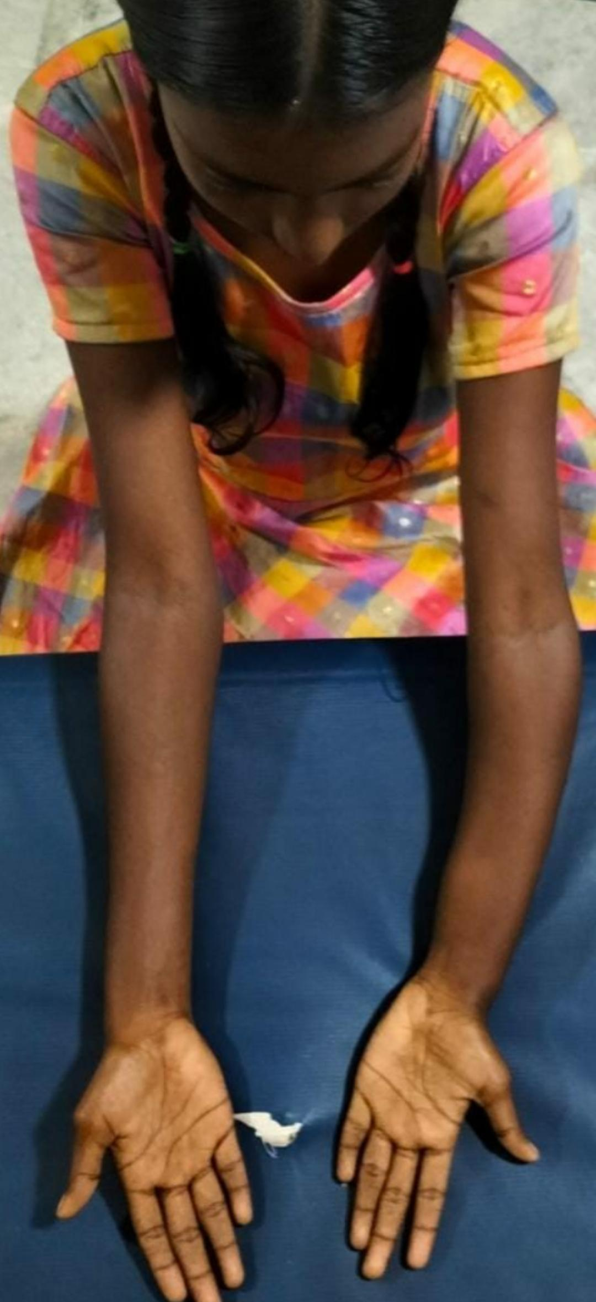
55th Annual Conference of Orthopedic Surgeon Society of Andhra Pradesh
Date 6 – 8 February,2026, Venue : Kurnool Medical College
Organized by : Department of Orthopaedics , Kurnool Medical College Kurnool
Correction of Forearm Deformity by Corrective Radial Osteotomy and Ulnar Lengthening by Distraction Osteogenesis in Hereditary Multiple Osteochondromatosis-a case report”
OSSAP_066
AUTHOR : T BALAJI, POST GRADUATE
INTRODUCTION
OPERATIVE FINDINGS
DISCUSSION
Multiple Hereditary Exostoses (MHE) is an autosomal dominant condition caused by EXT1 or EXT2 gene mutation.One of the manifestations of MHE is forearm deformity.Prevalence of the forearm deformity in MHE patients ranged from 40% to 74%.This forearm deformity causes cosmetic and functional prob-lems.Masada et al proposed a classification system for forearm deformities in order to help in planning of the treatment.
MASADA CLASSIFICATION
Type I The main osteochondroma formation is located in the distal portion of the ulna. The ulna is shortened, and there is bowing of the radius. However, the radial head is not dislocated-
Type II In addition to ulnar shortening, the radial head is dislocated
Type III The main osteochondroma formation is in the metaphysis of the distal radius, and there is relative shortening of the radius.
Excision of osteochondroma ,Osteotomy of the radius,Immediate ulnar lengthening was suggested for Masada type 1 deformities
We performed excision of the osteochondroma and radial correction by a closing wedge osteotomy at the center of rotation of angulation (CORA). The radius was fixed with a plate. For ulnar lengthening, osteotomy was performed at the proximal third of the ulna. Subsequently, It is fixed with monolateral external fixator. Finally, an intramedullary tens nail is inserted over the ulna to guide the regeneration.
The distraction process started 7 to 10 days after the surgery at a rate of 1 mm per day. The endpoint of distraction included neutral ulnar variance. At the end of lengthening, the fixator was kept in place until bone consolidation gets completed.
Patient followed up Post operatively for 6 months.The preoperative Radial articular angle (RAA), supination and pronation of forearm ,carpal slip(CS),Ulnar variance(UV),Radial bowing (RB ) were improved post operatively. There is no Postoperative complications,Left radius bowing were almost corrected and cosmetically improved.Forearm shortening compared to other forearm reduced .
CONCLUSION
CASE REPORT
Gradual ulnar lengthening significantly reduces cosmetic deformity and improves function in patients with Masada type I deformity. Our results supported early ulnar lengthening for patients with a tendency of dislocation of the radial head in type 1 masada deformities
A 15 years female patient came to opd with deformity over left forearm and swelling over volar aspect of wrist. No history of trauma, fever.No h/o loss of weight and apetite
On examination swelling was present over volar aspect of distal forearm.swelling was globular of size 5cm in diameter,With smooth surface,broad based ,sessile ,non tender.Angular deformity over shaft of radius with apex facing radially and shortening of 5cm compared to right forearm No distal neurovascular deficit
On evaluation radiographs shows Approximately 4.2 x 1.7 x 1.7 cm sized exophytic sessile osseous lesion with focal inflammatory changes noted arising from the distal end of ulna and displacing the deep muscle facia anteriorly.The lesion is continuous. The cartilage cap thickness 1.6 mm.
References:
1.Fogel Gretal (1984) Management of deformities of the forearm in multiple hereditary osteochondromas. J Bone Joint Surg Am 66(5):670–680
2.Masada K et al (1989) Operations for forearm deformity caused by multiple osteochondromas. J Bone Joint Sur Br vol 71(1):24–29

