Slide 1




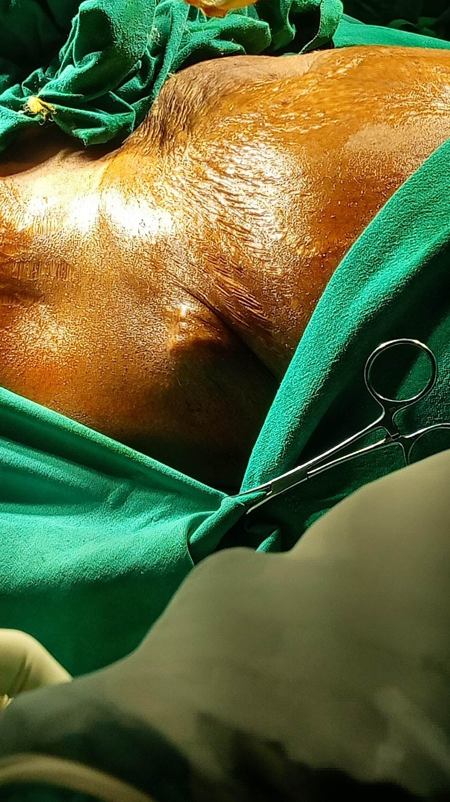
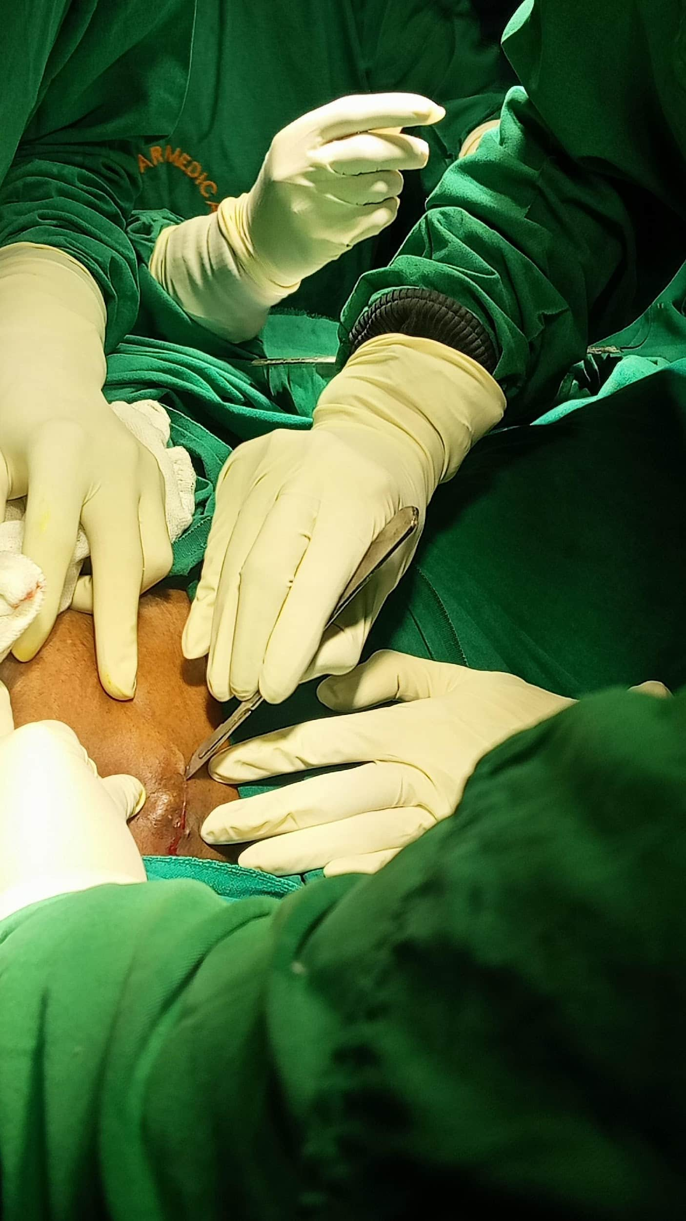
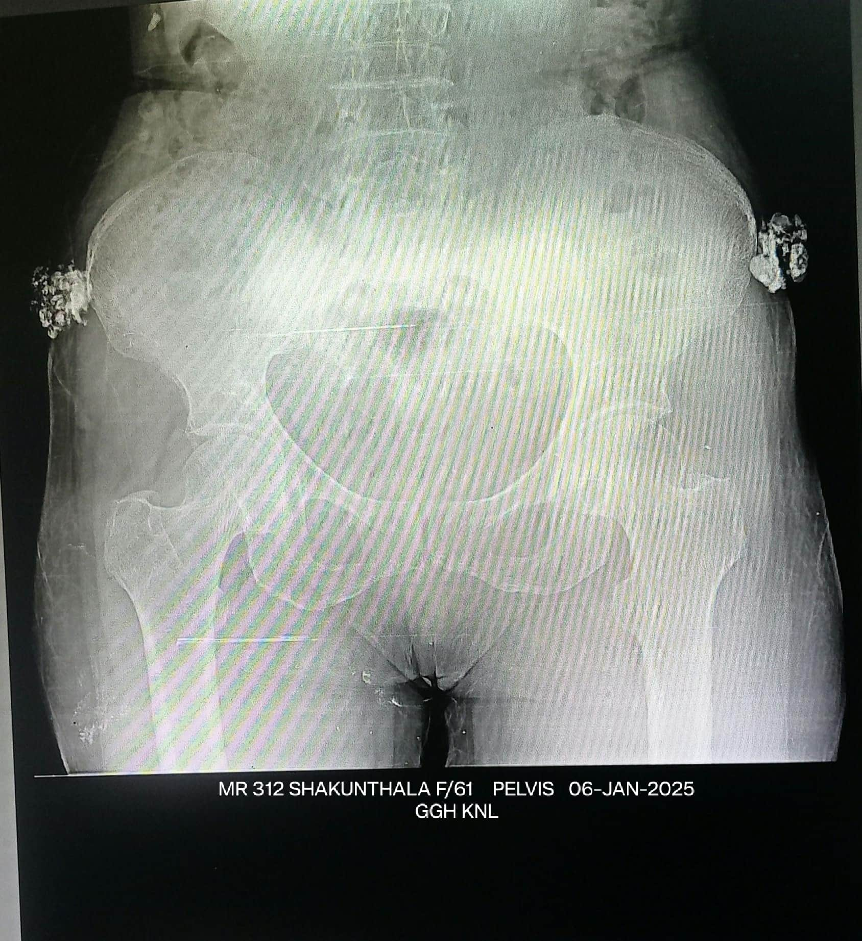
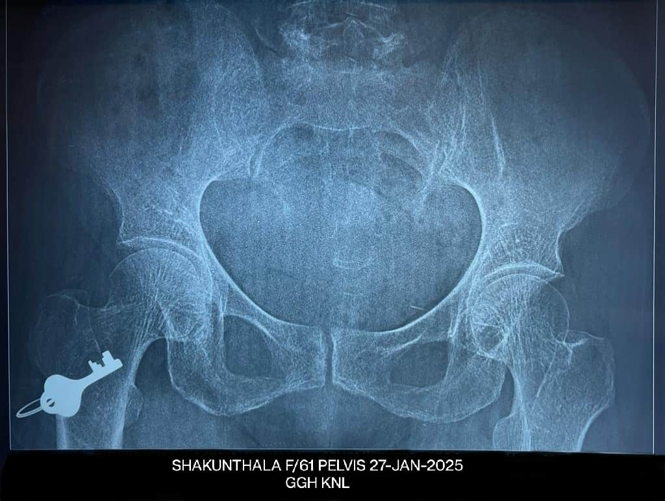
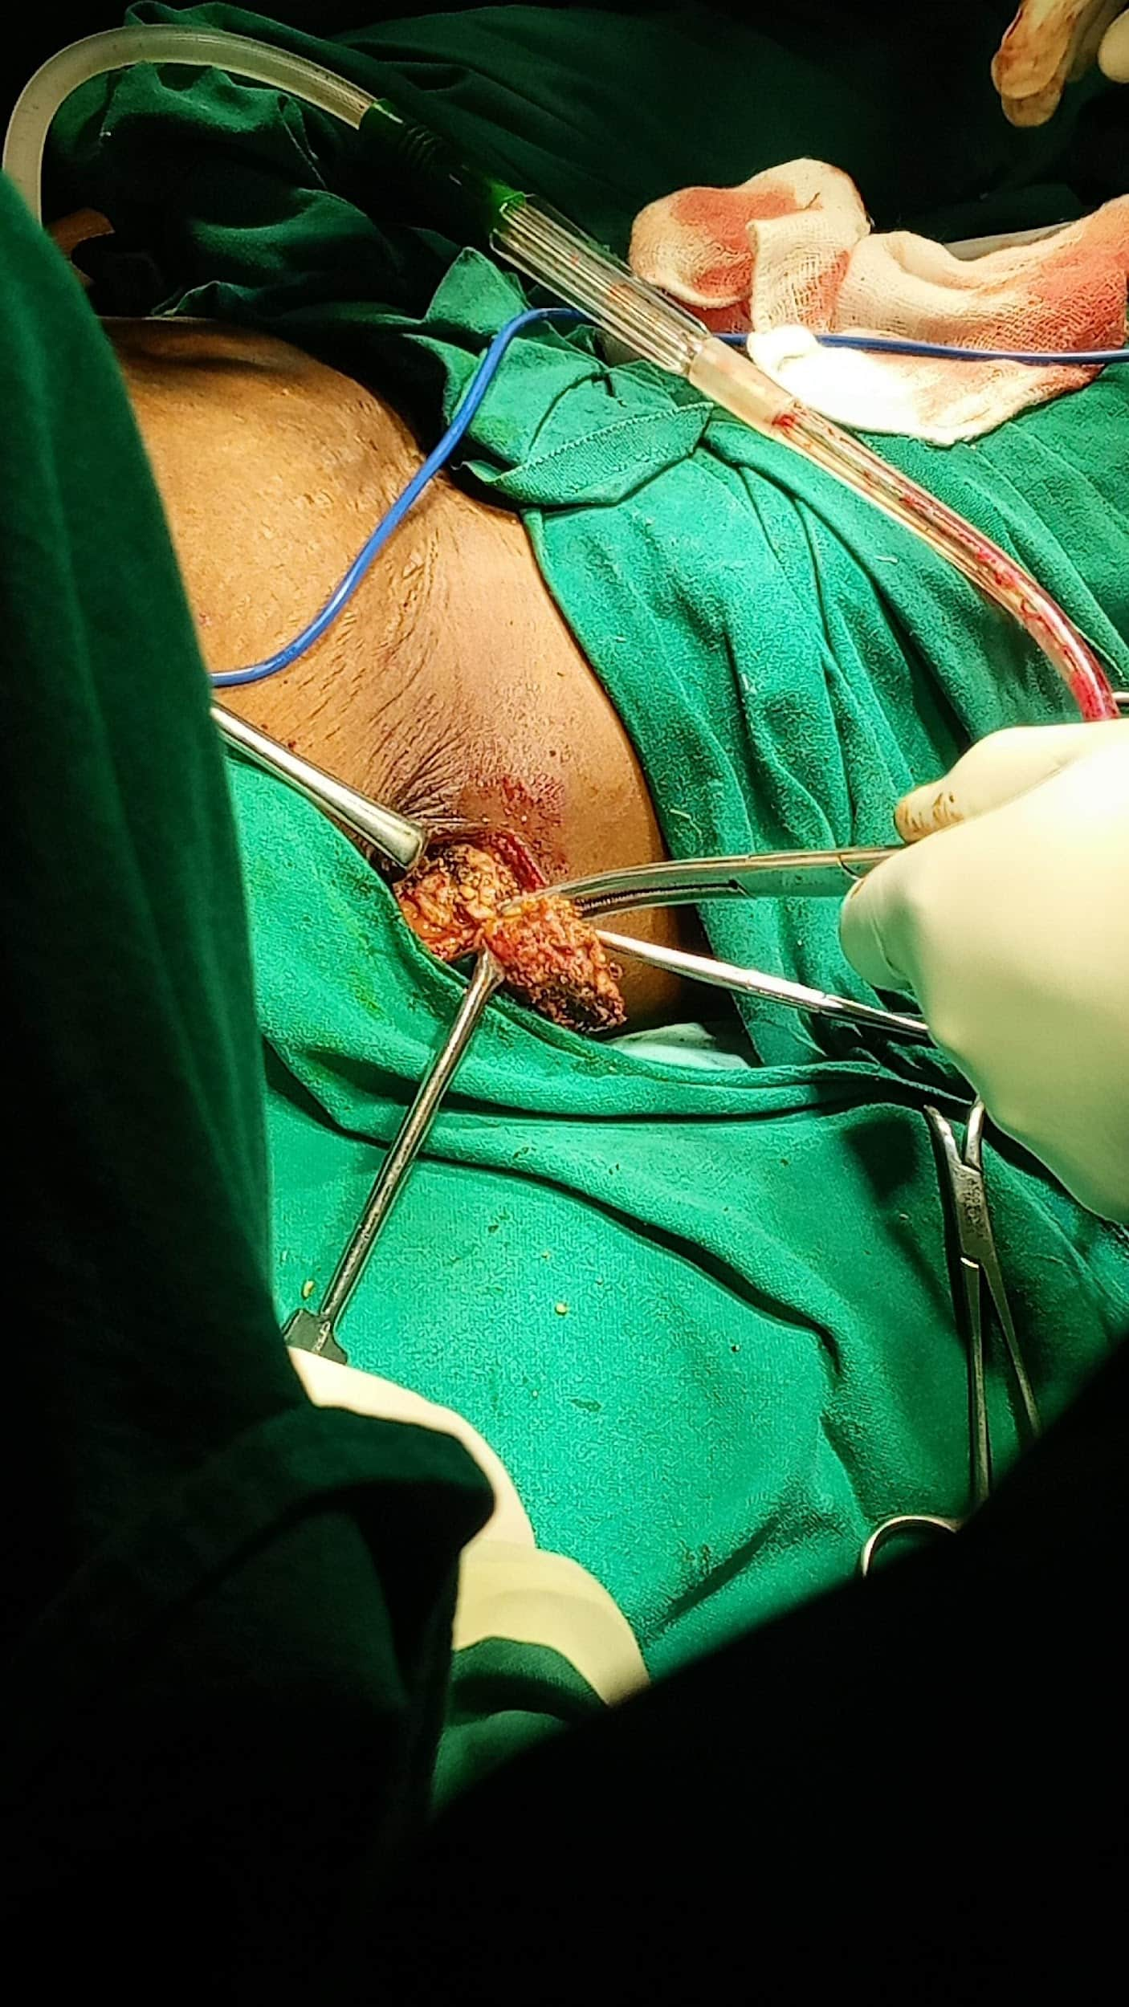
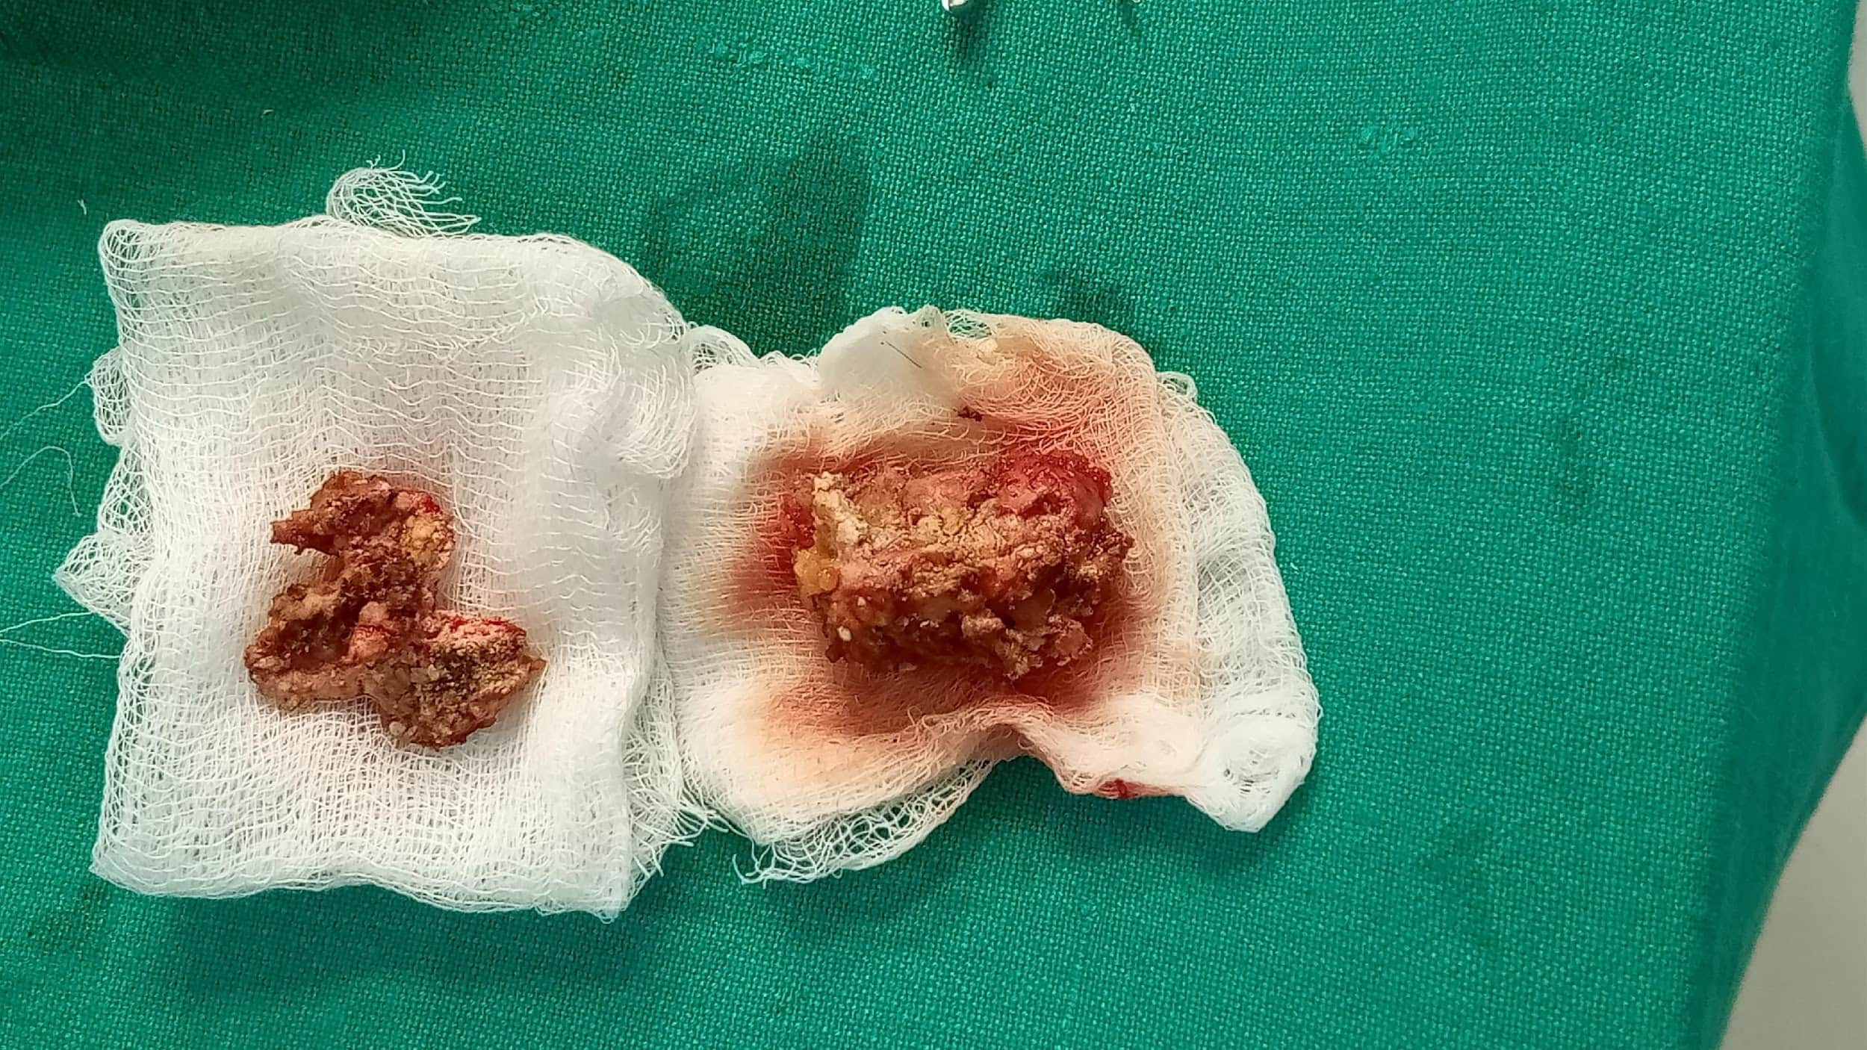
BILATERAL CALCINOSIS CUTIS : A RARE CASE REPORT
PRESENTER : Dr. G JAYENDRA REDDY, POST GRADUATE
GUIDE : Dr. CHANDRA SEKHAR MS ORTHO, ASST PROFESSOR
KURNOOL MEDICAL COLLEGE, KURNOOL DISTRICT. ID : OSSAP-068
INTRODUCTION
OPERATIVE FINDINGS
DISCUSSION
Calcinosis cutis is a rare disorder characterized by deposition of insoluble calcium salts in the skin and subcutaneous tissues.
It is classified into dystrophic, metastatic, idiopathic, iatrogenic calcification, and calciphylaxis.
Dystrophic calcinosis cutis is the most common type and occurs in areas of tissue damage despite normal serum calcium and phosphate levels
Common sites include fingers, forearms, and periarticular regions.
Bilateral gluteal involvement is extremely rare, prompting this report.
Bilateral excision of calcinosis cutis was performed under spinal anesthesia.
Intraoperatively, chalky white, lobulated calcified masses were found in the subcutaneous plane, not adherent to underlying muscle or bone.
Complete excision was achieved.
Post-operative recovery was uneventful with significant pain relief.
Post-operative radiographs confirmed complete removal.
Calcinosis cutis results from deposition of calcium phosphate crystals in soft tissues.
Dystrophic calcification occurs in damaged tissues with normal biochemical parameters.
The gluteal region is an uncommon site, and bilateral presentation is rare.
Differential diagnoses include myositis ossificans, tumoral calcinosis, calcified hematoma, and soft tissue tumors.
Surgical excision is indicated in symptomatic cases and shows excellent outcomes..
Pre op X ray
Post op x ray
CASE REPORT
A 62-year-old female presented with painless swellings over the bilateral lateral gluteal region for 10 years, gradually progressive, associated with pain for last 1yr
O/E : Bilateral, firm, mobile swellings with slip sign +ve
Investigations :Serum calcium, phosphate & Renal parameters – Normal
X-ray pelvis: lobulated soft-tissue calcifications over bilateral iliac region
MRI: well-defined subcutaneous lobulated calcified lesions
A diagnosis of bilateral dystrophic calcinosis cutis was made
CONCLUSION
Bilateral calcinosis cutis of the gluteal region is a rare entity.
Accurate diagnosis requires correlation of clinical, radiological, and biochemical findings.
Complete surgical excision offers effective symptomatic relief and good functional outcome.

