Slide 1



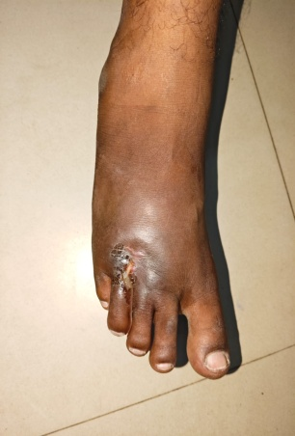
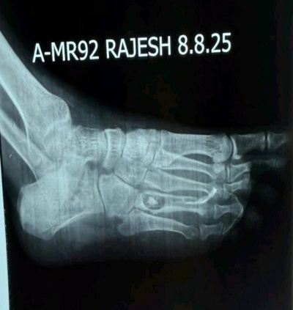
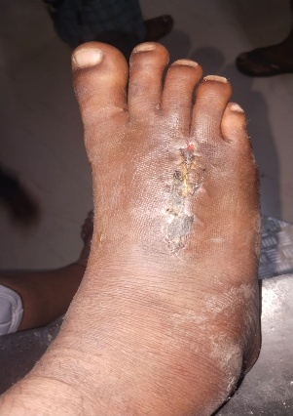
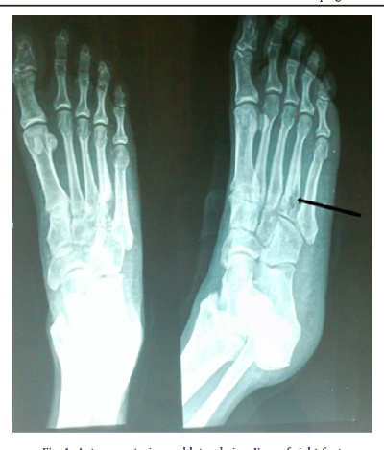
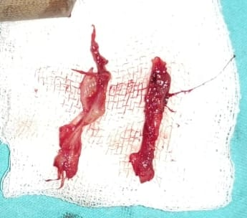
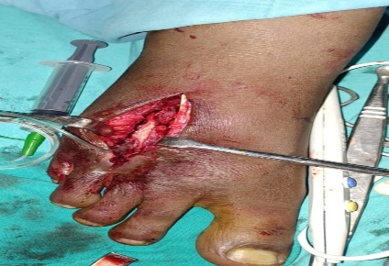
OSSAP _O70
55th Annual Conference of Orthopedic Surgeon Society of Andhra Pradesh
Date 20-22 February,2026, Venue : Kurnool Medical College
Organized by : Department of Orthopaedics , Kurnool Medical College Kurnool
Chronic Post-Traumatic Osteomyelitis of the Foot in a Young Adult: An Insidious Course
AUTHOR : DR .E.RAJA KUMAR:POST GRADUATE
GUIDE:DR.K.SRINIVAS PROFESSOR &HOD, COGUIDE:DR.BRAMHA MAHESHWAR REDDY , ASSISTANT PROFESSOR
INTRODUCTION
OPERATIVE FINDINGS
DISCUSSION
The patient underwent surgical management consisting of sequestrectomy, saucerization, excision of the sinus tract, and bone grafting . Intra-operative observations included Thickened, fibrotic sinus tract extending from plantar to dorsal surface .Necrotic bone fragments (sequestrum),Surrounding sclerotic bone margins , Infected granulation tissue and chronic inflammatory changes, Intra-operatively sequestrum removed and saucerization done ,sinus tract removed after injection radio opaque dye showing sinus tract
After thorough wound wash bone graft from iliac bone kept , wound closed on dorsal and plantar surface
Chronic osteomyelitis is characterized by persistent infection, devitalized bone, and compromised local vascularity. Trauma with subsequent ulceration can act as an entry point for infection, progressing insidiously over years if untreated. Imaging plays a critical role, with plain radiographs identifying chronic changes, sinograms mapping sinus tracts, and MRI delineating the full extent of bone and soft-tissue involvement.
Definitive management requires radical debridement, complete excision of sinus tracts, removal of sequestra, and restoration of bone integrity, often supplemented with bone grafting. Failure results in recurrence and chronic morbidity.
Chronic osteomyelitis following trauma remains a challenging orthopaedic condition, especially when it results from untreated or inadequately treatedcontiguous softtissueinfection. Delayed presentation often leads to sinus formation, sequestrum development, and extensive bone and soft-tissue involvement, increasing morbidity even in young, otherwise healthy individuals
CONCLUSION
CASE REPORT
Chronic post-traumatic osteomyelitis can present insidiously even in young, healthy patients. High clinical suspicion and appropriate imaging are essential fordiagnosis
Surgical management with thorough debridement and sequestrectomy remains the cornerstone of treatment Early diagnosis and timely intervention are crucial to prevent long-term disabilityand recurrence
A 29-year-old male presented with a 3-year history of persistent right foot pain and purulent discharge following a traumatic ulcer . There was no history of diabetes, immunocompromising illness, recent trauma,
Clinical examination revealed a chronic plantar forefoot ulcer with induration and granulation tissue.
Active purulent discharge was noted from the ulcer site . Plain radiographs showed cortical irregularity, sclerosis, periosteal reaction, and probable sequestrum involving metatarsals .
Sinogram demonstrated a sinus tract extending from the plantar to dorsal aspect of the foot.
MRI confirmed chronic osteomyelitis with associated soft-tissue involvement.
References
Cierny G, Mader JT, Penninck JJ. A clinical staging system for adult osteomyelitis. Clin Orthop Relat Res. 2003;414:7–24.
→ Widely used classification guiding treatment strategies in chronic osteomyelitis.
Mauffrey C, et al. Management of chronic osteomyelitis: current concepts. EFORT Open Rev. 2016;
→ surgical practice.

