Slide 1




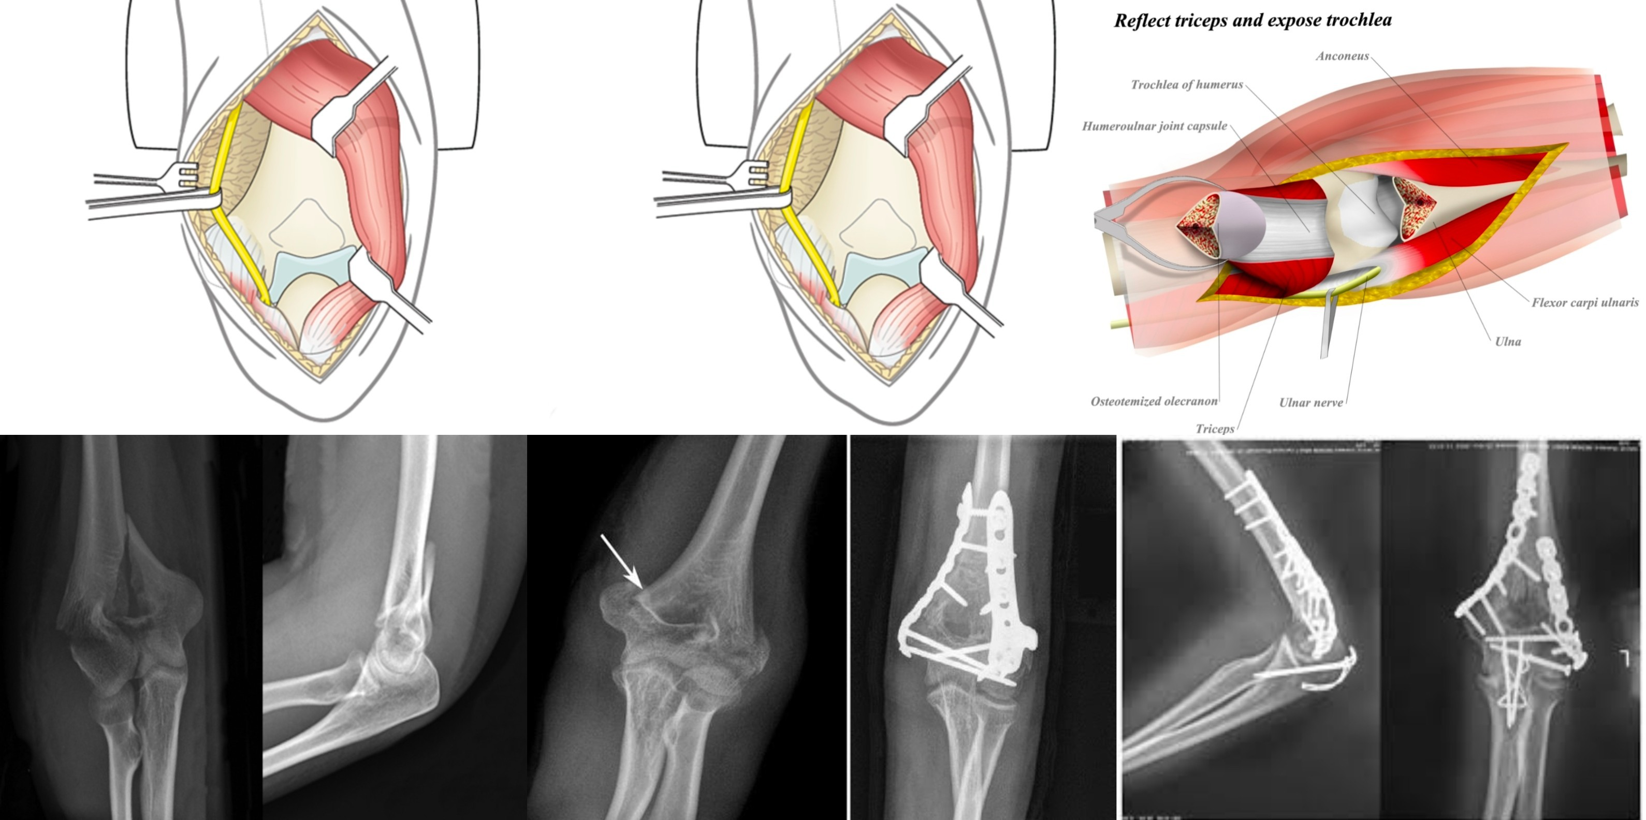
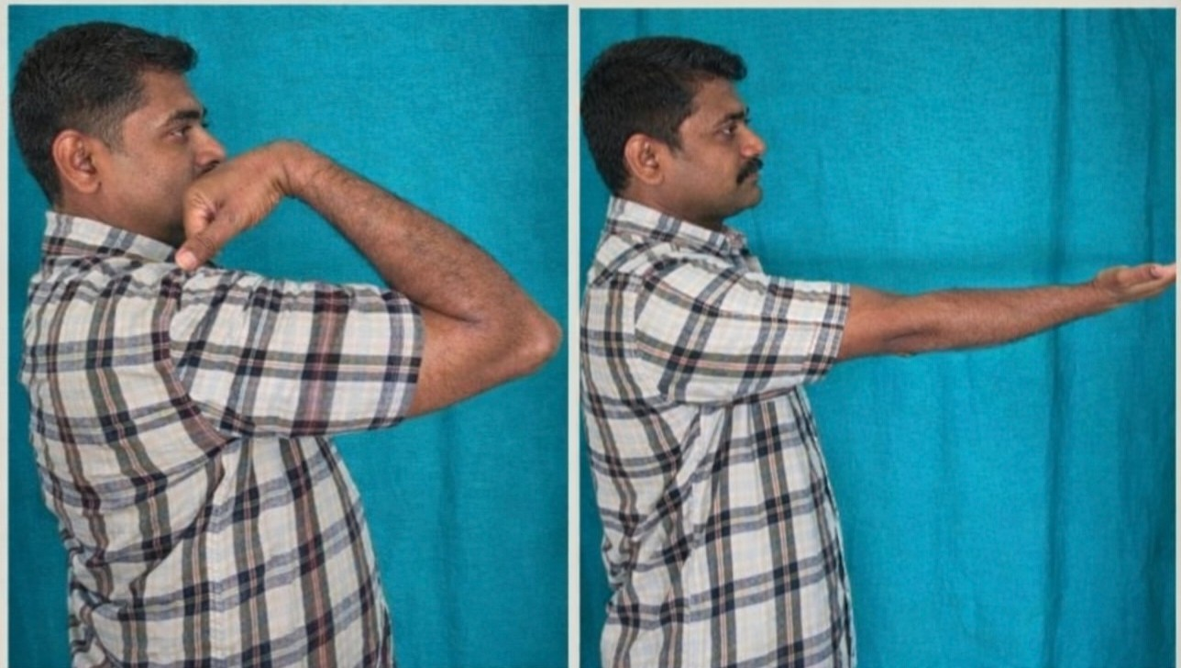
55th Annual Conference of Orthopedic Surgeon Society of Andhra Pradesh
Date 20– 22 February,2026, Venue : Kurnool Medical College
Organized by : Department of Orthopaedics, Kurnool Medical College Kurnool
REVISITING VON GORDOS APPROACH TO DISTAL HUMERUS FRACTURES
Registration id: OSSAP-82
PRESENTED : Dr CHENNAIAH G,POST GRADUATUE, ORTHOPEDICS
GUIDES : Dr G PRANEETH KUMAR REDDY, ASST PROFFESSOR : Dr Y RAMANA ,PROFESSOR
INTRODUCTION
OPERATIVE FINDINGS
DISCUSSION
Distal humerus fractures account for a small but complex group of elbow injuries due to
Intra-articular involvement, Comminution, Limited soft-tissue envelope
Surgical management requires Excellent visualization,Anatomical reduction of articular surface & Stable fixation allowing early mobilization
Traditional posterior approaches (especially olecranon osteotomy) provide wide exposure but are associated with complications such as: Nonunion, Implant prominence & Need for secondary surgery. Von Gorder’s approach is a posterior triceps-reflecting approach that avoids olecranon osteotomy while preserving the extensor mechanism, making it relevant for selected distal humerus fractures.
Posterior midline skin incision over the elbow. Ulnar nerve identified, decompressed, and protected throughout the procedure. Triceps muscle reflected medially and laterally from the posterior humerus without splitting or olecranon osteotomy.Adequate exposure of Distal humeral columns Posterior aspect of the articular surface Fracture fragments were visualized clearly, reduced anatomically, and fixed using plates and screws. Triceps was securely reattached during closure, ensuring restoration of the extensor mechanism.
Von Gorder’s approach provides a balance between exposure and soft-tissue preservation.
Advantages: Avoids olecranon osteotomy and its complications:
(Nonunion, Implant irritation), Preserves triceps continuity →better postoperative extension strength,Reduced surgical morbidity,Early rehabilitation possible
Limitations: Articular visualization is less than that achieved with olecranon osteotomy, Not ideal for:Severely comminuted intra-articular fractures,Complex AO type C3 fractures
Indications: Extra-articular distal humerus fractures,Simple intra-articular fractures,Patients where avoiding osteotomy is desirable
CONCLUSION
Von Gorder’s approach is a reliable posterior triceps-reflecting technique for selected distal humerus fractures. It provides sufficient exposure for stable fixation while minimizing complications associated with olecranon osteotomy.
Proper fracture selection is critical for success.
Revisiting this approach reinforces its continued relevance in modern orthopedic trauma surgery, especially where preservation of triceps function and reduction of surgical morbidity are priorities.
References:
1.Von Gorder GW-Surgical approach in fractures involving the distal end of the humerus.Journal of Bone and Joint Surgery (JBJS). 1940;22:969–981.
2.Morrey BF, Sanchez-Sotelo J-The Elbow and Its Disorders. 4th ed. Philadelphia: Elsevier; 2009(Chapter on surgical approaches to the elbow)
3.Campbell WC, Canale ST, Beaty JH-Campbell’s Operative Orthopaedics. 13th ed. Elsevier; 2017.(Posterior approaches to distal humerus)
CASE REPORT
Adult patient presenting after high-energy trauma with pain,swelling and restricted elbow movement.Clinical examination revealed tenderness and loss of elbow function without neurovascular deficit.Radiological evaluation:AP and lateral X-rays showed distal humerus fracture,CT scan used to define fracture geometry.Fracture pattern:Simple intra-articular fracture.Surgical plan:Open reduction and internal fixation using von Gorder’s posterior triceps-reflecting approach to minimize morbidity.

