Slide 1




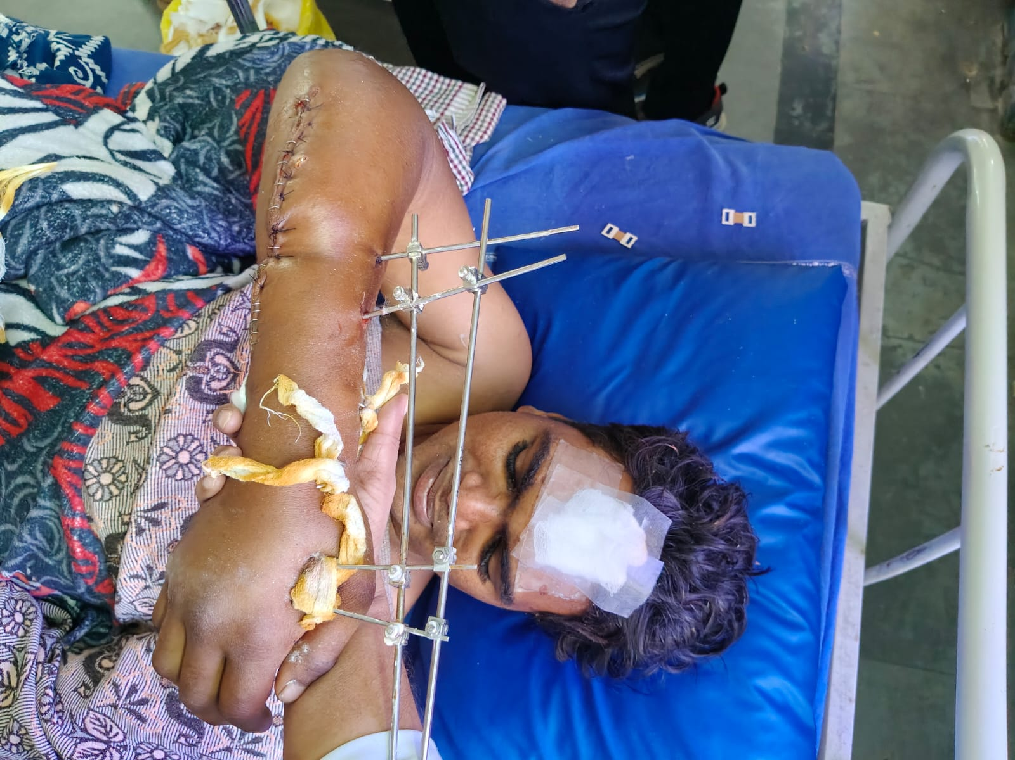
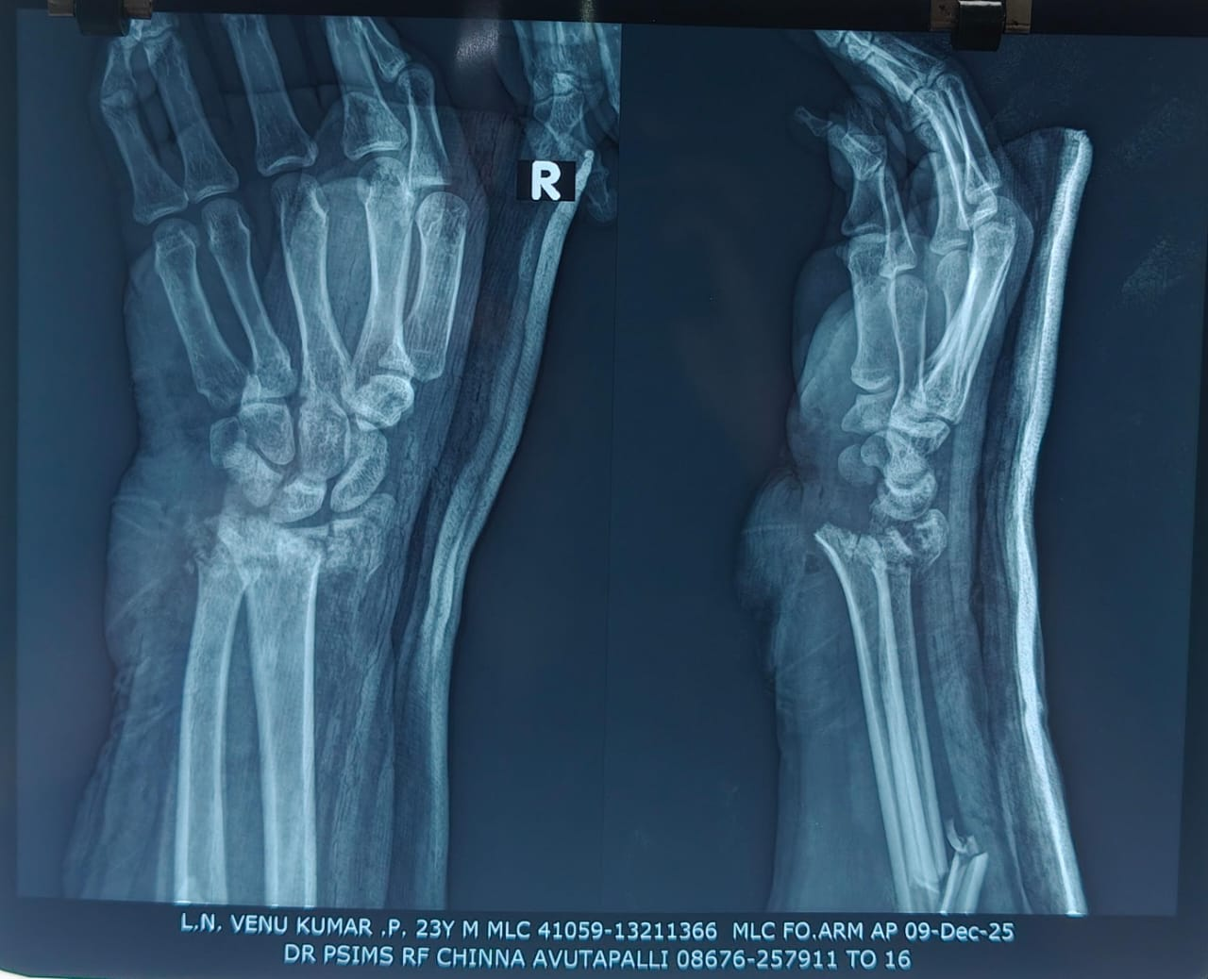
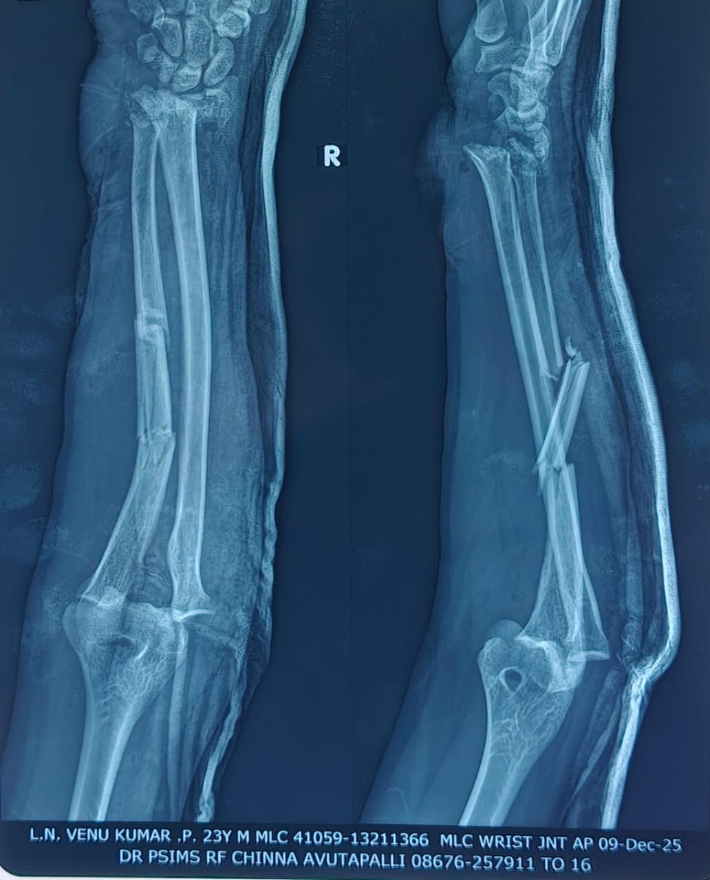
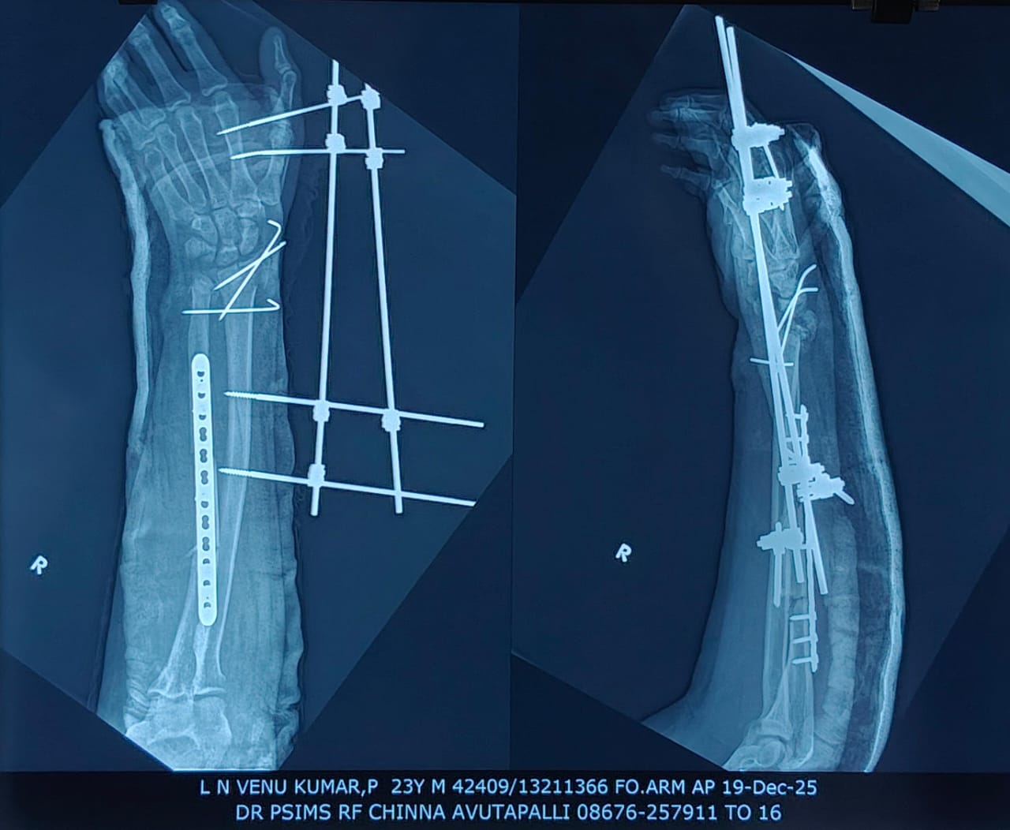
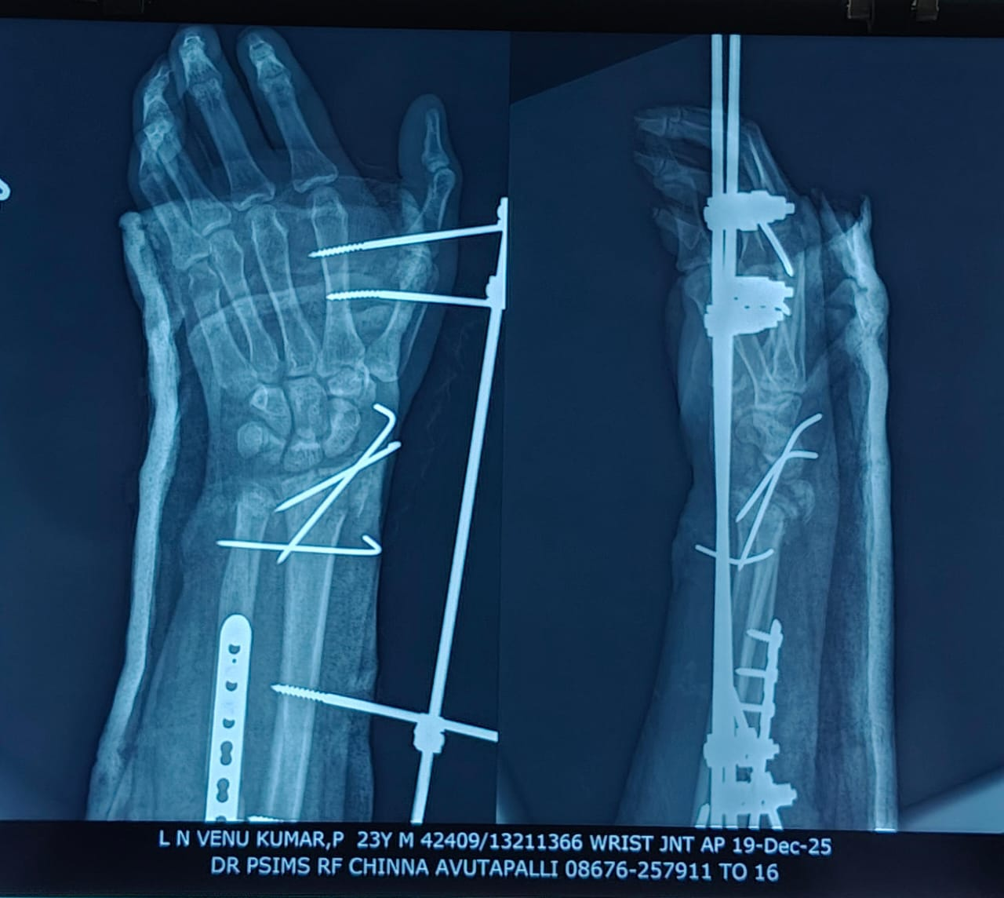
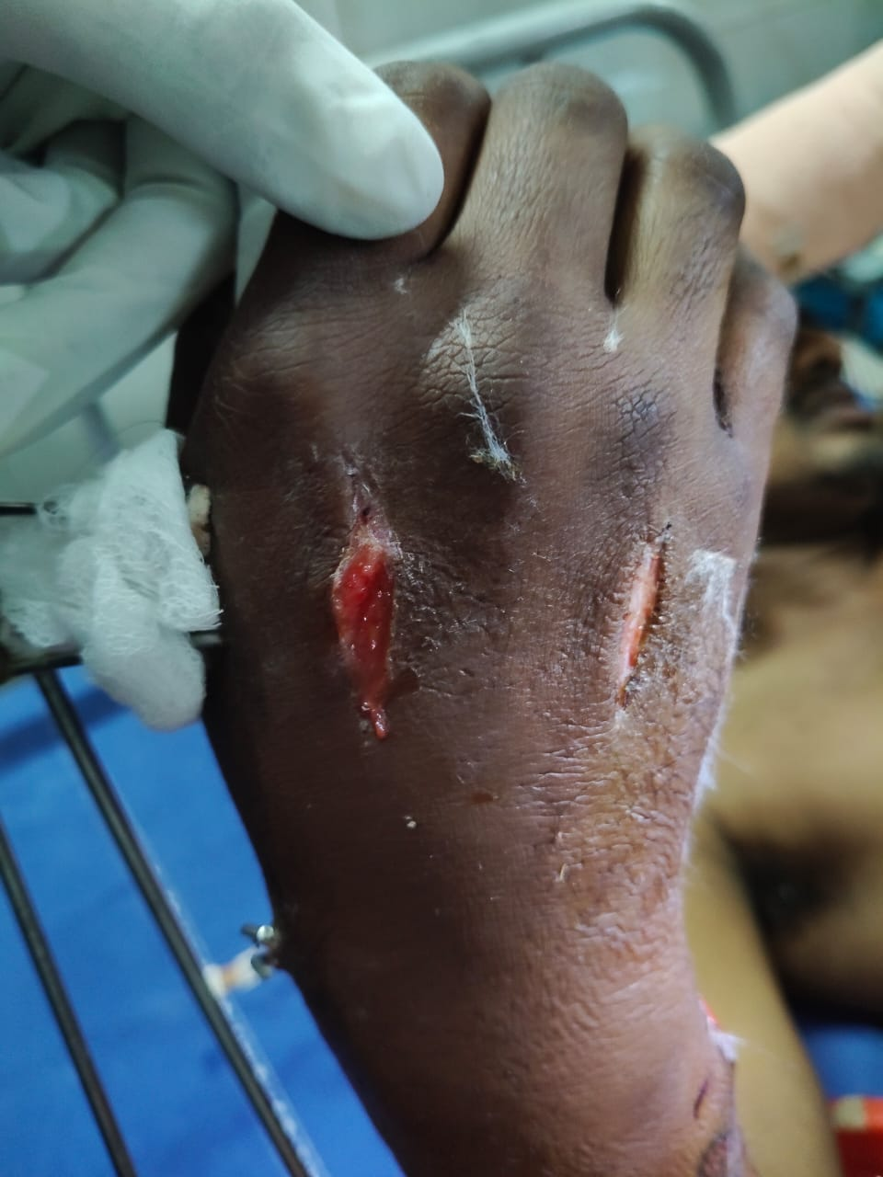
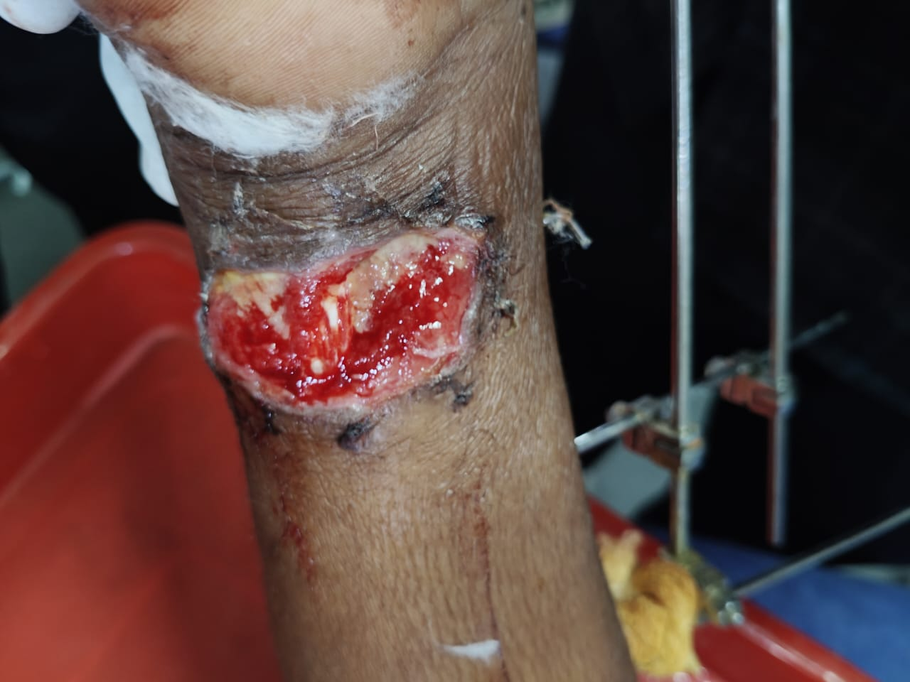
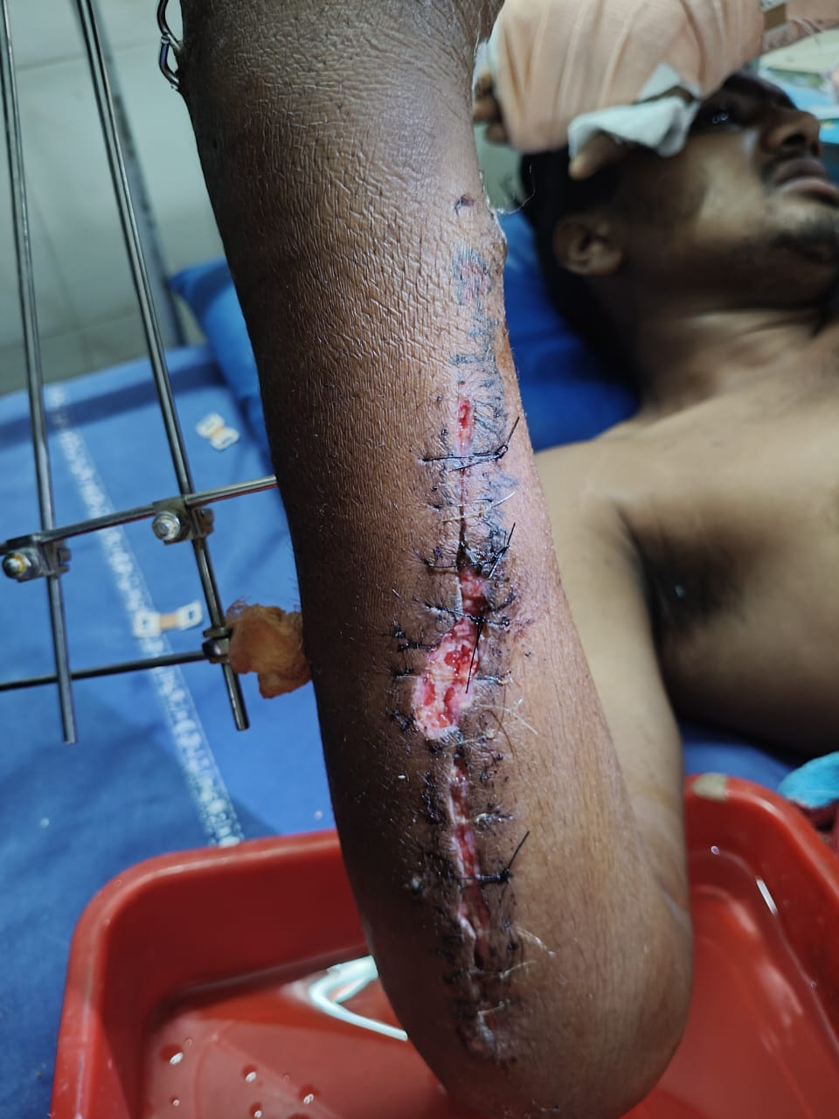
“WHEN FIXATION ISN’T THE FINISH LINE: ACUTE COMPARTMENT SYNDROME OF THE HAND AFTER COMPLEX UPPER LIMB FRACTURES”
PRESENTED BY – DR. HARSHITH GAJULAPALLI FINAL YEAR POSTGRADUATE
GUIDE – DR.B.B.JOGINATH ASST PROFESSOR, MS ORTHOPAEDICS, DNB ORTHO, MNAMS, MRCS, FELLOW IN SPINE SURGERY
INTRODUCTION
OPERATIVE FINDINGS
DISCUSSION
Acute compartment syndrome is a limb-threatening emergency caused by raised intercompartmental pressures, resulting in impaired local vascular circulation and tissue function. We present a 23-year-old man who developed compartment syndrome of the hand following fixation of a ipsilateral distal radius fracture with radiocarpal dislocation and Monteggia fracture. The diagnosis was made postoperatively based on clinical findings, and emergency fasciotomy was performed. This case highlights the need for early recognition and vigilant postoperative monitoring following complex upper limb fracture fixation.
Patient underwent wound reexploration and fasciotomy of extensor compartments of hand.
Hand compartment syndrome is an uncommon but limb-threatening condition that requires a high index of suspicion following hand and distal forearm fractures. Disproportionate pain is the most reliable early clinical sign, while preserved distal pulses and sensation do not exclude the diagnosis and may contribute to delay. Progressive elevation of intercompartmental pressure rapidly leads to muscle ischemia and irreversible necrosis if untreated. Although compartment pressure monitoring can assist in equivocal cases, diagnosis remains primarily clinical. Delayed recognition is associated with severe morbidity, including infection, contractures, and amputation, underscoring the importance of early diagnosis and prompt fasciotomy to preserve limb function, particularly in resource-limited settings.
POSTOP CLINICAL PICTURE ON DAY 2
CASE REPORT
PRE OP XRAYS
A 23-year-old male patient presented with pain associated with swelling in right forearm & right wrist due to alleged history of self fall from height. Patient was admitted; investigations were done and diagnosed as Ipsilateral Right Monteggia fracture with posterior dislocation of radial head and Right distal radius fracture with Distal radiocarpal joint dislocation. Patient then underwent plating to right ulna and ligamentotaxis to right distal radius. The right upper limb is secured in above elbow pop slab and saline stand elevation was done postoperatively. On postoperative day 2 patient developed severe pain, swelling, loss of sensations in right forearm and wrist & was unable to move the fingers of right hand. Patient was diagnosed as Compartment syndrome of right hand and forearm clinically.
CONCLUSION
Acute compartment syndrome of the hand following complex fracture fixation is rare but limb-threatening. High clinical suspicion and prompt decompression are essential to prevent irreversible functional loss and ensure favourable outcomes.
POSTOP XRAYS
POSTOP PICTURE AFTER FASCIOTOMY

