Slide 1
From Listhesis to balance
Surgical restoration of spinopelvic alignment in adult Lumbosacral Spondylolisthesis
PRESENTER :
DR.HARSHITH GAJULAPALLI
3rd YEAR POST GRADUATE
DR.PSIMS & RF
GUIDE :
DR.B.B.JOGINATH
ASSISTANT PROFESSOR
DR.PSIMS & RF

Slide 2
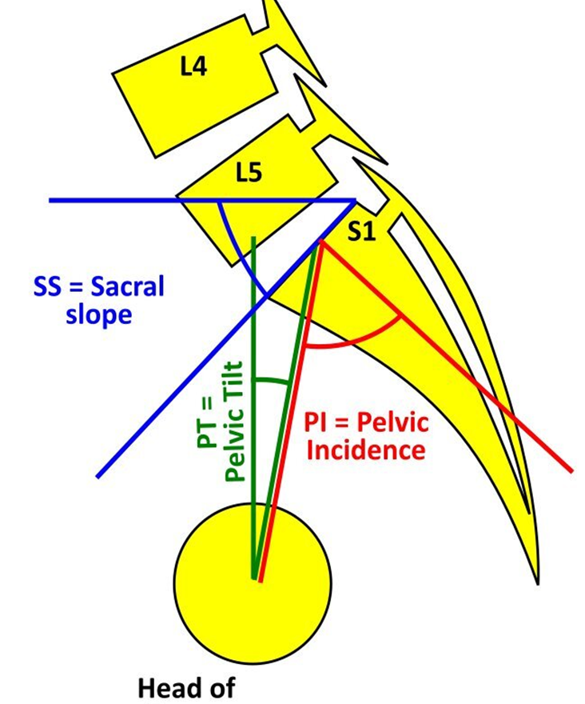
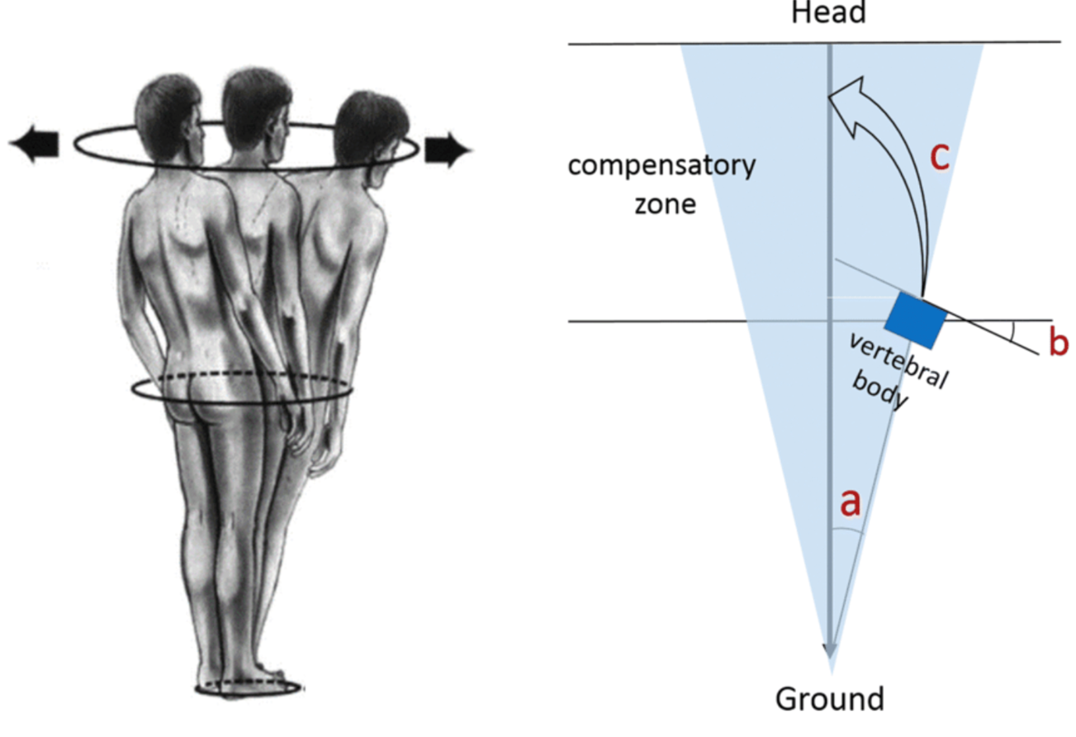
INTRODUCTION:
Spino-pelvis alignment maintains upright posture
Energy-efficient standing requires harmony - “Cone Of Economy”
Measured via PI, PT, SS, LL, SVA
PI = SS + PT
Notes:
Importance of maintenance of upright posture with minimal physical effort .
Beyond this zone , energy expenditure rapidly increases and eventually spinal misalignment results and external support may be necessary

Slide 3
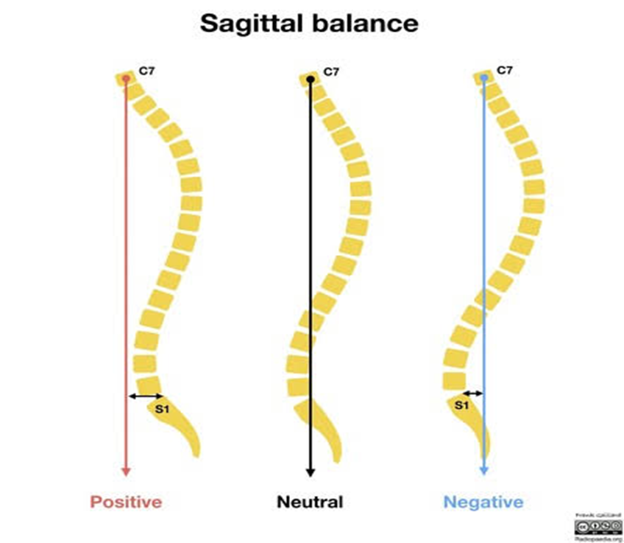
SPINOPELVIC PARAMETERS:
Sagittal Vertical Axis :
A plumb line is drawn vertically from the inferior endplate C7 to S1, and the distance is measured between the plumb line and the posterosuperior corner of S1

Slide 4
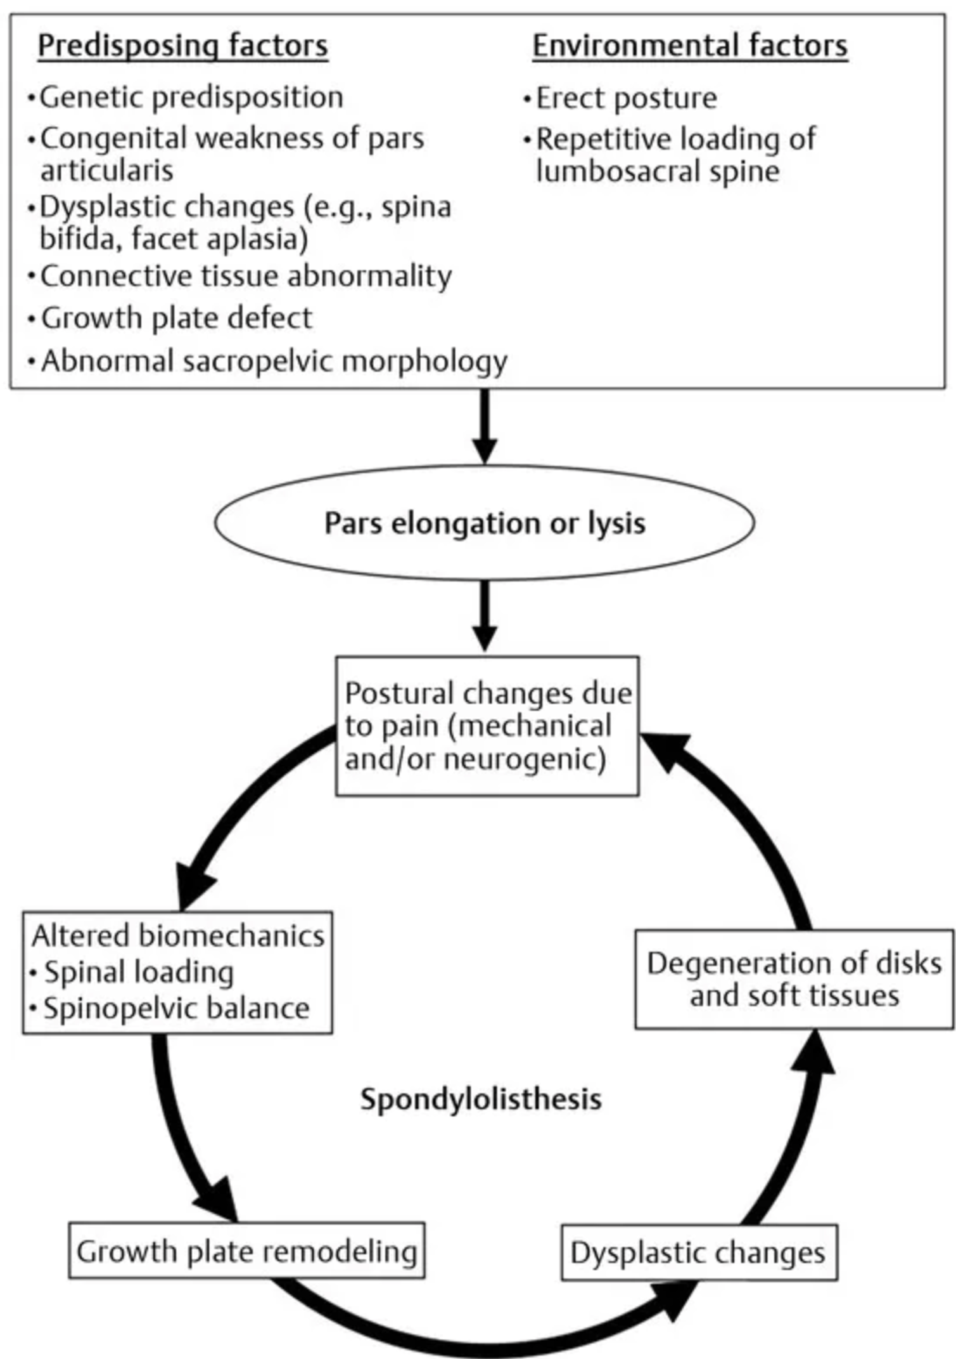
Patho mechanism of Spondylolisthesis :
Anterior slip disrupt Sagittal balance
Pelvic Retroversion develops
Lumbar lordosis
SDSG CLASSIFICATION
MEYERDING CLASSIFICATION
Notes:
Other classifications are: Wiltse classification
Marchetti & Bartolozzi classification.
SDSG – Type 1 - <50% slip and low <45 deg PI
2 - <50% slip & Normal 45-60 deg PI
3 - <50% slip & high PI >60 deg
4- > 50% slip Balanced pelvis (High SS/low PT)
5- >50% slip Retroverted pelvis (Low SS/high PT) & Balanced spine
6 - >50% slip Retroverted pelvis & unbalanced spine

Slide 5
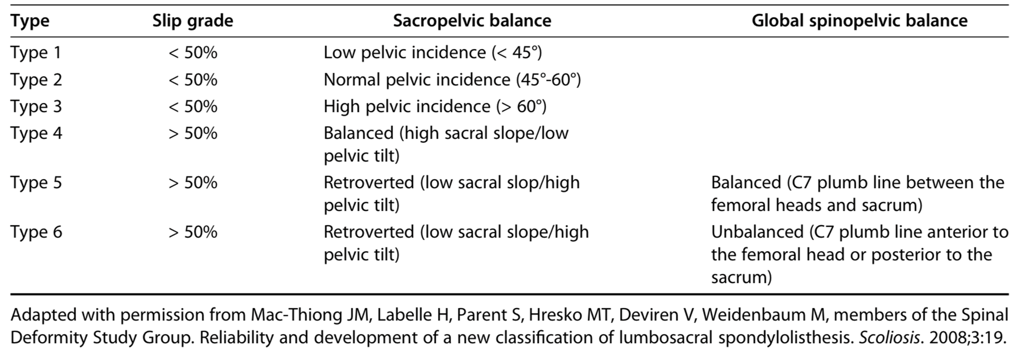
SDSG CLASSIFICATION

Slide 6
Concept of Balanced vs Unbalanced Pelvis
Balanced pelvis
Compensatory increase lumbar lordosis and decrease thoracic kyphosis of the spine adequate to maintain normal sagittal balance
Unbalanced Pelvis /Retroverted pelvis
Because of increased pelvic tilt that spine cannot accommodate the associated high L5 incidence angle , leading to positive forward balance.

Slide 7
Principles of Spondylolisthesis Surgery :
PT reduction : reversal of pelvic retroversion
SS increase : Sacral Horizontalization
LL restoration : Lumbar Alignment Correction
PI constant : Confirms measurement reliability
PI-LL normalization : Biomechanical Harmony
Reduction restores Global alignment - Not Just Slip Correction

Slide 8
AIMS & OBJECTIVES:
To study effectiveness of instrumentation, reduction and fusion by assessing radiological spinal sagittal parameters.
MATERIALS & METHODS:
Study Place : Dr. PSIMS & RF, Vijayawada.
Type of Study : Prospective Observational Cohort
30 patients who underwent instrument fixation and fusion procedure after diagnosis of spondylolisthesis.
Assessment by calculating sagittal vertical axis (SVA), lumbar lordosis (LL), pelvic incidence (PI), pelvic tilt (PT), sacral slope (SS), preoperatively and post operatively during follow up at 1,12 and 24 months.

Slide 9
INCLUSION CRITERIA
EXCLUSION CRITERIA
Patients aged 25-60 years.
Individuals with lumbar spondylolisthesis SDSG grade 2-5 confirmed via X-ray.
Individuals with spondylolisthesis Meyerding grade 2 & 3.
Patients scheduled for surgical intervention.
Subjects with spinal deformities or trauma.
Patients with high grade spondylolisthesis SDSG type 6
Patients with high grade spondylolisthesis Meyerding grade 4 & 5.
Pregnant individuals.
Subjects with scoliotic deviations.
Subjects with congenital anomalies or post-polio residual paralysis.
Patients undergoing conservative treatment.

Slide 10
Statistical analysis:
The normality of the data was assessed using the Kolmogorov–Smirnov test.
Quantitative variables were compared using paired t-tests for normally distributed data, while the Wilcoxon test was employed for nonnormally distributed data.
A P-value of < 0.05 was considered statistically significant.
Data entry and analysis were conducted using Microsoft Excel and Statistical Package for the Social Sciences software version 21.0.

Slide 11
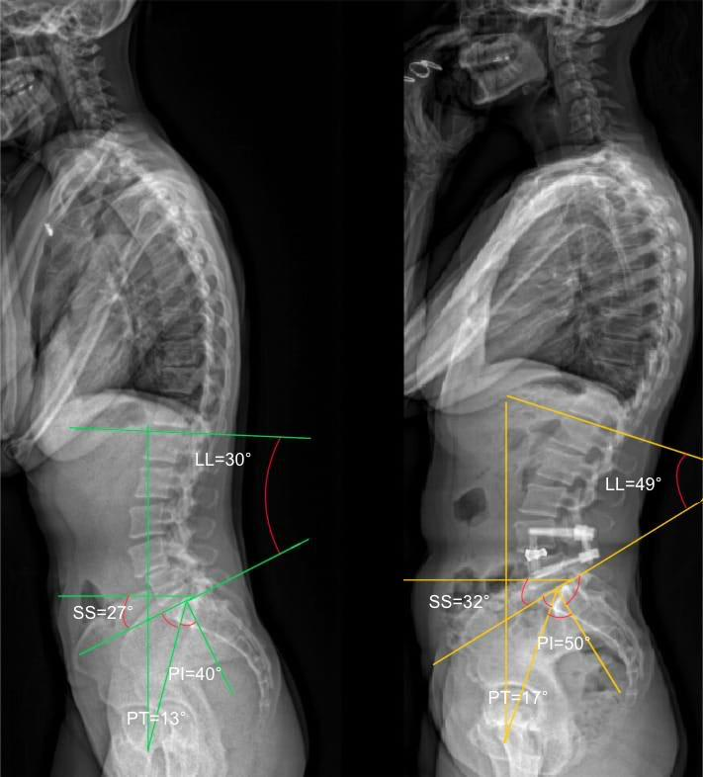
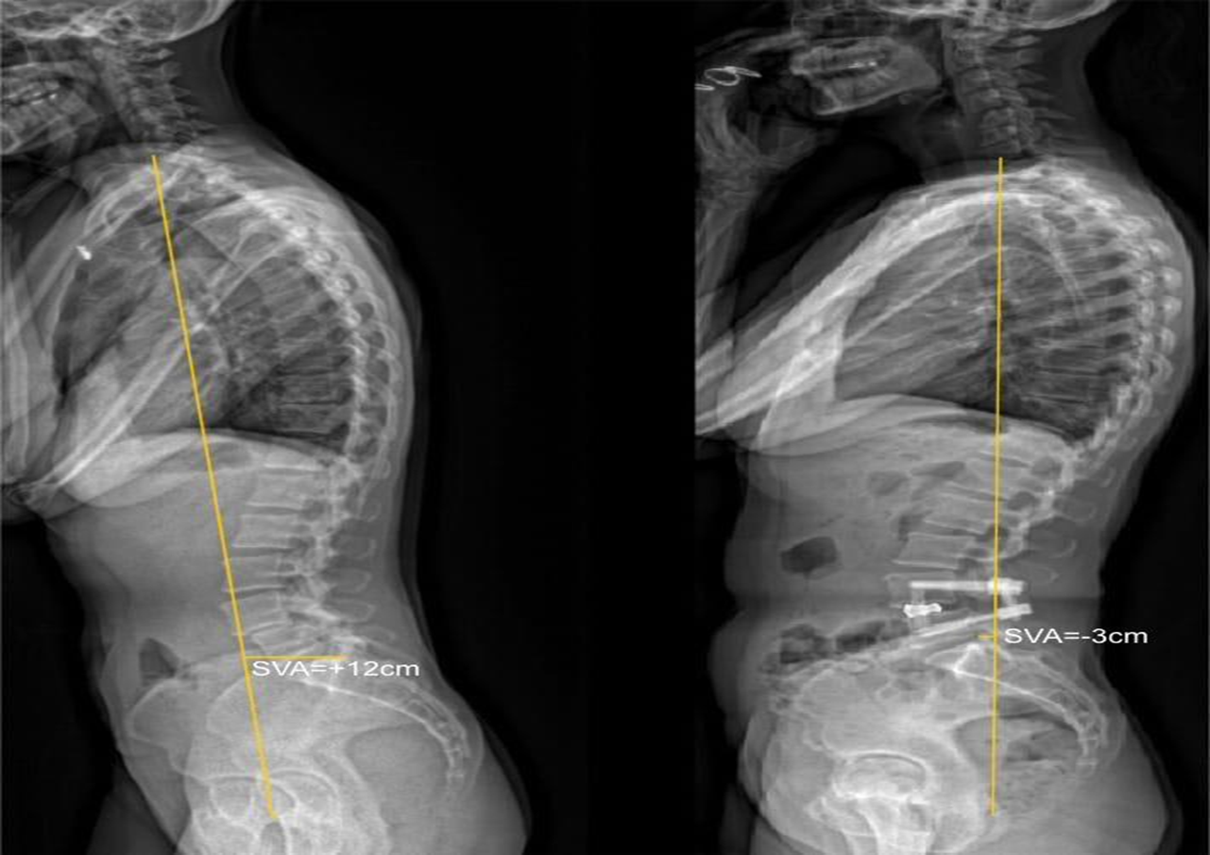
SPINOPELVIC PARAMETERS
Picture : Pre- and Post-operative assessment of PT, SS,LL,PI and SVA of a Case.

Slide 12
RESULTS
30 study participants, 9 male & 21 female.
Mean age – 44.10 ± 9.20 years.
PI showed a minimal reduction following surgery & this change is not statistically significant (p=0.28).
PT has significant reduction (p<0.001),
SS & LL has significant increase of p<0.01 & p<0.001 respectively post surgery.
PI showed a minimal mean change of 1.30 ± 6.50, with a median change of zero, indicating relative stability.
PT demonstrated a mean reduction of 4.60 ± 5.20, with a median change of 4.0. SS showed a mean increase of 3.40 ± 5.60, with a median change of 4.0.
LL improved with a mean change of 4.80 ± 5.70 and a median change of 4.0, reflecting measurable post-operative alteration in spinal alignment parameters.

Slide 13
CONCLUSION
Surgical instrumentation, reduction, and fusion for lumbosacral spondylolisthesis (SDSG Grades 2-5) are highly effective in reversing sagittal malalignment.
Profound statistical improvement in LL and a significant normalization of PT, effectively unloading compensatory pelvic mechanisms.
Most notably, the achievement of a physiologic PI-LL mismatch (reduced to 8.00 ± 11.97 p < 0.05) across all grades including SDSG Grade 4 & 5 validates that anatomical reduction is both achievable and superior for restoring global harmony.

Slide 14
Take home message
These results argue strongly against the 'fusion-in-situ' approach, asserting instead that active restoration of spinopelvic parameters is essential to optimize the biomechanical longevity of the spine and improve patient-reported outcomes.
We advocate for the mandatory integration of spinopelvic parameter analysis into the preoperative planning for all patients undergoing lumbosacral stabilization.

Slide 15
REFERENCES
Roussouly P, Pinheiro-Franco JL. Biomechanical analysis of the spino-pelvic organization and adaptation in pathology. European Spine Journal. 2011 Sep;20(Suppl 5):609.
During J, Goudfrooij H, Keessen W, Beeker TW, Crowe A. Toward standards for posture: postural characteristics of the lower back system in normal and pathologic conditions. Spine. 1985 Jan 1;10(1):83-7.
Abdu WA, Sacks OA, Tosteson AN, Zhao W, Tosteson TD, Morgan TS, Pearson A, Weinstein JN, Lurie JD. Long-term results of surgery compared with nonoperative treatment for lumbar degenerative spondylolisthesis in the Spine Patient Outcomes Research Trial (SPORT).

Slide 16
Diebo BG, Ferrero E, Lafage R, Challier V, Liabaud B, Liu S, Vital JM, Errico TJ, Schwab FJ, Lafage V. Recruitment of compensatory mechanisms in sagittal spinal malalignment is age and regional deformity dependent: a full-standing axis analysis of key radiographical parameters. Spine. 2015 May 1;40(9):642-9.
Park SJ, Lee CS, Chung SS, Kang KC, Shin SK. Postoperative changes in pelvic parameters and sagittal balance in adult isthmic spondylolisthesis. Operative Neurosurgery. 2011 Jun 1;68:ons355-63.
Mehta VA, Amin A, Omeis I, Gokaslan ZL, Gottfried ON. Implications of spinopelvic alignment for the spine surgeon. Neurosurgery. 2015 Mar 1;76(suppl_1):S42-56.
Bydon M, Alvi MA, Goyal A. Degenerative lumbar spondylolisthesis: definition, natural history, conservative management, and surgical treatment. Neurosurgery Clinics. 2019 Jul 1;30(3):299-304.

Slide 17
THANK you

