Slide 1
FUNCTIONAL OUTCOME OF DISPLACED MIDDLE THIRD CLAVICLE FRACTURES TREATED BY PLATE OSTEOSYNTHESIS
PRESENTER :
GUIDE:
DR. Y KARTHIK
POST GRADUATE ,
DEPARTMENT OF ORTHOPAEDICS,
DR. PSIMS & RF.
DR. A SANDEEP
ASSOCIATE PROFESSOR, DEPARTMENT OF ORTHOPAEDICS,
DR.PSIMS & RF.

Slide 2
Introduction:-
The clavicle connects the thorax to the shoulder girdle and is essential for shoulder movement.
Clavicle fractures are common, accounting for 5–12% of all fractures, most frequently affecting the mid-shaft due to its narrow structure and biomechanical stresses.
Non-operative management of mid-shaft fractures may lead to delayed healing, neurological symptoms, cosmetic deformity, and reduced shoulder function.
Early surgical fixation, particularly in displaced mid-shaft fractures and active individuals, helps prevent complications, provides rapid pain relief, restores shoulder mechanics, and allows early functional recovery.
Surgical options include plating and intramedullary fixation methods. Among these, open reduction and internal fixation with plating offers rigid stabilization, early mobilization leading to improved overall shoulder function.

Slide 3
AIM OF STUDY
To evaluate the functional outcomes of open reduction and internal fixation (ORIF) using plate osteosynthesis in displaced middle-third clavicle fractures.

Slide 4
Methodology
Prospective study (Nov 2022 – Nov 2024)
30 adult patients with displaced mid-third clavicle fractures
Treated with locking compression plate
Functional outcome assessed using Constant–Murley score
Inclusion Criteria:
Age 18–60 years
Displacement >2 cm / Shortening >2 cm
Comminuted or segmental fractures
Exclusion Criteria:
Age <18 or >60 years
Undisplaced fractures
Medically unfit for surgery

Slide 5
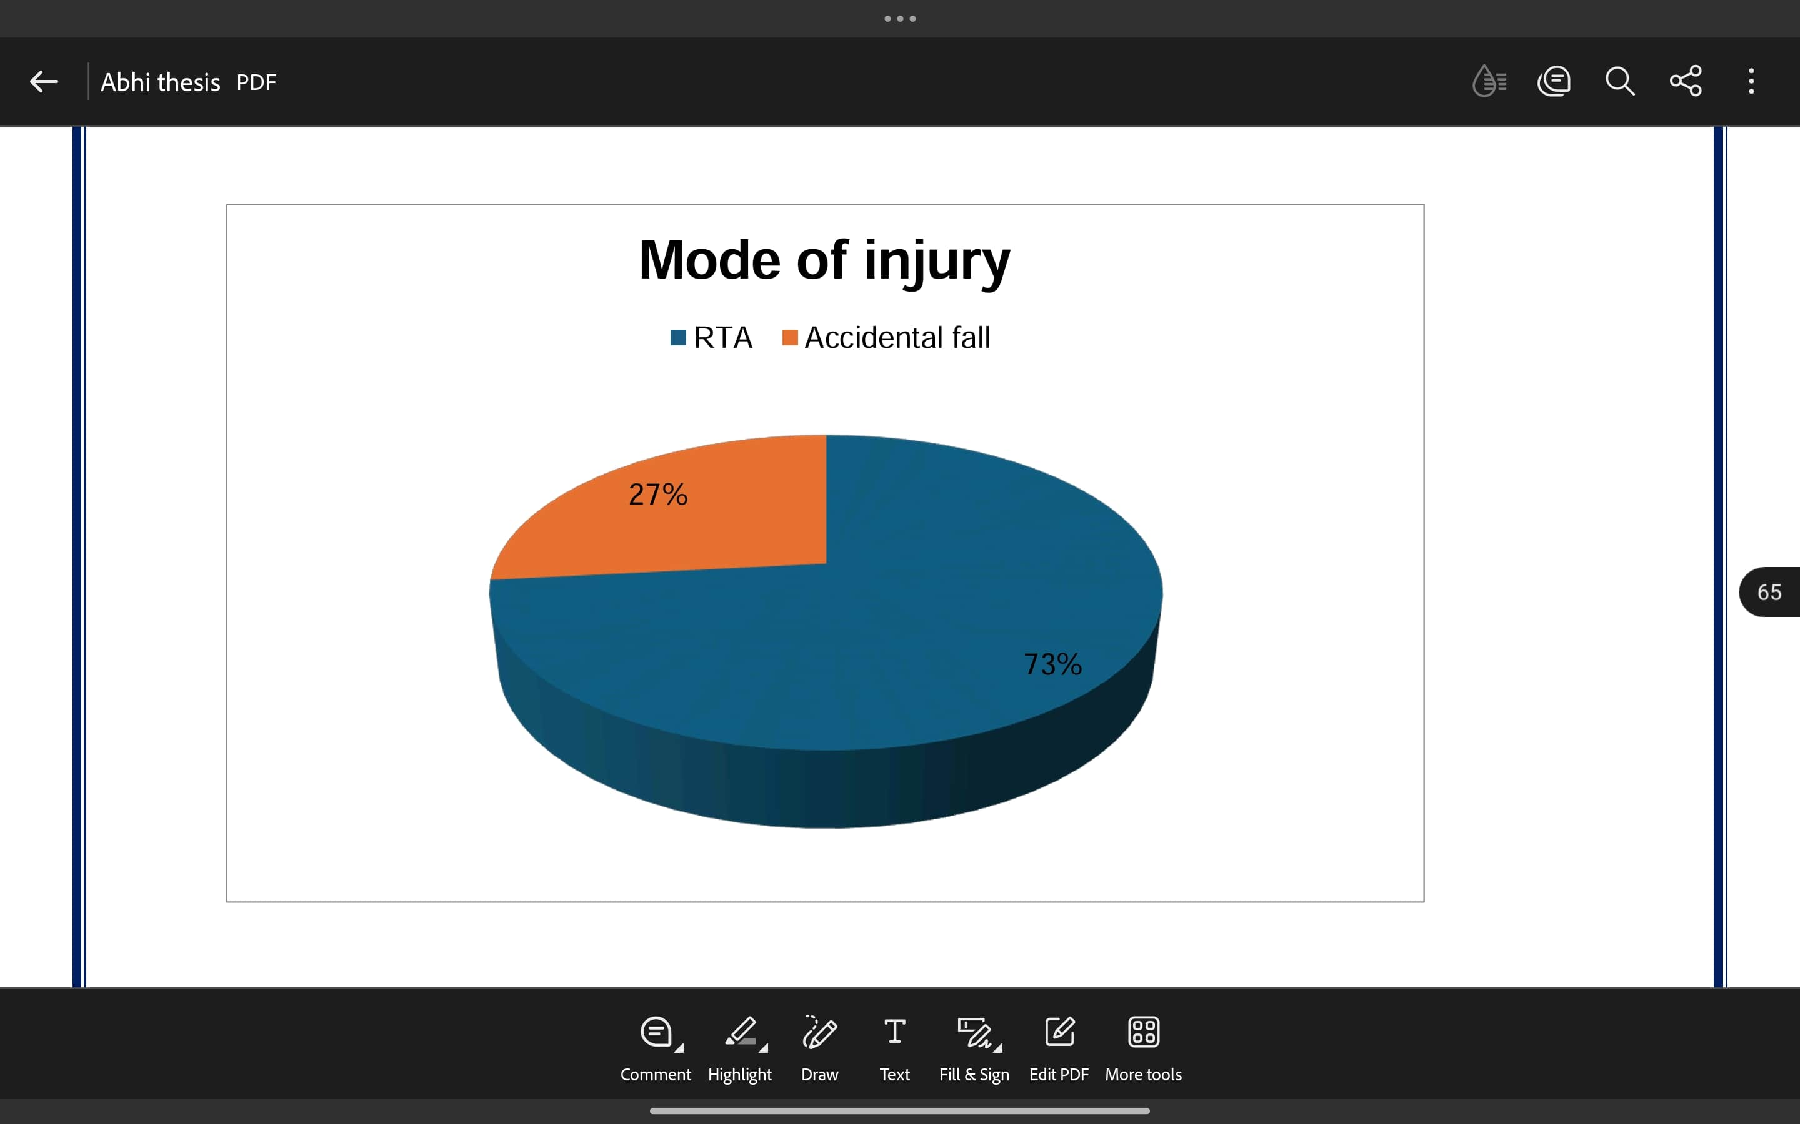
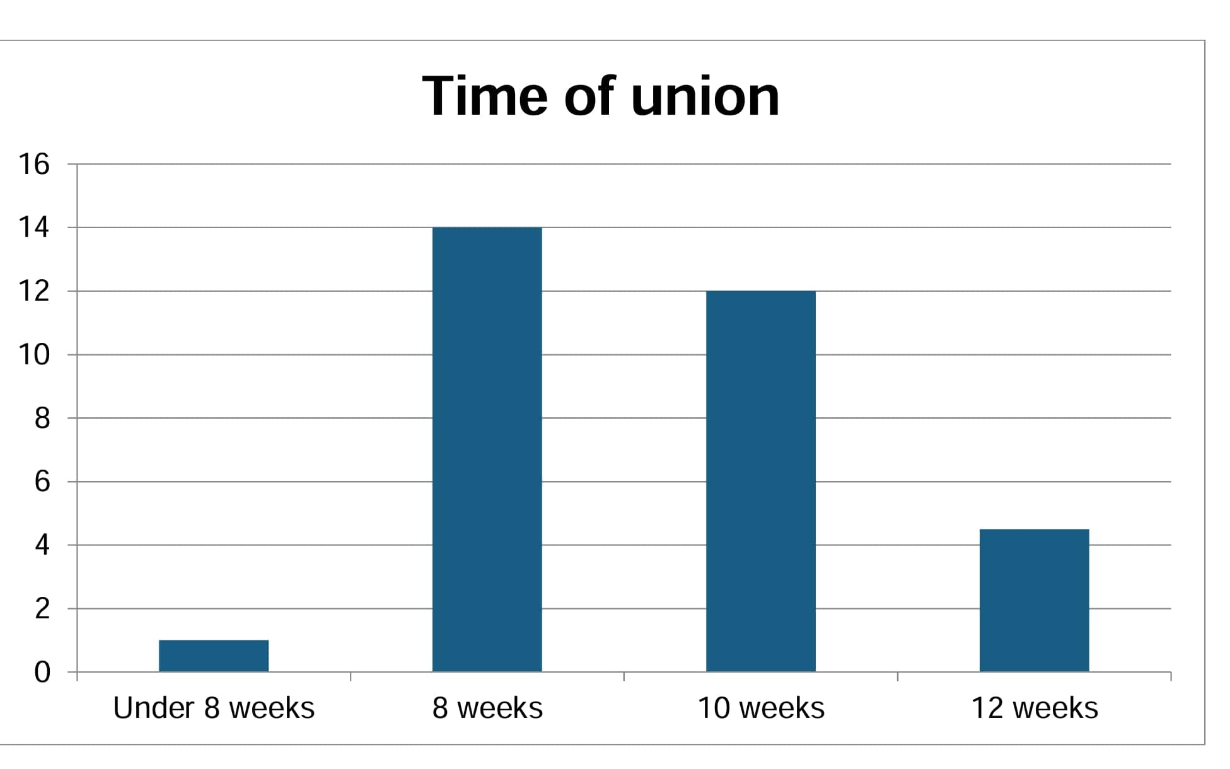
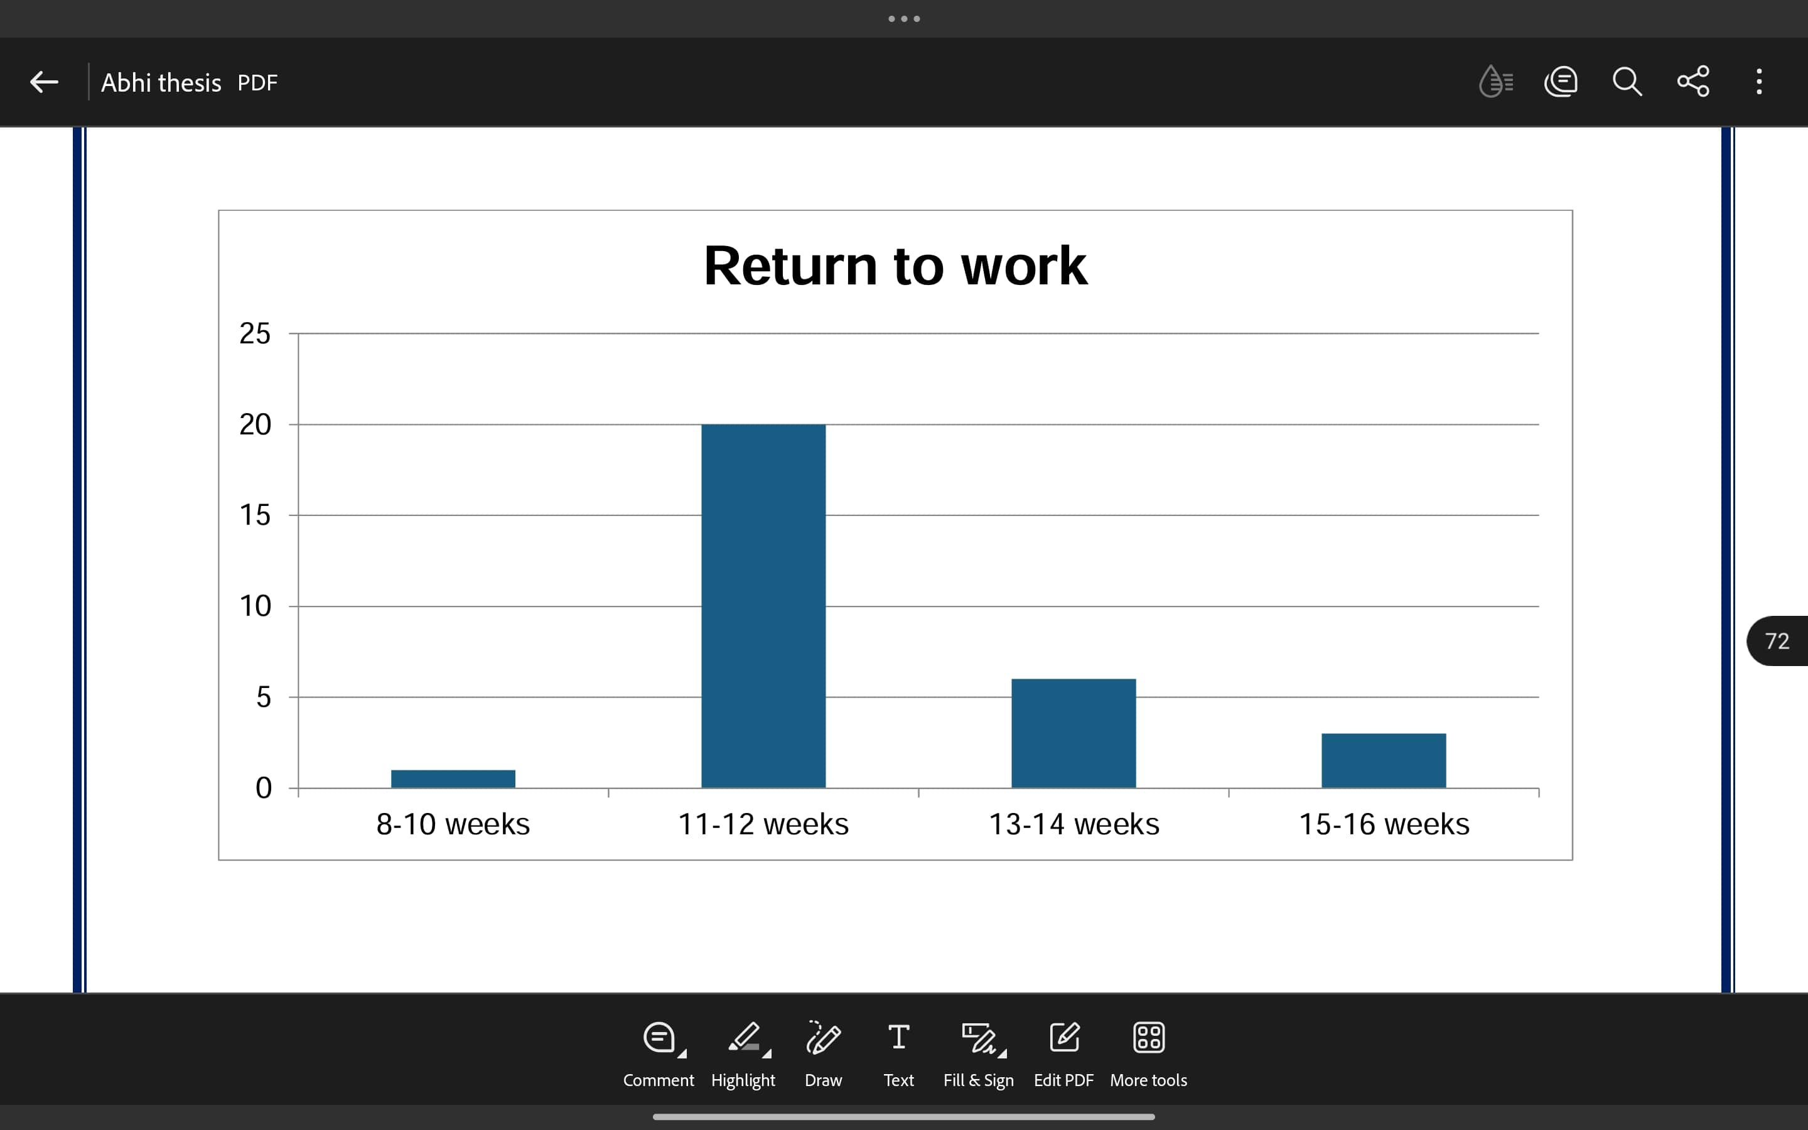
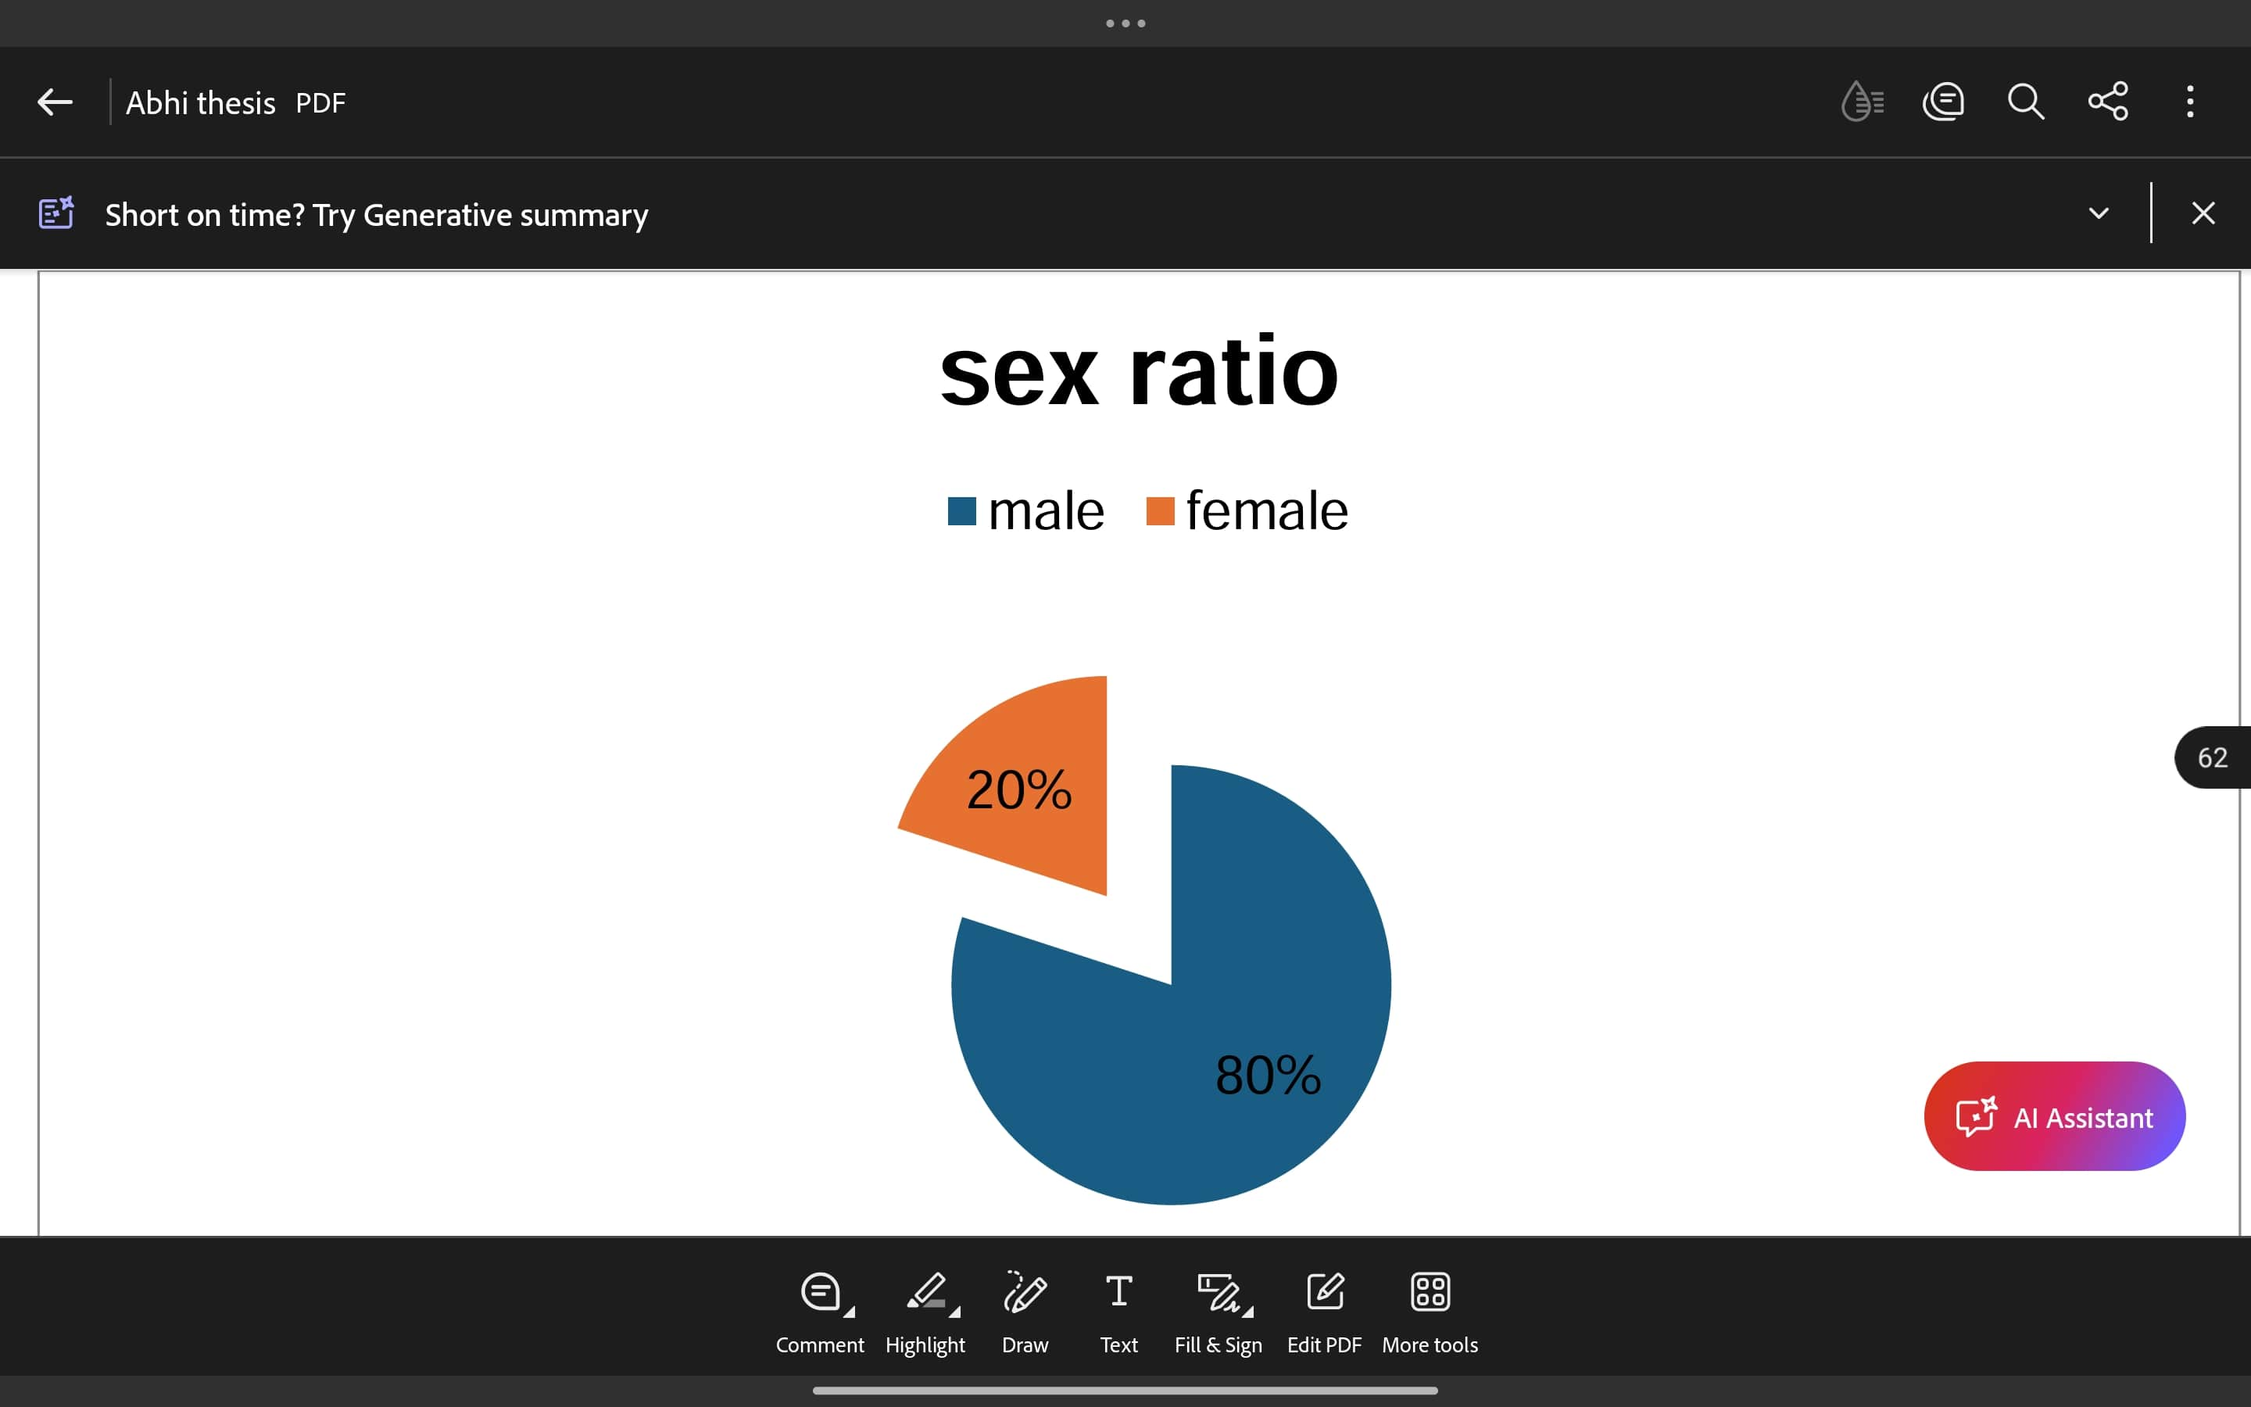
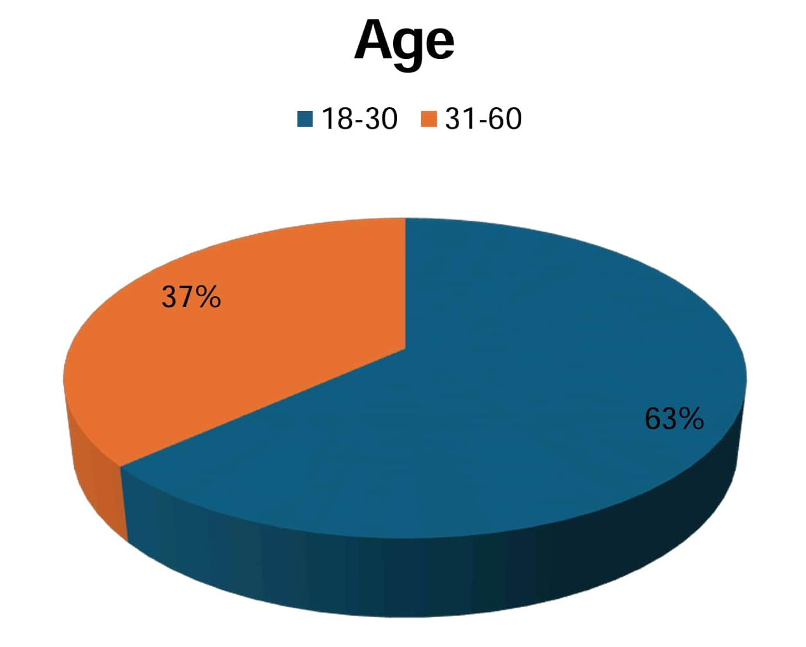
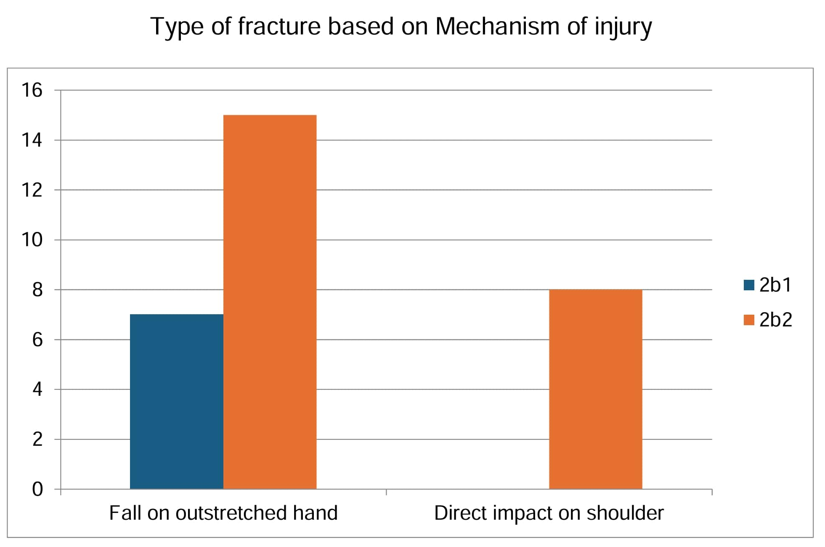
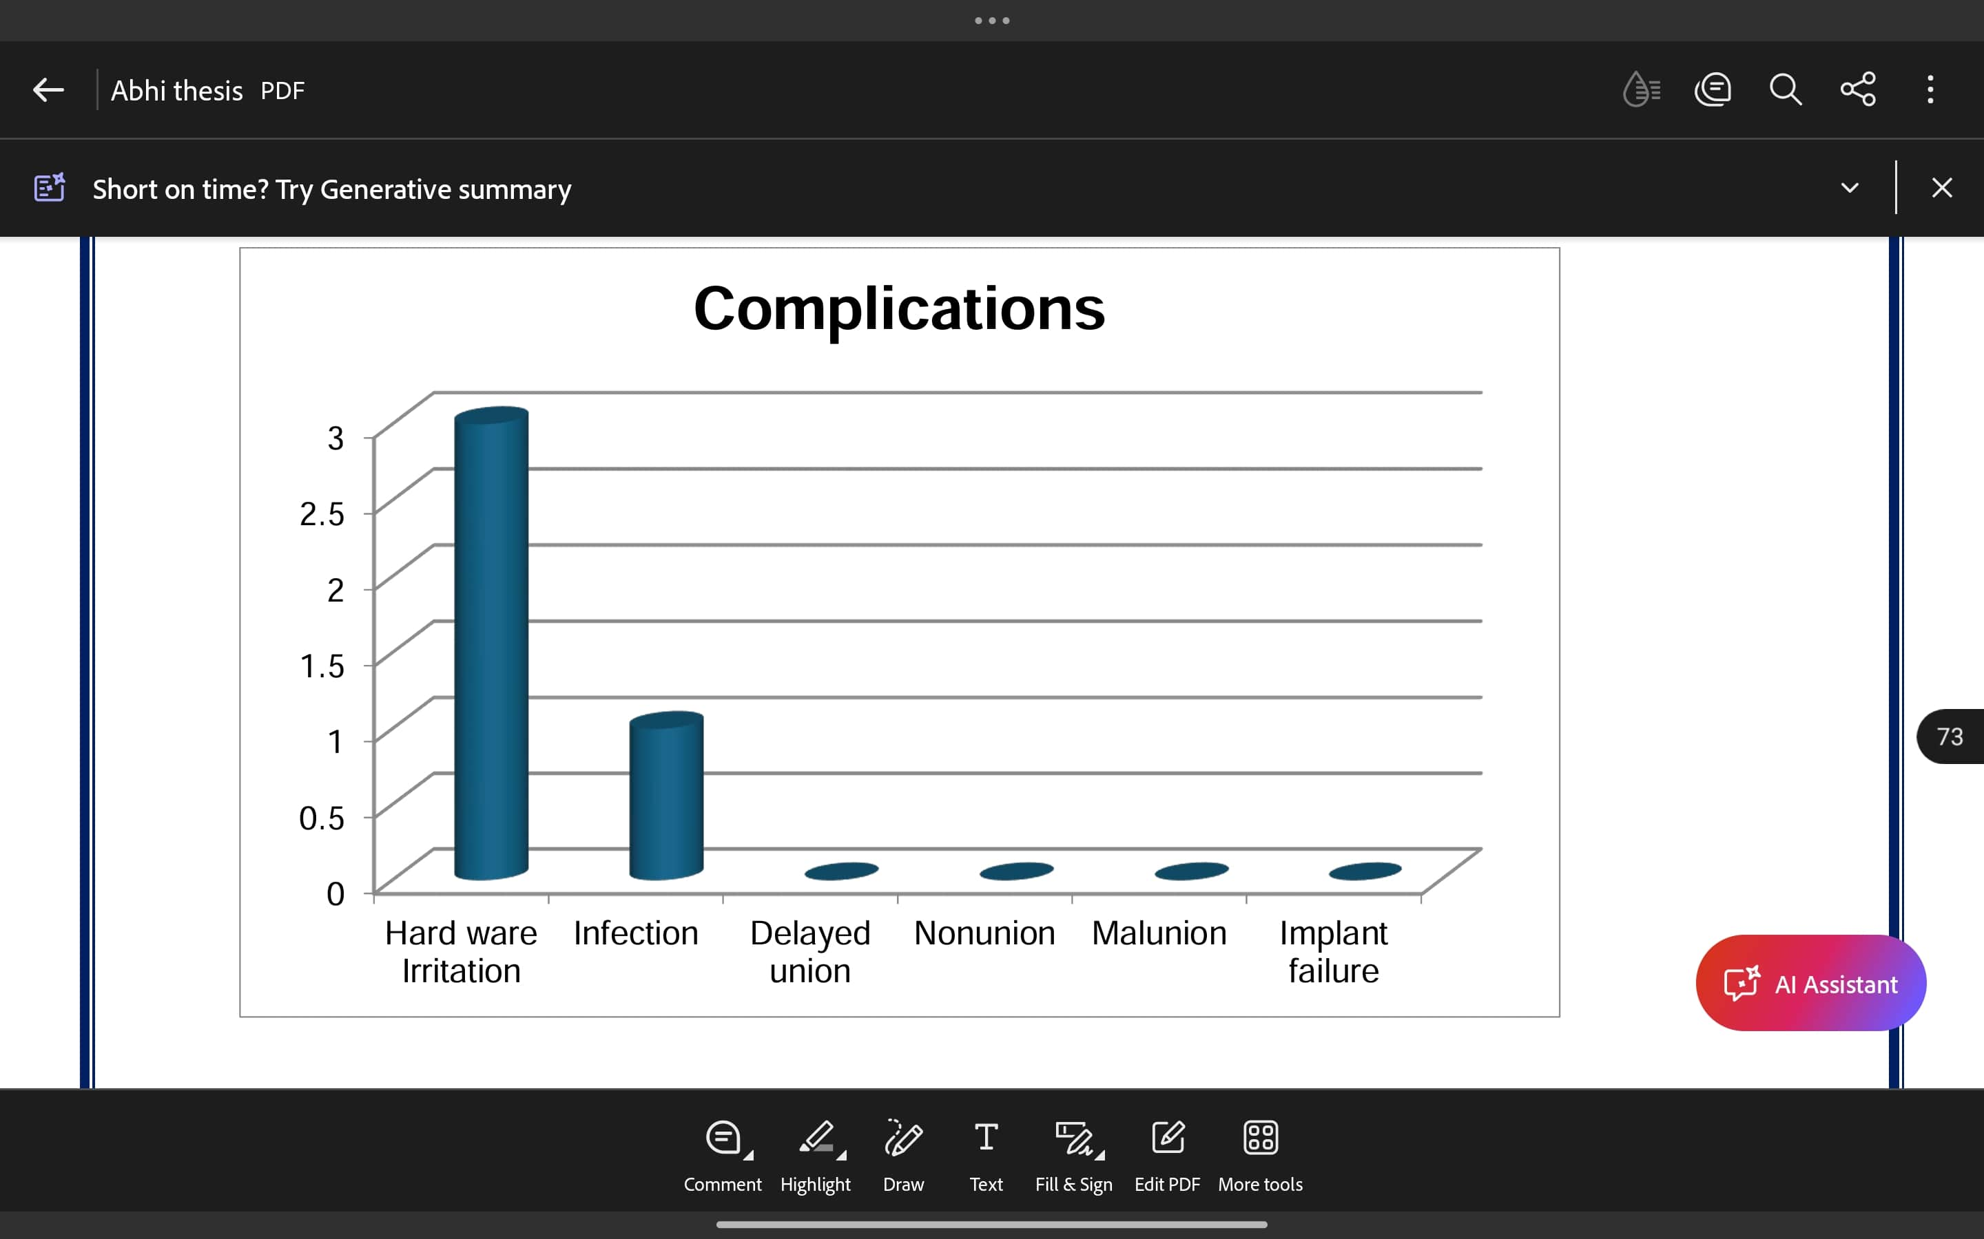
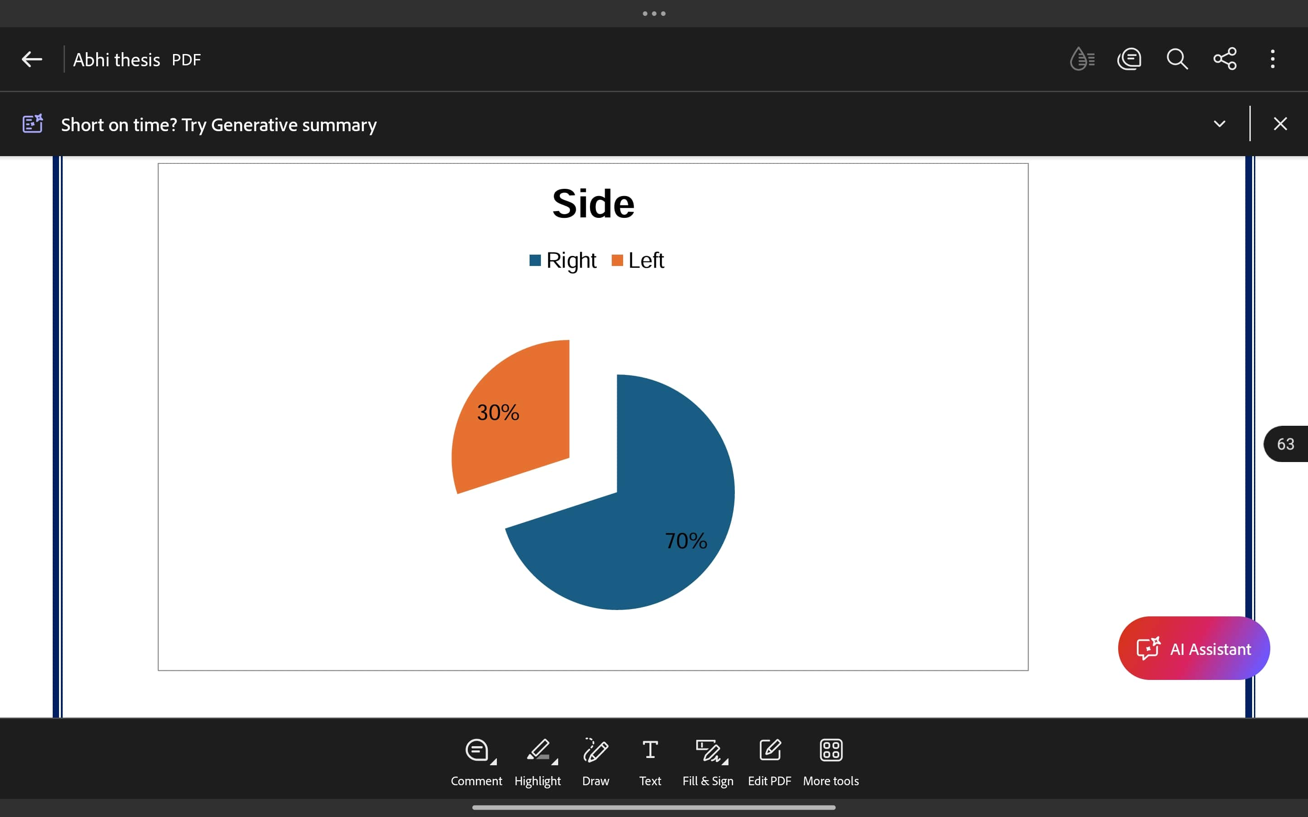
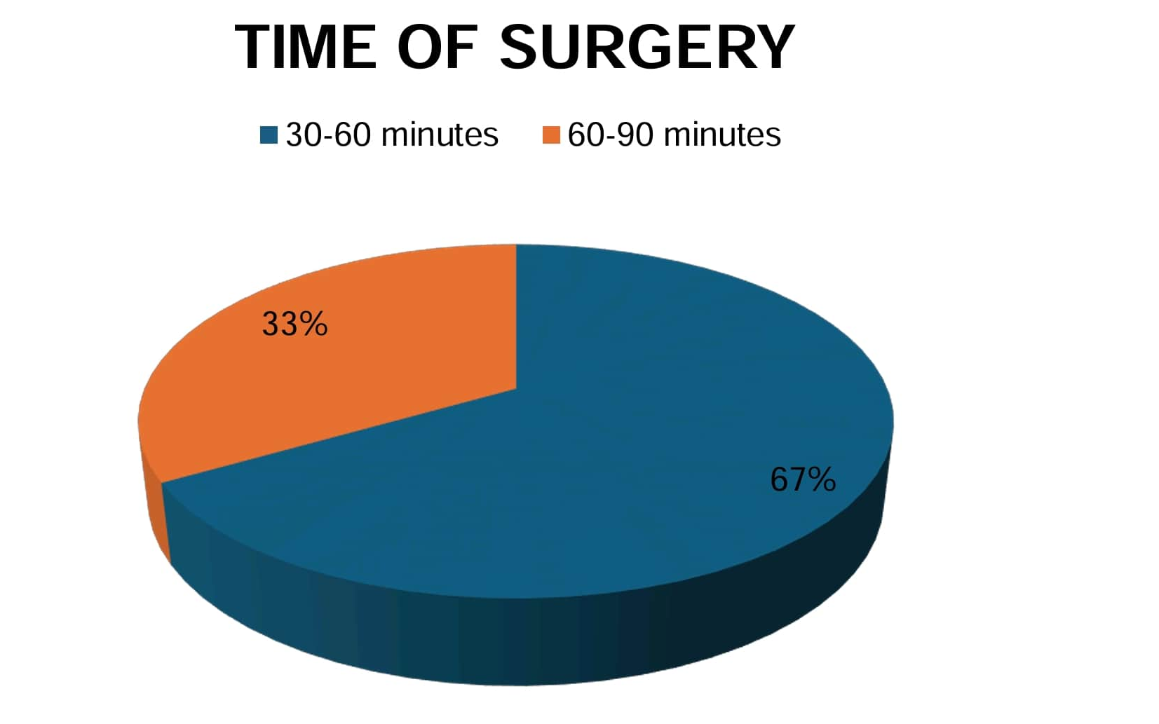
Results
Number of patients | Constant and Murley score | Result
30 | 90-100 | Excellent
In our research , all 30 patients treated with open reduction and internal fixation produced excellent functional outcome.

Slide 6

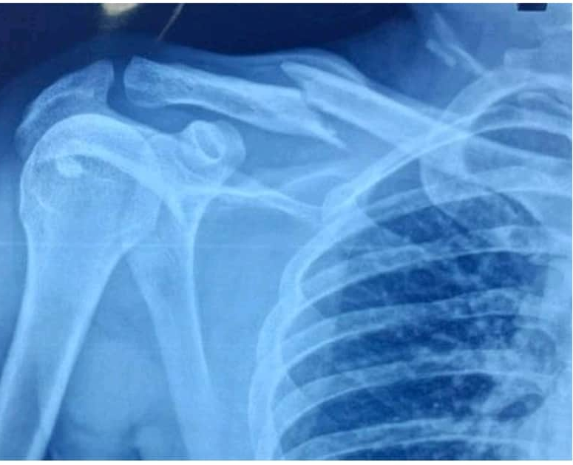
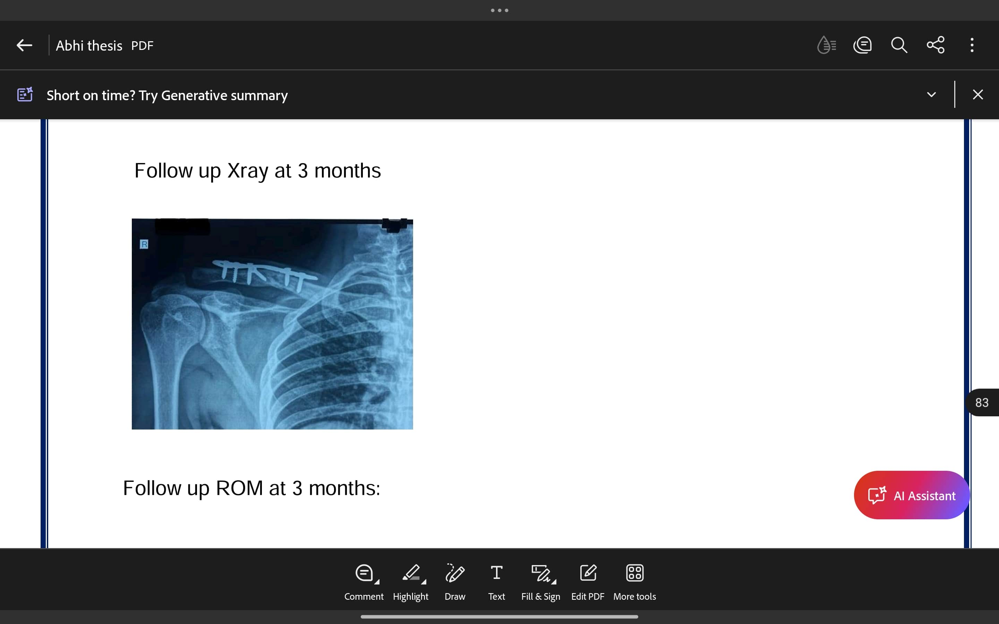
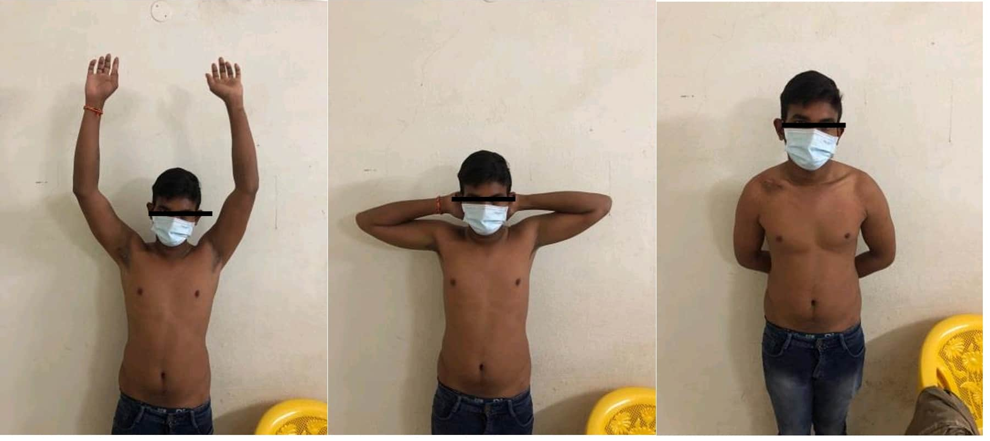
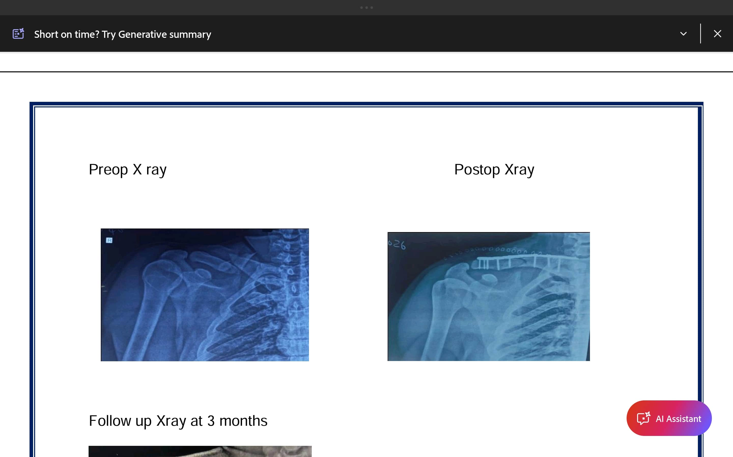
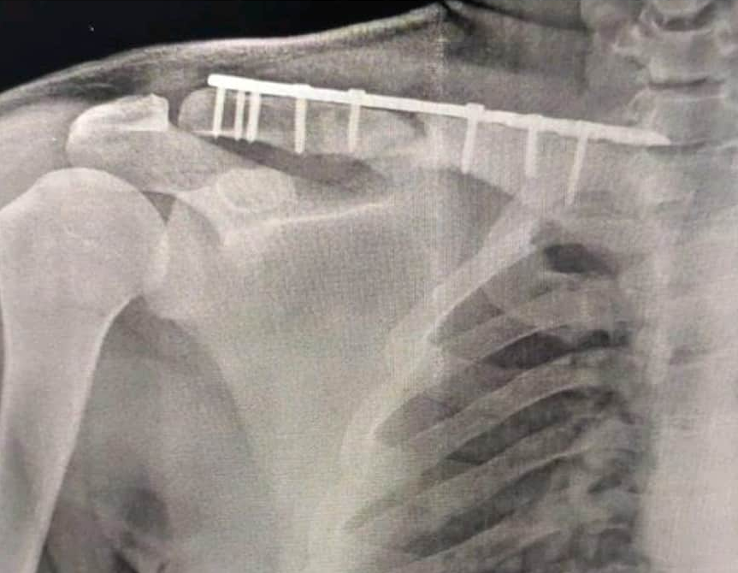
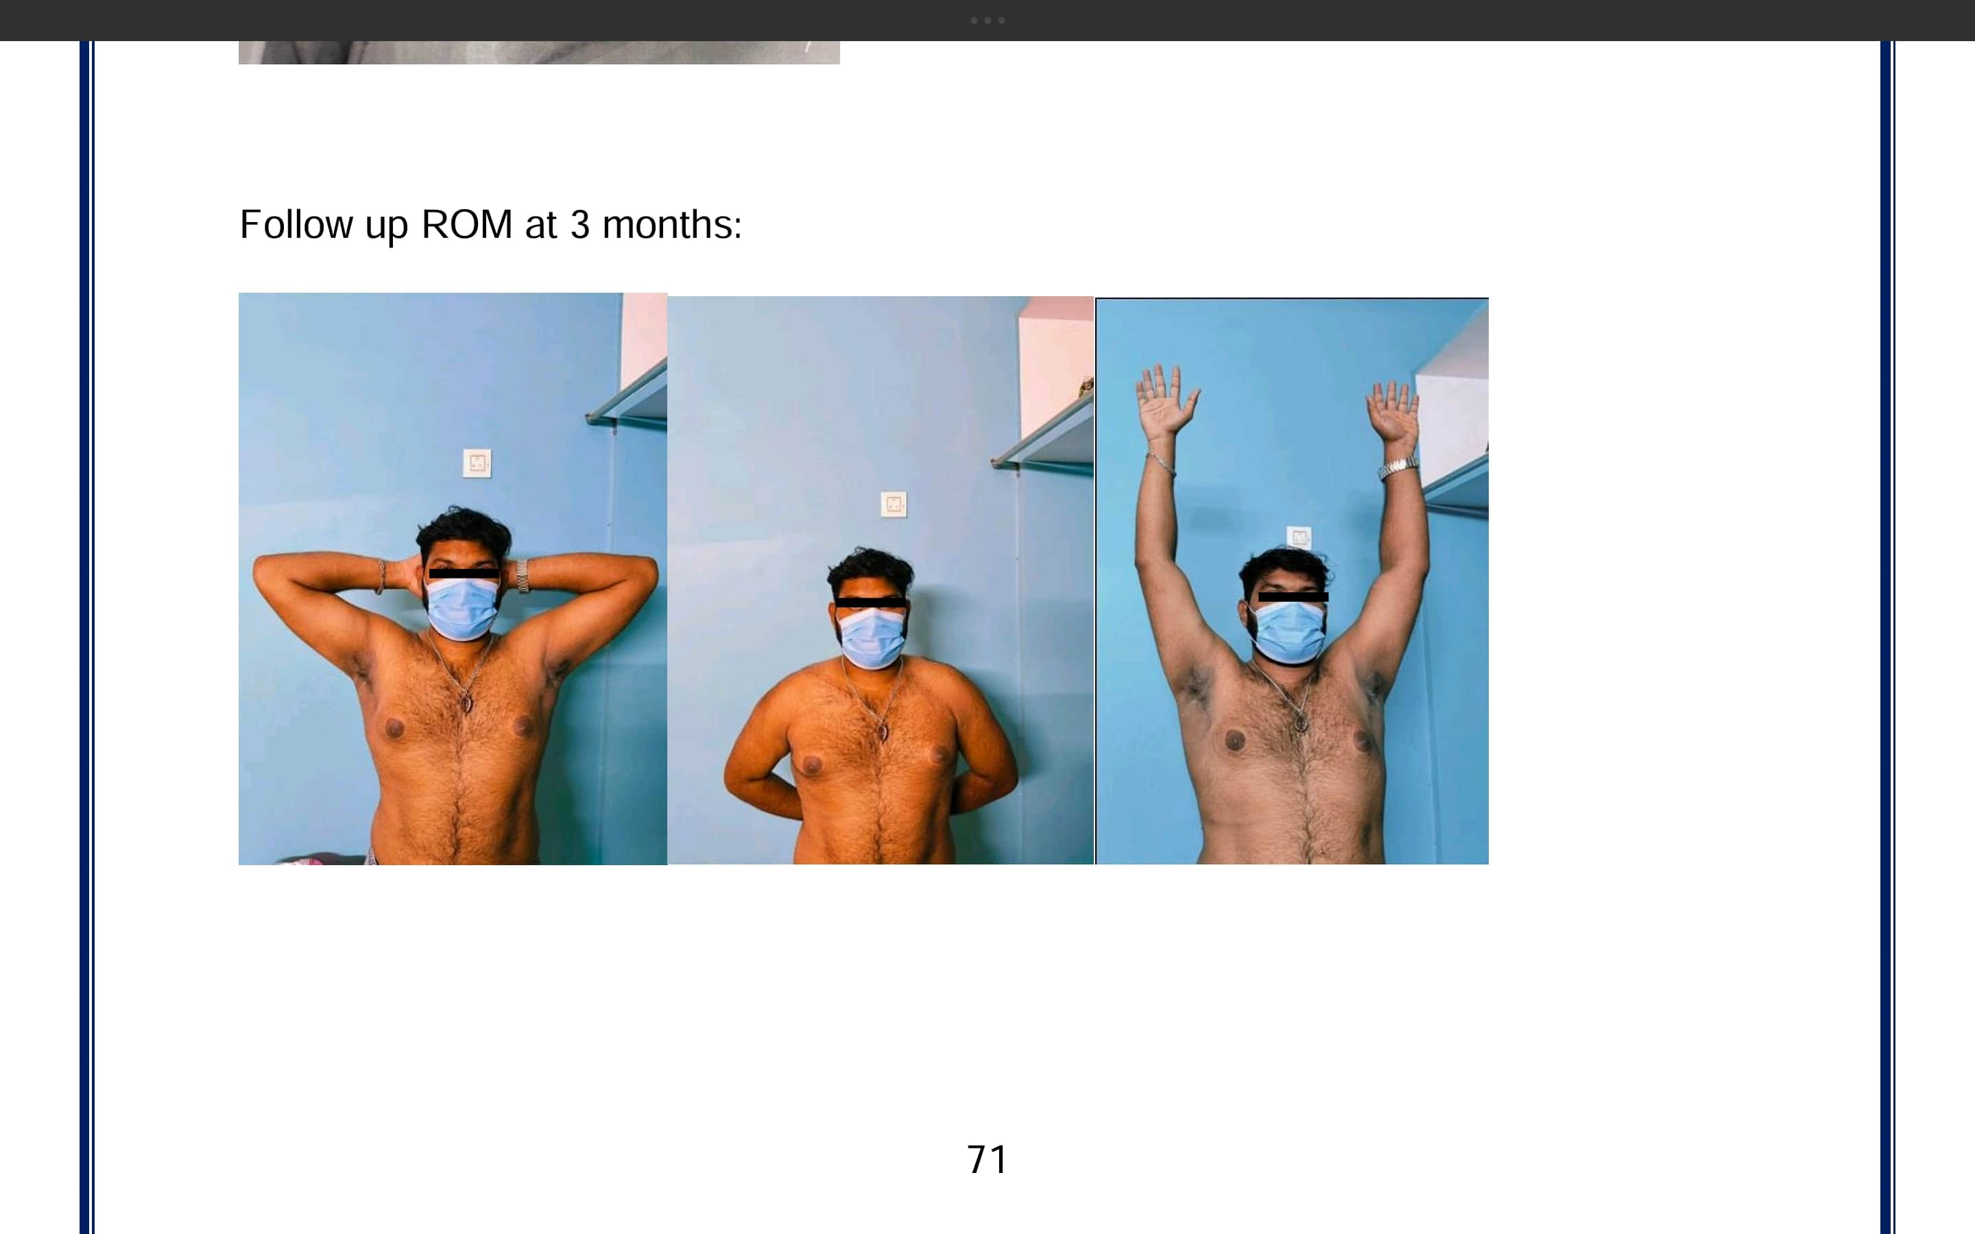
Pre-op Xray
Immediate
post-op Xray
Follow up Xray @ 3 months
Follow up ROM
@ 3 months
Case-1
Case-2

Slide 7
CONCLUSION :-
Open reduction and internal fixation of displaced mid-shaft clavicle fractures provides high union rates with excellent functional outcomes.
The injury predominantly affects young males, with the right clavicle most commonly involved.
Road traffic accidents are the leading cause, and fall on an outstretched hand is the most frequent mechanism.
Robinson type 2B2 fractures are the commonest pattern, especially following RTAs.
Most fractures unite within 8–10 weeks, enabling return to work by ~12 weeks.
Complications are minimal and manageable, with no major adverse outcomes.
Limitations :-
Small sample size, absence of a comparison or control group, short follow-up period (3 months) preventing assessment of long-term results.

Slide 8
REFERENCES :-
Biomechanical comparison of the Locking Compression superior anterior clavicle plate with seven and ten hole reconstruction plates in midshaft clavicle fracture stabilization. Lars Eden & Stefani International Orthopedics Doht & Sönk P. Frey. ; (SICOT) (2012)36:2537–2543e
Dr. Pinnamaneni Sankara Rao and Dr. SrikanthChoppara. Prospective study of middle 1/3rd clavicle fracture managed with clavicle contoured plates. International Journal of Orthopaedics Sciences 2017; 3(3): 06-09
Thomas D. Donnelly*, Robert J. MacFarlane.Fractures of the Clavicle: An Overview;The Open Orthopaedics Journal, 2013, 7, (Suppl 3: M6) 329-333
Elidrissi Mohammed, MD, H Mahadane Functional Outcome of Midclavicular Fracture Fixation Utilising a Reconstruction Plate; Malays Orthop J 2013 Nov;6-9
Dhoju D, Shrestha D, Parajuli NP, Shrestha R, Sharma V Operative Fixation of Displaced Middle Third Clavicle (Edinburg Type 2) Fracture with Superior Reconstruction Plate Osteosynthesis; Kathmandu Univ J(KUMJ).2011OctDec ;9(36);286-90
I.R. Murray, BMedSci Risk Factors for Nonunion After Nonoperative Treatment of Displaced Midshaft Fractures of the Clavicle, Jbjs july 2013.
Charles A. Rockwood Jr., Frederick A. Matsen III(2017) The shoulder Pages 291-363.Elsevier
Michael D. Mcee (2015)Rockwood and Green’s Fractures in adults ,Wolters Kluwer

