Slide 1



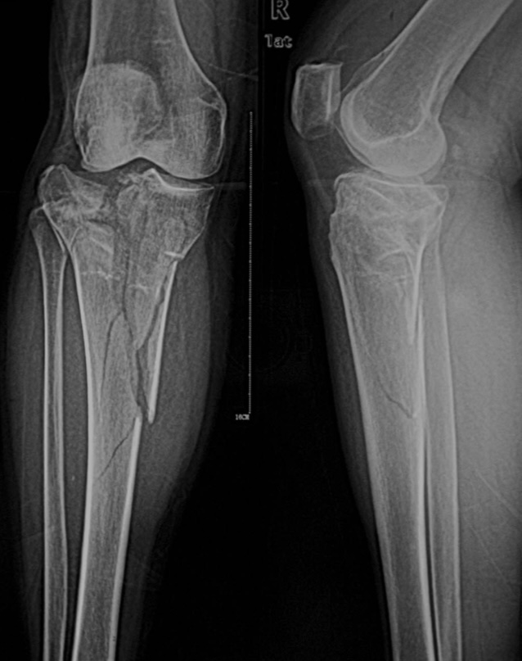
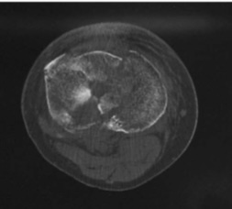
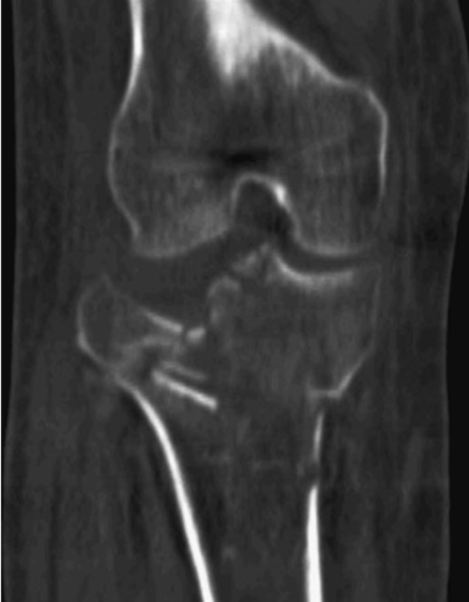
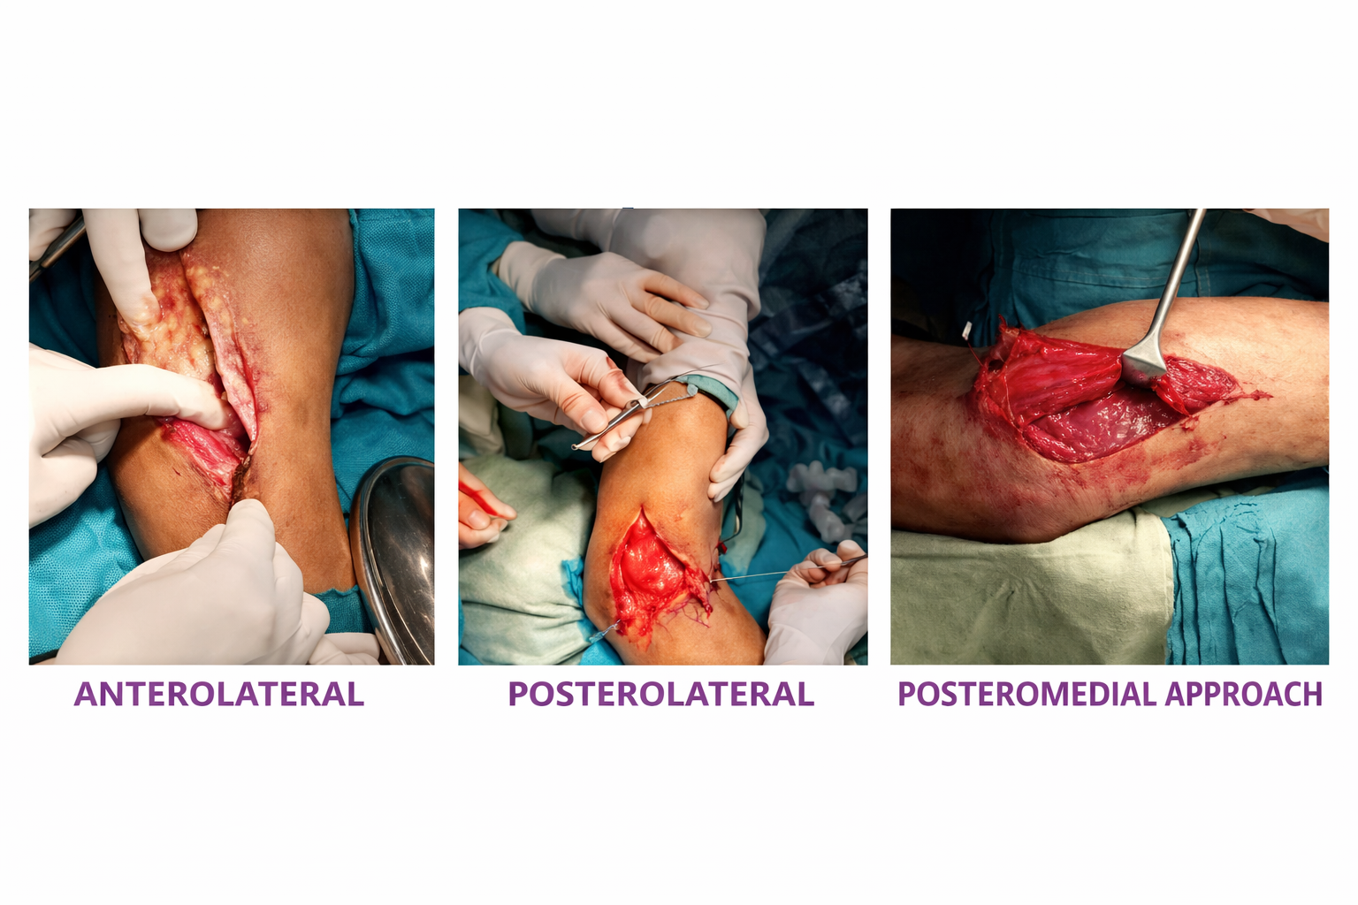
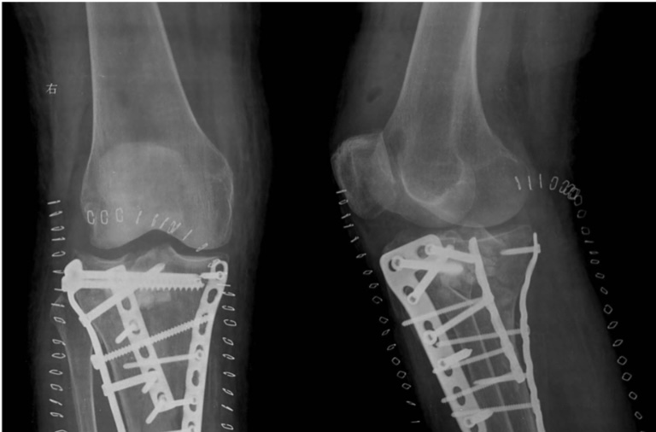
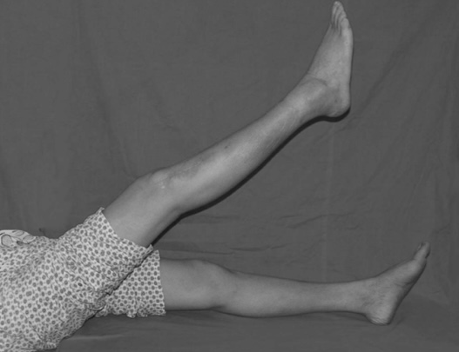
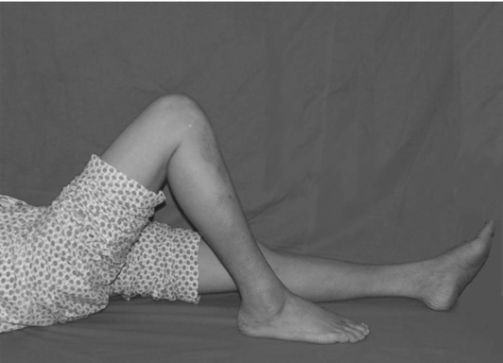
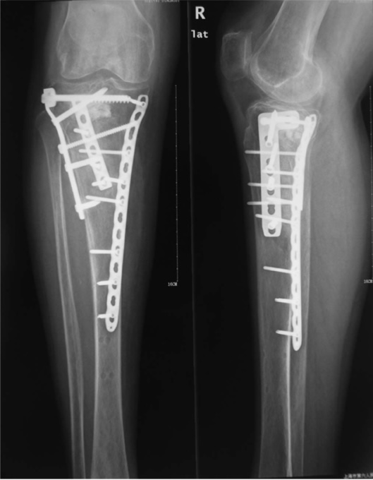
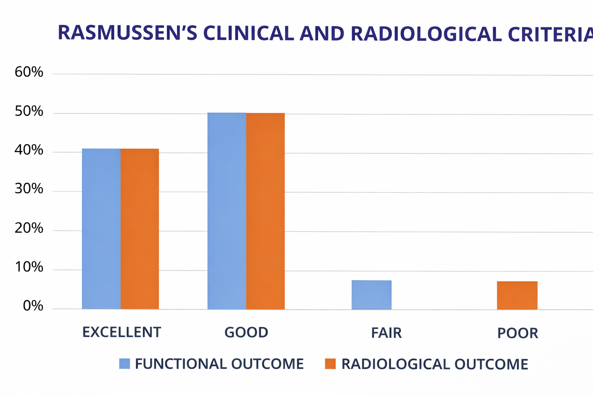
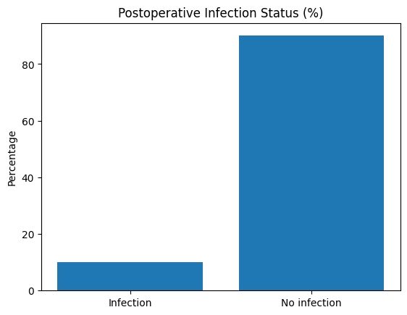
FUNCTIONAL OUTCOME OF COMPLEX TIBIAL PLATEAU FRACTURES SURGICALLY MANAGED BY OPEN REDUCTION AND INTERNAL FIXATION WITH COLUMN SPECIFIC PLATING
Presenter - Dr V ANJANEYA RAMESH REDDY, Post graduate, Guide - Dr V NANDAGOPAL,Associate Prof. Dr PSIMS &RF
55th Annual Conference of Orthopedic Surgeon Society of AndhraPradesh
Organized by : Department of Orthopaedics, Kurnool Medical College Kurnool
INTRODUCTION
Pre OPERATIVE FINDINGS
DISCUSSION
DISCUSSION
Pre operative
x ray
Tibial plateau fractures were more commonly seen in the active productive age group (25- 50 years) due to high-energy trauma.
• posteromedial and posterior fractures are often not able to fix with anterolateral plate alone. Fixation of posteromedial and posterolateral fractures is essential in obtaining an excellent clinical and radiological outcome in the high energy tibial plateau fractures.
• Failure to fix the posteromedial fragment results in varus collapse, decreased range of motion and poor clinical outcome in displaced tibial plateau fractures.
In recent years, the three-column fixation technique for complex tibial plateau fractures has evolved, emphasizing a three-dimensional understanding of fracture patterns. Traditional classification systems rely on two-dimensional imaging, often focusing only on medial and lateral fixation while neglecting posterior stabilization. With increased use of CT scan evaluation, the importance of posterior fixation, particularly for the posteromedial fragment, is now being recognized as essential for optimal fracture management.
Pre operative ct scan
OPERATIVE FINDINGS
IMMEDIATE POSTOPERATIVE XRAY
RESULTS
• Majority - male (90%) - RTA, no significant diff. on the side affected.
• Fracture distribution- 80% of two- column fracture 50% (Schatzker type V 60% and type VI 40%), and 20% of three-column fractures (Schatzker Type V 70% and Schatzker VI 30%) included
• 40% of patients had an excellent outcome, 50% of patients had a good outcome, 10% of patients had poor clinical, and 10% had fair radiological outcome.
• No patient developed neurovascular injury, no implant breakage, no varus valus deformity, no delayed union, or non- union in our study.
• Infection- Two cases of bicolumnar tibial plateau fracture, treated with appropriate antibiotics
• F/u period- longest was 12 months, shortest was 4 months, mean was 10 months.
MATERIALS & METHODS
Type of study: Prospective.
Place of study: Dr.Pinnamaneni SIMS&RF
Sample size and inclusion criteria: 20 patients with displaced tibial plateau fractures with posterior column involvement.
Duration of study: 1 ½ years (December 2023 to May 2025).
Material: Proximal tibial locking plates, T/L buttress plates, posteromedial and posterior tibial locking plate,6.5 and 4mm cancellous screws (locking, non-locking), 4.5, 4.9 mm cortical screws (locking, non-locking).
Position of patient during surgery: Both supine and prone
Approach: Posteromedial (Loben Hoffer), posterolateral (mod.Frosch),Antero lateral.
1 YEAR FOLLOW-UP
1 YEAR FOLLOW-UP XRAY
CONCLUSION
Three-column fixation is an advanced fixation concept in treating complex tibial plateau fractures, especially useful for multiplanar fractures involving posterior column with excellent functional outcome.

