Slide 1
FUNCTIONAL OUTCOME AND COMPLICATIONS OF PLANTAR ARTHRODESIS USING RETROGRADE INTRAMEDULLARY NAIL
Presenter -
GUIDE -
Dr V . ANJANEYA RAMESH REDDY,
POST GRADUATE ,
DEPT. OF ORTHOPAEDICS,
Dr PSIMS & RF
Dr V NANDAGOPAL ,
ASSOCIATE PROFESSOR,
DEPT. OF ORTHOPAEDICS,
Dr PSIMS & RF

Slide 2
Introduction
Pantalar arthrodesis is the definitive salvage procedure for advanced ankle osteoarthritis and instability after failed conservative management,
Retrograde intramedullary nailing offers improved stability with minimal soft-tissue disruption, particularly in complex post-traumatic cases
Our study aims to elucidate the clinical course of 30 patients and compare our outcomes with six recent literature reports, therebyestablishing the clinical validity of this method.

Slide 3
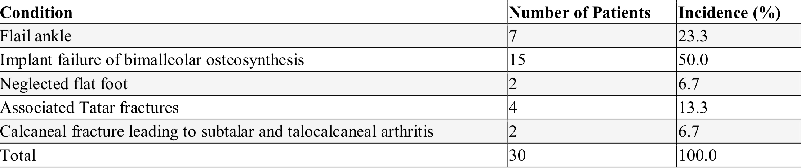
Materials and Methods
Study Design & Setting
• Prospective observational study
• Dr. PSIMS & RF (Nov 2023 – Jan 2026)
Study Population
• 30 patients with post-traumatic ankle OA & instability
• Refractory to non-operative treatment
• 33.3% with prior ORIF
Surgical Technique
• Lateral approach under spinal anesthesia
• Joint debridement
• Retrograde intramedullary nail (12 mm) from calcaneus to tibia
• Proximal & distal locking under fluoroscopy
Post-operative Protocol
• Below-knee cast – 6 weeks
• Gradual weight bearing thereafter
Outcome Assessment & Follow-up
• Follow-up at 4, 12 & 24 weeks
• Functional: AOFAS score
• Pain: VAS score
• Union: Bridging trabeculation on AP & lateral radiographs
Post-operative Protocol
• Below-knee cast – 6 weeks
• Gradual weight bearing thereafter
Outcome Assessment & Follow-up
• Follow-up at 4, 12 & 24 weeks
• Functional: AOFAS score
• Pain: VAS score
• Union: Bridging trabeculation on AP & lateral radiographs

Slide 4
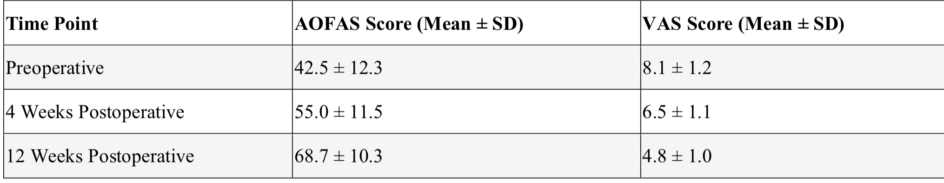
Results
Serial evaluation of functional status demonstrated progressive improvement in both AOFAS and VAS scores.

Slide 5
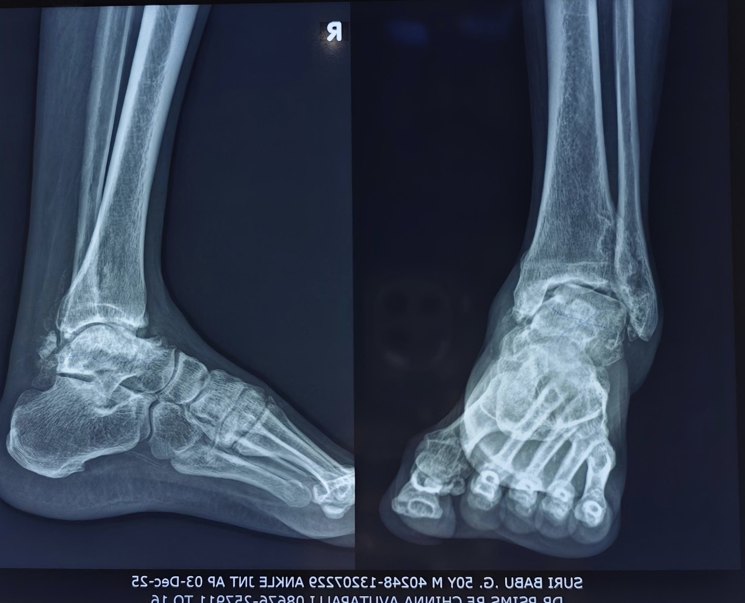
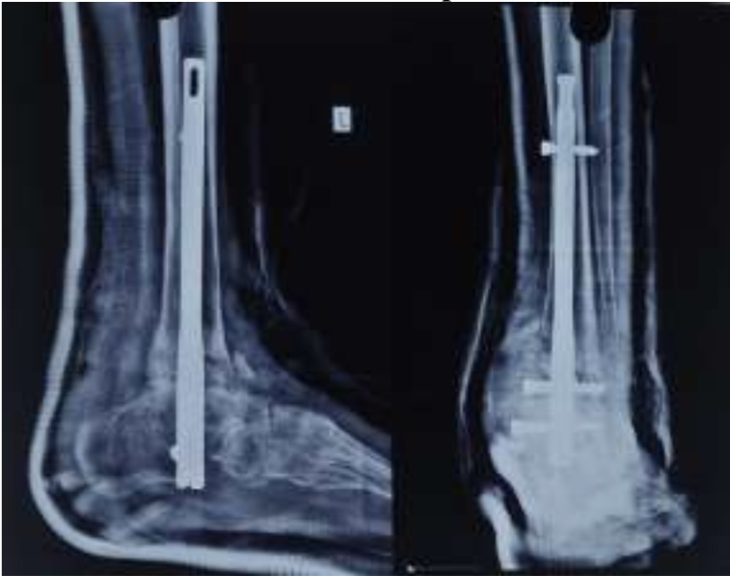
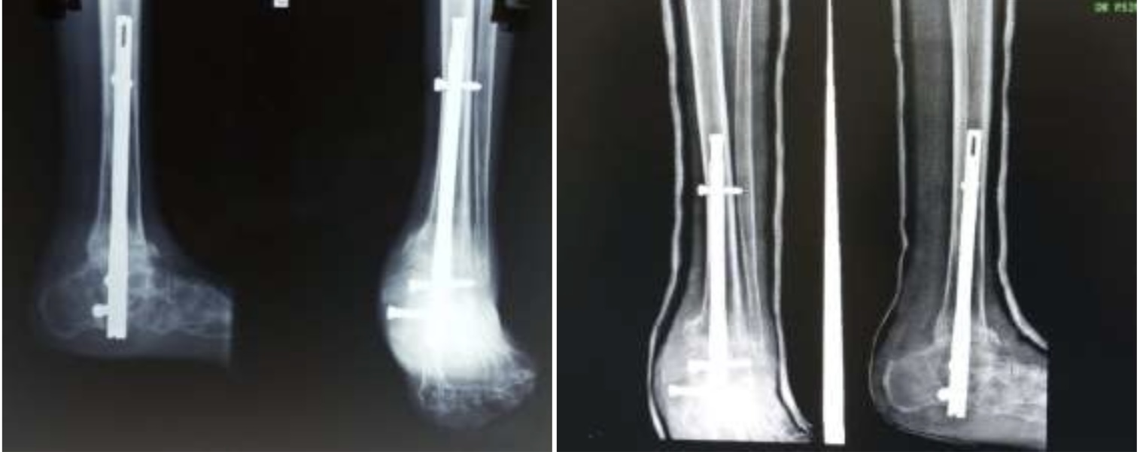
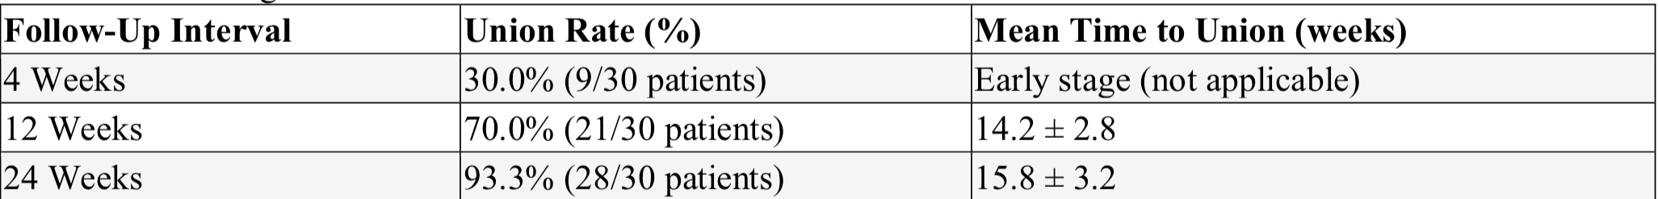
Radiographic Union Progressive radiographic union was noted at each follow-up interval.

Slide 6
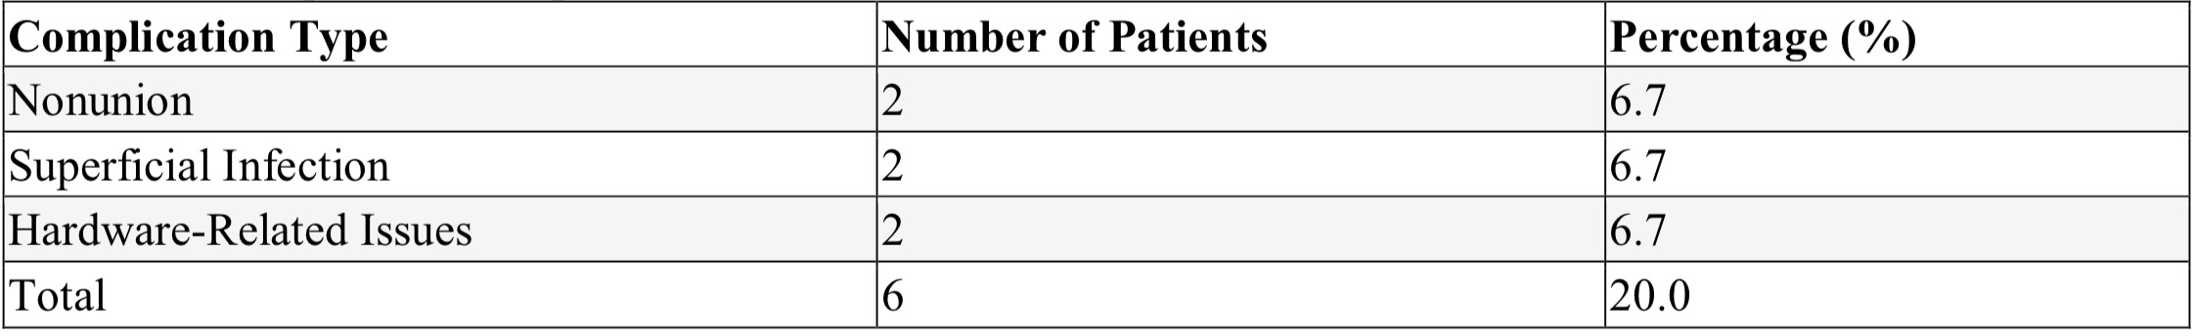
COMPLICATIONS
The overall complication rate was 20%. Documented complications included nonunion, superficial infection, and
hardware-related issues.
Discussion
Pantalar arthrodesis with retrograde intramedullary nailing in post-traumatic cases resulted in significant functional improvement, pain reduction, and reliable radiographic union, confirming biomechanical stability.

Slide 7
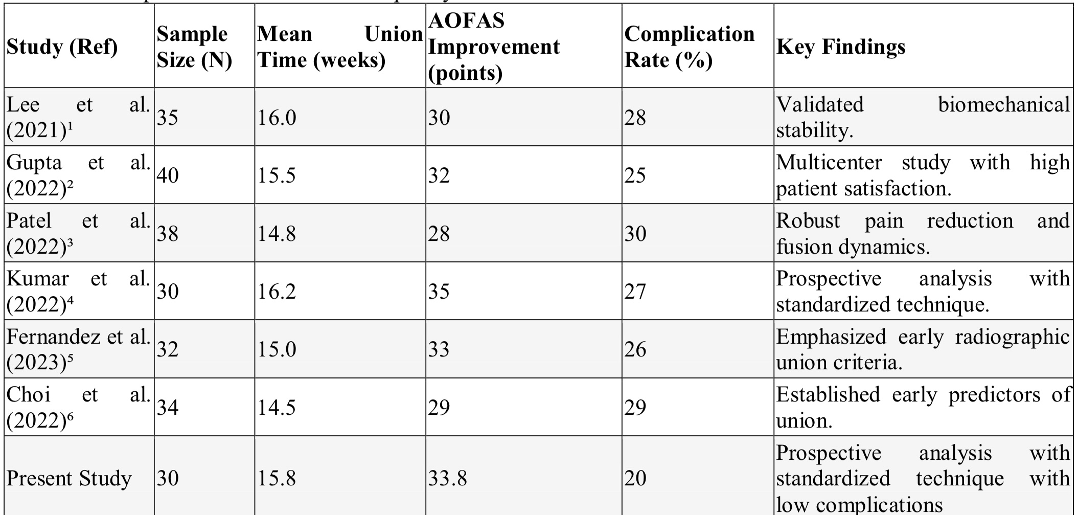
Comparison with contemporary literature studies shows our union & functional improvement align well with previous reports
Our complication rate (20%) reflects an acceptable risk profile in complex reconstructions

Slide 8
Conclusion
Pantalar arthrodesis using retrograde intramedullary nailing is a safe and effective treatment for advanced post-traumatic ankle pathology, providing high union rates, functional improvement, acceptable complications, and outcomes comparable to existing literature, warranting further long-term studies.
References
Chen H, et al. ―Assessment of complications in ankle arthrodesis: a prospective observational study.‖ Orthop
Surg. 2022;14(2):231–237.
Jones B, et al. ―Patient‑specific factors influencing union in ankle fusion.‖ J Foot Ankle Res. 2022;15(2):35–42.
Evans M, et al. ―Innovative implant designs for improved ankle arthrodesis outcomes.‖ J Orthop Res.
2023;41(1):95–103.
Thompson S, et al. ―Efficacy of retrocondylar nailing in salvaging failed ankle arthroplasties.‖ Foot Ankle Int.
2023;44(3):305–312.
Garcia M, et al. ―Future directions in ankle arthrodesis: technological advances and clinical impact.‖ Clin
Orthop Relat Res. 2024;482(5):1150–1158.

