Slide 1




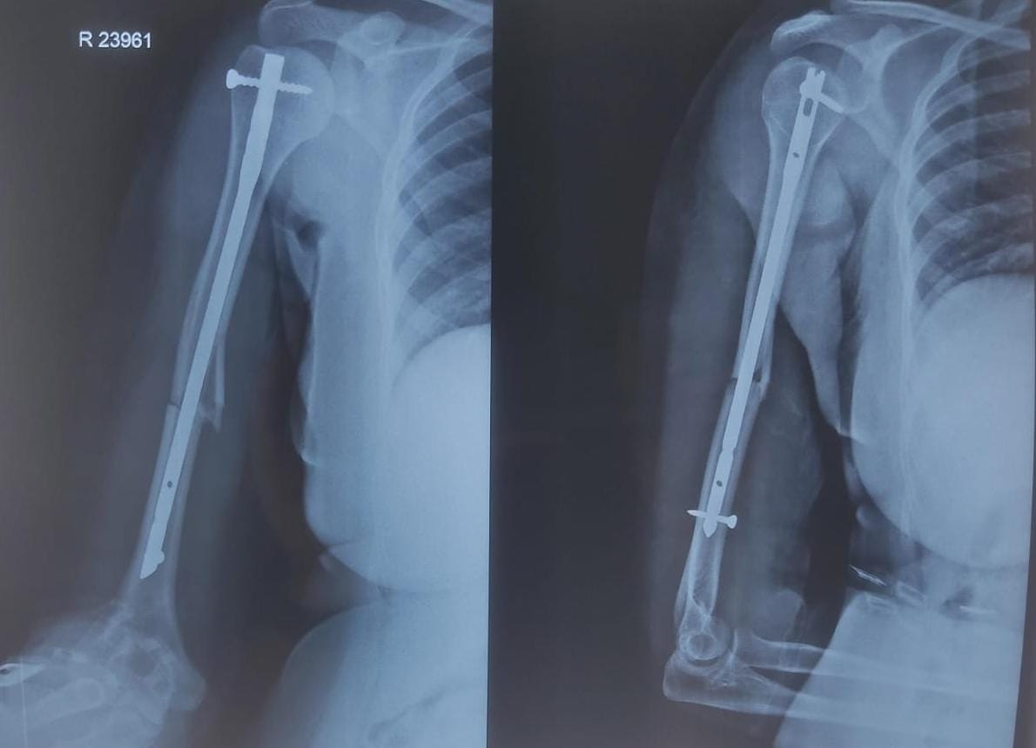
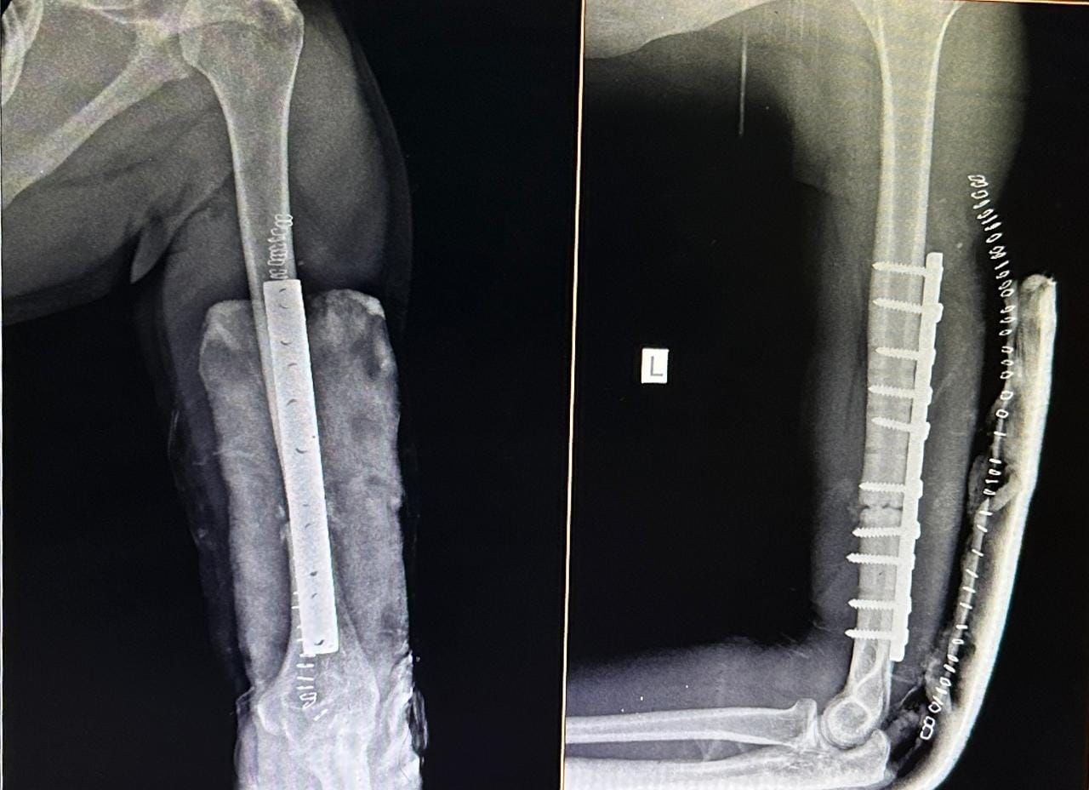
AUTHOR:-DR.K BHANU PRAKASH REDDY ORTHOPEDIC RESIDENT
GUIDE:-DR A. SANDEEP
DR. PSIMS & RF
55th Annual Conference of
Orthopedic Surgeon Society of Andhra Pradesh
Date 6 – 8 February,2026, Venue : Kurnool Medical College
Organized by : Department of Orthopaedics, Kurnool Medical College Kurnool
INTRODUCTION
MATERIALS AND METHODS
DISCUSSION
Surgical fixation of humeral shaft fractures generally involves plating or nailing. Despite the extensive literature comparing outcomes after ORIF with plating and IMILnailing for acute humeral diaphyseal fractures, the superior treatment strategy still remains controversial.
The purpose of this study is to compare the functional outcome of each method of fixation (dynamic compression plating and interlocking nailing) for the shaft of humerus fracture and to analyse statistically significant difference in the results of these two methods in terms of functional outcome, rate of healing and complications.
We conducted a prospective randomized control trial study from December 2023 to May 2025. We selected patients above 18 years of age with humerus shaft fracture. We excluded patients treated other than compression plate or interlocking nail, those with pre-existing shoulder and elbow pathology & pathological fractures of humerus.
On the first post-operative day the adequacy of fixation was evaluated using plain radiography and if found satisfactory active shoulder and elbow mobilization was started. All the patients in both the groups received 3 days of standard antibiotic protocol. All the patients were clinically evaluated using DASH score and with plain radiography at 1 month, 3 months and 6 months follow up.
The duration for clinical and radiological union was noted. If there are no signs of clinical and radiological union after 16 weeks of fracture considered as delayed union and if the absence of union of fracture even after 32 weeks after injury are categorized as non-union. The Functional outcome with DASH Score was analysed by independent chi-square test (p value).
The average fracture healing time in our study was found to be 11.75 weeks for plating group and 15.2 weeks for nailing group. Our findings of better functional outcome and less complications in the DCP group. Nailing incurs a greater risk of complications related to the shoulder function. Our study shows no statistical significant difference in intra operative complications, but there is significant difference in the case of post-operative complications especially shoulder function impairment favouring plating. The poor outcome in intramedullary interlocking nailing group is attributable to rotator cuff tear and shoulder impingement.
CONCLUSION
AIMS & OBJECTIVES
To compare the results of Compression Plating and Interlocking Nailing in the treatment of shaft of humerus fracture with reference to Rate of healing, Functional outcome, Complications & Morbidity.
Based on our operative results and follow up of cases, we concluded that ORIF with dynamic compression plates was found to be superior to intra medullary interlocking nailing for the management of shaft humerus fractures, in terms of better functional outcome, faster radiological union and less post-operative complications.

