Slide 1




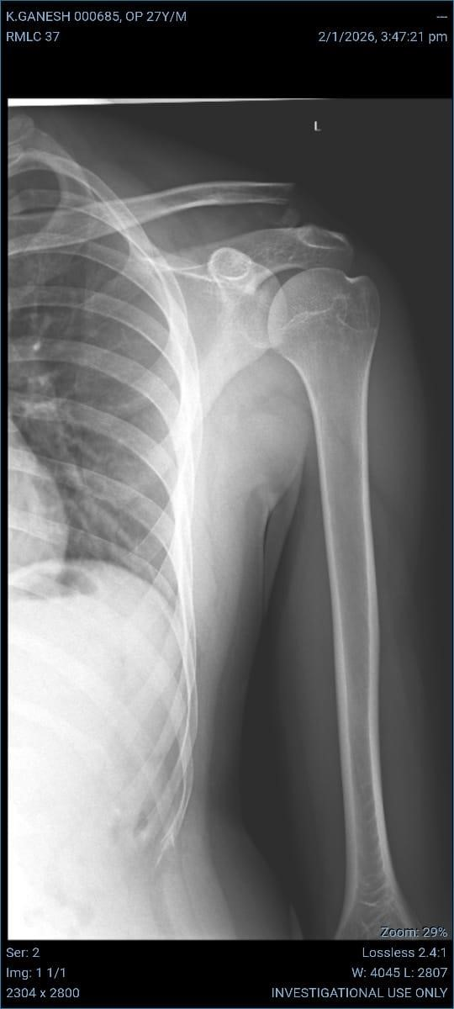
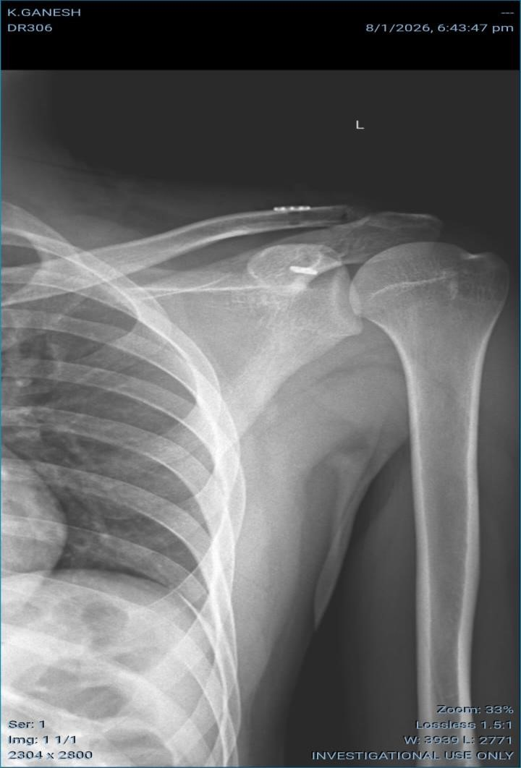
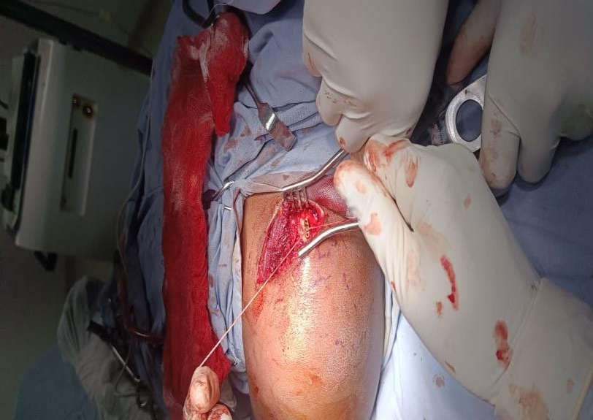
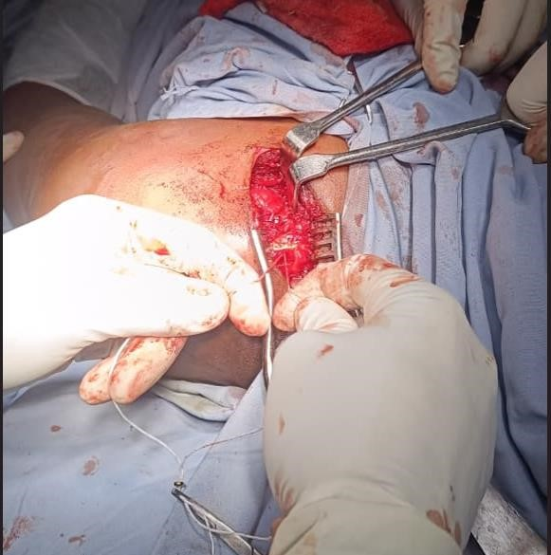
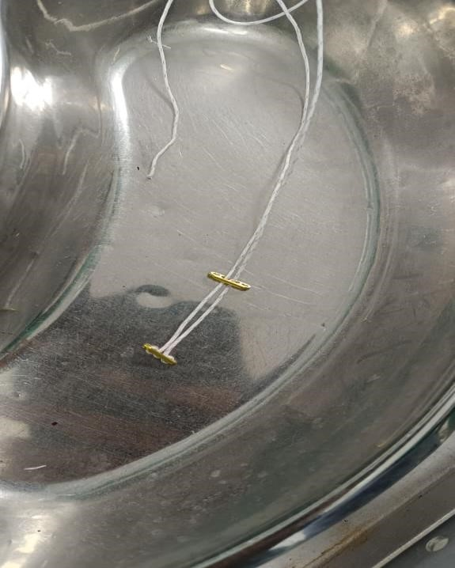
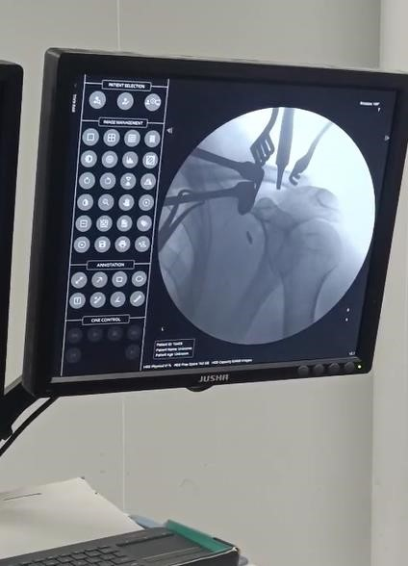
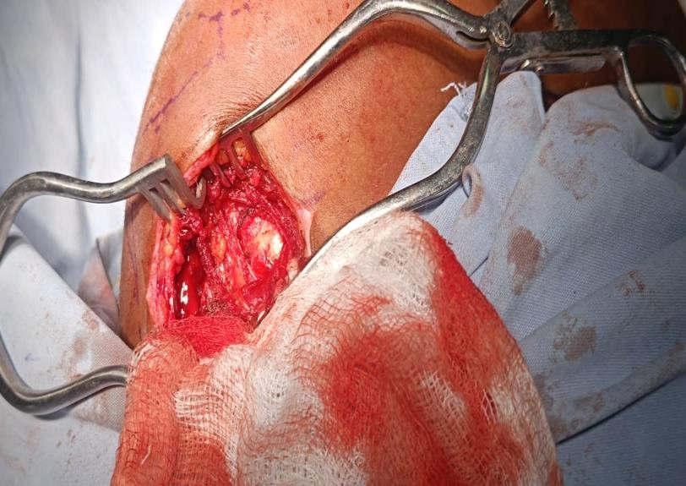
55th Annual Conference of Orthopedic Surgeon Society of Andhra Pradesh
Date 6 – 8 February,2026, Venue : Kurnool Medical College
Organized by : Department of Orthopaedics, Kurnool Medical College Kurnool
Double Endobutton Technique for Repair of Complete Acromioclavicular Joint and Coracoclavicular Joint Dislocations
Presenter – Dr. Pranabesh Mondal (2nd Year PGT, Government Medical College, Srikakulam
INTRODUCTION
OPERATIVE FINDINGS
DISCUSSION
Traumatic separation of the AC joint is common, particularly in the athletic population. Complete rupture of the Coracoclavicular ligament is common to all of the more severe grades of injury (Rockwood Type III or greater). The weight of the arm places constant deforming force on the fixation construct during biologic healing. In the acute setting, there is a robust healing response after ligament rupture, and additional grafting may not be necessary as long as the initial fixation can remain stable during the healing process. In the chronic setting, it is necessary to add biologic graft material to the fixation construct to ensure long-term stability and function. A Novel technique for repairing or reconstructing the Coracoclavicular ligament using a device, the Endobutton Continuous loop, which has a long successful track record in Anterior Cruciate Ligament reconstructions. The device is modified for use in the shoulder by adding a second Endobutton to the construct, creating a knotless fixation. The Endobutton is placed through holes in the clavicle and Coracoid, reproducing the normal course of the Conoid portion of the Coracoclavicular ligament. The device may be used alone or in conjunction with a variety of biologic materials depending on whether the surgery is being performed in the acute or chronic setting.
Patient in beach-chair position with head secured.
Affected shoulder and clavicle fully exposed and draped.
Image intensifier positioned for true AP & Zanca views.
A Superior or Saber cut approach is a straight incision running directly from front to back over the Coracoid and Clavicle is given, soft tissue is dissected and Deltoid is split in line with its fibers are periosteum is elevated over the lateral end of Clavicle and Coracoid.
A drill hole is made over lateral Clavicle directed over the base of the coracoid, and the drill should be aimed slightly anteriorly. After drilling through the clavicle, the guide wire is easily passed in between the clavicle and coracoid. Once the tip of the guide wire is confirmed to be entering the coracoid well centered between the medial and lateral edges, The 4-mm Endobutton drill is now used to ream over the drill tip guide wire. With the clavicle well reduced, the Endobutton depth gauge is used to determine the channel length.
Next Endobuttons are prepared – The Fiber wire is passed through the Middle two holes of the Endobutton and next passed through the end holes on both sides securing the 1st Endobutton in middle of the Fiber wire .
The First Endobutton is passed through the Clavicle hole that was made using Endobutton passer and next passed through the Coracoid and checked under C-arm guidance for confirmation.
Next with the suture holder holding the second
Endobutton, the Ends of Fiber wires are passed through the middle two holes and next through the lateral two holes. Now second Endobutton is turned over so that it lays flat on the Clavicle bone. Tie the sutures on top of the Endobutton loop. This now locks the loop in place and completes the reconstruction of the conoid portion of the coracoclavicular ligament.
Reduction confirmed under fluoroscopy Sequential tightening of sutures maintaining reduction.
Next vertical and horizontal stability is checked.
Subcutaneous tissue and skin closed in layers.
Sterile dressing and arm sling applied.
A novel technique for the reconstruction of complete Acromioclavicular joint separation by using an Endobutton Continuous Loop that has been modified for use in the shoulder. The device is placed through holes in the Coracoid and Clavicle reproducing the course of the Conoid portion of the Coracoclavicular ligament. The Endobutton Continuous Loop material has been shown to have both strength and stiffness in excess of the native anatomy, ensuring a stable reduction. The procedure is simple, has low morbidity, and can be easily adapted.
Other available procedures maybe –
Open reduction and Clavicular Hook Plate fixation
ligament reconstruction techniques (like Weaver-Dunn or using grafts/tape)
other fixation devices like Surgilig / DogBone
All procedures aiming to restore the coracoclavicular (CC) ligaments and stabilize the joint, with options varying by injury severity (Rockwood Type III-VI) and surgeon preference.
Follow up - Immediate post op - Patient was advised for immobilization in Arm sling pouch. Gentle exercises for the hand, wrist, and elbow are permitted. Pendulum exercises started in 5th to 7th day post-op, but active shoulder motion was not allowed. Pain subsided on 4th week follow up visit and patient allowed passive abduction of 90 degree without pain. Active-assisted and gentle passive ROM exercises allowed after 4th week, including overhead elevation after 6th week. The goal is to restore normal glenohumeral and scapulothoracic motion. Thus, strengthening exercises implemented after repeat xray seen and reduction confirmed on follow up visit. Rotator cuff strengthening with resistance bands is initiated for the patient to work toward achieving full, pain-free active ROM at 9th week Patient was advised to avoid Contact / collision sports or heavy weight lifting until 6 to 12th month.
CASE REPORT
A 27 years Male patient presented to OPD with alleged complaints of Pain over Left shoulder region due to fall from bike 2 days back. After fall pain started suddenly and he could not abduct his left arm, he applied ice pack for 2 days and taken over the counter analgesics for pain. Tenderness was present over left shoulder with prominent bony swelling over Left shoulder, Scarf test and O’Brian’s tests were Positive. Xray – Avulsion of Lateral end of Left Clavicle with 16 mm widening of Acromioclavicular joint and Superior displacement of the clavicle indicating disruption. MRI – Displaced fracture of Lateral end of Clavicle with fluid filled gap of 1.7 × 0.6 cm with lateral end of clavicle displaced superiorly with Disruption of Coracoclavicular ligament with Supraspinatus , Infraspinatus and Teres Minor muscle Normal and Soft tissue edema of superior Deltoid fibers. Thus, patient is Diagnosed as Closed Rockwood Type III Injury of Left Acromioclavicular Joint Disruption.
Pre op xray Post op xray
INTRA OP PICTURES
CONCLUSION
When compared with traditional hook plate fixation and ligament reconstruction procedures, the double Endobutton technique demonstrates comparable or superior stability, reduced implant-related complications, and improved patient comfort. It restores native coracoclavicular biomechanics, avoids subacromial impingement, and allows early rehabilitation.
This method provides stable anatomical fixation without the need for implant removal, resulting in better functional recovery and lower morbidity

