Slide 1
A COMPARATIVE STUDY OF OUTCOME OF DISTAL RADIOULNAR INSTABILITY IN GALEAZZI FRACTURES TREATED WITH CONSERVATIVE VS K-WIRE FIXATION

Slide 2
Design: Prospective study, October 2023–December 2024, at King George Hospital, Visakhapatnam.
Sample: 30 adults (>18 years) with Galeazzi fracture and intra‑operative DRUJ instability, all treated with radius ORIF using a 3.5 mm DCP plate.
Groups (non‑randomized, 15 patients each):
Conservative group: Above‑elbow POP cast in full supination for 4–6 weeks.
K‑wire group: DRUJ transfixation with 1.6/1.8 mm K‑wire from ulna to radius, 2–3 cm proximal to distal radius, forearm in full supination, K‑wire removed at 4–6 week

Slide 3
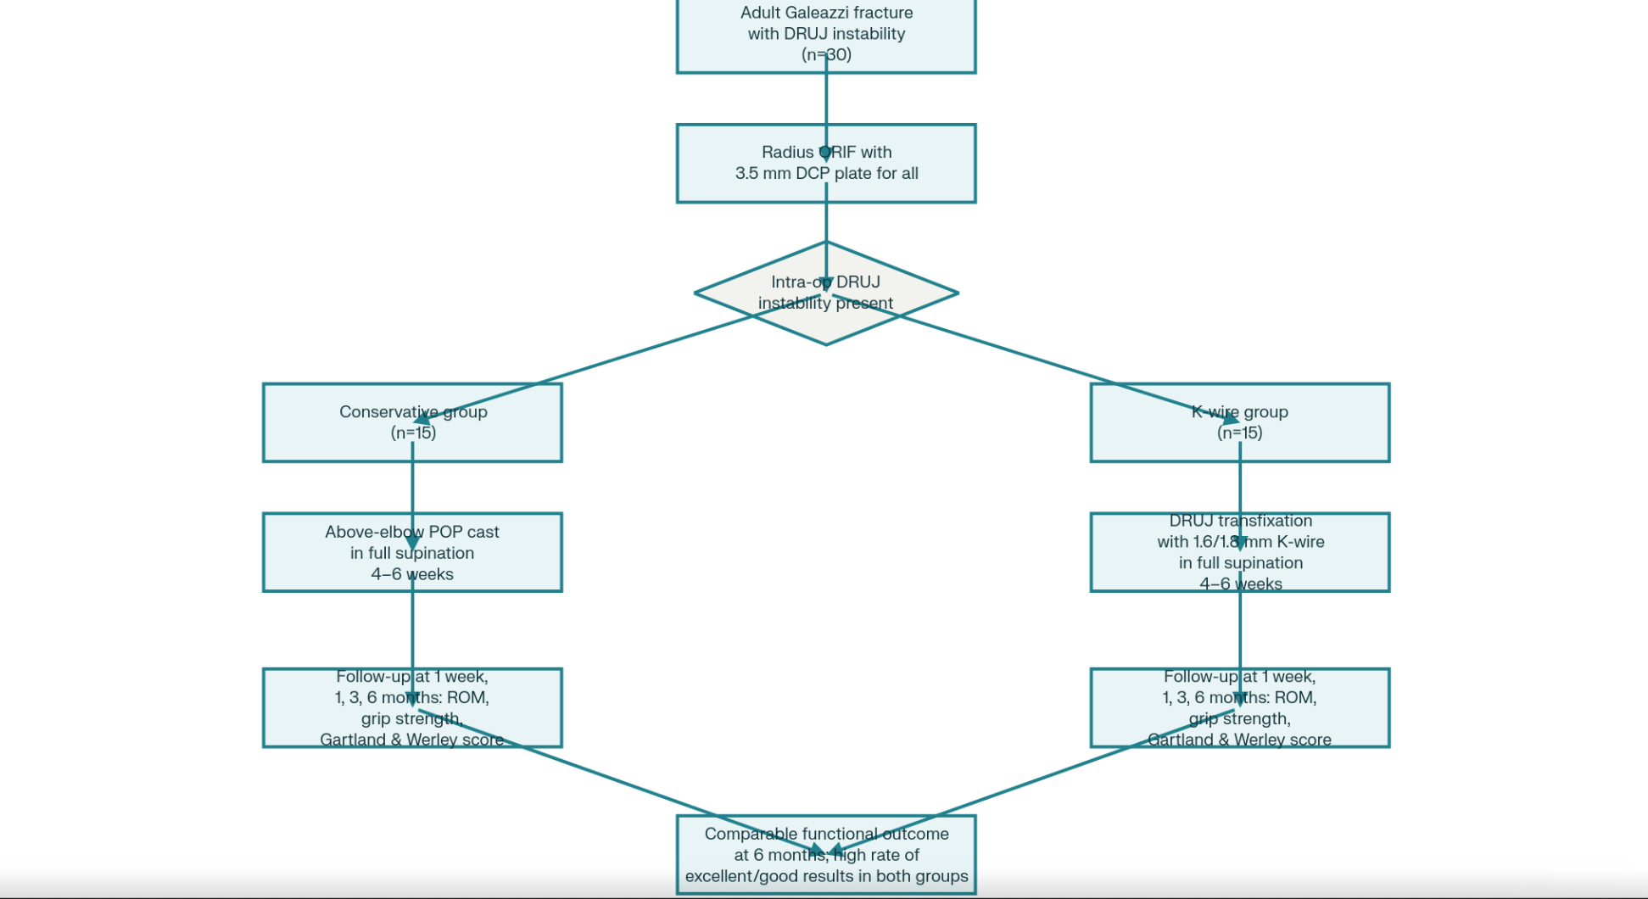

Slide 4
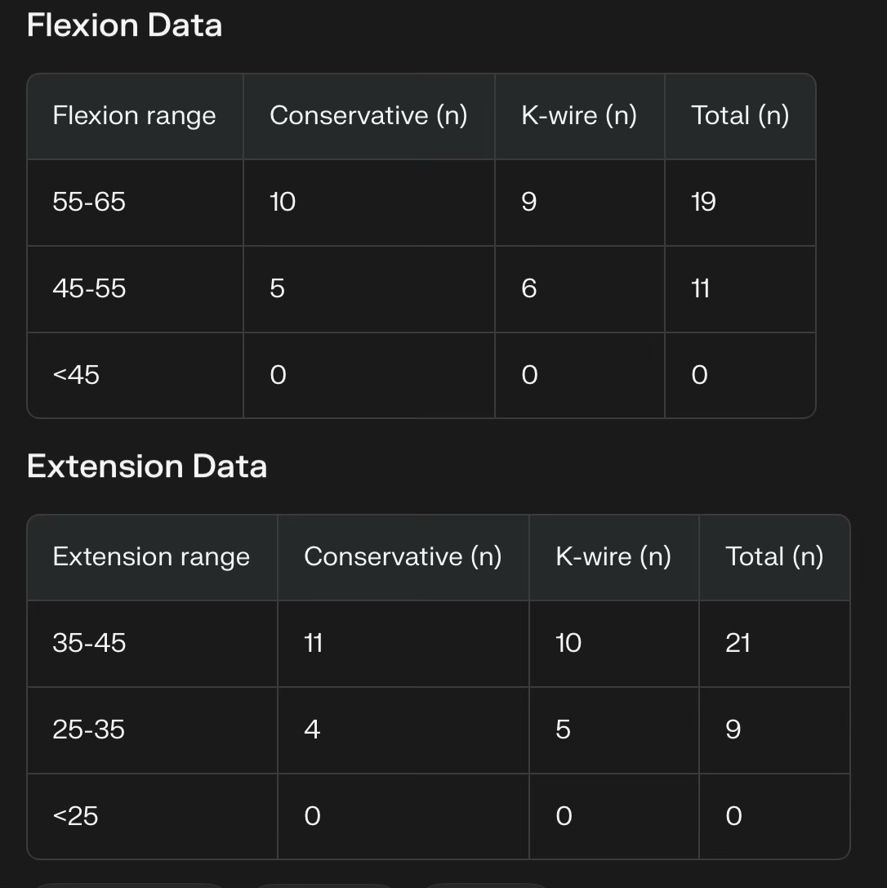
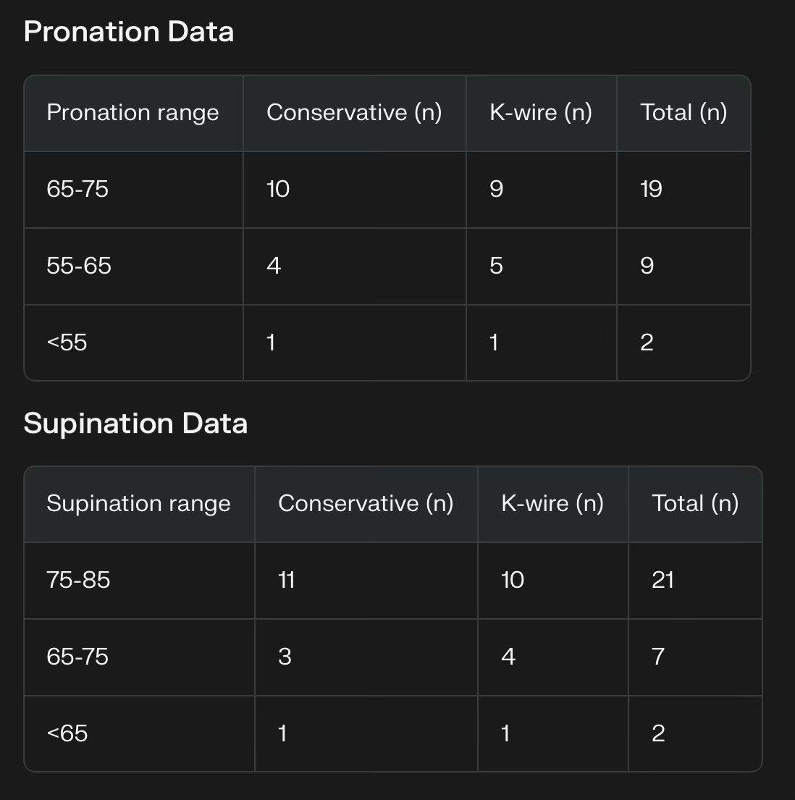
COMPARISON OF RANGE OF MOVEMENTS

Slide 5
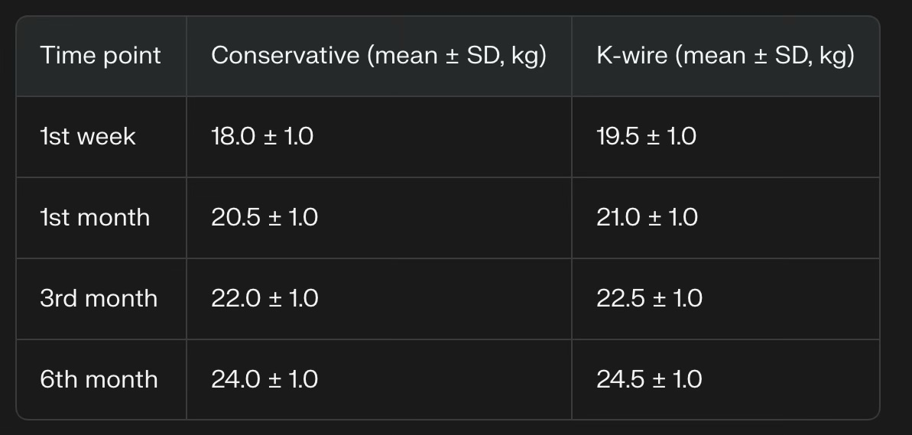
GRIP STRENGTH PROGRESSION
Both groups show steady recovery; K‑wire group is consistently ~0.5–1.5 kg higher but clinically small.

Slide 6
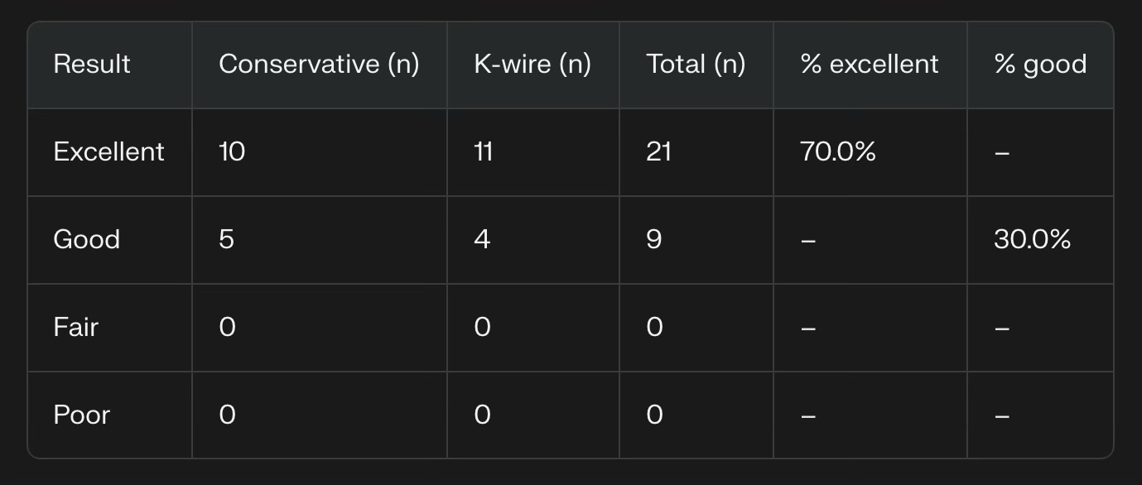
FUNCTIONAL OUTCOME ( GARTLAND AND WERLEY ) at 6 months

Slide 7
KEY STATISTICAL TAKEAWAYS
Sample: 30 patients, equally split: 15 conservative, 15 K‑wire.
Demography: young predominance (50% aged 18–30), male 73.3%, right‑side injury 66.7%, RTA mechanism 56.7%.
ROM: majority in highest strata for flexion (≥55°), extension (≥45°), pronation (≥65°) and supination (≥75°); no severe motion loss.
Grip strength: improved by ~6 kg over 6 months in both groups; final means 24.0 vs 24.5 kg.
Function: at 6 months, 100% of patients in both groups fall into excellent or good categories on Gartland & Werley; no fair/poor outcomes.

Slide 8
CONCLUSION
POP casing in full supination and DRUJ K‑wire transfixation, following stable radius plating, are clinically equivalent at 6 months for DRUJ instability in Galeazzi fractures in this cohort.

