Slide 1




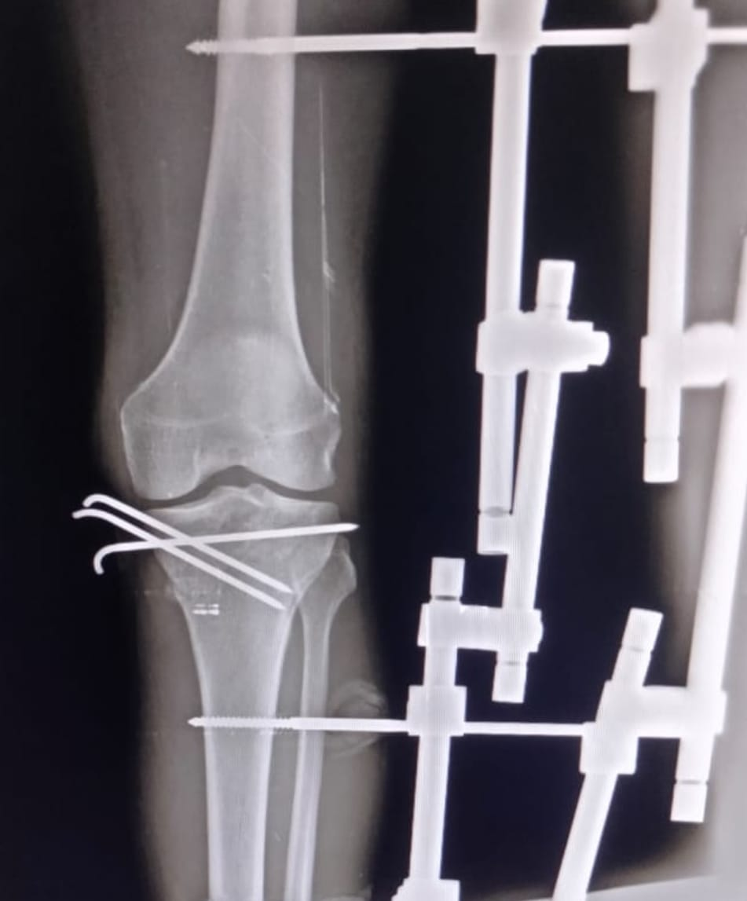
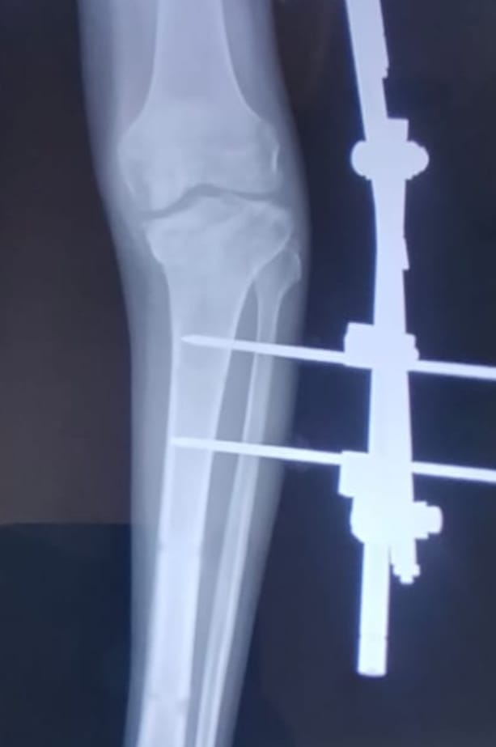
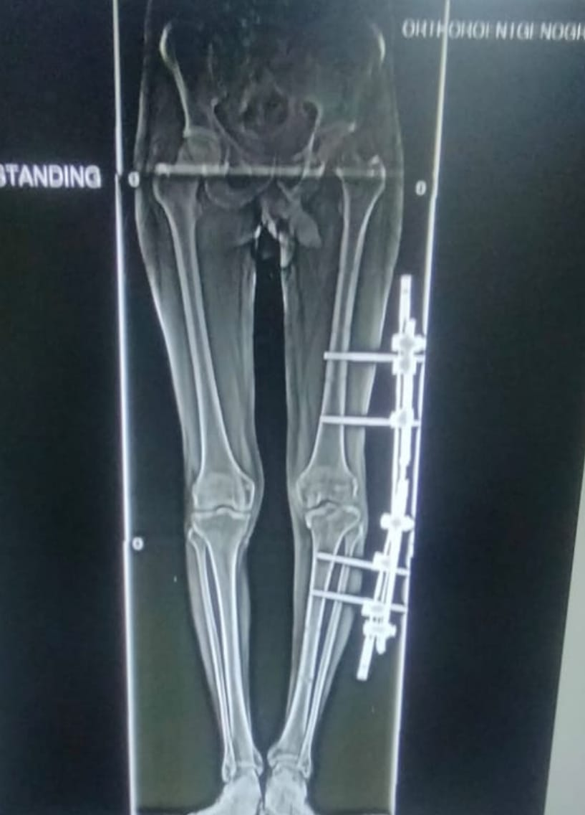
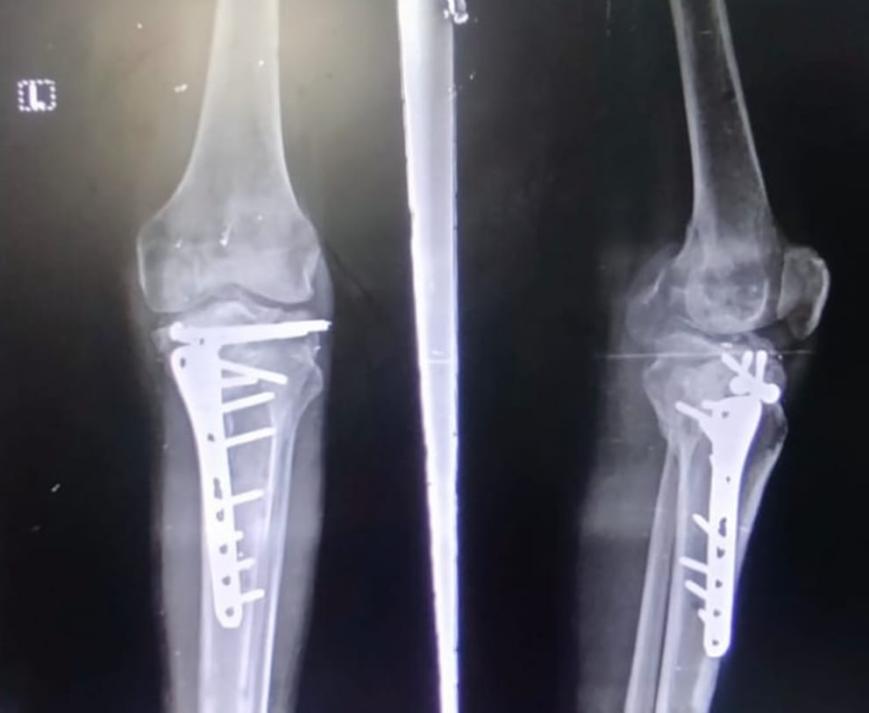
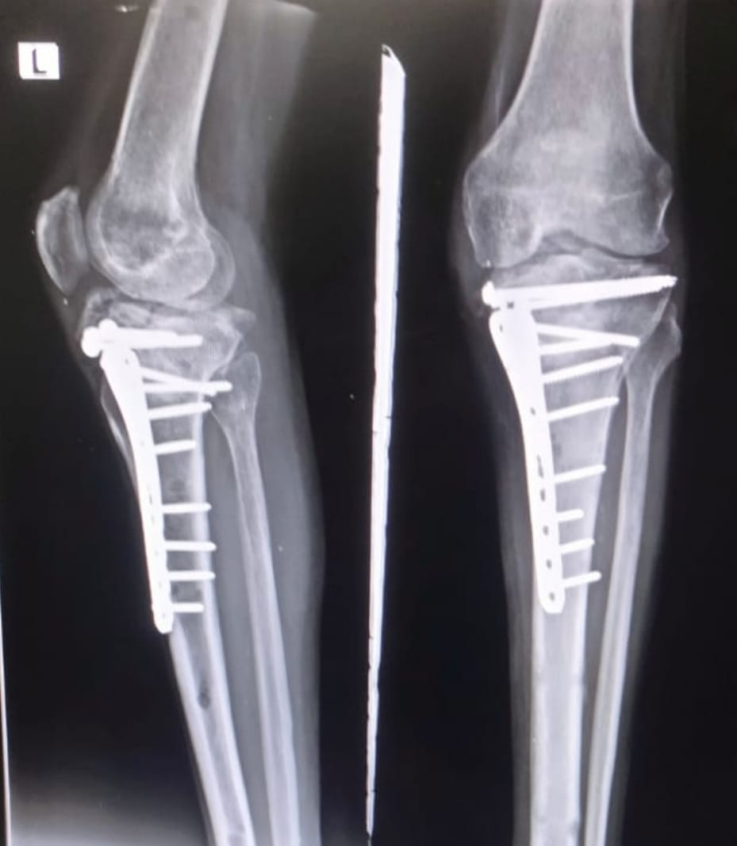
55th Annual Conference of
Orthopedic Surgeon Society of Andhra Pradesh
Date 6 – 8 February,2026, Venue : Kurnool Medical College
Organized by : Department of Orthopaedics, Kurnool Medical College Kurnool. ID : OSSAP - 099
INTRODUCTION
OPERATIVE FINDINGS
DISCUSSION
Pagoda deformity refers to a specific intra-articular deformity of the knee characterized by depression of the medial tibial plateau, often seen in advanced varus osteoarthritis or post trauma
This condition creates a pagoda-like shape in the tibial plateau on imaging, where the medial side sinks inward, leading to joint incongruity and instability. It differs from extra-articular deformities, as standard high tibial osteotomy (HTO) fails to correct it full
Posterimedial approach
Tibial condylar valgus osteotomy done
Fragment elevated and gap is filled with iliac bone graft
It is fixed with raft screws and medial plating
Patient presented with compound type 3b proximal tibia fracture .Patient was initially treated with exfix and k wires.Exfix removal done after soft tissue healing and pin holiday was given .But patient lost to follow up and later presented about 6 months after injury with knee pain and decreased range of movements , and varus deformity . X rays and scanogram done. Deformity calculated .Tibial condylar Valgus osteotomy done .Medial tibial fragment elevated and gap is filled with iliac bone graft and fixed with Medial plating and raft screws. After 3 months follow up fracture showed radiological union with full extension and flexion upto 90°
CASE REPORT
CONCLUSION
A 48 year old presented with open proximal tibia fracture . Wound debridemnt and external fixator applied with k wire fixation of proximal tibia fracture . Wound healing got delayed and patient developed pagoda deformity due to collapse of medial fragment
Pagoda deformity is a distinctive intra-articular knee abnormality characterized by medial tibial plateau depression, often resembling a pagoda or arrowhead on X-rays. Effective management typically involves targeted surgeries like tibial condylar valgus osteotomy to restore joint congruence and stability, particularly when extra-articular corrections alone fail

