Slide 1



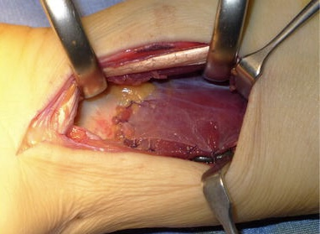
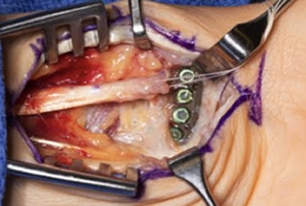
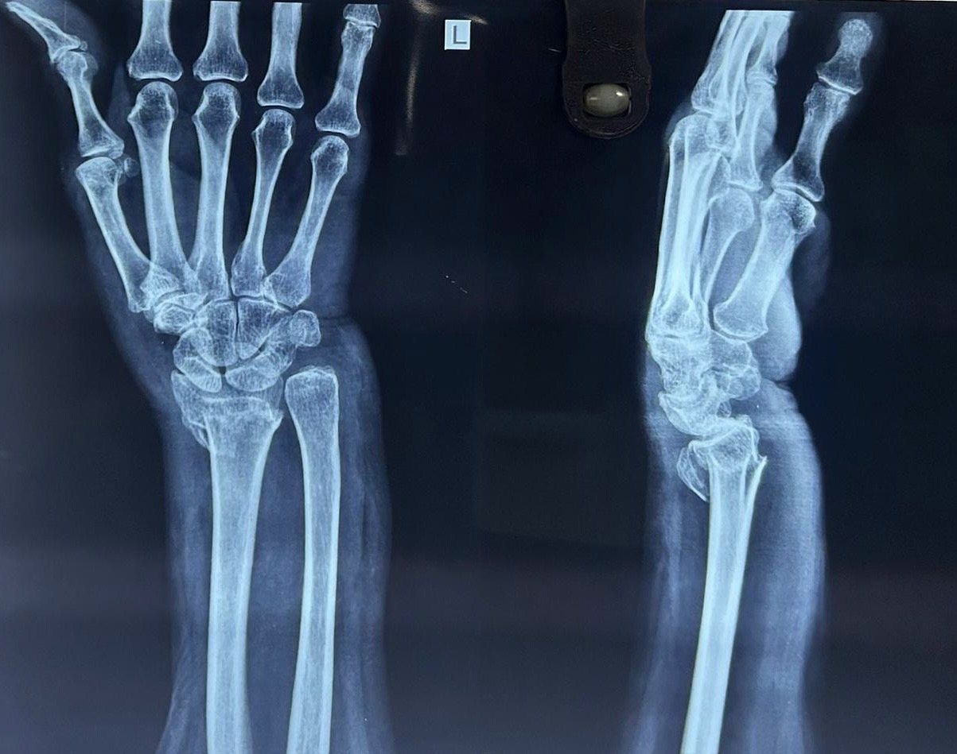
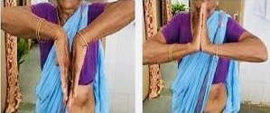
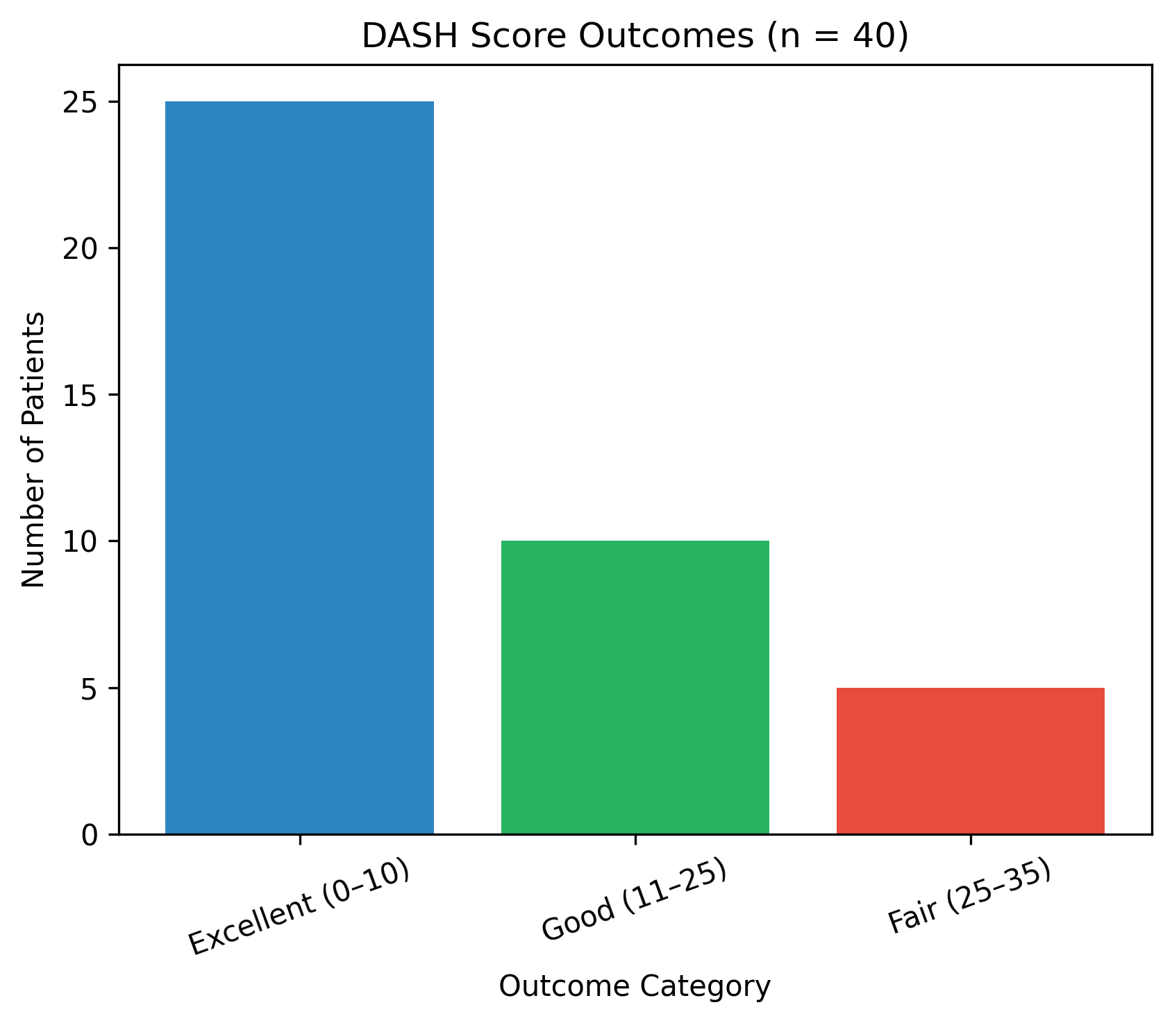
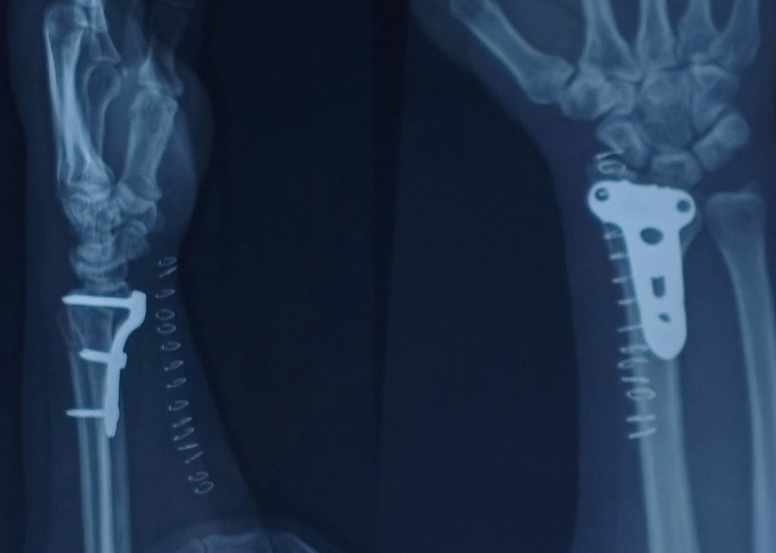
To Evaluate the Functional Outcomes of the Distal Radius Plating in Elderly patients
[Presenter :Dr Sainath P ,PG] [Guide : Dr A Sandeep , Associate Professor , DR Psims& RF]
55th Annual Conference of Orthopedic Surgeon Society of Andhra Pradesh
Department of Orthopaedics, Kurnool Medical College, Kurnool
INTRODUCTION
EXCLUSION CRITERIA
Intra OP picture
RESULTS
Distal radius fracture is one of the most common fracture of Upper extremity accounts for 15% of all fractures
Recently,Volar locking plate is widely accepted as an efficient treatment for unstable distal radius fractures due to advantages of direct reduction & Stable fixation with locking plate as well as early mobilisation is possible
Patients with associated Ulna fracture
Open/Infected fractures
Vascular injuries
Severe Co-morbid conditions
Sex distribution: Out of 40 patients, 12 (30%) were males and 28 (70%) were females.
Side of injury: Right distal radial fractures were seen in 30 patients (75%), while left-sided fractures occurred in 10 patients (25%).
DASH Scores of 40 cases were:-
Excellent outcome: 25 patients (62.5%) had excellent functional results with DASH score 0–10
Good: 10 patients (25%) with DASH score 11–25
Fair: 5 patients (12.5%) with DASH score 25–35
Pre OP Xray
Wrist ROM (Post Op)
Method
Complications:
Reflex sympathetic osteodystrophy: 3 cases (7.5%)
Malunion: 8 cases (20%)
Study Design: Prospective case series
Study Period: January 2025 – January 2026
Study Location: Dr PSIMS &RF
Sample Size: 40 patients
Procedure : ORIF -Plating to Distal radius done by experienced orthopaedic surgeons
Post OP Xray
Discussion
INCLUSION CRITERIA
Comminuted distal radius fractures are common, but treatment is challenging due to difficulty in achieving good reduction and fixation
Open reduction and internal fixation (ORIF) is indicated for Unstable distal radius fractures & Fractures with articular incongruity
Adequate bone stock is necessary to permit - A stable construct
Early range of motion is possible
Conclusion
Age above 40 Years
Fresh traumatic fractures
No previous surgeries
Internal fixation with plate and screws provides excellent results with good fracture reduction.
K-wire fixation, though simple, has a higher chance of malunion.
3 months follow up

