Slide 1
A COMPARATIVE PROSPECTIVE STUDY OF PROXIMAL FEMORAL NAIL AND DYNAMIC HIP SCREW IN THE TREATMENT OF INTERTROCHANCTERIC FRACTURE
PRESENTER :
GUIDE:
DR SAINATH P
POST GRADUATE ,
DEPARTMENT OF ORTHOPAEDICS,
DR. PSIMS & RF.
DR. A SANDEEP
ASSOCIATE PROFESSOR, DEPARTMENT OF ORTHOPAEDICS,
DR.PSIMS & RF.

Slide 2
Introduction:-
Intertrochanteric hip fractures are common in elderly (>60 years), especially osteoporotic women, and usually result from low-energy trauma such as trivial falls
Though occurring in well-vascularized cancellous bone, these fractures carry high morbidity and mortality due to complications of malunion, prolonged immobility, and systemic issues; ~30% mortality within one year is reported
Poor reduction or fixation leads to varus collapse with external rotation, causing limb shortening, abnormal gait, delayed mobilization, and increased risk of cardiopulmonary and vascular complications.
Stability depends on bone quality (osteoporosis), degree of comminution, and external factors such as quality of reduction, surgical technique, and implant choice.
DHS allows controlled collapse but has higher risk of mechanical failure in unstable or comminuted fractures. So,DHS preferred only in Stable inter trochanteric fractures
PFN, being intramedullary, aligns with the mechanical axis, offers better stability, less blood loss, shorter surgery, earlier mobilization, and better limb length preservation.So,PFN done for Unstable inter trochanteric fractures

Slide 3
AIM OF STUDY
To compare functional outcomes of intertrochonteric femoral fracture treatment using Proximal femoral nail(PFN) vs Dynamic Hip screw (DHS)

Slide 4
Methodology
Prospective study (Jan 2025 –Jan 2026)
30 adult patients with inter trochanteric fractures
Treated with Proximal femoral nail(PFN) & Dynamic Hip screw (DHS)
Functional outcome compared based on Morbidity score,Time of fracture union & Range of movements
Inclusion Criteria:
Adults 40 years or older
Fresh traumatic inter trochonteric fractures
Patients who were able to walk independently before injury
Exclusion Criteria:
Age <40 years
Pathological fractures due to tumors,metabolic bone diseases or infections
Medically unfit for surgery with Severe Comorbidites

Slide 5
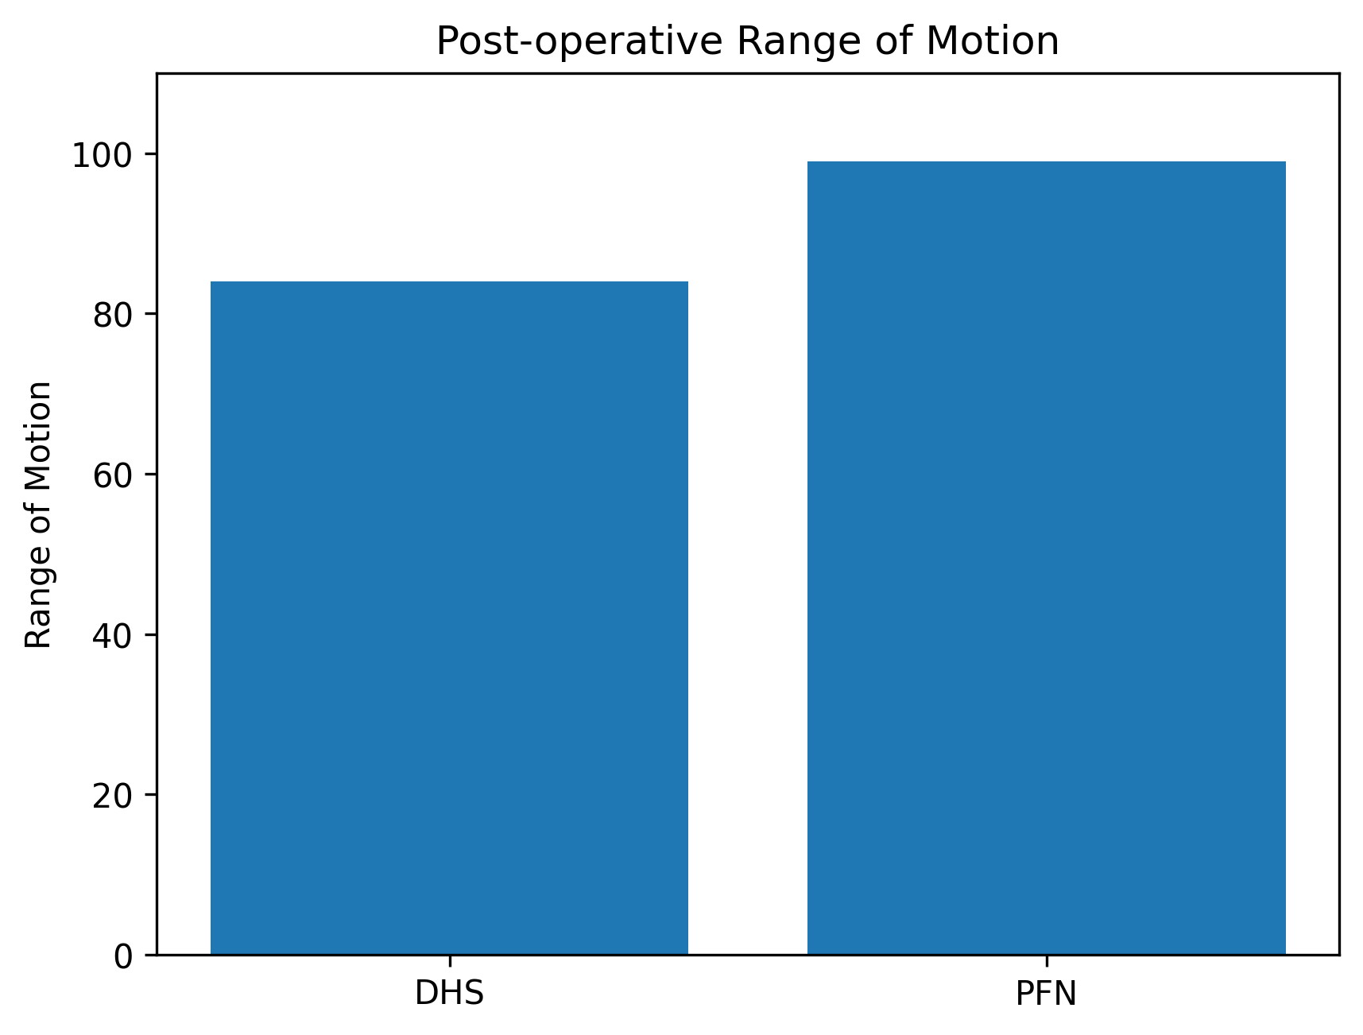
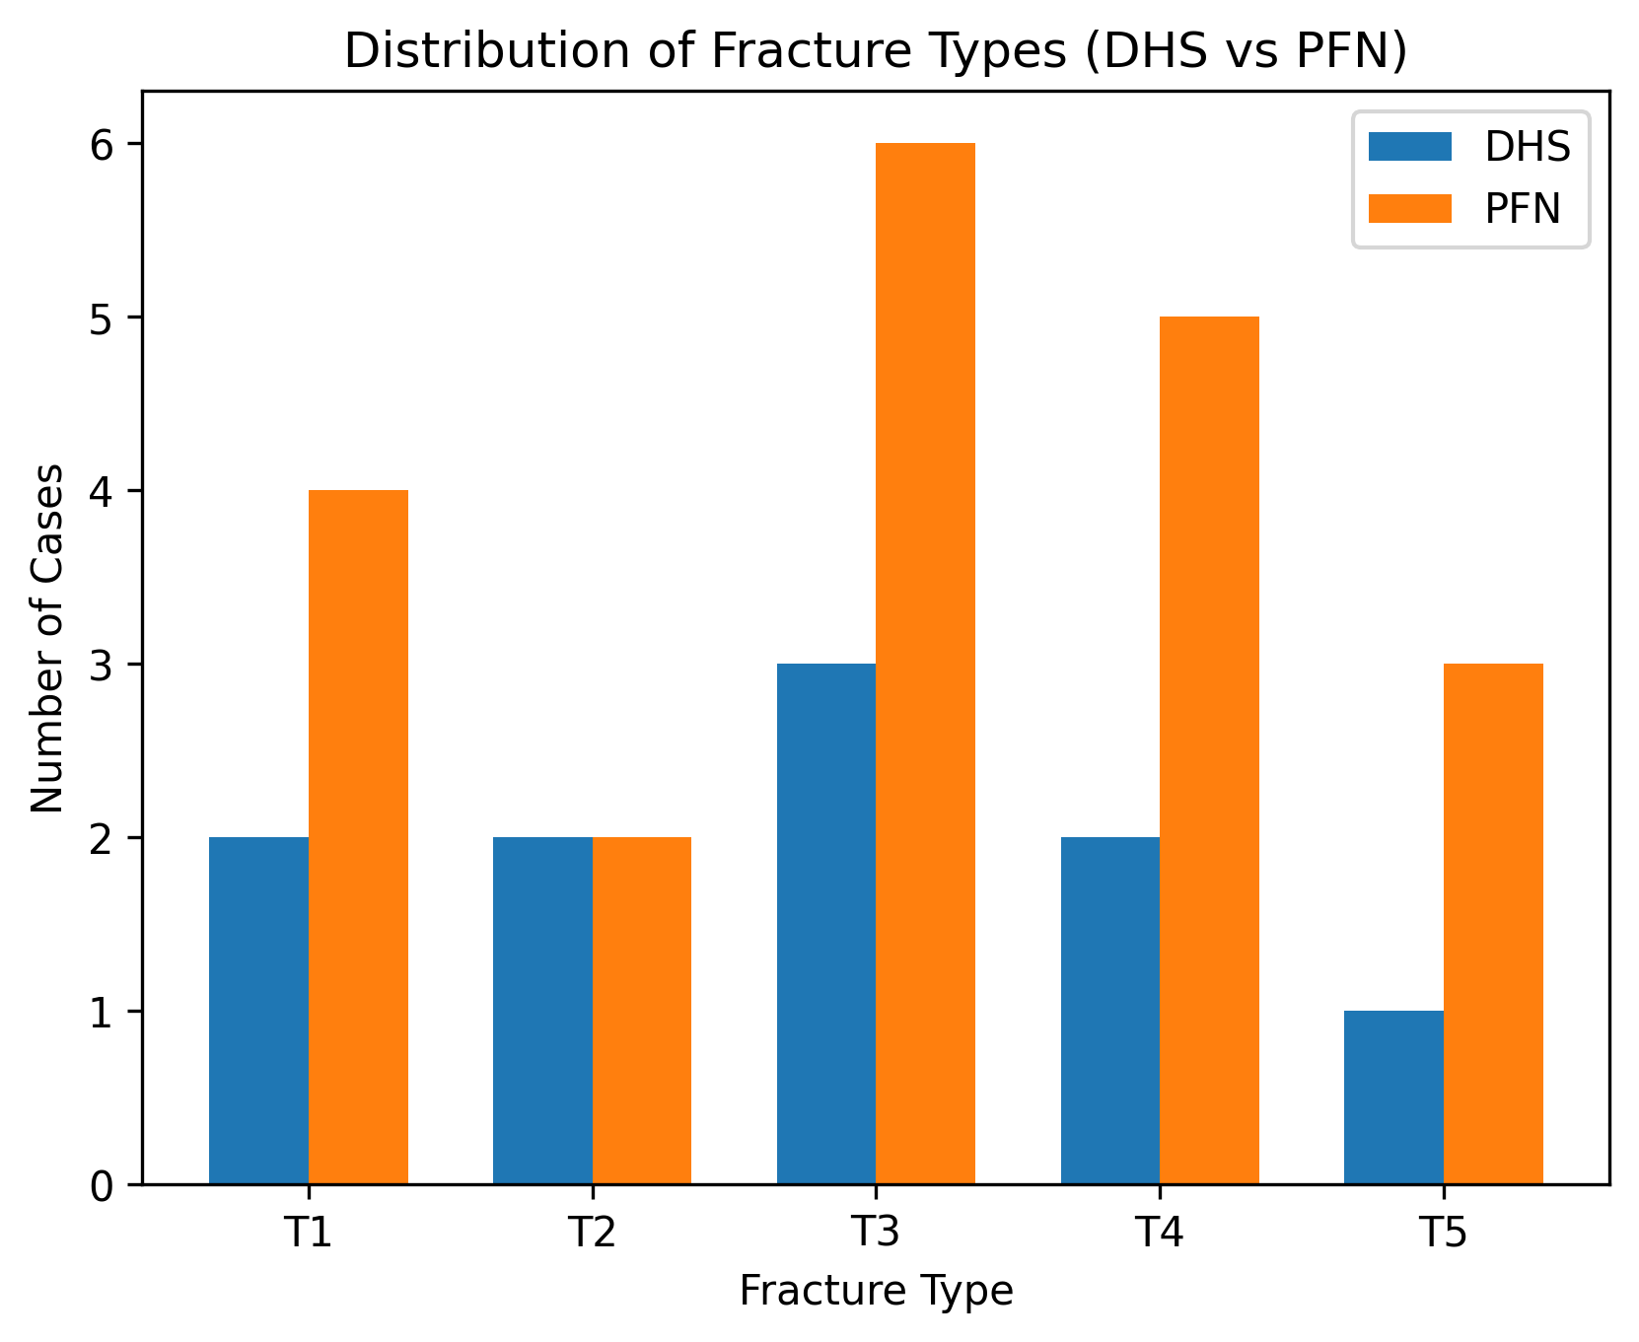
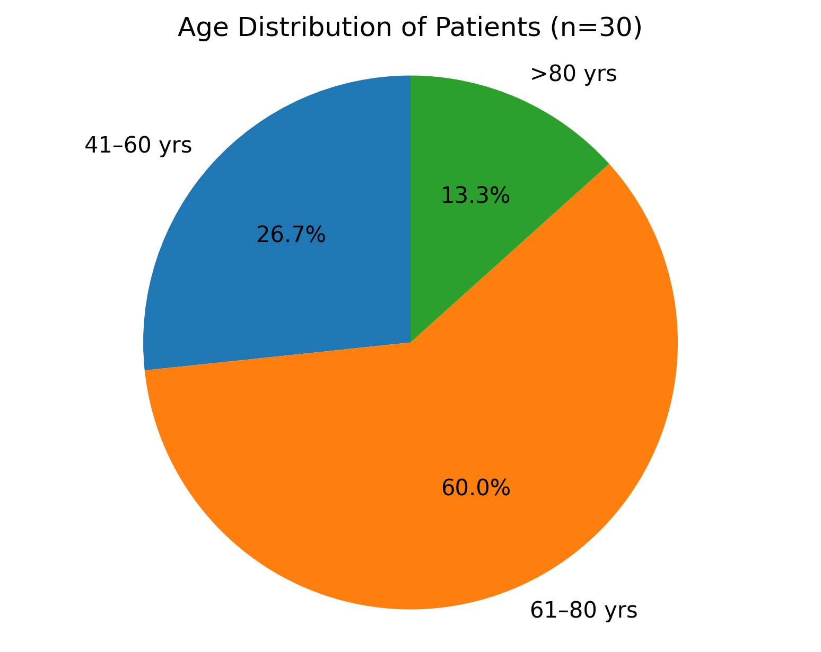
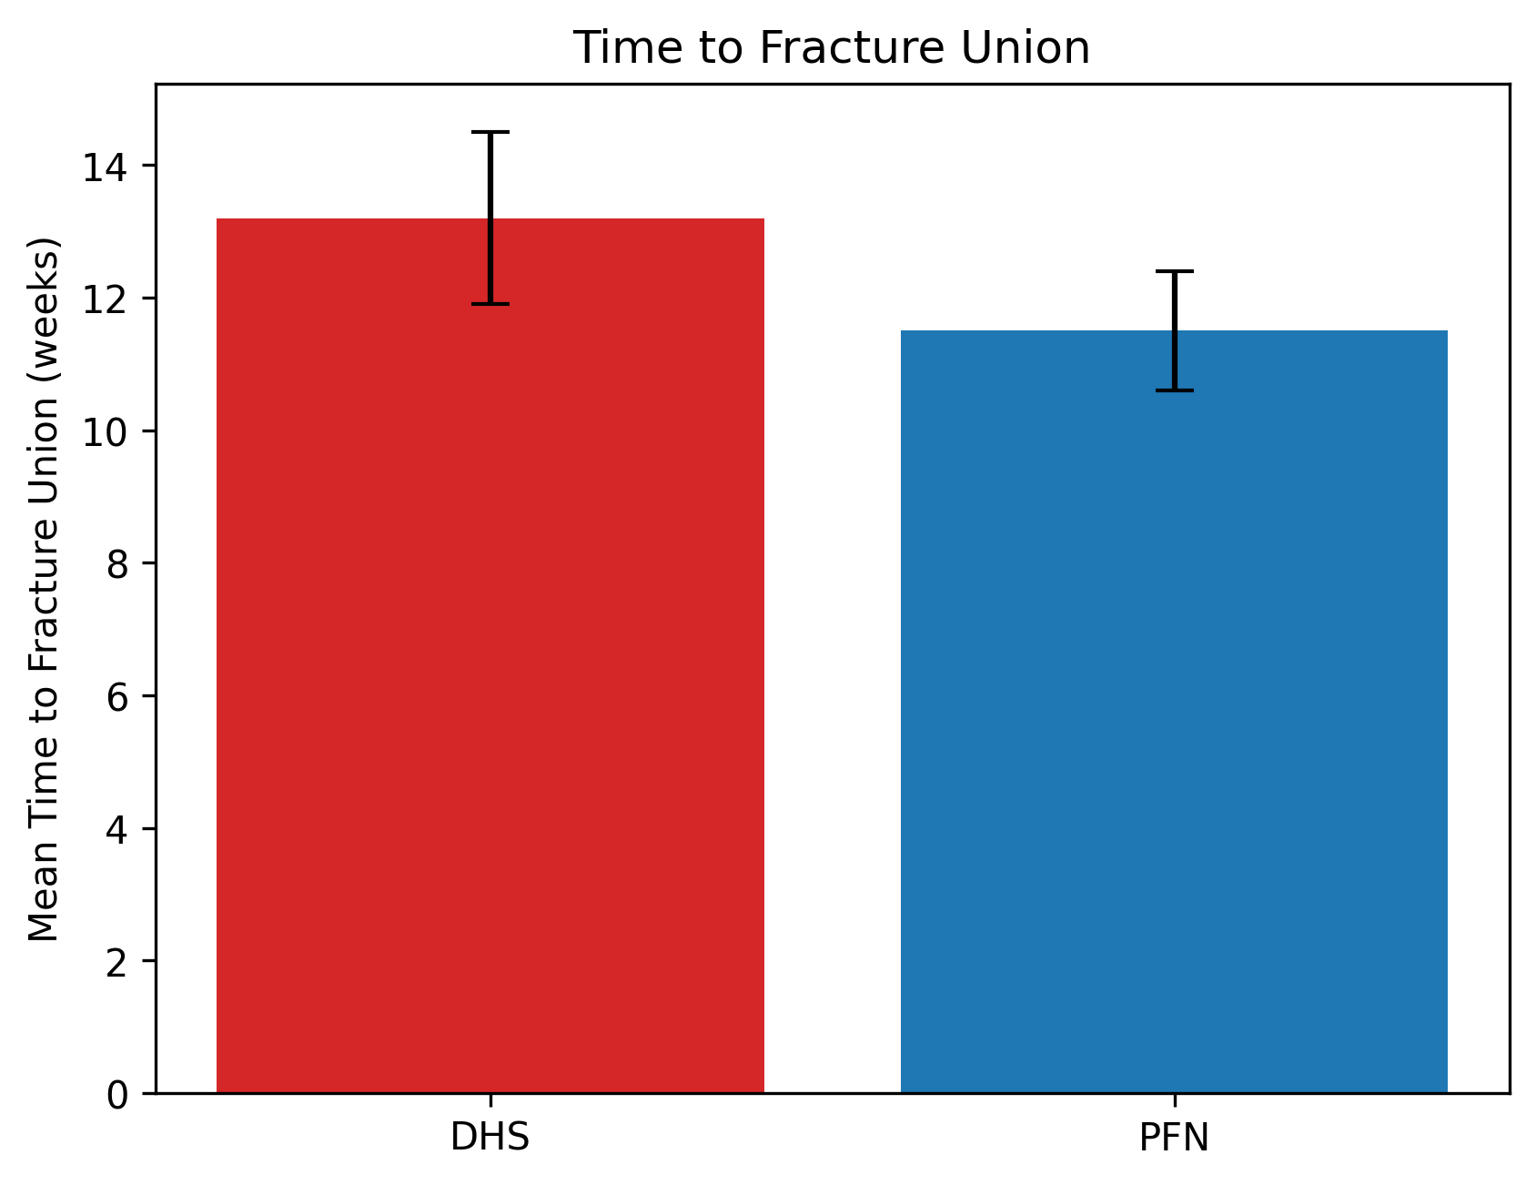
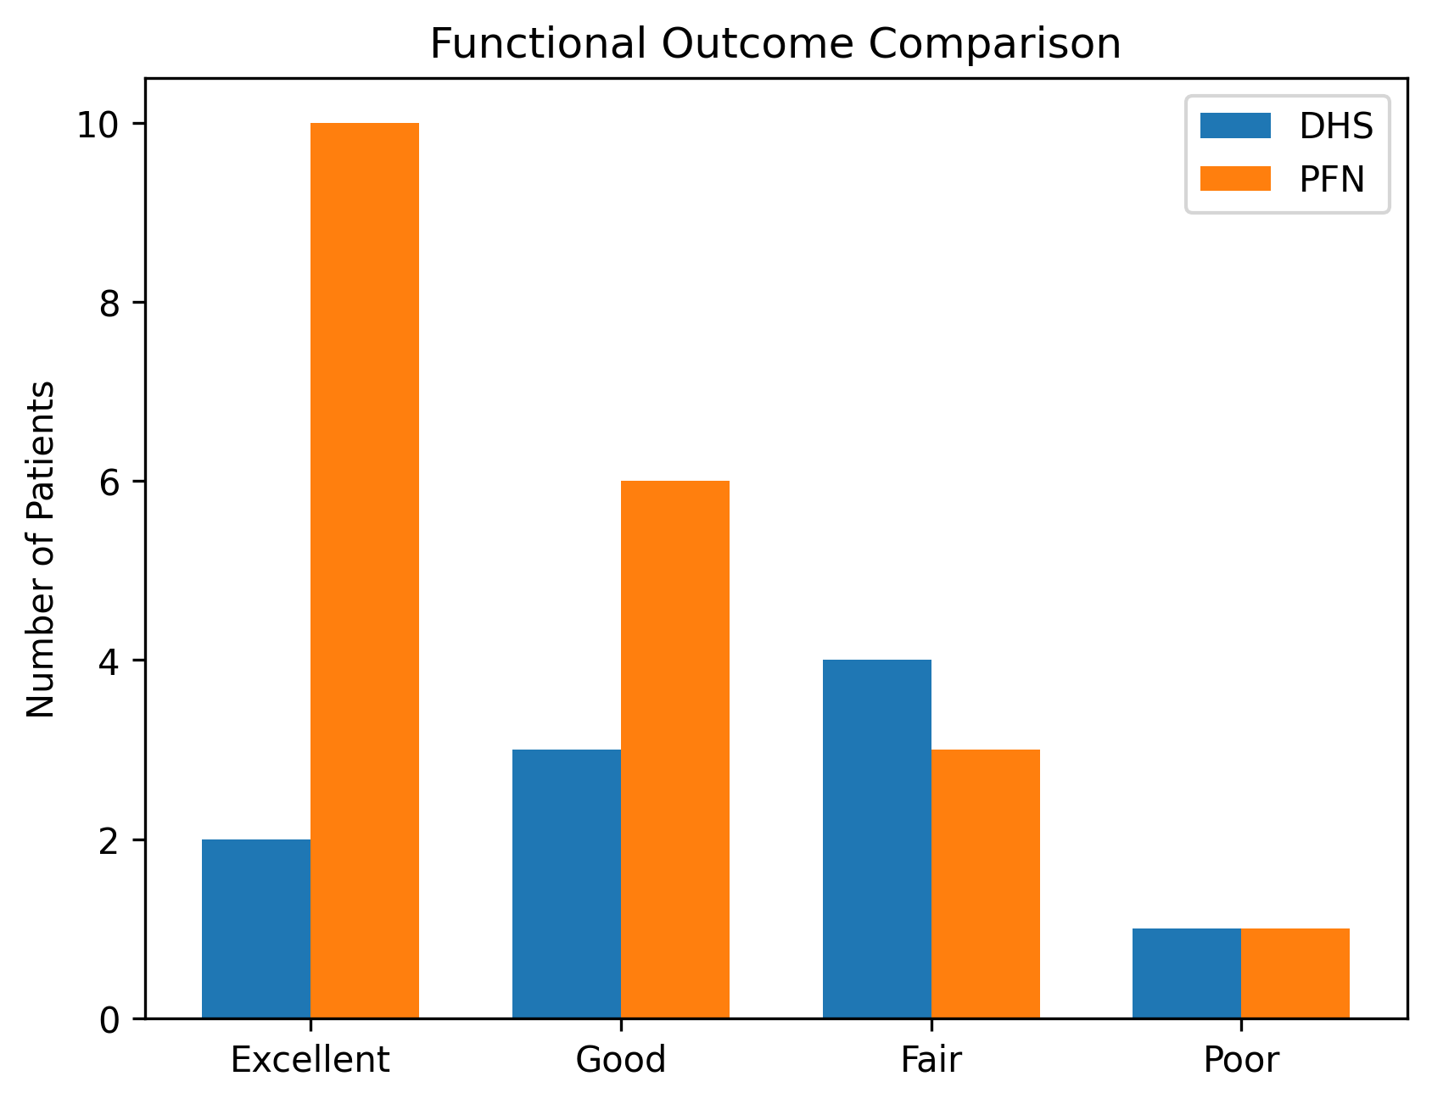
Results
JENSEN MODIFICATION OF EVANS CLASSIFICATION
(Type 1&2 -Stable;Type 3,4&5 -Unstable)
(Among Unstable fractures)

Slide 6
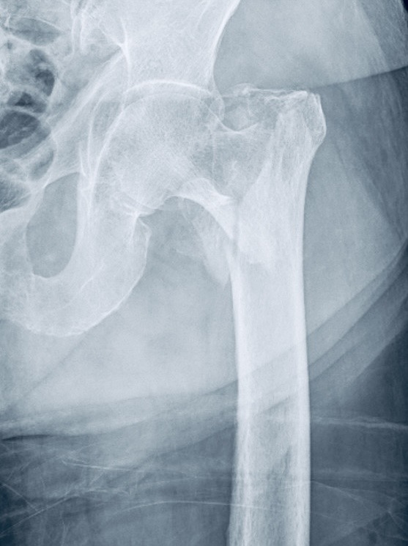
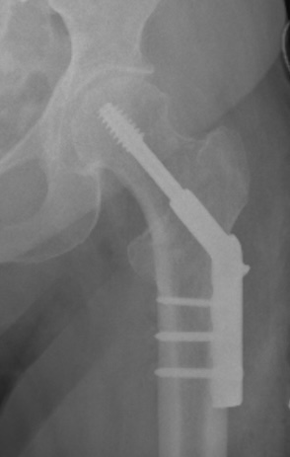
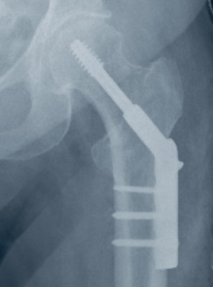
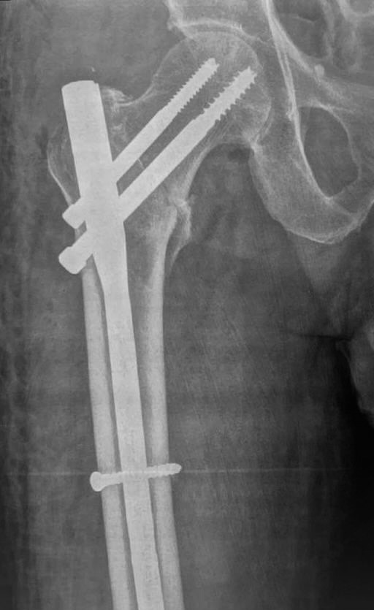
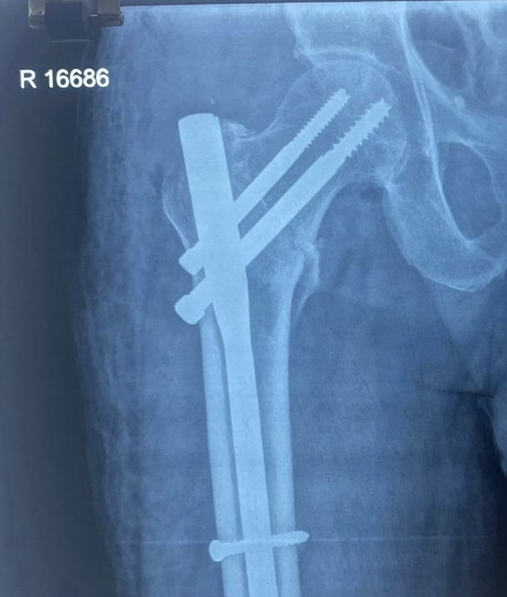
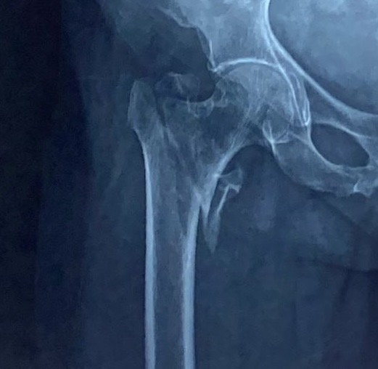
Pre OP | immediate Post OP | 3 Months follow up
Immediate
post-op Xray
Pre-op Xray
Case-1(DHS)
Case-2 (PFN)

Slide 7
CONCLUSION :-
PFN showed shorter incision length, reduced operative time, and better post-operative pain scores compared to DHS.
Implant cost was less with DHS than with PFN;Proper placement of Lag screw is important in reducing implant failure (Cut-out)
PFN resulted in less limb shortening, improved hip range of motion, and faster fracture union.
Superiority in unstable fractures:- Functional outcomes were superior with PFN, particularly in unstable intertrochanteric fractures.
Overall conclusion: PFN is a more effective and reliable fixation method than DHS for both stable and unstable intertrochanteric fractures, providing better early functional recovery, with a trend toward fewer complications.
Limitations :-
Small sample size,
Randomisation not done
It is an observational study

Slide 8
REFERENCES :-
Attum B, Pilson H. Intertrochanteric Femur Fracture. [Updated 2023 Aug 8]. In:
StatPearls
[Internet]. Treasure Island (FL): StatPearls Publishing; 2025
Jan-. Available from: ht﻿﻿﻿
Thorngren, KG. (2014). Fractures of the Femoral Neck and Proximal Femur. In:
Bentley, G. (eds) European Surgical Orthopaedics and Traumatology. Springer, Berlin, Heidelberg. ht
﻿﻿﻿Cornell CN. Internal fracture fixation in patients with osteoporosis. J Am Acad Orthop Surg. 2003 Mar-Apr; 11(2):109-19. doi: 10.5435/00124635-200303000-
00005. PMID: 12670137.
López-Hualda A, Arruti-Pérez E, Bebea-Zamorano FN, Sosa-Reina MD, Villafañe JH, Martínez-Martin J. Morbidity and Mortality Analysis in the Treatment of Intertrochanteric Hip Fracture with Two Fixation Systems: Dynamic Hip Screw (DHS) or Trochanteric Fixation Nail Advance (TFNA). Geriatrics (Basel). 2023 Jun 8;8(3):66. doi:10.3390/geriatrics8030066. PMID: 37367098;PMCID: PMC10298446
﻿﻿﻿Ozkan K, Türkmen I, Sahin A, Yildiz Y, Erturk S, Soylemez MS. A biomechanical
comparison of proximal femoral nails and locking proximal anatomic femoral plates in femoral fracture fixation: A study on synthetic bones. Indian J Orthop. 2015 May-
Jun;49(3):347-51. doi: 10.4103/0019-5413.156220. PMID: 26015637; PMCID:
PMC4443419.

