Slide 1




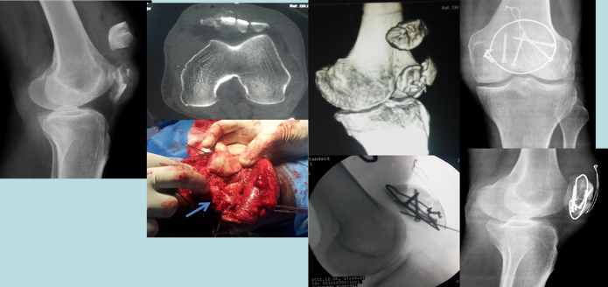
"Is Articular Reconstruction Feasible in OTA- C2, C3 Comminuted Patellar Fractures?"- A Novel Technique for Patellar Articular Reconstruction and Fixation.
AUTHORS : DR K V NAGA CHANDRA ,CO AUTHORS : DR ATHMARAM,DR SATISH,DR RAGHAVENDRA RAJU
INTRODUCTION
OPERATIVE FINDINGS
DISCUSSION
Patellar fractures constitute about 1% of all skeletal injuries.Currently, many methods of treatment are advocated for comminuted patellar fractures like patellectomy (partial/complete), tension band wiring, cerclage wiring, and screw fixation. Articular reconstruction of the comminuted fracture is challenging and essential for good functional outcome.The objective is study functional outcome using our novel technique for meticulous articular reduction of comminuted fragments.
9 fractures were closed fracture and 3 was open fracture ,which was treated by wound wash, wound debridement, primary internal fixation of the patella and primary wound closure in all the cases. In our novel technique meticulous articular reduction of comminuted fragments is done by everting the major fragments and direct observation of reconstruction of articular facet, then final reduction of fragments stable fixation, restoration of extensor apparatus and early mobilization.
The average follow up was 27.83 months (13-49 month) and average knee outcome survey ADLS was good result 90.08% (range 78.98%-97.11%). Complete union was seen in all the cases by 14 weeks follow up (mean 10.83 weeks). All patients achieved functional range of movements for routine daily activity and average Knee range of movement at final follow up was 119.08⁰.Three patients had restricted knee movements due to poor compliance of patients for rehabilitation because of ipsilateral long bone fracture. 3 patients had knee range less than 120⁰ in which associated fracture was in 3 patients and C3 type fracture in 2 patients. None of the patients had knee extensor lag. There was no implant cut out, non-union, or avascular necrosis of the bony fragments observed at the time of follow up in any of our patients. Comminuted fractures of patella are very common due its to subcutaneous location. Patellectomy is no longer considered in treatment of severely comminuted fractures. Meticulous reduction of comminuted patella fractures is essential for good functional outcome.
CONCLUSION
CASE REPORT
We prospectively analysed 12 patients who sustained comminuted patellar fracture classified as 34- C2, C3 type fracture (AO/OTA classification). 9 fractures were closed fracture and 3 was open fracture
Good three dimensional articular reconstruction of patellar facet is possible by direct observation of fragment reduction by meticulous handling of soft tissues and fragments. By this surgical technique good functional results can be achieved for comminuted patellar fractures.

