Slide 1




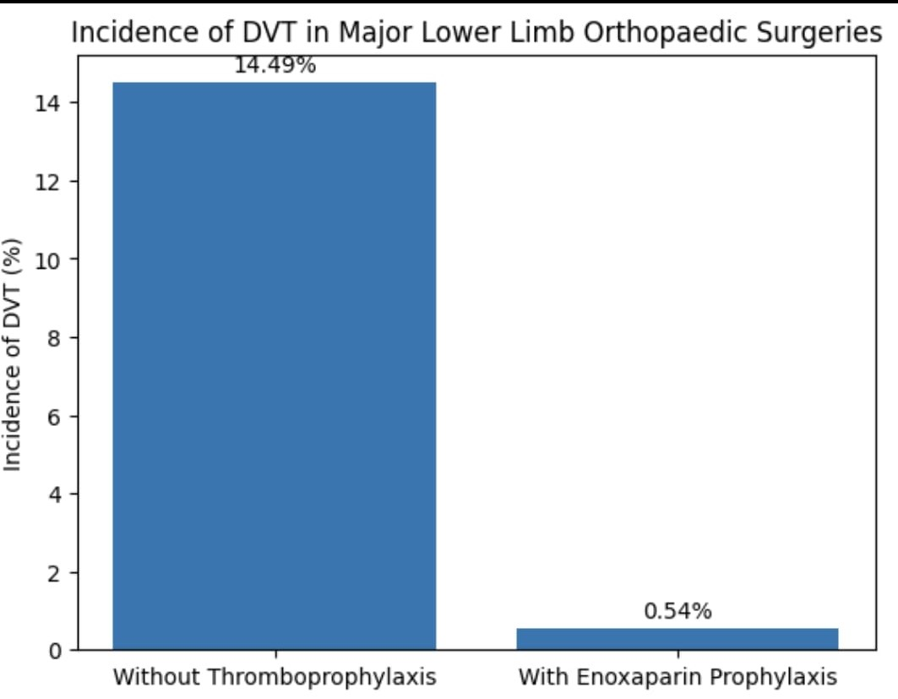
EFFICACY OF ENOXAPARIN AS A THROMBOPHYLACTIC AGENT IN MAJOR LOWER LIMB ORTHOPAEDIC SURGERIES
AUTHORS : DR NARAYANASWAMY NAIK ,CO AUTHORS : DR ATHMARAM ,
DR SATISH, DR RAGHAVENDRA RAJU
INTRODUCTION
OPERATIVE FINDINGS
DISCUSSION
Out of 185 cases only one case (0.54%) was positive for DVT at second follow up venous Doppler, at 11th post op day. In rest of the 184 cases there was no evidence of DVT in any venous Doppler scan.
Incidence of DVT in Indian population with major lower limb trauma is 14.49%(3,4) incidence reduced to 8% after prophylaxis.
The incidence of VTE was 14.49% after surgery for hip and proximal femur fracture without administration of VTE prophylaxis and was only 8% when prophylaxis was administered(1). Enoxaparin is one of the leading agents in this class being registered for use in this indication. [2]This study has been done to evaluate the efficacy of Enoxaparin as a thrombo prophylactic agent in major lower limb orthopaedic surgeries in Indian population.
Required data was collected from patients admitted in GMC,ATP. All patients included in study were assessed pre- operatively with structured questionnaire and physical examination and screened for DVT radio logically by Doppler Ultra sound, Blood investigations like PT and aPTT, with other routine investigations. *Inclusion Criteria*
Arthroplasty-(Hip and Knee),Major Trauma-(Surgeries for fractures around Hip, Femur fracture surgeries.) *Exclusion Criteria* Proved cases of DVT , Pathological fracture , Pregnancy , Hypersensitivity to heparin , Patient at risk for bleeding complications
CONCLUSION
CASE REPORT
Incidence of DVT in Indian population is 14.49% without thromboprophylaxis. The incidence of DVT is 0.54 % in our institution with thromboprophylaxis using Enoxaparin .we recommend to use thromboprophylaxis in all major lower limb orthopaedics surgeries.
During the study period, 185 patients undergoing Surgeries for fracture around hip, femur fracture surgery, patients undergoing Hip and Knee Arthroplasty were given prophylaxis for DVT

