Slide 1


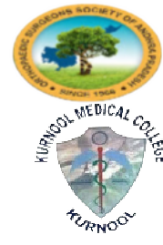

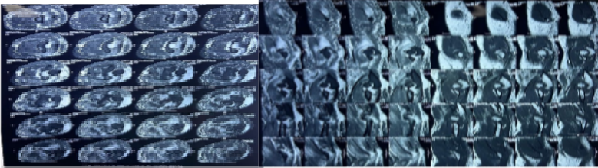
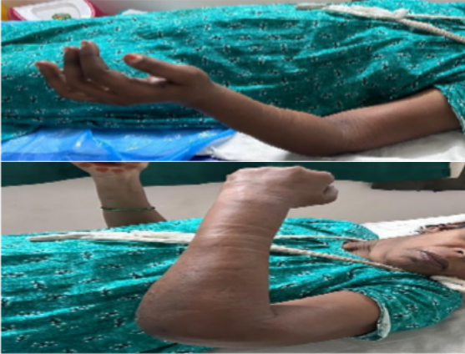
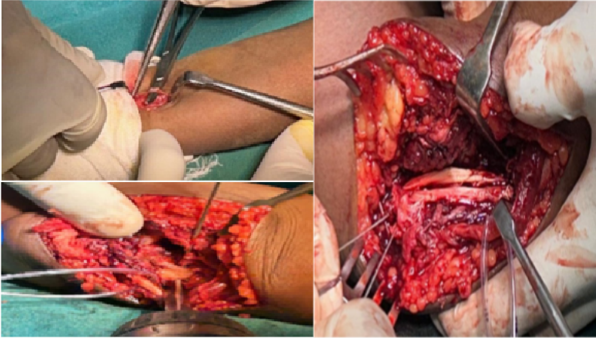
TITLE :- ULNAR COLLATERAL LIGAMENT RECONSTRUCTION VIA TOMMY JOHNS
55th Annual Conference of
Orthopedic Surgeon Society of Andhra Pradesh
Date 6 – 8 February,2026, Venue : Kurnool Medical College
Organized by : Department of Orthopaedics, Kurnool Medical College Kurnool
SURGERY IN ACUTE TRAUMATIC POSTEROMEDIAL ROTATORY INSTABILITY OF ELBOW
AUTHOR : Dr . A.S.I.R.AJMAL ANSARE , POST GRADUATE , GITAM INSTITUTE OF MEDICAL SCIENCE AND RESEARCH CO AUTHORS : Dr. Y.KRISHNA CHAITANYA- ASSISTANT PROFESSOR , Dr. A.S.S.PHANI ESWAR – SENIOR RESIDENT
INTRODUCTION
DISCUSSION
The ulnar collateral ligament of the elbow is a well developed ligament that can be described as three distinct portions ulnar collateral ligament plays an important role in valgus stability. valgus stability is divided equally among the ulnar collateral ligament, the anterior capsule, and the bony articulation with the elbow in full extension. At 90 degrees of flexion, the ulnar collateral ligament provides 55% of the stability to valgus stress, with the anterior bundle being the primary stabilizer . Disruption of the anterior bundle of the medial ulnar collateral ligament is by far the most common form of recurrent elbow instability. The anterior bundle is divided into two nonisometric bands: an anterior band, which is taut at 0 to 60 degrees, and a posterior band, which is taut at 60 to 120 degrees. The procedure, first done in 1974 by Dr. Frank Jobe, has become a relatively common operation. The incidence of ulnar collateral ligament reconstruction in 15- to 19-year old players is 22 per 100,000 in the Pearl Diver insurance database.
UCL reconstruction is indicated for acute complete rupture of UCL with posteromedial instability to do their daily activities . Cain et al. evaluated 743 athletes who had ulnar collateral ligament reconstruction with a minimum of 2 years’ follow-up. Eighty-three percent returned to the same level or a higher level of competition at less than 1 year from surgical stabilization. In a statistical analysis of 147 Major League Baseball pitchers, Makhni et al. found that 67% were able to return to same competitive level as before their surgery. The rehabilitation protocols play an essential role in instability management: they should be tailored and started as soon as possible, protecting the healing of the elbow stabilizers while, at the same time, avoiding stiffness occurrence.
Results:- The results of this surgery was patient had a posteromedial rotatory instability and ulnar collateral ligament reconstruction was done via flexor carpi radialis provided elbow stability at 90 degree flexion and extension.
OPERATIVE FINDINGS
SURGICAL TECHNIQUE:- A 2 cm skin incision given over flexor carpi radialis tendon near wrist flexion crease and FCR tendon graft was harvested and graft preparation was done and 10 cm skin incision given via medial approach to elbow and bone tunnels were made over proximal ulna and medial epicondyle using 3.2 mm drill bit. A 15 cm long graft was passed through bone tunnels in a figure of 8 fashion and sutured. Tensioning of graft was done in neutral and 45 degree flexion.. Post operatively elbow was secured in Above Elbow POP cast in 90-degree flexion and supination. after 3 weeks full elbow extension with flexion of 110 degree was obtained. suture removal was done on post op day 14.
Viable graft choices include palmaris longus, gracilis or semitendinosus autograft. Clinical studies report excellent outcomes of UCLR for both recreational and elite level atheletes with regard to return to sports and postoperative performances.
There was no injury to ulnar nerve,elbow stiffness and weakness leading to decreased performance .
CASE REPORT
a 49-year-old female came to emergency with a complaint of pain and swelling over left elbow due to H/O fall from 2 wheeler over left elbow in flexed position.
O/E – Active valgus extension overload test was positive .and elbow instability at 90 degree flexion . Xray of elbow showed posterior dislocation with
Undisplaced fracture of radial head. On MRI Elbow there was complete tear of lateral collateral and ulnar collateral ligament.
CONCLUSION
Ulnar collateral ligament reconstruction in posteromedial instability via tommy john surgery has excellent outcome with return to her daily activities.

