Slide 1
CARTILAGINOUS STORM IN SYNOVIUM . A CASE REPORT ON A RARE CASE OF SYNOVIAL CHONDROMATOSIS IN A 28 YEAR OLD FEMALE
PRESENTED BY Dr. A.S.I.R.AJMAL ANSARE
GUIDE - Dr. M SAI KRISHNA (ASSOCIATE PROFESSOR)
DEPARTMENT OF ORTHOPAEDICS GIMSR

Slide 2
ABSTRACT :-
Primary synovial chondromatosis of the hip.is a rare benign metaplastic condition of the synovium of unknown aetiology.
We report a case of 27 year old female presented to us with pain and restriction of movements of the hip treated by debridement and removal of loose bodies via anterior approach to the hip. A literature search was performed to identify studies describing outcome after surgical treatment of synovial chondromatosis of hip by various methods like arthroscopic debridement, total hip arthroplasty and debridement via arthrotomy. Post operative outcome of our case was assessed by post operative radiograph and harris hip score.

Slide 3
INTRODUCTION
Synovial chondromatosis is a non-neoplastic condition where metaplastic cartilage nodules in the synovium of the joints, bursa, or tendon sheath are present. Lesions are almost always monoarticular and tend to occur in large joints, with the most frequent location in the knee and less frequently in the pelvis, elbows, wrists, ankles, and temporomandibular joints .
Primary synovial chondromatosis (also known as Reichel syndrome or Reichel-Jones-Henderson syndrome) is characterised by synovial metaplasia of unknown aetiology.

Slide 4
Various theories such as raised bone morphogenic protein (BMP), interleukin-6 (IL-6), and vascular endothelial growth factor-A (VEGF) and trauma leading to the synovial metaplasia and formation of loose bodies in Primary synovial chondromatosis have been suggested but yet unproven [2].Microscopically, SC is characterised by the formation of multiple cartilaginous proliferating nodules. These nodules detach and form nodules within the joints or surrounding soft tissue.Primary ‘Synovial chondromatosis’ of the hip (PrSC of the hip) is an uncommon condition, and its prevalence is not exactly known.

Slide 5
AIM
The current CASE REPORT is to emphasise on presentation of a rare case of synovial chondromatosis and its management.

Slide 6
METHODS
We present a case of 27 year old female came to our opd with pain right hip since 1 year associated with restriction of movements of right hip. Pain was insidious in onset and gradually progressive.
Plain radiographs of pelvis with both hips ap view was suggestive of multiple loose bodies around the right femoral neck (Fig 1).
MRI of both hips were suggestive of synovial chondromatosis (Fig 2, 3).
The pre-operative HARRIS HIP SCORE was 62.5.
Surgical procedure: under spinal anesthesia and under strict aseptic precautions via Smith-Peterson approach hip joint capsule was exposed anteriorly after reflecting the head of rectus femoris. The capsule was incised and and loose bodies were extracted.

Slide 7
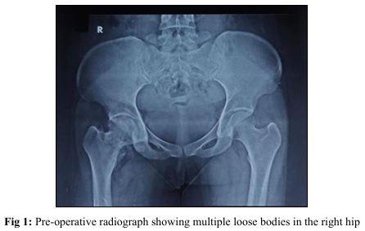

Slide 8
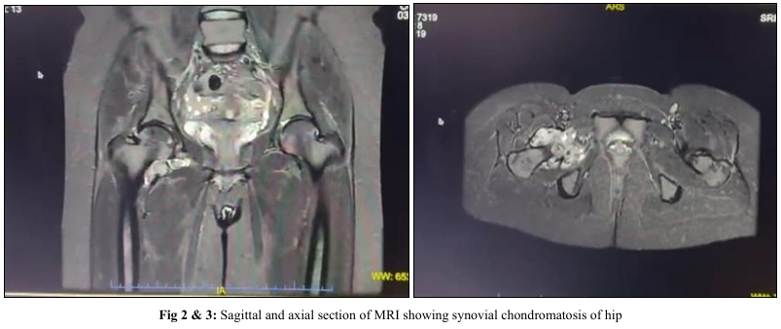

Slide 9
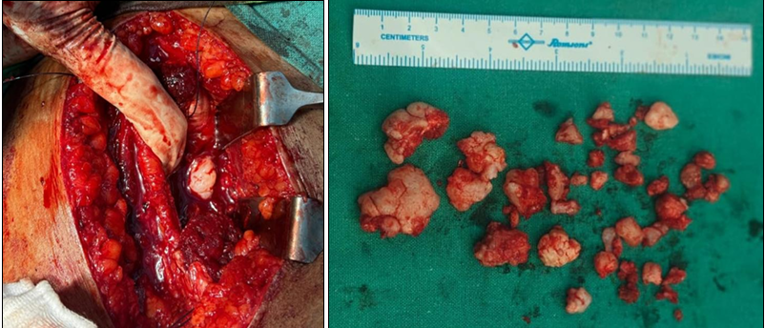

Slide 10
RESULTS
Post operative radiograph confirmed the removal of loose bodies (Fig 6).
Histopathological examination confirmed the diagnosis of synovial chondromatosis
Post operative HARRIS HIP SCORE was 78 at 1 month and 96 at 3 months follow-up.
No evidence of recurrence was noted.

Slide 11
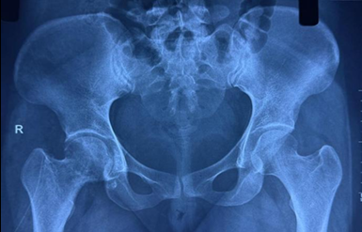

Slide 12
DISCUSSION
Management of the case depends upon the extent of symptoms like pain and restriction of movements whilst the definitive mode of treatment given in the literature was open arthrotomy and excision.
Arthroscopic synovectomy and removal of loose osteochondral fragments/loose bodies are effective and safe. However, there is a mean recurrence rate of 7.1%.
Total hip arthroplasty (THA) or joint reconstruction remains a cornerstone in the management of patients with extensive disease, recurrence after open or arthroscopic synovectomy, and in patients with underlying arthritis.

Slide 13
CONCLUSION
Primary synovial chondromatosis of hip is a rare condition characterised by pain and restriction of movements of hip.
Debridement and excision of loose bodies via arthrotomy through anterior approach can be choosen as an option for treatment if there are no changes of arthritis of the joint however long term follow-up is needed to check for any recurrences.

Slide 14
REFERENCES
1.K. Unni, C. Inwards, Dahlin’s Bone Tumours, 6th ed., Lippincott & Willliams, USA, 2020. p. 36–39.
2.Habusta SF, Tuck JA. Synovial chondromatosis. In: StatPearls [Internet]. Treasure Island (FL: StatPearls Publishing; 2022 May 8, 2022 Jane. PMID: 29262110.
3.Li Y, Zhou Y, Wang Y, Crawford R, Xiao Y. Synovial macrophages in cartilage destruction and regeneration-lessons learnt from osteoarthritis and synovial chondromatosis. Biomed Mater. 2021 Dec 9;(1):17.
4.Fang S, Li H, Wang Y, et al. Surgical hip dislocation for treatment of synovial chondromatosis of the hip. Int Orthop. 2021 Nov;45(11):2819e2824.
5.Gilbert SR, Lachiewicz PF. Primary synovial osteochondromatosis of the hip. Am J Orthoped. 1997 Aug;26(8):555e560

Slide 15
6.de Sa D, Horner NS, MacDonald A, et al. Arthroscopic surgery for synovial chondromatosis of the hip. Arthroscopy. 2014 Nov;30(11):1499e1504.
7.Schoeniger R, Naudie DD, Siebenrock KA, Trousdale RT, Ganz R. Clin Orthop Relat Res. 2006 Oct;451:195e200.
8.Prabowo Y, Saleh I, Pitarini A, Junaidi MA. Int J Surg Case Rep. 2020;74:289e295.
9.Iyengar KP, Mishra A, Vaish A, Kurisunkal V, Vaishya R, Botchu R. J Clin Orthop Trauma. 2022 Nov 13;35:102068.

Slide 16
THANK YOU

