Slide 1




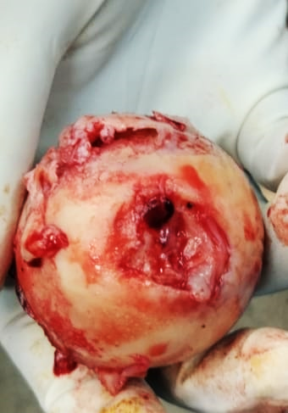
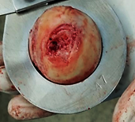
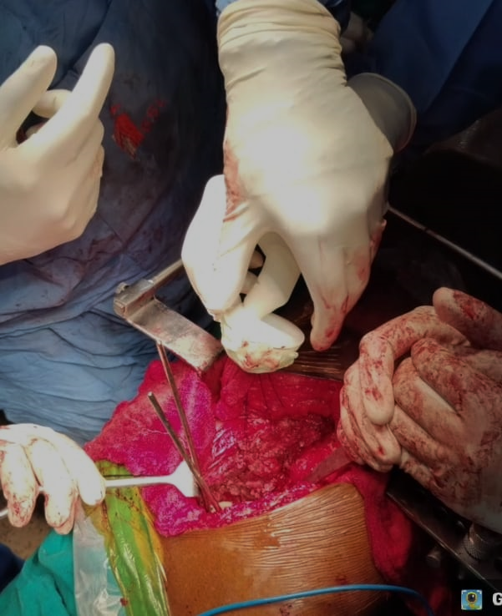
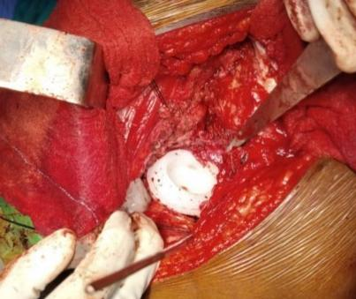
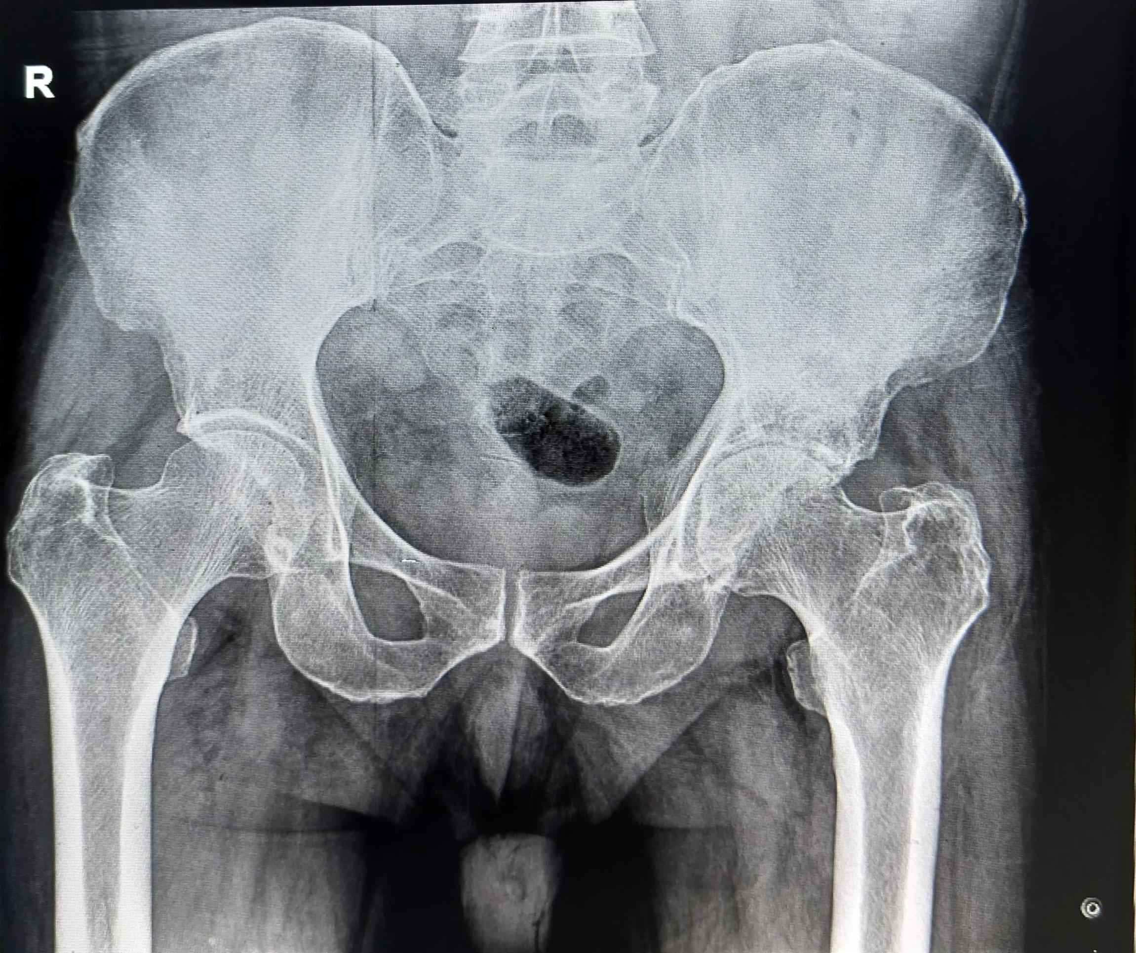
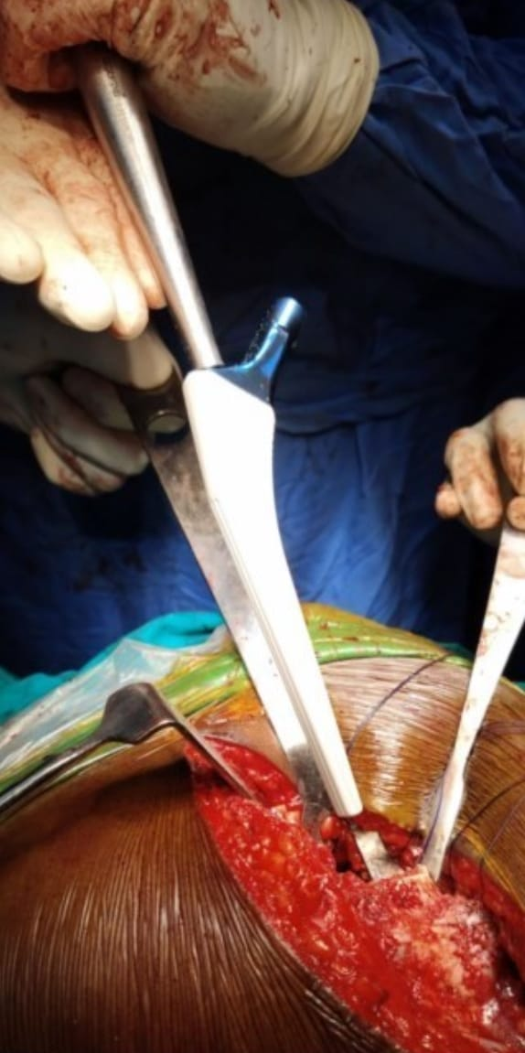
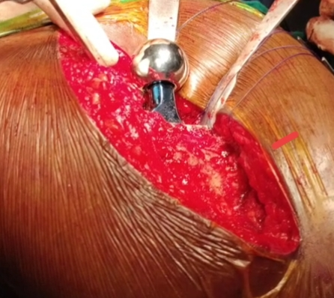
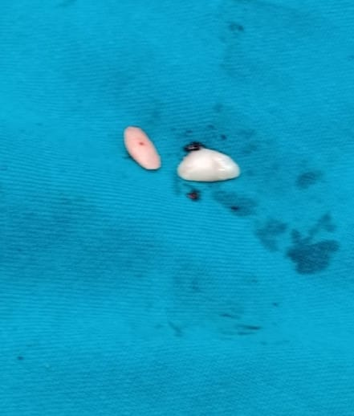
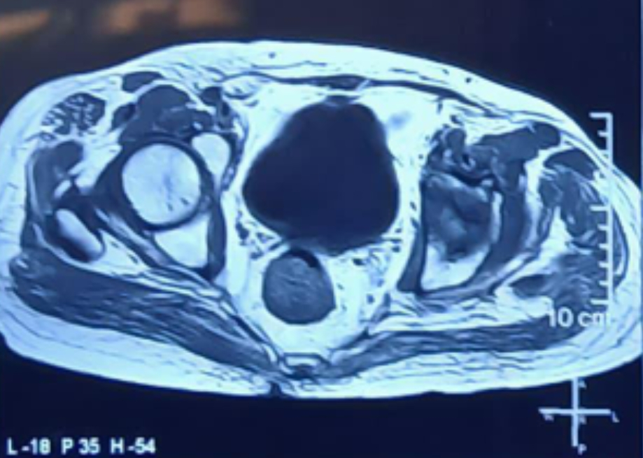
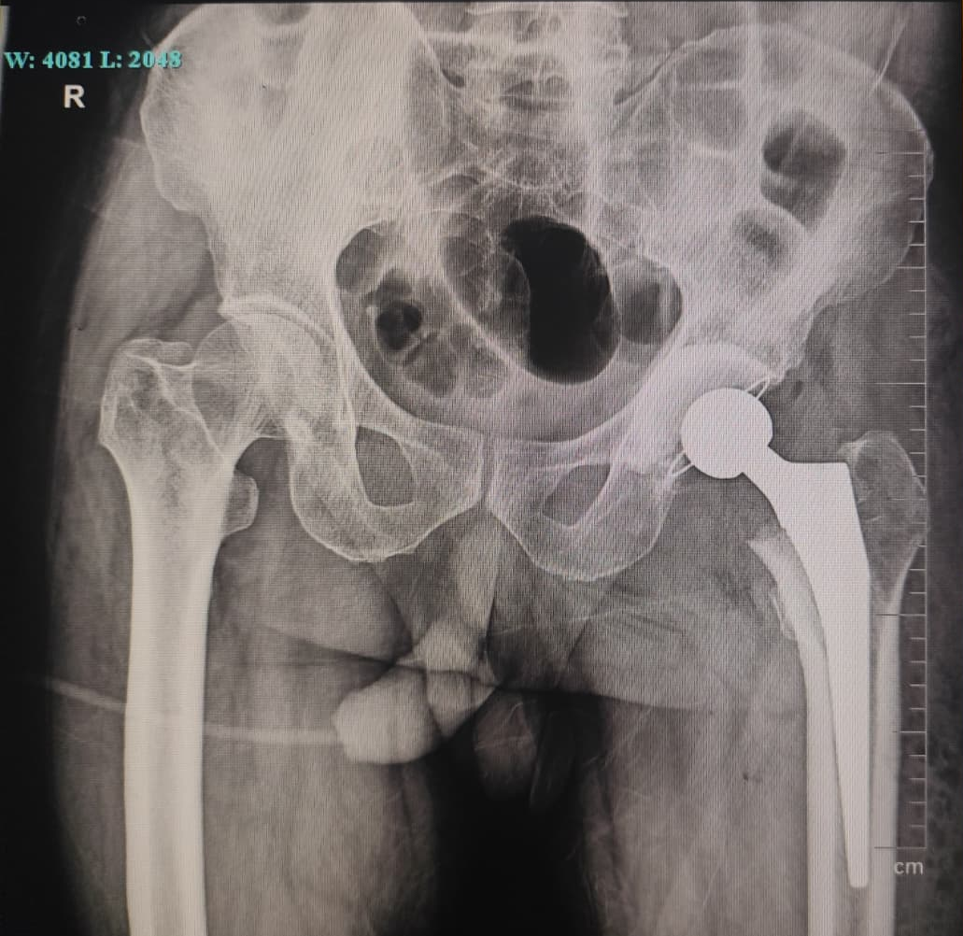
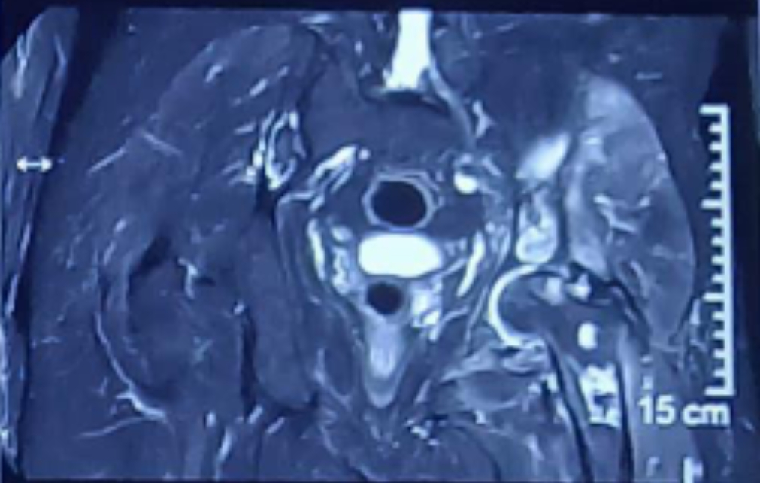
55th Annual Conference Of Orthopedic Surgeon Society Of Andhra Pradesh
A rare case of Non-Hodgkin’s Lymphoma of pelvis and hip treated with Reverse Hybrid Total Hip Arthroplasty
AUTHOR : Dr. M S S V KRISHNA SAI
CO-AUTHORS: Dr. R SATYA SRI TEJA, Dr. V NAGESWARA RAO
INTRODUCTION
OPERATIVE FINDINGS
DISCUSSION
Osteoarthritis of the hip may be primary (idiopathic) or secondary to identifiable causes such as avascular necrosis, hematological disorders, or malignancy, where bony infarcts compromise subchondral bone and accelerate degeneration.
Non-Hodgkin’s lymphoma can predispose to bony infarction through marrow infiltration, vascular compromise, or treatment-related ischemia, making secondary hip osteoarthritis exceedingly rare.
Total hip arthroplasty, particularly reverse hybrid fixation, is an effective treatment for end-stage disease in the setting of compromised bone quality.
METHOD:
Reverse hybrid total hip arthroplasty performed under regional anesthesia (combined spinal–epidural) using a posterior (Southern Moore) approach.
A 10–12 cm curvilinear posterior skin incision made, centered over the greater trochanter
Hip joint exposed; capsular adhesions identified and released
Intra-articular loose bodies removed
Femoral head noted to have osteophytes, addressed during preparation
Resected femoral head measuring 47 mm in diameter sent for histopathological examination
Acetabulum reconstructed with a cemented 50 mm acetabular cup using 40 g full-dose antibiotic-loaded (gentamicin) bone cement
A 32 mm (+1) femoral head and an uncemented 11 mm femoral stem implanted
Adequate stability and restoration of limb length achieved
Wound closed in layers
Immediate postoperative period uneventful
Standard postoperative rehabilitation protocol initiated
Secondary osteoarthritis of the hip due to NHL-related bony infarcts is uncommon.
Lymphomatous marrow infiltration, treatment-related vascular compromise, and post-radiotherapy ischemic injury can lead to bony infarction, causing subchondral collapse and rapid degeneration.
MRI is crucial for detecting lymphomatous deposits and infarct patterns, particularly when HPE confirms osteonecrosis.
Total hip arthroplasty (THA) is the standard treatment for end-stage disease.
Reverse hybrid THA offers stable fixation in compromised bone.
RESULTS
Clinical Course: Uneventful postoperative recovery with primary wound healing.
Intravenous zoledronic acid was administered to reduce bone resorption and provide pain relief.
Follow-Up: Assessed at 1 week, 1, 3, and 6 months; patient achieved independent ambulation and able to do his daily activities starting from 3rd month
The Harris Hip Score improved from 45 preoperatively to 82 at 6 months.
Histopathology: Microscopic examination of the resected head confirmed necrotic, non-viable lytic bone (Osteonecrosis).
CASE REPORT
Case Presentation
A 64-year-old man with diffuse large B-cell lymphoma, previously treated with six cycles of R-CHOP chemotherapy and palliative radiotherapy to the left hip 6 months ago, and currently on maintenance lenalidomide (12th cycle), presented with a three-month history of progressive left hip pain and limp. There is no history of trauma.
Clinical Examination
The patient had an antalgic gait with fixed flexion deformity(20°), true limb shortening (1cm), and painful global restriction of left hip range of motion.
Head of femur (resected) osteophytes were noted
Implanting Cemented Acetabular Cup
TAKE HOME MESSAGE
PRE-OP IMAGING
Suspect: Bony infarction in lymphoma patients with persistent hip pain.
Detect: Use MRI to identify early infarcts missed by plain radiographs.
Treat: Reverse Hybrid THA effectively manages end-stage disease in compromised bone.
Plain radiograph of pelvis with both hips(AP VIEW):
Tönnis Grade 3 end-stage Osteoarthritis of Left hip with severe narrowing of joint space and subchondral sclerosis.
Uncemented femoral stem implant
Femoral Head implant
Intra-op tissue sample sent for biopsy
CONCLUSION
Secondary OA from NHL-related infarcts is a challenge involving compromised bone stock and clinically very rare entity.
Reverse Hybrid THA is an effective salvage strategy, offering optimal balance of cemented acetabular stability and biological femoral fixation, ensuring excellent functional recovery
MRI PELVIS WITH BOTH HIPS:
Advanced degenerative changes of the left hip.
Extensive bony infarcts with serpiginous medullary signal abnormalities involving the left femoral head and neck, proximal femur, iliac blades, and acetabulum.
Deposits likely Lymphomatous noted in the left iliac blade, left femoral head and neck.
POST-OP IMAGING
REFERENCES
Postoperative plain radiograph of the pelvis with both hips (AP view) shows left reverse hybrid total hip arthroplasty, with a cemented acetabular component and uncemented femoral stem, in satisfactory alignment, with no evidence of periprosthetic fracture, dislocation, or loosening.
Vadivelu R, Kar N, Margetts MJ, Abdul-Cader AH. Non-Hodgkin’s lymphoma as an unexpected diagnosis in hip arthroplasty. Arch Orthop Trauma Surg. 2002;122:532-4.
Jain S, Magra M, Dube B, et al. Reverse hybrid total hip arthroplasty. Bone Joint J. 2018;100-B:1010-7.
ACKNOWLEDGEMENT
I sincerely thank Dr. R. Satya Sri Teja, Associate Professor and Dr. V. Nageswara Rao, Head of the Department of Orthopaedics, along with the faculty of Orthopaedics and the Department of Radiology, GSL Medical College & General Hospital, for their guidance and support.

