Slide 1
COMPARATIVE STUDY OF CONSERVATIVE MANAGEMENT VERSUS ANATOMICAL LOCKING PLATE FIXATION IN MIDSHAFT CLAVICLE FRACTURES
Author : Dr. MAKAM JAGADEESH BABU Postgraduate Dept. of Ortho GMC-KADAPA
Co-Author: Dr. K.B.VIJAYA MOHAN REDDY Prof & HOD, Dept. Of Ortho GMC-KADAPA
Co-Author: Dr. GUDE JAYARAM Associate Professor Dept. of Ortho GMC-KADAPA
Co-Author: Dr. M. Chatrapathi Hanuman Assistant Professor, Dept. of Ortho GMC-KADAPA

Slide 2
INTRODUCTION
Clavicle fractures are common injuries of the shoulder girdle, with midshaft fractures accounting for approximately 70–80% of all clavicle fractures.
Although conservative management has traditionally been the standard treatment, displaced midshaft clavicle fractures are associated with higher rates of malunion and delayed union.
Surgical fixation using anatomical locking plates provides stable fixation and facilitates early mobilization.
AIM : THIS STUDY COMPARES THE FUNCTIONAL AND RADIOLOGICAL OUTCOMES OF CONSERVATIVE MANAGEMENT AND ANATOMICAL LOCKING PLATE FIXATION IN ADULT MIDSHAFT CLAVICLE FRACTURES.

Slide 3
METHOD OF STUDY
A total of 40 adult patients with closed midshaft clavicle fractures were included in the study and divided into two groups:
Group A (n = 20): Managed conservatively using an arm sling or figure-of-eight bandage
Group B (n = 20): Treated surgically with open reduction and internal fixation using an anatomical locking plate
Patients were followed up clinically and radiologically every 4weeks .
Fracture union,
Complications,
Time to return to daily activities were documented.
Functional outcomes were assessed using the Constant–Murley score and DASH score.

Slide 4
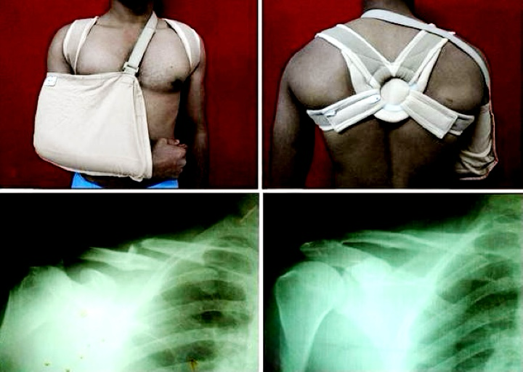
Operative Technique – Group A (20 Patients)
Treatment was carried out using an arm sling or figure-of-eight bandage.
Immobilization was continued for pain relief, followed by gradual mobilization.
Pendulum exercises and shoulder range-of-motion exercises were initiated once pain permitted.
Patients were followed up regularly for clinical and radiological assessment of fracture healing.

Slide 5
Operative Technique – Group B (20 Patients)
Anesthesia : General / Reginal
The patient was positioned supine with a sandbag beneath the ipsilateral scapula.
An incision was made over the superior aspect of the clavicle centered over the fracture site.
Fracture fragments were anatomically reduced and fixed using Clavicle plate placed on the superior surface.
Adequate screw fixation was achieved on either side of the fracture.
Wound closure was done in layers and the limb supported in a sling postoperatively.

Slide 6
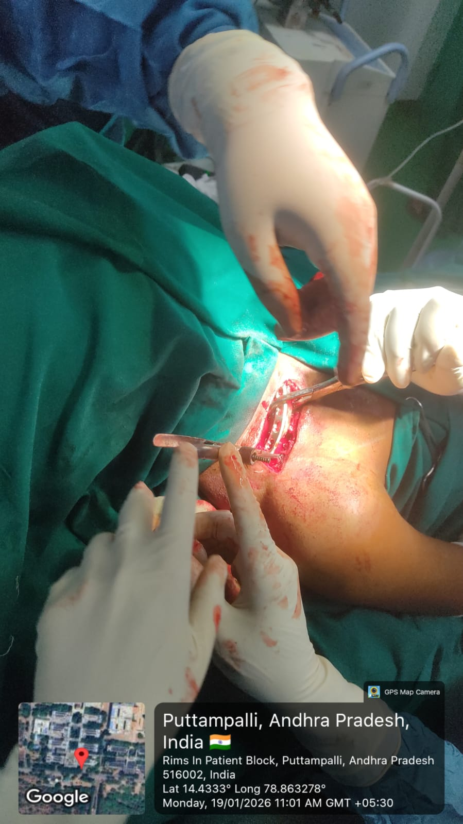
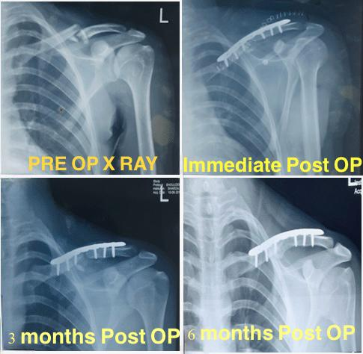
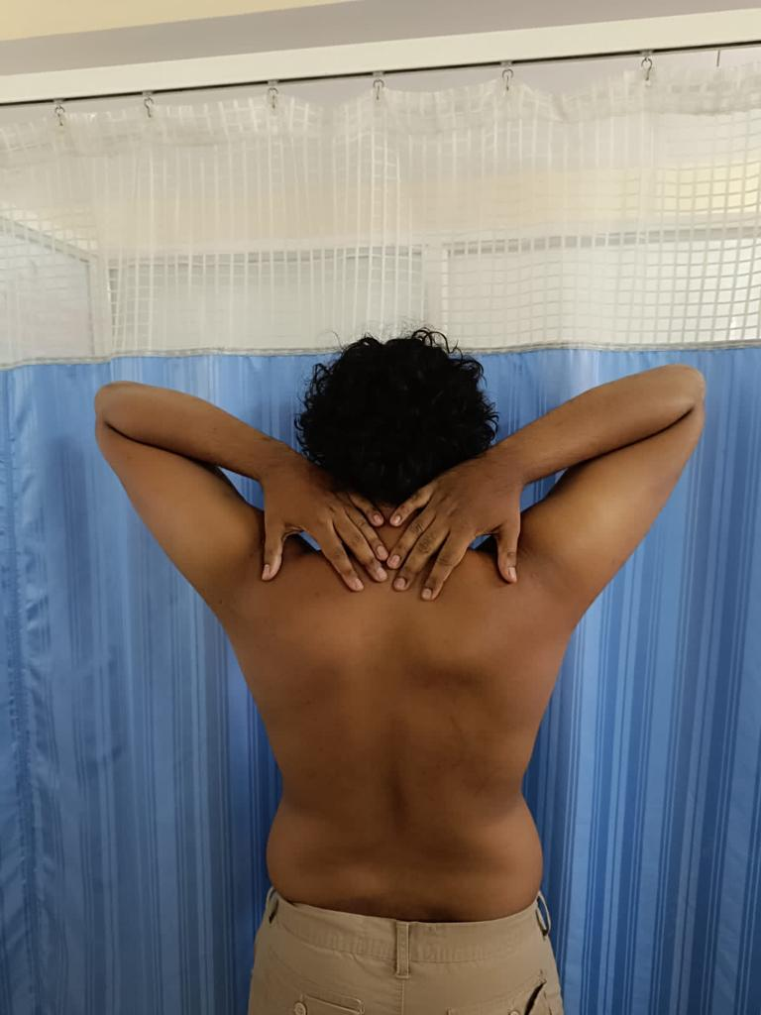
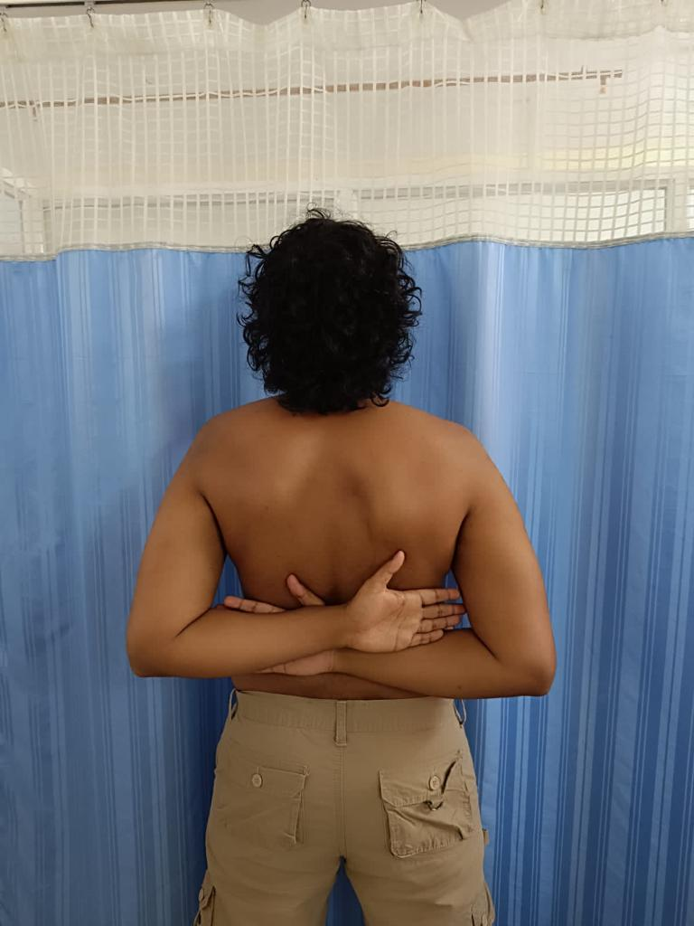

Slide 7
PARAMETER | Group A (Conservative) | Group B (Plate Fixation)
Treatment method | Arm sling / Figure-of-eight bandage | ORIF with anatomical locking plate
Time to union | 16.6 week for union | 6.4 weeks for union
Functional outcome | Acceptable in undisplaced fractures | Better early functional recovery
Malunion | More common (2/20) | Rare
Nonunion | Low (1/20) | Nil
Delayed union | More frequent (4/20) | Rare (1/20)
Complications | Malunion, cosmetic deformity | Infection, implant irritation
Return to work | Delayed (12-18wks) | Earlier (8wks)
Cosmetic | No scar | Hypertrophic scar (2/20)
Infection | Nil | Superficial (1/20)
Patient satisfaction | Moderate | Higher

Slide 8
PARAMETER | Group A (Conservative) | Group B (Plate Fixation)
Mean DASH score | 24 ± 5 | 10 ± 4
< 10 (Excellent) | 4 (20%) | 14 (70%)
10–30 (Good) | 10 (50%) | 6 (30%)
> 30 (Poor) | 6 (30%) | 0
Mean Murley score | 78 ± 6 | 90 ± 5
Excellent | 6 (30%) | 12 (60%)
Good | 8 (40%) | 6 (30%)
Fair | 4 (20%) | 2 (10%)
Poor | 2 (10%) | 0

