Slide 1

Annual Conference of
₅₅th
Orthopedic Surgeon Society of Andhra Pradesh
Date 20 -22 February, 2026, Venue : Kurnool Medical College
Organized by : Department of Orthopaedics, Kurnool Medical College Kurnool
FUNCTIONAL OUTCOME OF INTRA- ARTICULAR AND COMMUNITED DISTAL RADIUS FRACTURES TREATED BY LIGAMENTOTAXIS
.
AUTHOR : Dr.REDDY THOTA LIKHITHA, POST GRADUATE
CO -AUTHOR : Dr K B VIJAY MOHAN REDDY, PROFESSOR AND HOD,
Dr.U. RAMA MANOHAR, ASSOCIATE PROFESOR,
Dr.L.ANAND, ASSISTANT PROFESSOR
GOVERNMENT MEDICAL COLLEGE,
KADAPA
.

Slide 2
₅₅th
Annual Conference of
Orthopedic Surgeon Society of Andhra Pradesh
Date 20 -22 February,2026, Venue : Kurnool Medical College
Organized by : Department of Orthopaedics, Kurnool Medical College Kurnool
INTRODUCTION
Fracture of Distal end Radius are most common fracture of upper limb constituting 75% of all forearm fractures and 17% of all fractures.
This Fractures shows Bimodal age distribution in children and elderly.
Osteoporosis and Fall on outstretched hand are the major risk factors.
Decreased Cortical bone and Increase in weak Cancellous bone at Metaphyseal area is the predisposing factor for Distal end Radius fracture .
In active and independent individual,Distal end Radius fracture is early manifestation of osteoporosis which predicts hip fracture later years.

Slide 3
₅₅th
Annual Conference of
Orthopedic Surgeon Society of Andhra Pradesh
Date 20-22 February,2026, Venue : Kurnool Medical College
Organized by : Department of Orthopaedics, Kurnool Medical College Kurnool
AIM
To study the Functional Outcome and duration for union in Intra-articular Distal Radius fracture treated with External fixator using Ligamentotaxis.
Restoration of range of movements and grip strength while doing normal daily activities .
Decrease the chances of post traumatic arthritis.
METHODS :
Prospective study
Duration: June 2024 – October 2025.
Sample size: 100 patients.
Included Intra-Articular and Comminuted Distal Radius fractures.
Treatment: External fixation based on Ligamentotaxis.
Standardized postoperative rehabilitation protocol.
Functional assessment using Gartland and Werley scoring system.

Slide 4
₅₅th
Annual Conference of
Orthopedic Surgeon Society of Andhra Pradesh
Date 20-22 February,2026, Venue : Kurnool Medical College
Organized by : Department of Orthopaedics, Kurnool Medical College Kurnool
RESULTS
Majority of patients: 41–60 years
Male predominance
Mode of injury:
• Road traffic accidents – 66%
• Self-fall in elderly patients
Fracture union achieved within 6–8 weeks in most cases
Complications:
• Pin tract infection – 12%
• Wrist stiffness – 5%
Functional outcome :
• 78% – Excellent to Good
• 14% – Fair
• 8% – Poor

Slide 5
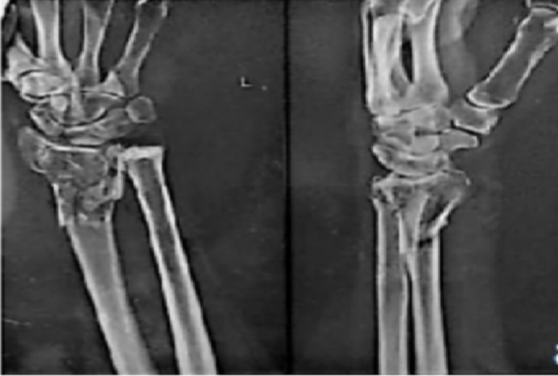
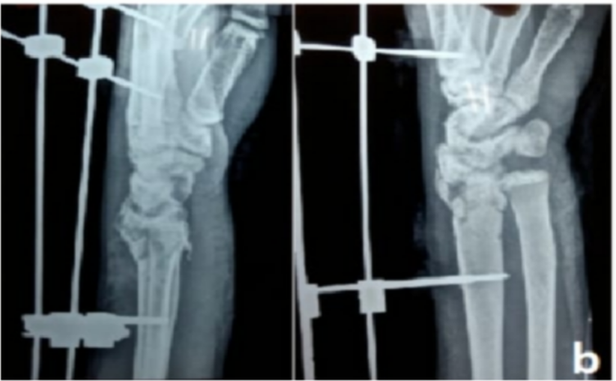
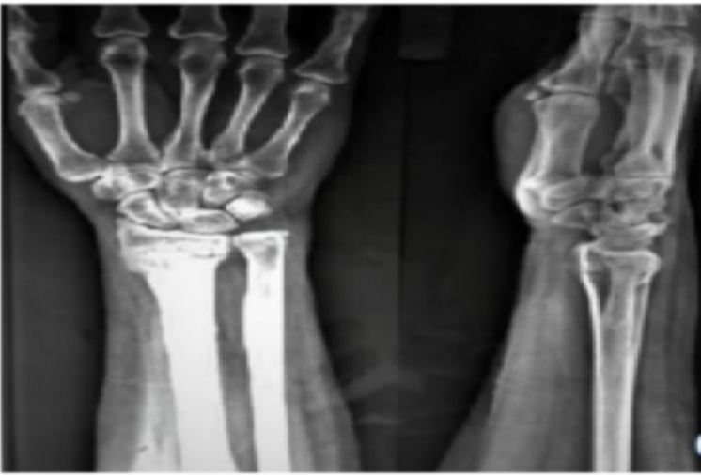
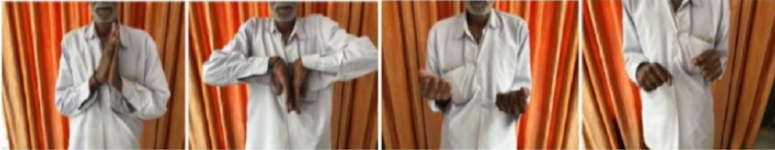
₅₅th
Annual Conference of
Orthopedic Surgeon Society of Andhra Pradesh
Date 20 -22 February,2026, Venue : Kurnool Medical College
Organized by : Department of Orthopaedics, Kurnool Medical College Kurnool
PRE -OP X RAY. POST -OP X RAY
FOLLOW UP X RAY
•
RANGE OF MOVEMENTS

Slide 6
₅₅th
Annual Conference of
Orthopedic Surgeon Society of Andhra Pradesh
Date 20 -22 February,2026, Venue : Kurnool Medical College
Organized by : Department of Orthopaedics, Kurnool Medical College Kurnool
CONCLUSION
Ligamentotaxis enables indirect reduction of articular fragments
Maintains soft tissue integrity and fracture biology
Particularly useful in comminuted and open fractures
Complications were minor, predictable, and manageable
Functional outcome correlated more with soft tissue injury than minor residual deformity
External fixation using Ligamentotaxis provides satisfactory anatomical and functional outcomes
Facilitates Early Mobilisation and reduces joint stiffness
Allows effective soft tissue and wound management
Cost-effective, reproducible, and suitable for high-volume centers
Remains a valuable treatment option in comminuted intra-articular distal radius fractures

Slide 7
₅₅th
Annual Conference of
Orthopedic Surgeon Society of Andhra Pradesh
Date 20-22 February,2026, Venue : Kurnool Medical College
Organized by : Department of Orthopaedics, Kurnool Medical College Kurnool
REFERENCES :
Margaret McQueen M, Rockwood CA. Fractures of the distal radius and ulna. Chapter-32, In: Rockwood CA, Matsen FA, Wirth MA, Lippitt SB, editors, Upper Extremity. 3rd edition Philadelphia: Saunders, 2004, 455-519.
Vogt MT, Cauley JA, Tomaino MM, Stone K, Williams JR, Herndon JH. Distal radius fractures in older women: A 10-year follow-up study of descriptive characteristics and risk factors. The study of osteoporotic fractures. J Am Geriatr Soc. 2002; 50(1):97-103.
BengnérU,Johnell 0. Increasing incidence of forearm fractures. A comparison of epidemiologic patterns 25 years apart. Acta Orthop Scand. 1985; 56:158-60.

Slide 8
₅₅th
Annual Conference of
Orthopedic Surgeon Society of Andhra Pradesh
Date 20 -22 February,2026, Venue : Kurnool Medical College
Organized by : Department of Orthopaedics, Kurnool Medical College Kurnool
THANK YOU

