Slide 1


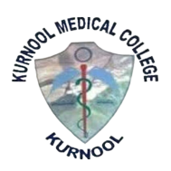
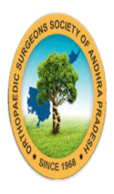
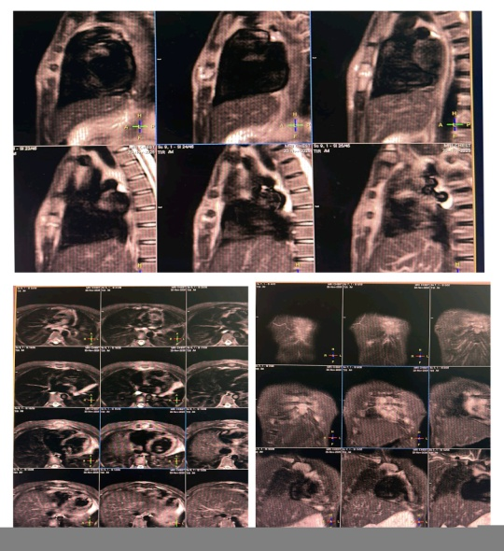
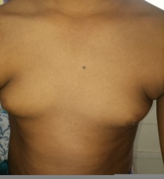
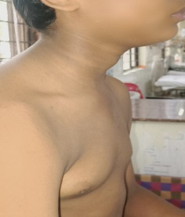
PRIMARY STERNAL OSTEOMYELITIS IN A CHILD A RARE ORTHOPAEDIC ENTITY
AUTHOR : Dr. REDDYTHOTA LIKHITHA , POST GRADUATE ,
CO-AUTHOR: Dr. K B VIJAY MOHAN REDDY , PROFESSOR AND HOD ,
Dr. U. RAMA MANOHAR, ASSOCIATE PROFESSOR ,
Dr. D.NAGESWARA REDDY, ASSISTANT PROFESSOR
GOVERNMENT MEDICAL COLLEGE , KADAPA .
.
OSSAPCON ID -139
INTRODUCTION
OPERATIVE FINDINGS
DISCUSSION
Examination showed ill-defined, Erythematous, firm, tender swelling (≈2 cm) over the body of sternum ,Fixed to underlying bone.
Laboratory findings, Elevated WBC count, ESR, and CRP. Imaging -X-ray chest -Normal. HRCT- Cortical erosions and bony destruction of sternal body with adjacent Myositis and Chondritis.
MRI- Ill-defined Lytic lesion with tiny sinus tract extending into subcutaneous plane. FNAC- Acute inflammatory infiltrate; sterile culture .Management: Intravenous antibiotics
Primary Sternal Osteomyelitis (PSO) is an exceptionally rare condition in children, accounting for <1% of paediatric Osteomyelitis.
Clinical presentation is often non-specific, leading to delayed diagnosis and inappropriate initial treatment. PSO is termed primary when there is no adjacent focus of infection such as thoracic surgery, chest trauma, CPR, or vascular catheterization. Early recognition is crucial to prevent serious complications including Mediastinitis, Chronic osteomyelitis, and chest wall instability.
Primary sternal osteomyelitis (PSO) is extremely rare in children, accounting for <1% of paediatric osteomyelitis.
• Absence of preceding trauma or surgery and non-specific symptoms often result in delayed diagnosis.
• Pre sternal chest pain worsening in the supine position may serve as an important early clinical clue. Initial plain radiographs are frequently normal, making early diagnosis challenging.
• MRI is the imaging modality of choice, accurately detecting early marrow involvement, cortical destruction, and soft-tissue extension.
• Prompt initiation of appropriate antibiotic therapy leads to excellent outcomes.Delayed treatment can result in Mediastinitis,Chronic osteomyelitis, and chest wall deformity.
CASE REPORT
A male child presented with symptoms of High-grade continuous fever for 20 days. Anterior chest pain for 15 days, worsening on supine and relieved on sitting up position.
CONCLUSION
This rare case underscores that early clinical suspicion ,timely imaging and prompt surgical debridement with targeted antibiotic therapy are pivotal in achieving excellent outcomes in paediatric Primary Sternal Osteomyelitis .

