Slide 1




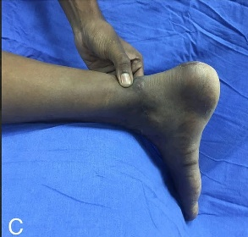
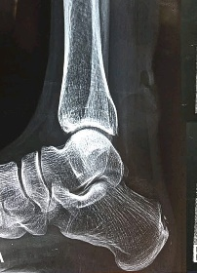
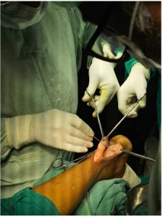
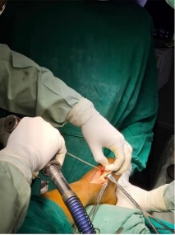
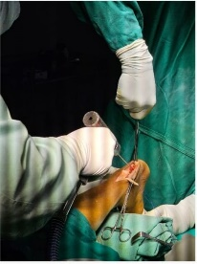
CHRONIC TENDOACHILLES TENDON TEAR TREATED WITH FHL TENDON AUGUMENTATION WITH INTERFERENCE SCREW FIXATION
AUTHOR : DR.M.PRIYADARSINI PG , CO-AUTHOOR : DR.CH.V. MURALI KRISHNA MS ORTHO (PROFESSOR )
Investigations:mri showing:chronic rupture with retracted ends ,calcification, attenuation of tendon fiers
Approach:posterior approach
Signifiant tendon gap is identified,with poor tendon quality and surrounding scar tissue is excised , gap is measured using sterile scale,
Fhl tendon harvested and transferred
Tendon passed through calaneal tunnel and fixed with interference screw
DEPARTMENT O ORTHOPEDICS, ANDHRA MEDICAL COLLEGE , KING GEORGE HOSPITAL VISAKHAPATNAM
Tendo Achilles is the most commonly ruptured tendon in the lower limb.
Chronic tendoachilles tears are challenging due to delayed presentation and poor tissue quality
flexor hallucis longus tendon also a plantar flexor acting in the same phase of gait cycle as Achilles tendon advantages with fhl augumentation with interference screw fixation : strong initial fixation , biological and mechanical reinforcement ,allows early rehabilitation
INTRODUCTION
OPERATIVE FINDINGS
DISCUSSION
Chronic tendoachilles ruptures are injuries which presented >4-6 weeks after injury.
delay in presentation leads to tendon retraction,degeneration,
and gap formation primary end to end suturing not possible flexor hallucis longus augmentation provides dynamic plantar flexion strength
CONCLUSION
CASE REPORT
HISTORY: 55 yr male presented with chronic rt heel pain,limp f/b trauma
C/F: palpable gap over tendoachilles,
positive Thompson test,
weak plantarlexion
Flexor halluccis longus augumentation using intereferene screw fixation is safe and reliable technique for chronic tendoachilles tear
It restores plantar flexion strength and provides good functional recovery

