Slide 1




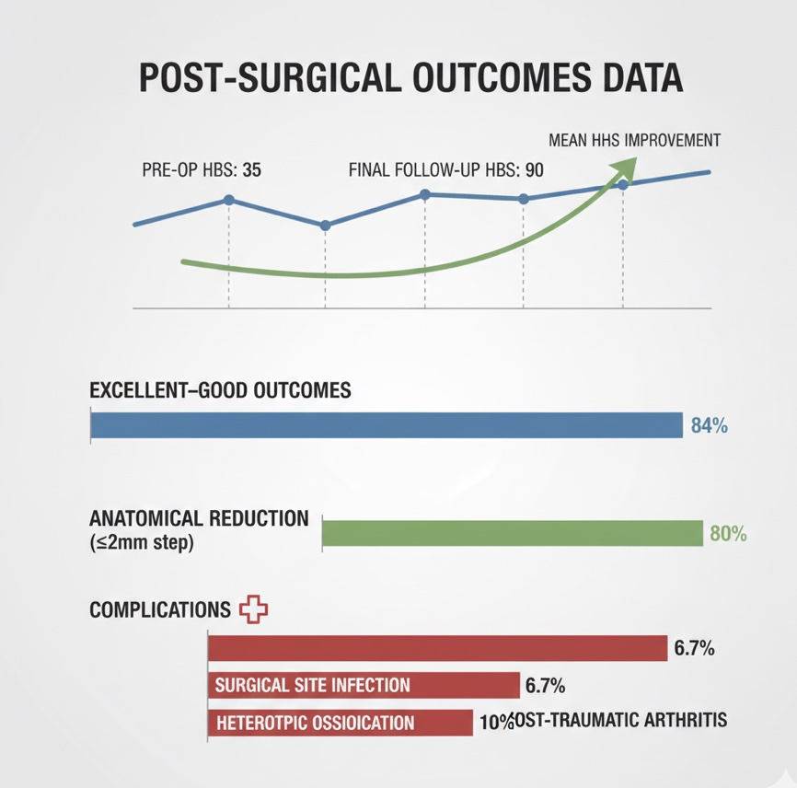
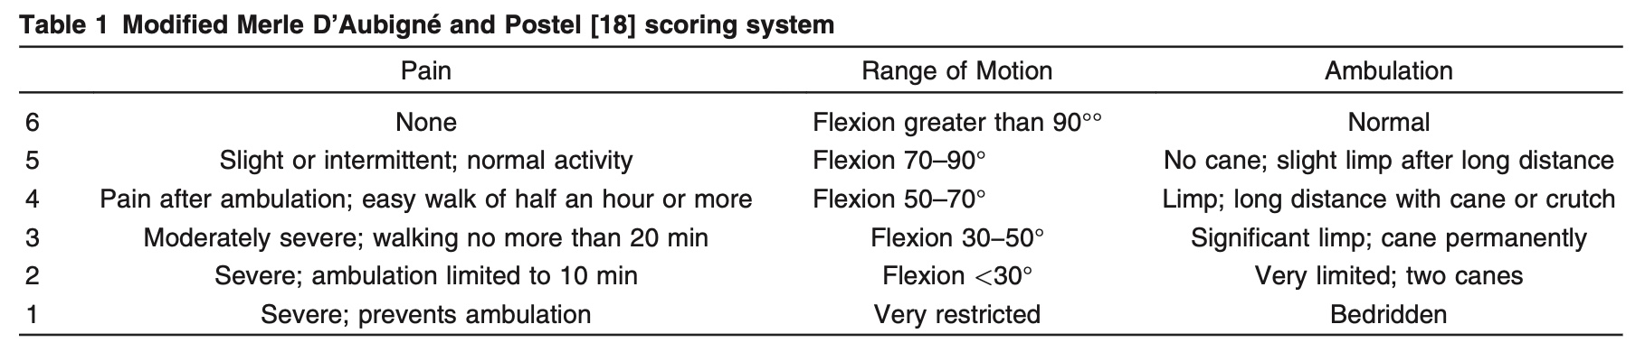
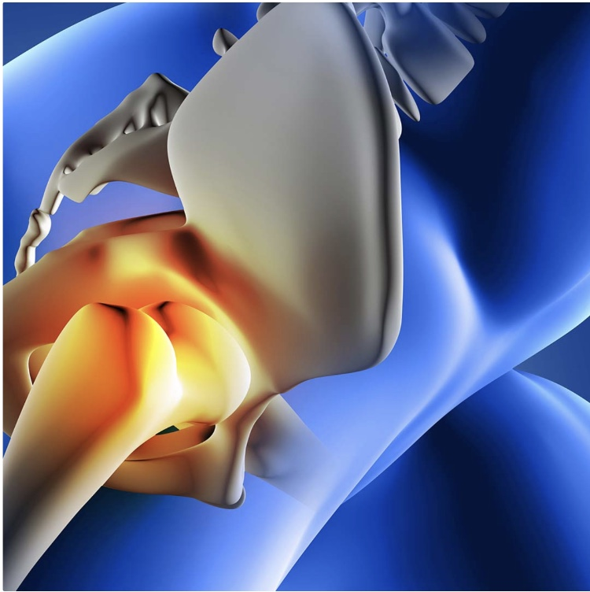
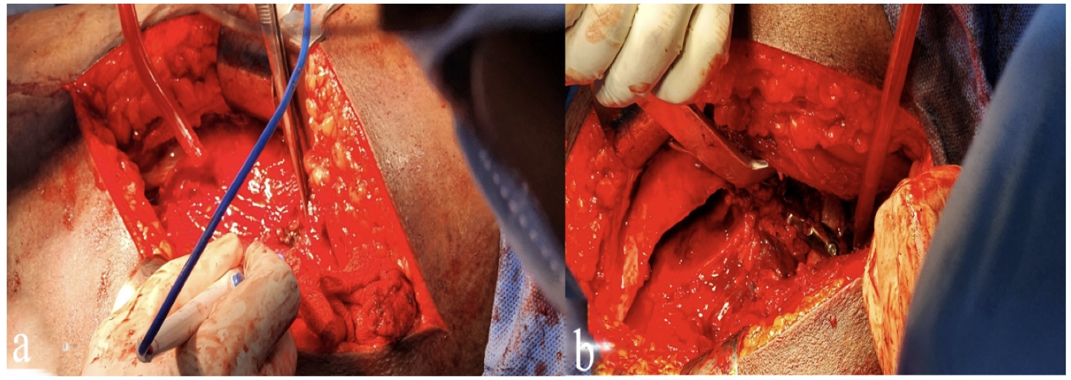
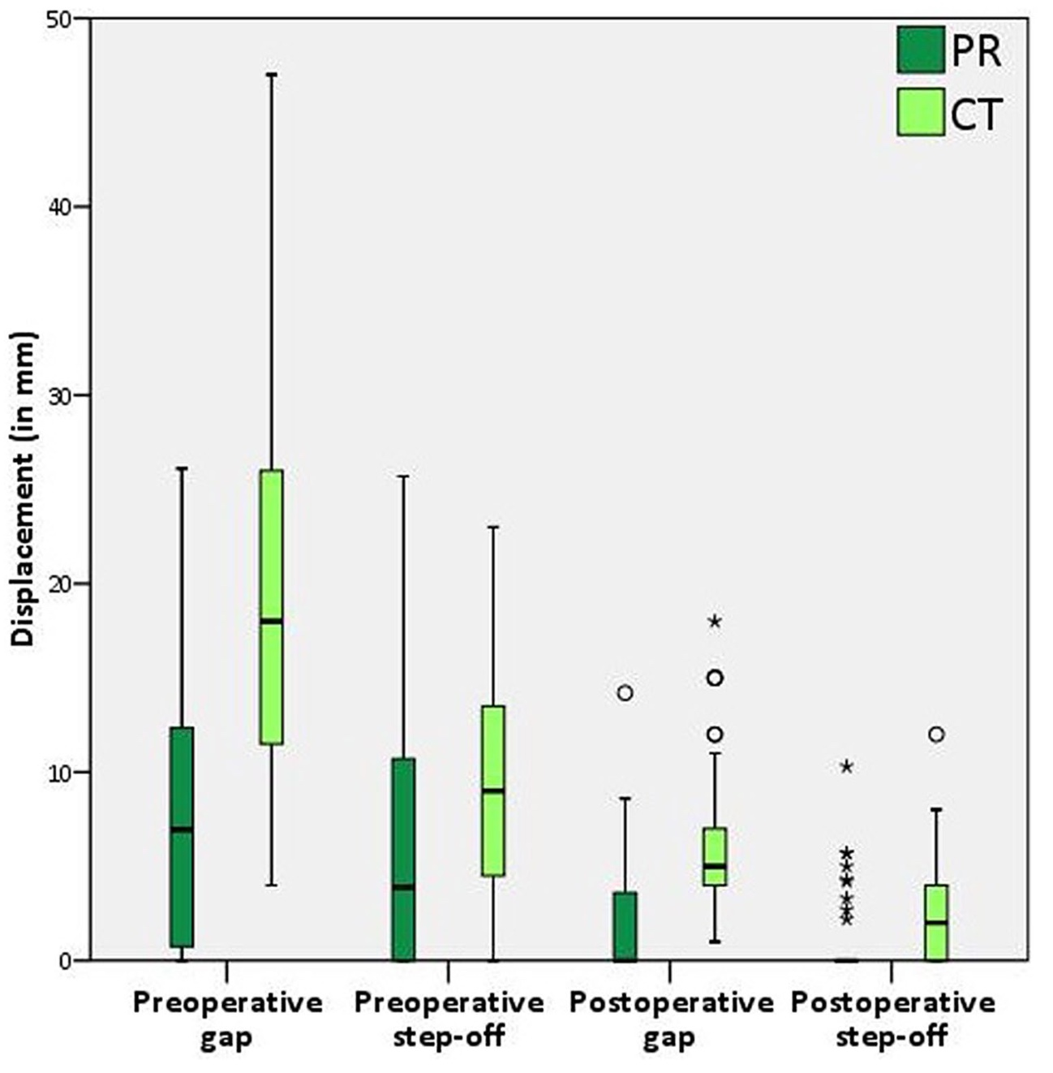
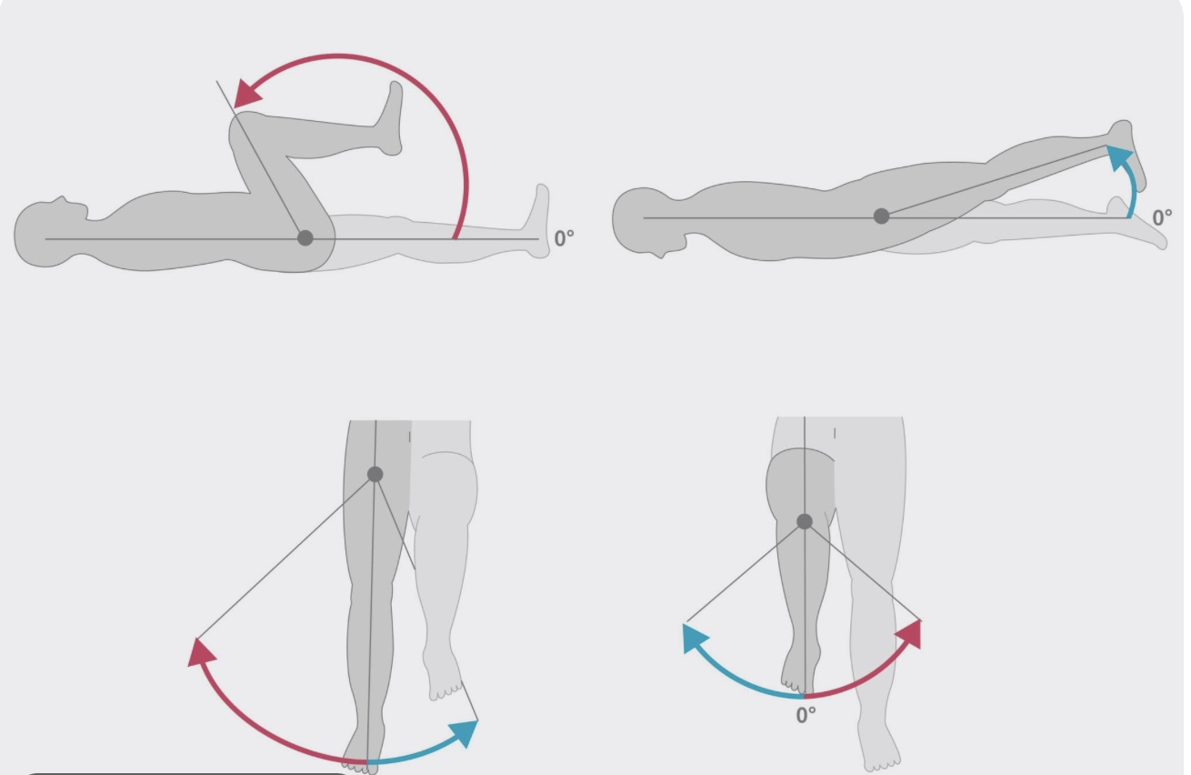
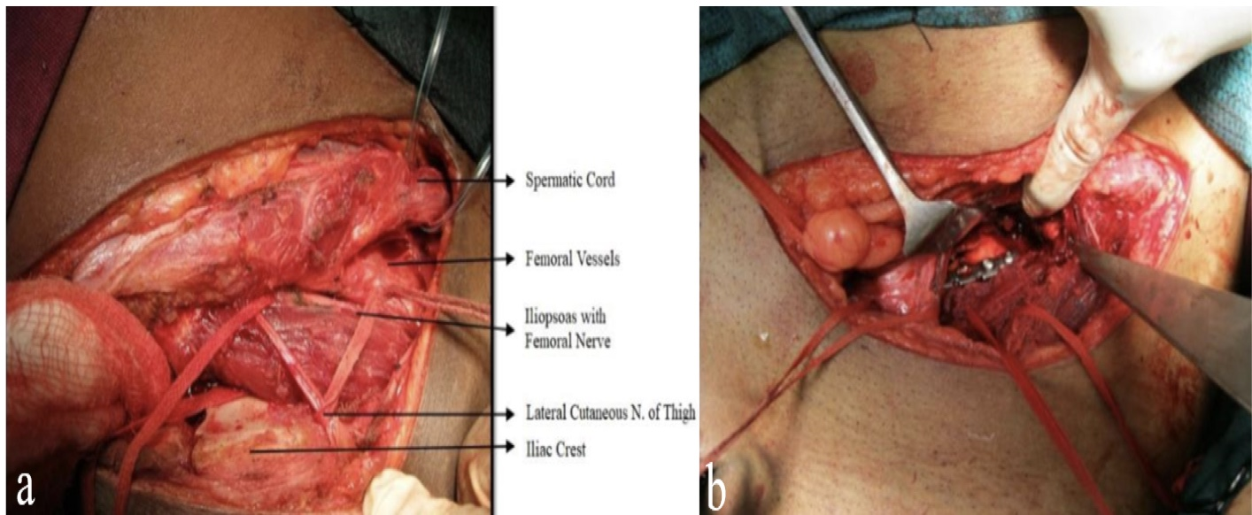
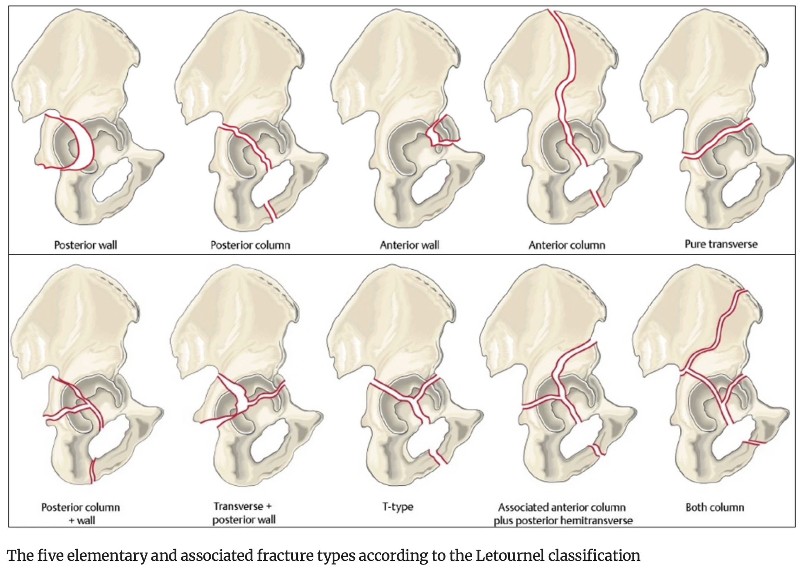
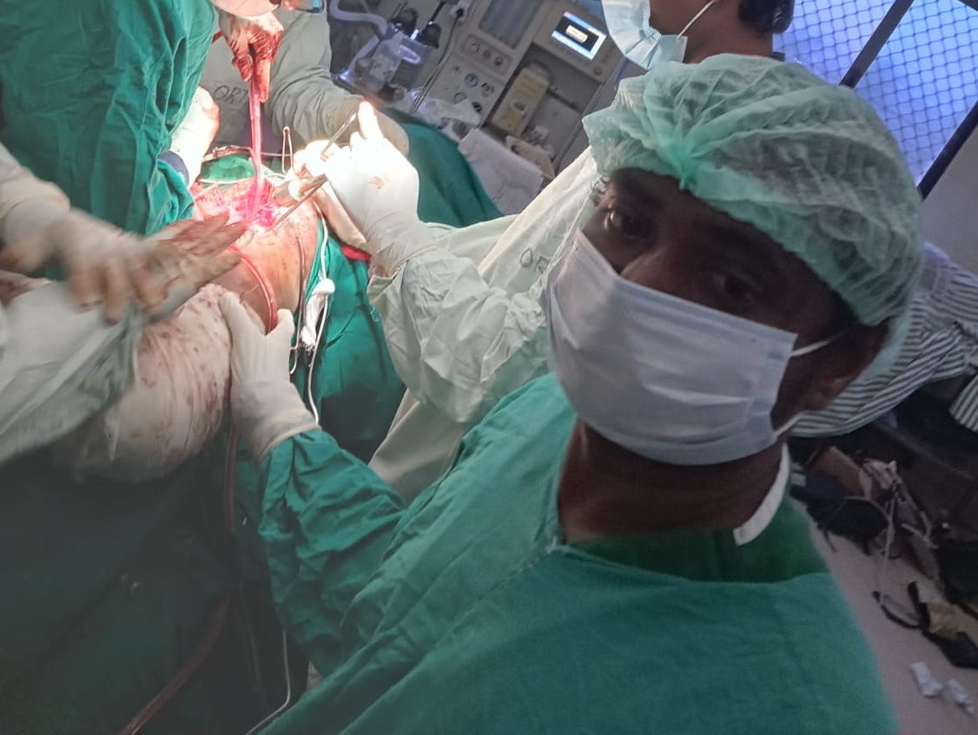
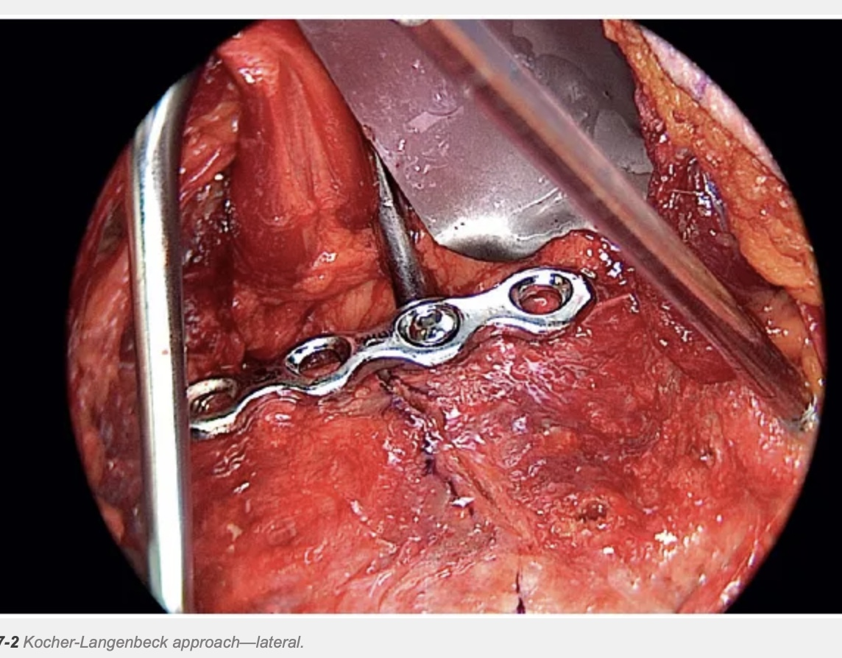
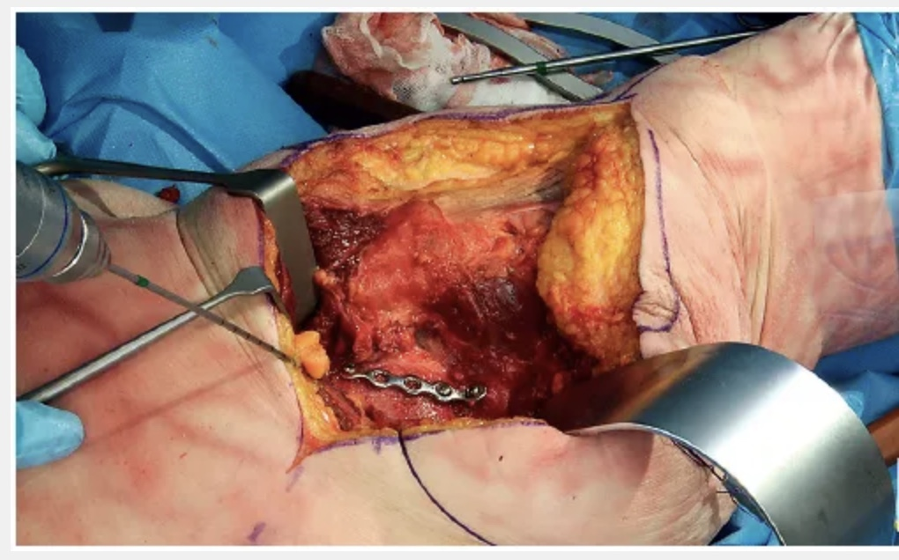
FUNCTIONAL OUTCOME OF SURGICAL MANAGEMENT OF DISPLACED ACETABULAR FRACTURES:A PROSPECTIVE STUDY
AUTHOR:DR V KRISHNA RAO FINAL YEAR POST GRADUATE
CO-AUTHOR:PROF.DR B PARDHA SARADHI;ASSISTANT PROF. DR S RAMESH CHANDRA
OSSAP ID 143
INTRODUCTION
OPERATIVE FINDINGS
DISCUSSION
  ACETABULAR FRACTURES ARE COMPLEX ARTICULAR INJURIES THAT REPRESENT A SIGNIFICANT CHALLENGE TO ORTHOPAEDIC SURGEONS. THEY TYPICALLY OCCUR IN YOUNG INDIVIDUALS DUE TO HIGH ENERGY TRAUMA.
  KEY CHALLENGES :
  DEEP ANATOMICAL LOCATION
  COMPLEX 3-DIMENSIONAL GEOMETRY
PROCEDURE:OPEN REDUCTION AND
INTERNAL FIXATION WITH RECON PLATES
AND SCREWS
FOLLOW-UP:MINIMUM 12 MONTHS
ASSESSMENT TOOL:HARRIS HIP SCORE
MODIFIED MERLE D'AUBIGNÉ AND POSTEL [18] SCORING SYSTEM
RADIOLOGICAL EVALUATION:MATTAS CRITERIA
SURGICAL APPROACH:
KOCHER-LANGENBECK APPROACH
METHODS
STUDY DESIGN:PROSPECTIVE STUDY
SAMPLE SIZE:30 PATIENTS
FRACTURE CLASSIFICATION:
JUDET -LETOURNAL
CONCLUSION
OPERATIVE FIXATION OF DISPLACED ACETABULAR FRACTURES YIELDS
FAVOURABLE FUNCTIONAL OUTCOMES WHEN ANATOMICAL REDUCTION
IS ACHIEVED AND STABLE FIXATION IS MAINTAINED.
ANTERIOR APPROACH
MODIFIED STOPPA
KEY MESSAGE
QUALITY OF ARTICULAR REDUCTION IS THE STRONGEST PREDICTOR OF
FUNCTIONAL OUTCOME IN ACETABULAR FRACTURES

