Slide 1




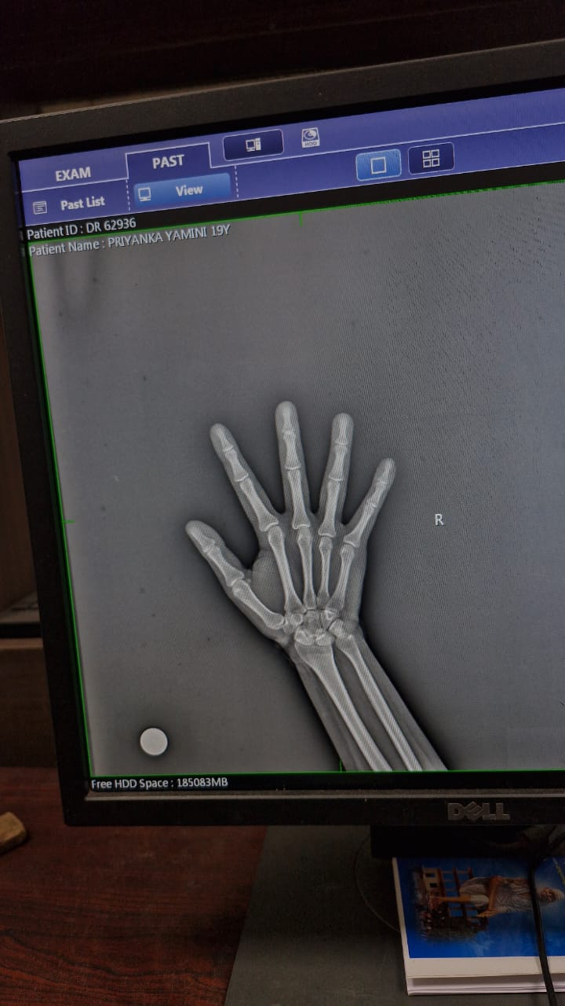
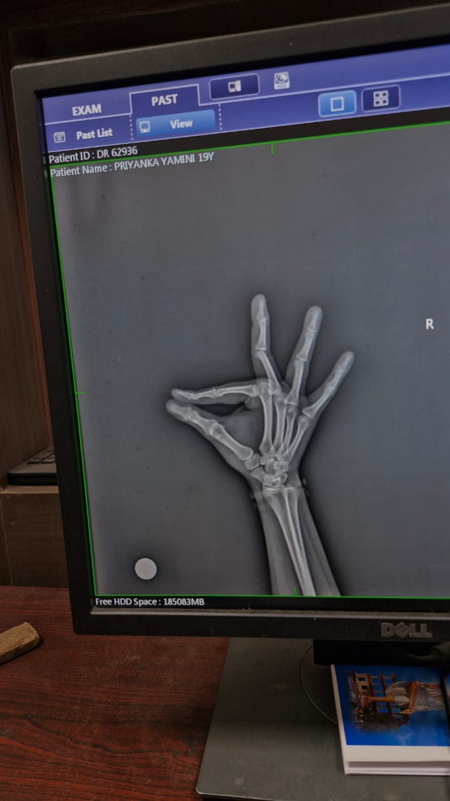
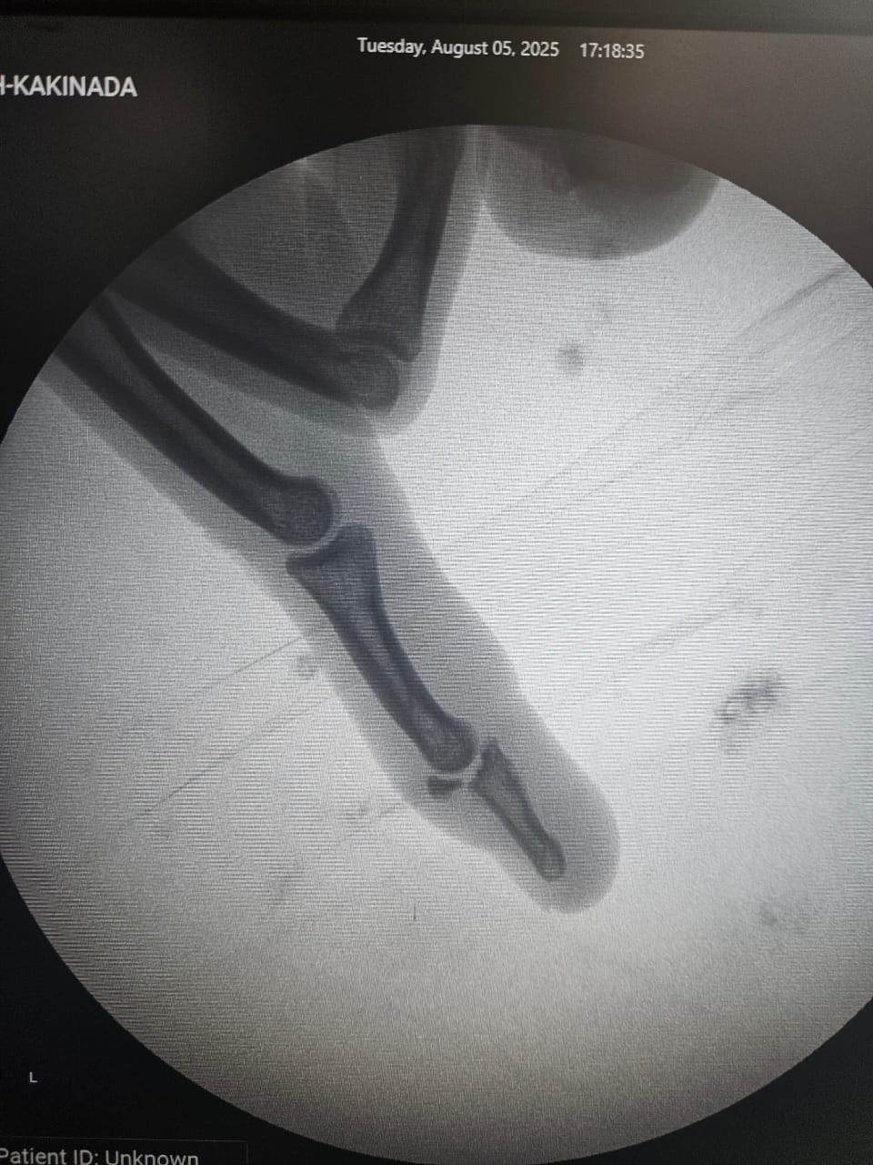
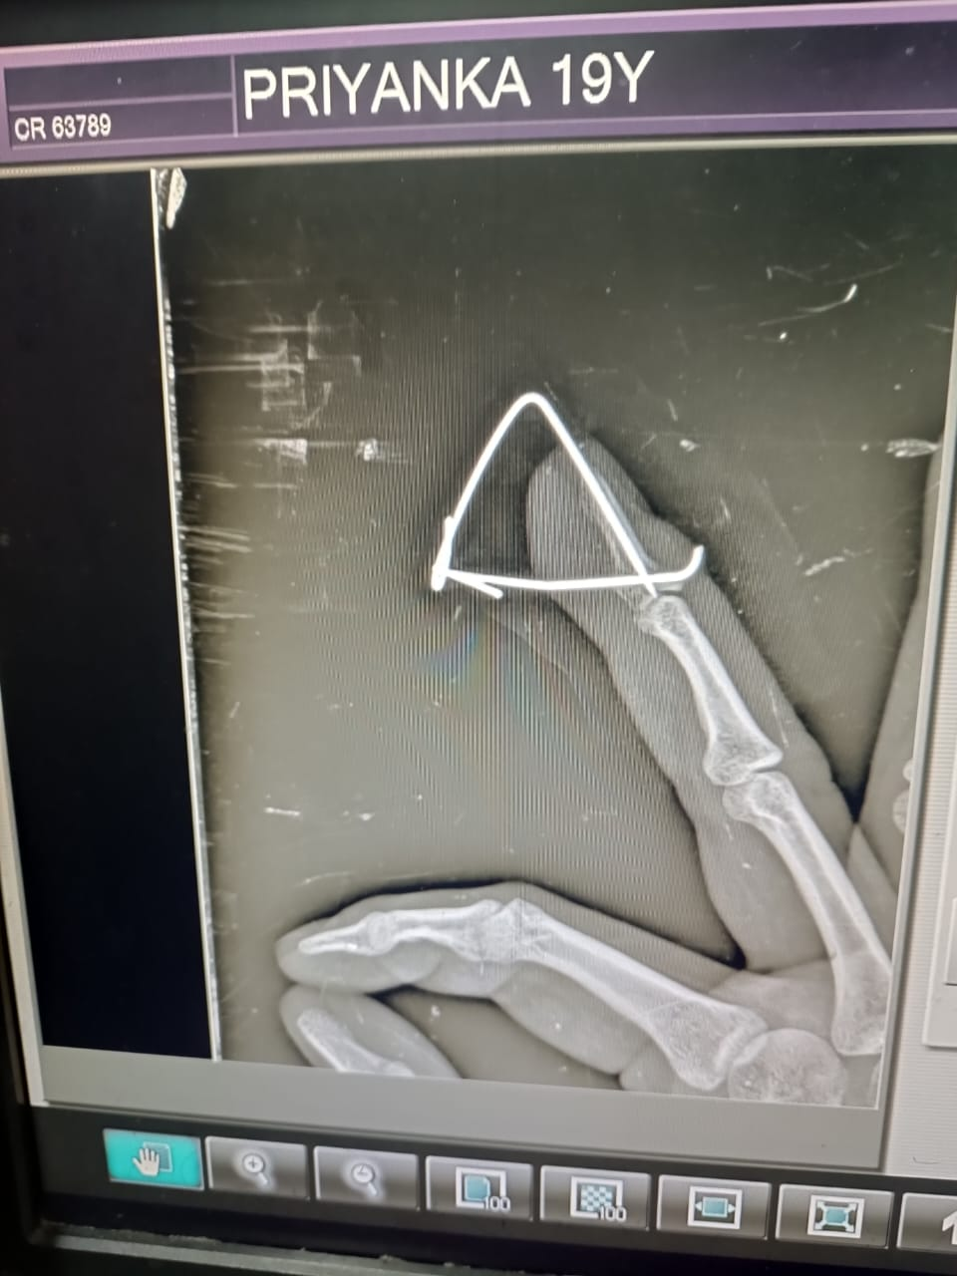
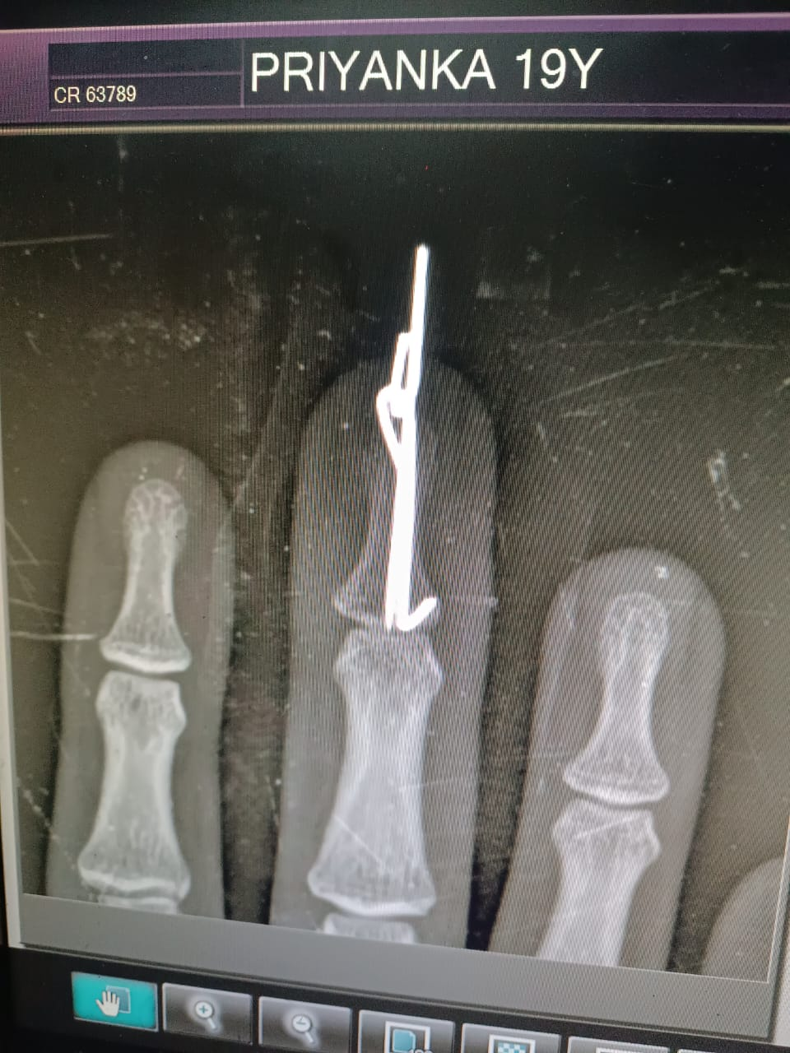
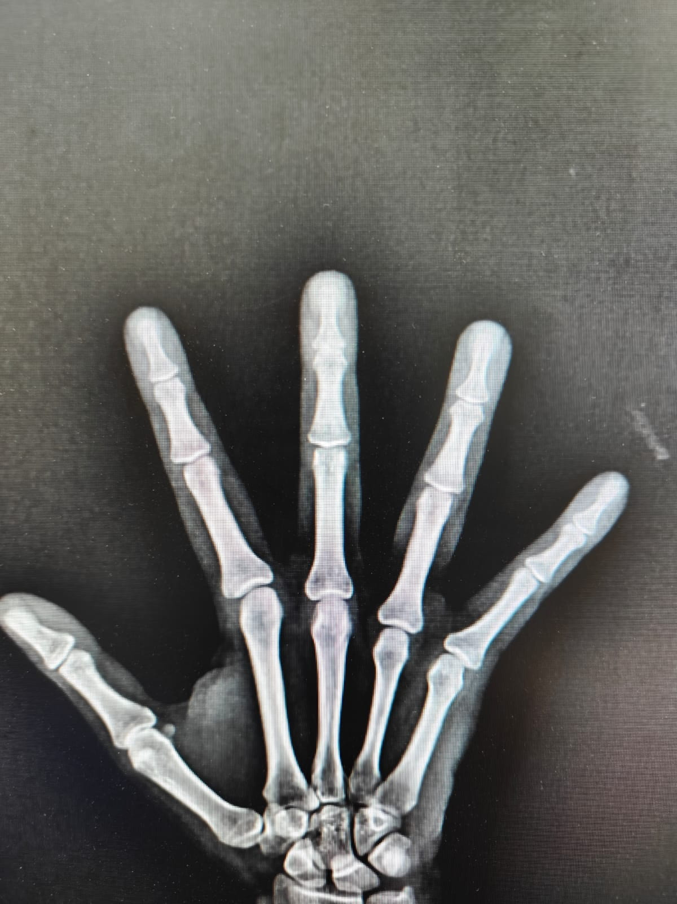
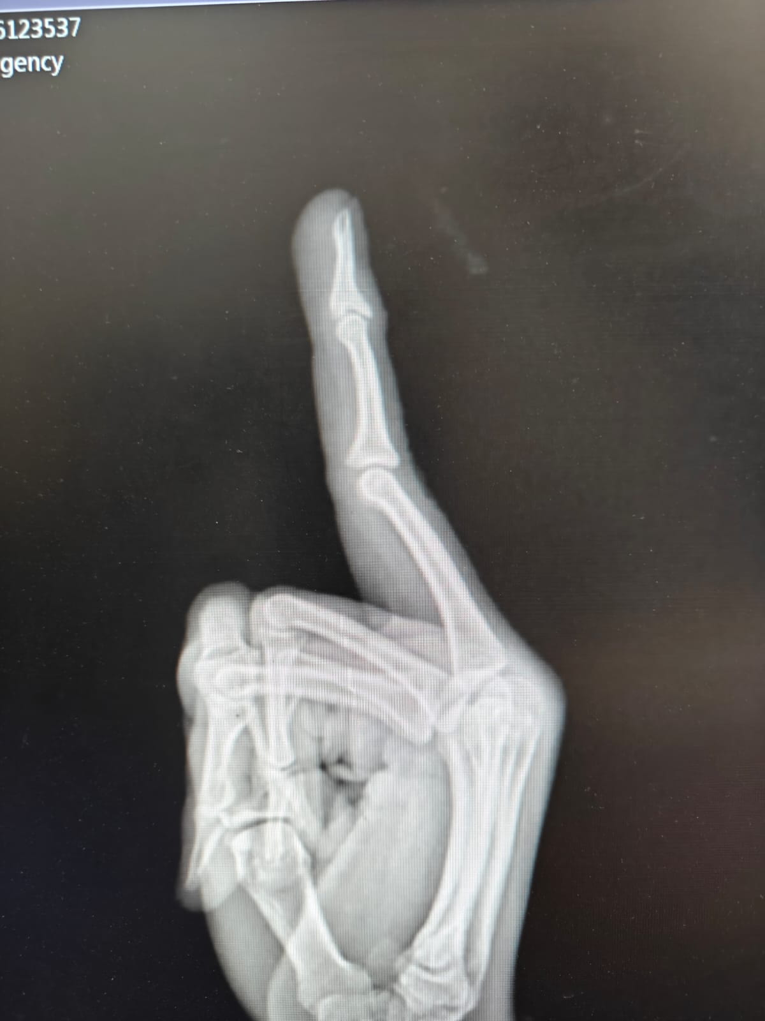
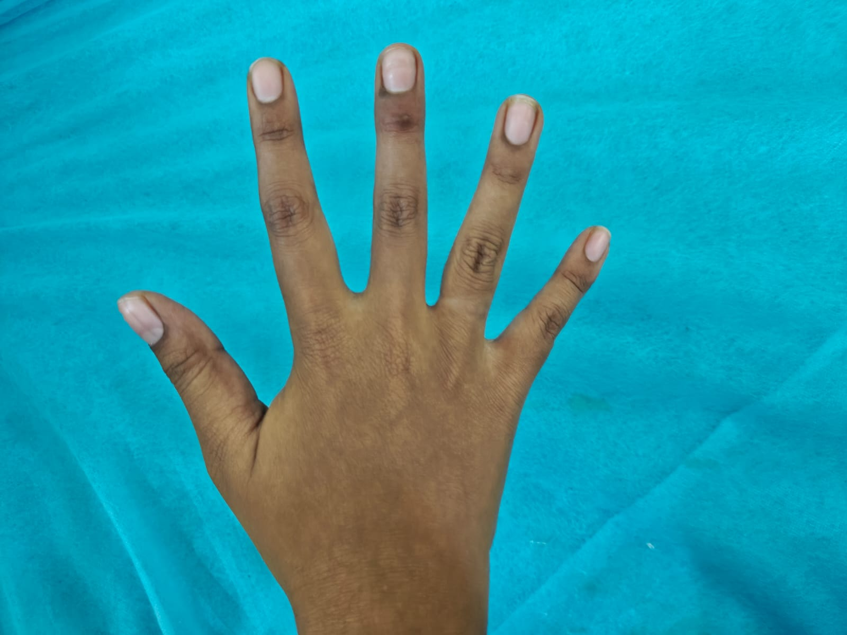
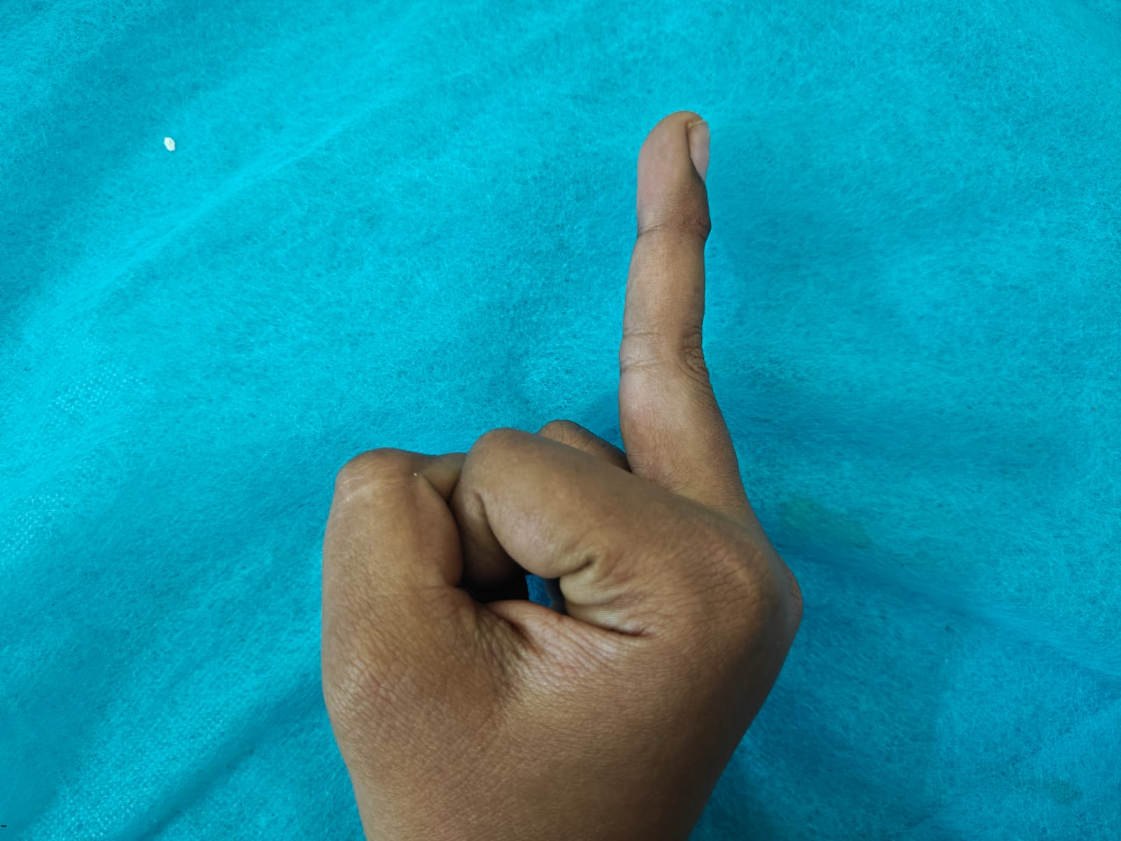
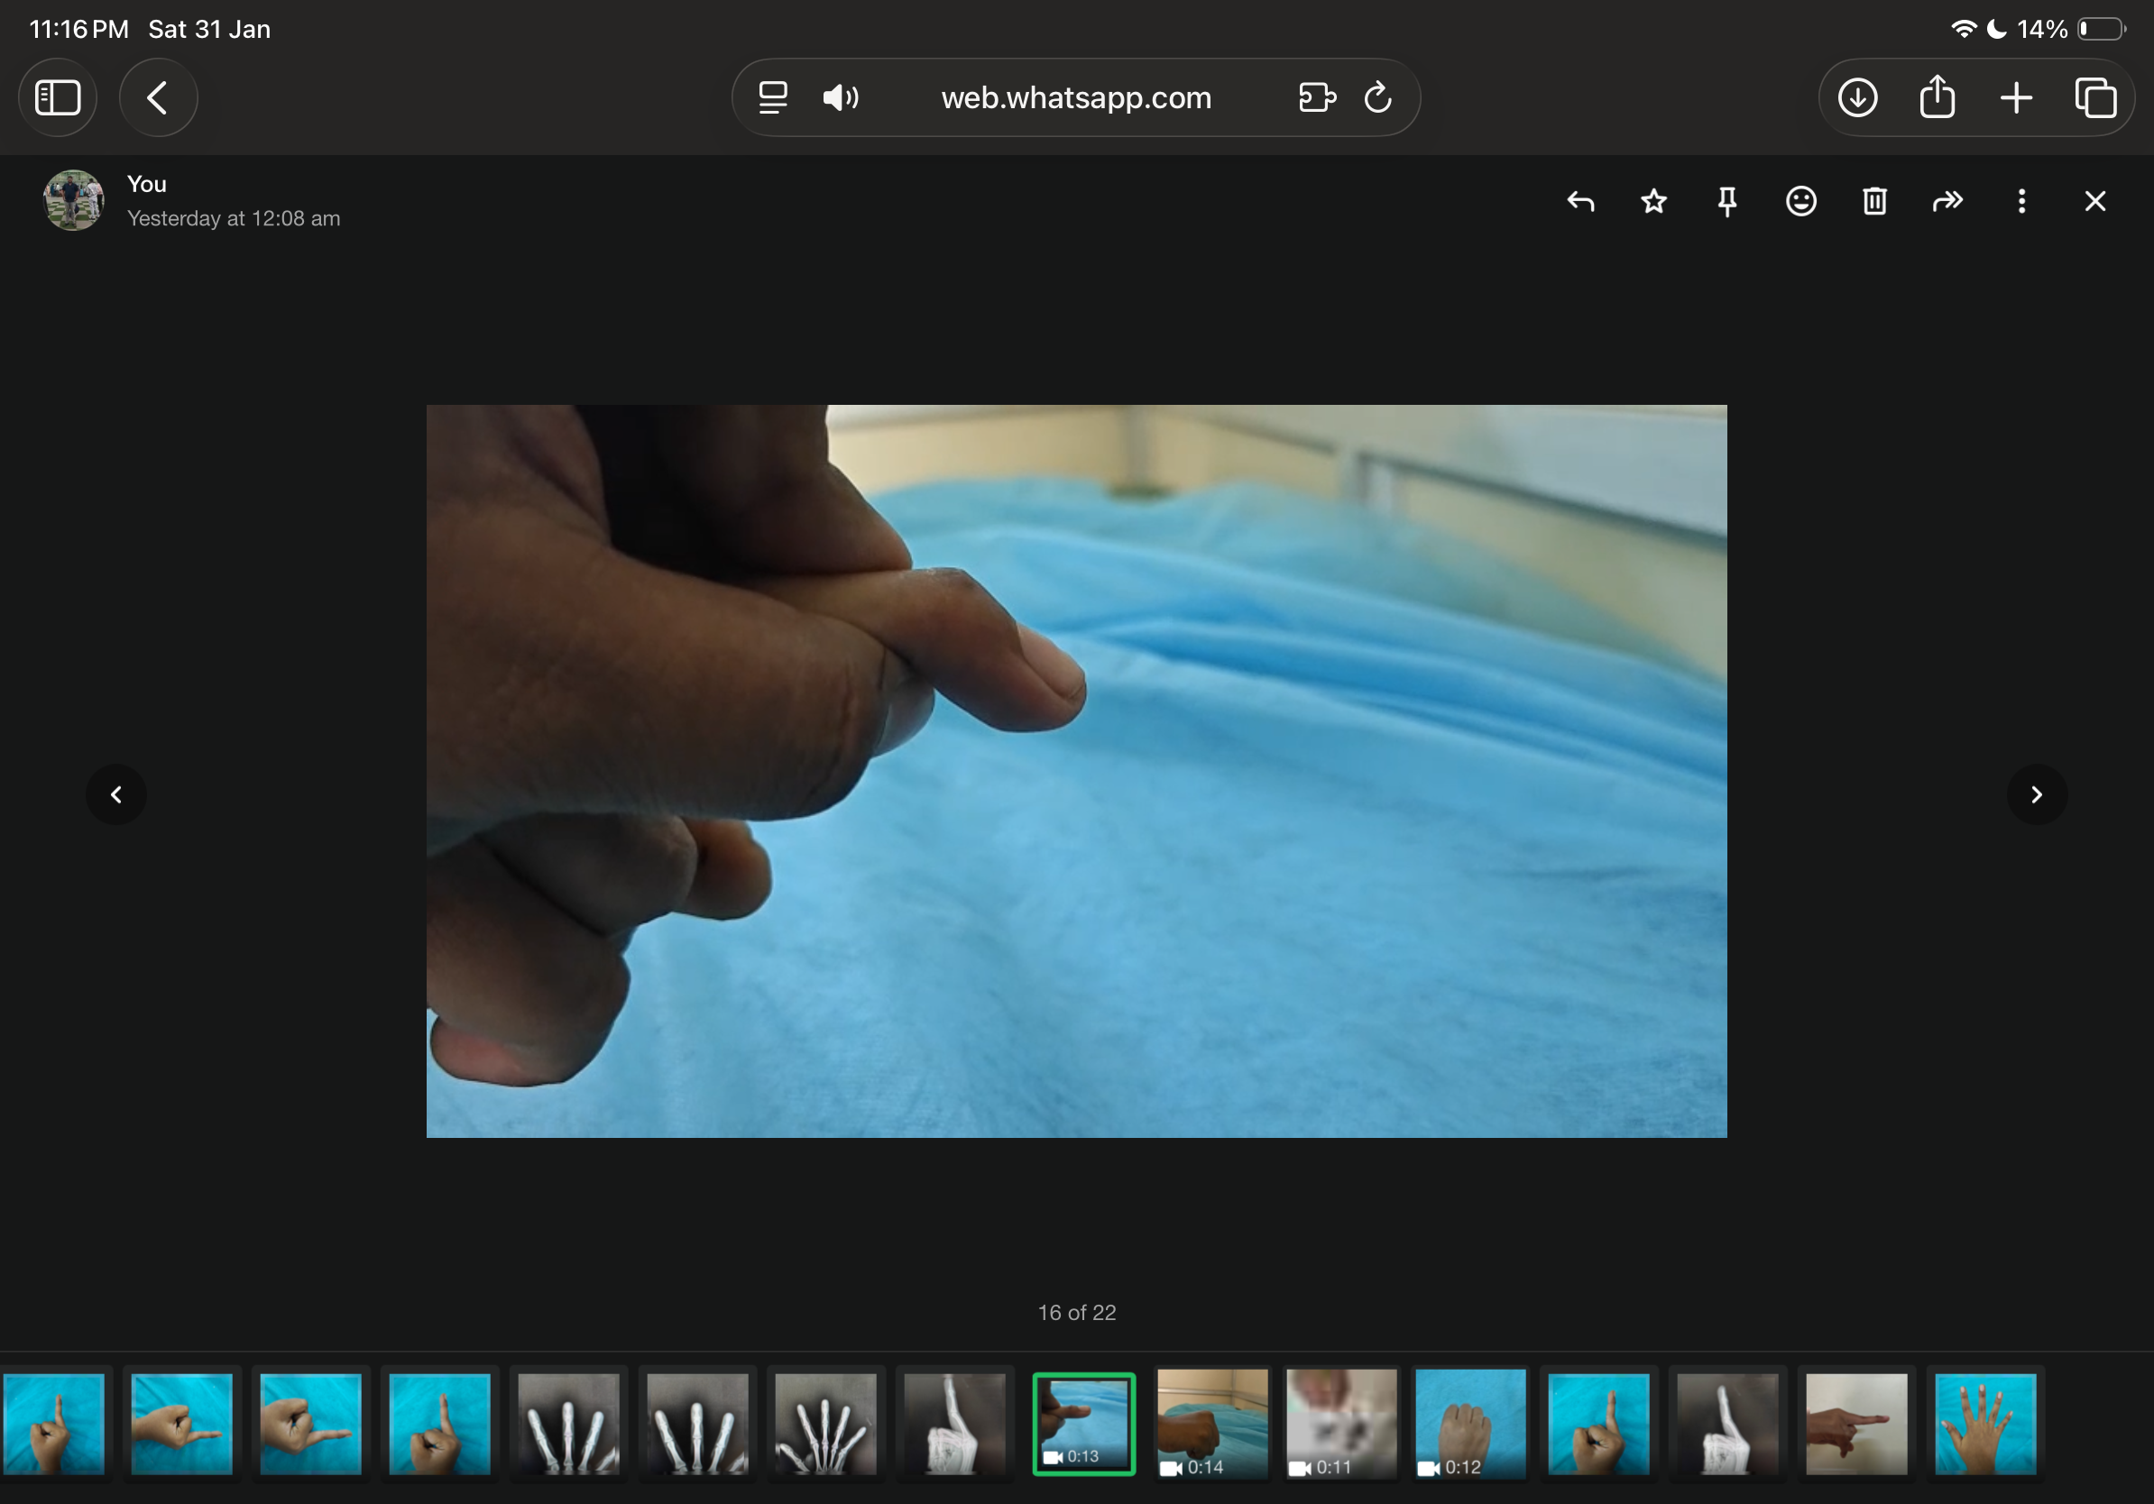
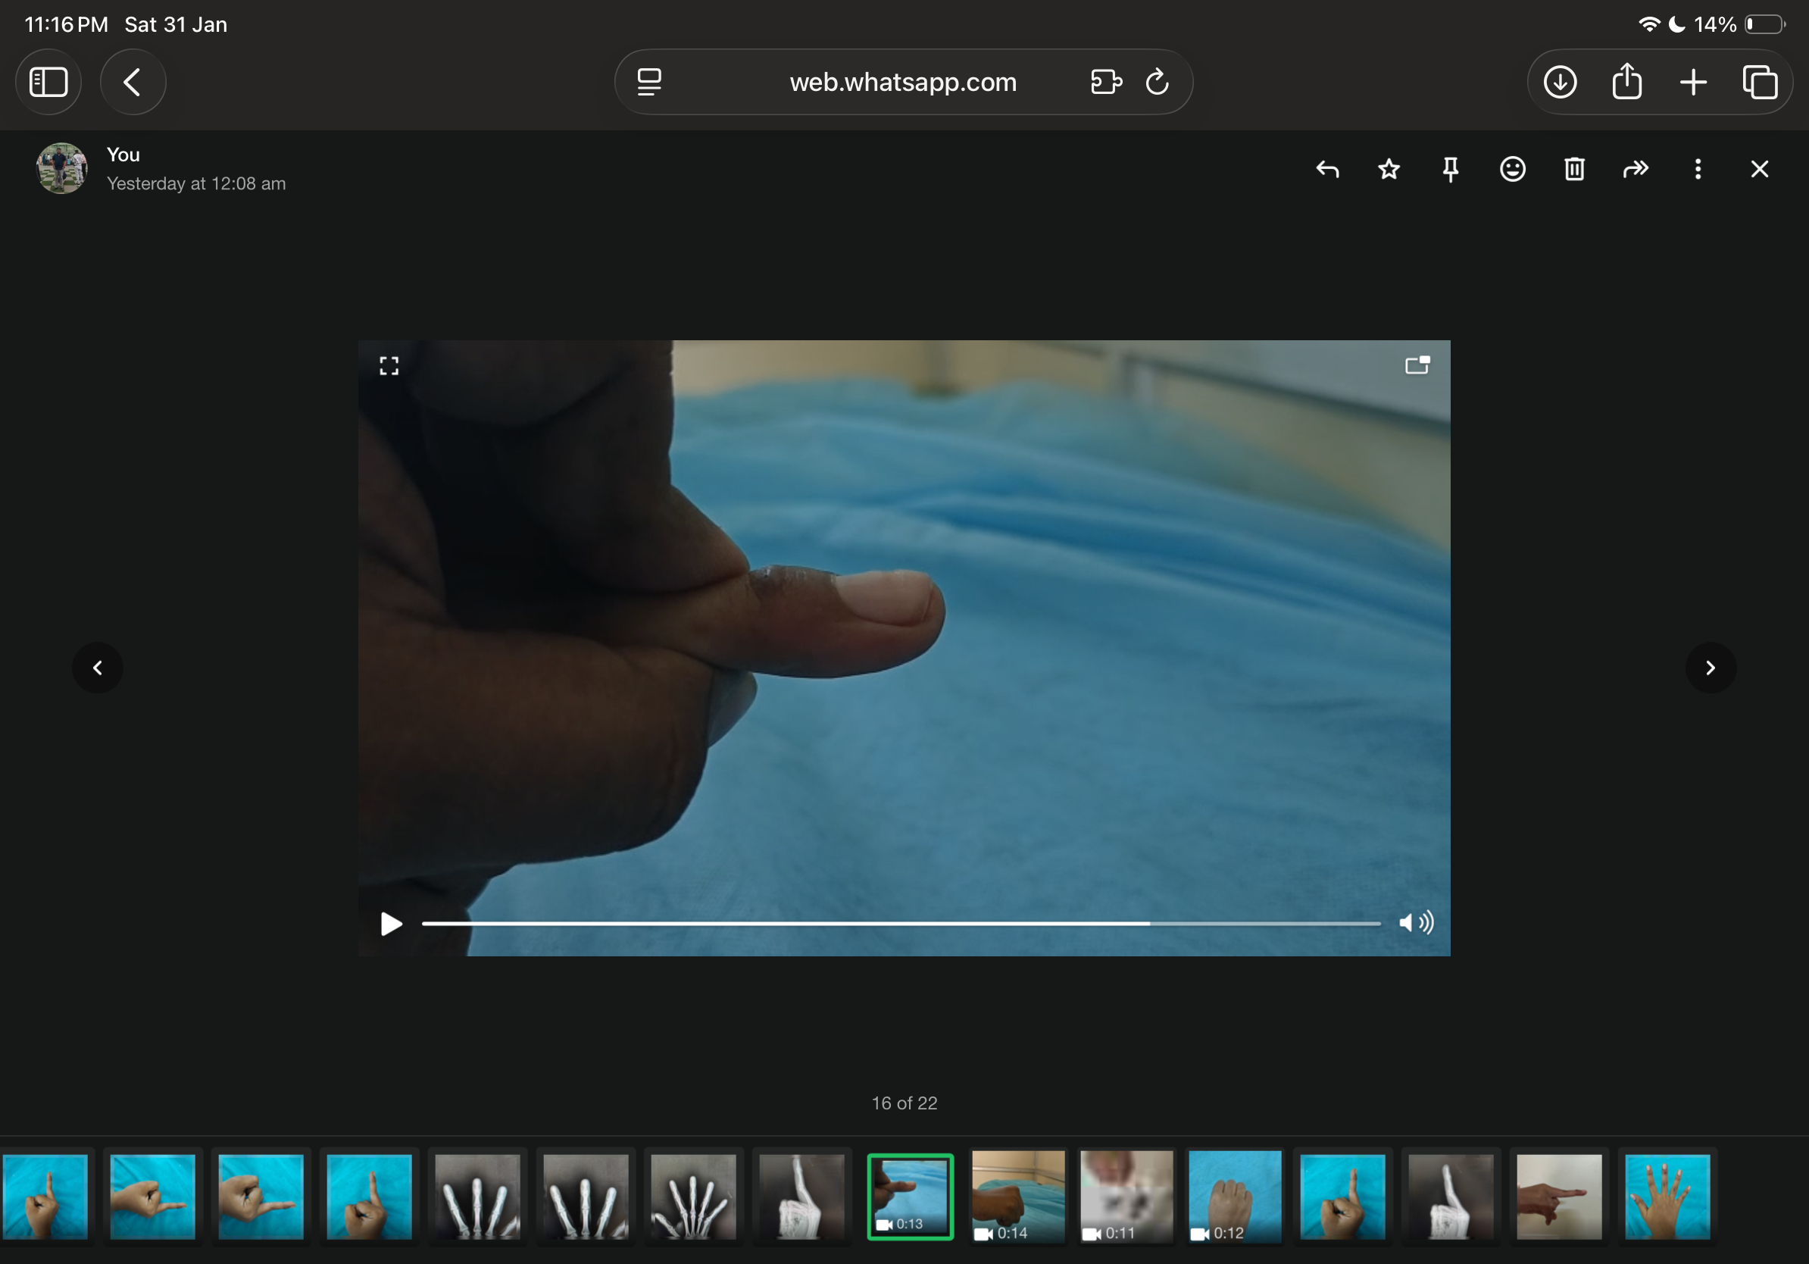
DELTA FRAME EXTERNAL FIXATION FOR BONY MALLET FINGER – A CASE SERIES
Dr Kumar Asutosh
Rangaraya Medical College
OSSAP-144-ABS-12
55th Annual Conference of Orthopedic Surgeon Society of Andhra Pradesh
Organized by : Department of Orthopaedics, Kurnool Medical College Kurnool
INTRODUCTION
OPERATIVE FINDINGS
DISCUSSION
Bony mallet finger is an avulsion fracture of the dorsal base of the distal phalanx resulting in loss of active extension at the DIP joint. Surgical intervention is indicated in fractures involving more than one-third of the articular surface, volar subluxation of the distal phalanx, or failure of conservative management. Extension block K-wire technique is commonly employed; however, it demands precise wire placement and may be associated with joint penetration, pin migration, and loss of reduction. Delta frame external fixation offers a minimally invasive alternative that provides stable fixation, controlled reduction, and maintenance of joint congruity.
All procedures were performed under digital block anesthesia with strict aseptic precautions and fluoroscopic guidance. Following closed reduction, a percutaneous Kirschner wire was inserted transversely into the head of the middle phalanx to serve as a proximal anchor. A second Kirschner wire was placed into the distal phalanx distal to the fracture fragment. These wires were connected externally using clamps to construct a delta-shaped frame.Gradual and controlled distraction across the DIP joint achieved indirect reduction of the dorsal avulsion fragment through ligamentotaxis. Intraoperative fluoroscopy confirmed anatomical restoration of the articular surface, correction of volar subluxation where present, and maintenance of DIP joint congruity. The DIP joint was not transfixed in any case. Stable fixation was obtained in all three patients.
Although the extension block K-wire technique is effective, it carries risks related to joint transfixation, technical difficulty, and loss of reduction. Delta frame external fixation provides adjustable and controlled reduction while preserving soft tissues and avoiding joint penetration.Postoperatively, the delta frame allowed stability while facilitating early mobilization of adjacent joints. Pin tract care was performed regularly. The external fixator was retained for a mean duration of 5 weeks, after which it was removed once radiological signs of union were evident. Supervised DIP joint mobilization was initiated following frame removal.All fractures achieved union without loss of reduction. At final follow-up, the mean DASH score improved from 42 preoperatively to 6, reflecting significant functional recovery. No major complications such as pin loosening, infection, or residual extensor lag were observed. These outcomes are comparable to those reported with the extension block K-wire technique while minimizing joint-related complications.
CASE REPORT
This case series includes three patients diagnosed with unstable bony mallet finger injuries involving more than one-third of the articular surface, with or without volar subluxation of the distal phalanx. All patients underwent clinical and radiological evaluation. Functional outcome was assessed using the DASH score. The mean preoperative DASH score was 42, indicating significant functional impairment. Delta frame external fixation was performed in all cases after obtaining informed consent.
CONCLUSION
Delta frame external fixation is a reliable and minimally invasive technique for the management of unstable bony mallet finger injuries. In this three-case series, it provided stable fixation, maintained joint congruity, allowed early rehabilitation, and resulted in significant improvement in DASH scores at follow-up. The technique offers outcomes comparable to the extension block K-wire method while reducing the risk of joint penetration and loss of reduction, making it an effective alternative in selected cases.
Case no. | Age/Sex | Finger Involved | Fixator Duration | Pre Op DASH | Post Op DASH | UNION | Complications
1 | 19/F | 3rd | 6 wks | 45 | 8 | Yes | Nil
2 | 32/F | 4th | 6 wks | 40 | 5 | Yes | Nil
3 | 24/M | 2nd | 6 wks | 41 | 6 | Yes | Nil

