Slide 1




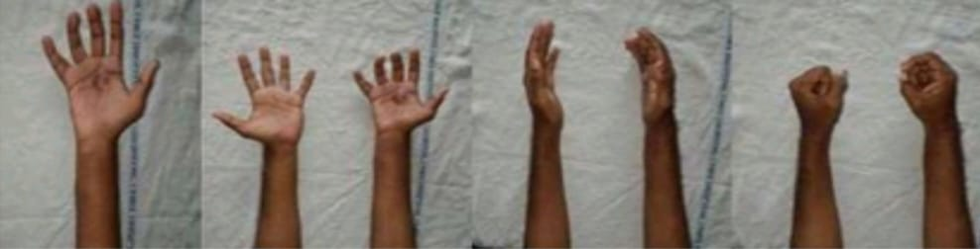
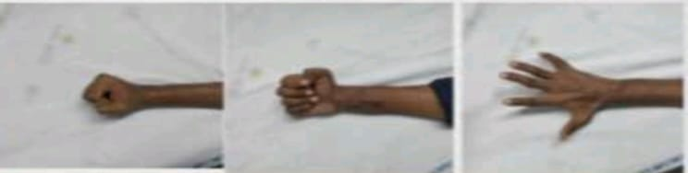
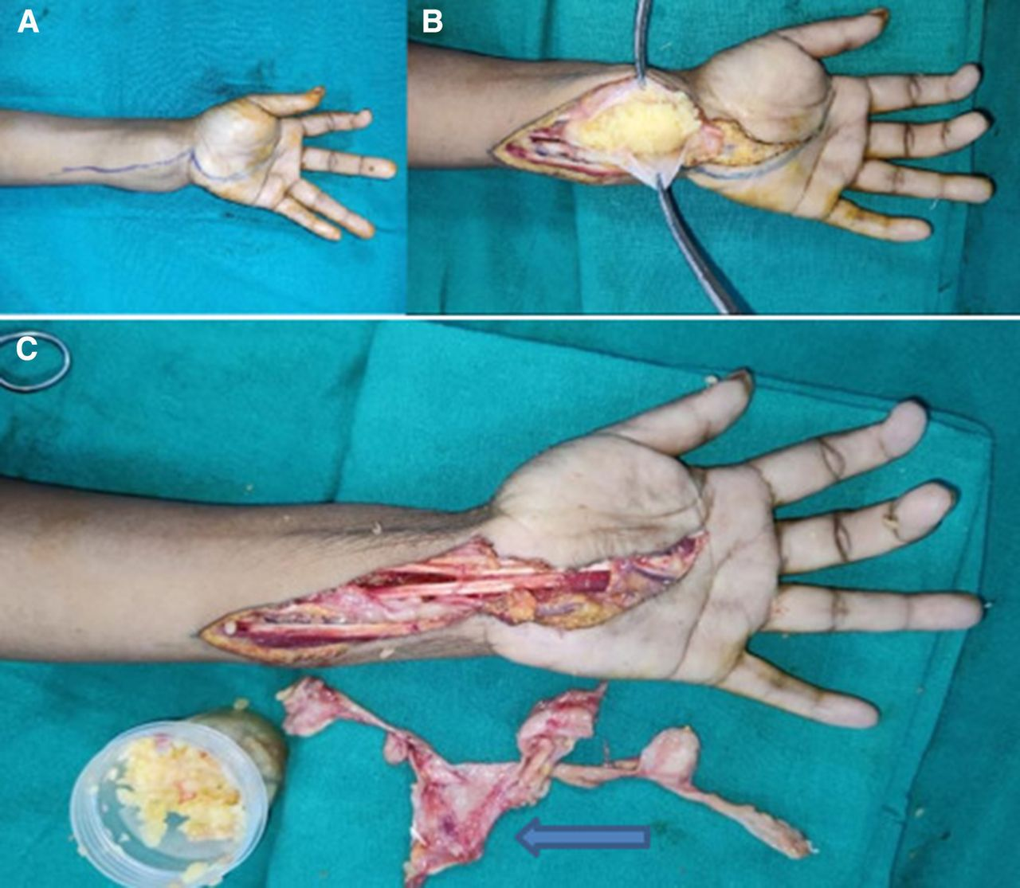
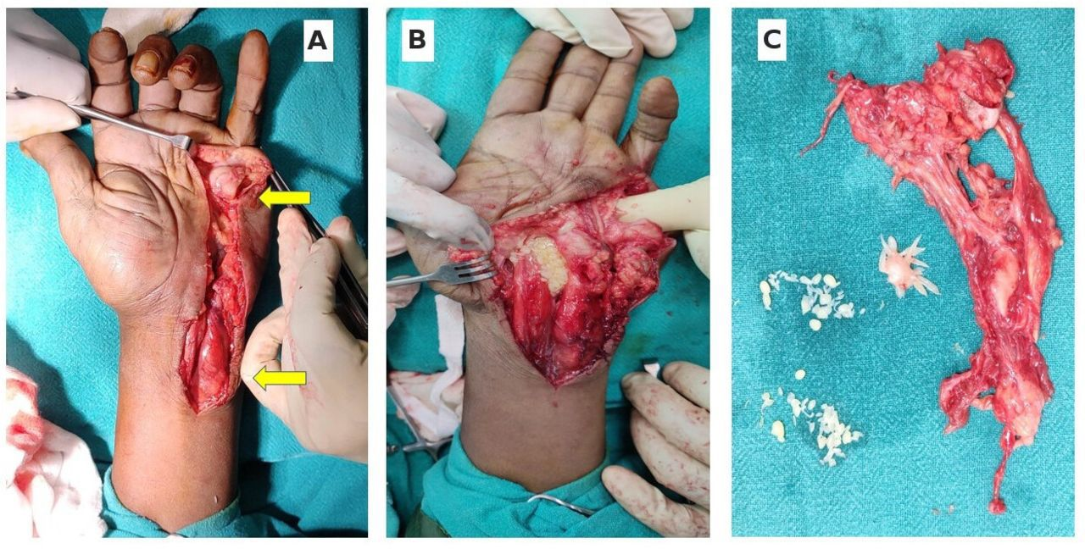
55th Annual Conference of
Orthopedic Surgeon Society of Andhra Pradesh
Date 6 – 8 February,2026, Venue : Kurnool Medical College
Organized by : Department of Orthopaedics, Kurnool Medical College Kurnool
INTRODUCTION
OPERATIVE FINDINGS
DISCUSSION
1.Compound palmar ganglion of wrist and hand is a rare disease which poses a significant public health challenge.
2.It constitutes less than 1% of extra pulmonary tuberculosis.
3.It is common in males usually involving the dominant hand .It can be clinically suspected and can be confirmed by histopathological report.
4.Compound palmar ganglion can be due to tubercular tenosynovitis of flexor tendons or secondary to wrist tubercular arthritis
5.Early diagnosis and complete surgical excision of the diseased tissue along with appropriate anti tubercular treatment gives a better outcome .
1.Flexor retinaculum release with excision biopsy and debulking tenosynovectomy of flexor tendons and radial and ulnar bursae was done and sent for HPE under supraclavicular block.
2.Swelling opened and about 150 ml of fibrinous exudate along with RICE WATER BODIES or MELON SEED BODIES was drained.
Clinical photograph
Tuberculosis is still a widespread disease in India.
Though lymph nodes are the most frequent extrapulmonary site for TB, tuberculous infection of the tenosynovium is one entity that should not be delayed in treatment because of the destructive nature of the lesion and the permanent disability it causes.
Melon seed bodies are characteristic of compound palmar ganglion of tuberculous etiology. Immediate initiation of treatment in the form of complete debulking and ATT is essential because of the notorious nature of the disease, as it destroys the underlying bones.
After debulking, early physiotherapy is essential to attain the maximum functionality of the hand.
Follow up:
CASE REPORT
CONCLUSION
A 22 year male, right hand dominant who presented with pain and progressive swelling over the volar aspect of right palm and wrist was clinically suspected with compound palmar ganglion and confirmed with histopathological report, was treated with incision drainage followed by flexor tenosynovectomy and tenolysis along with ATT and was mobilized with slab for 1 month and later Dynamic splint was given.
1.Extra pulmonary tuberculosis resulting in tubercular tenosynovitis is an extremely rare presentation.
2.Delay in diagnosis can result in flexor tendons destruction and gross restriction of hand function.
3.So, suspecting compound palmar ganglion, with early debridement , tenosynovectomy, tenolysis and anti tubercular drugs will give good functional outcome.
Thus we conclude insisting the possibility of tuberculosis in chronic flexor tenosynovitis of the wrist should always be kept in mind.

