Slide 1
FUNCTIONAL AND RADIOLOGICAL OUTCOME OF PROXIMAL HUMERUS FRACTURES TREATED WITH LOCKING COMPRESSION PLATE
AUTHOR: DR. POOJITHA SONTHI
2nd YEAR POST GRADUATE
CO-AUTHOR: DR. P. SUJITH DEVA PRASAD
PROFESSOR & HOD
DEPARTMENT OF ORTHOPAEDICS
INSTITUTE: SANTHIRAM MEDICAL COLLEGE, NANDYAL.

Slide 2
INTRODUCTION:
Proximal humerus fractures account for about 4 to 5% of all fractures.
It accounts for up to 45% of all humeral fractures.
Non operative treatment for fractures of proximal humerus in elderly patients resulted in pain, stiffness, loss of function and muscle power, hence operative treatment is preferred.
Among various operative techniques PHILOS plating has gained importance.
AIMS AND OBJECTIVE:
To determine functional and radiological outcome of proximal humerus fractures treated with locking compression plate (PHILOS plate).

Slide 3
MATERIALS AND METHODS:
Source of the Study : Santhiram Medical College And General Hospital, Nandyal
Study Design : Prospective Study
Sample Size : 20 of either sex.
Inclusion Criteria :
1)Patients with proximal humerus fractures aged more than 18 years of either sex.
2) Satisfy Neer’s criteria for operative displacement i.e. displacement of >1 cm between the major fracture fragments or angulation of the articular surface of >45 degrees and Neer’s two, three and four part fractures.
3) Consenting to study
Exclusion Criteria:
Patients with 1) Open fractures ,Pathological fractures
2) Associated neurovascular injury, Associated head injury

Slide 4
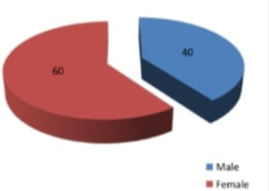
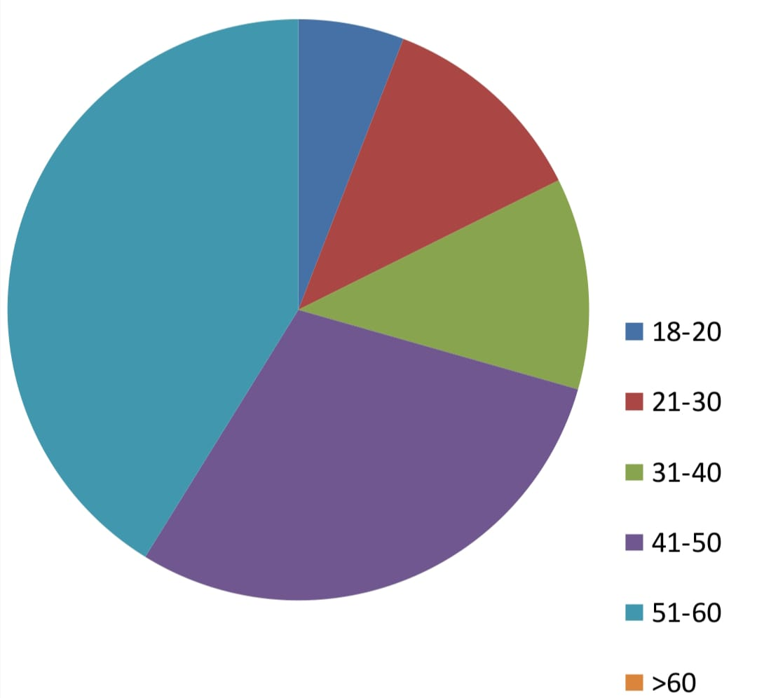
RESULTS AND OBSERVAION:
TABLE – I SEX DISTRIBUTION
S.NO. | SEX | No. of patients | Percentage
1 | Female | 12 | 60
2 | Male | 8 | 40
TABLE – II AGE DISTRIBUTION
S.NO. | Age (in years ) | NO. of patients | Percentage
1 | 18-20 | 1 | 5
2 | 21-30 | 2 | 10
3 | 31-40 | 2 | 10
4 | 41-50 | 5 | 25
5 | 51-60 | 7 | 35
6 | >60 | 3 | 15

Slide 5
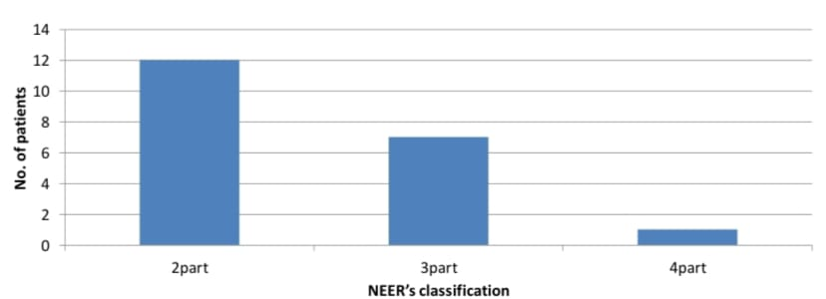
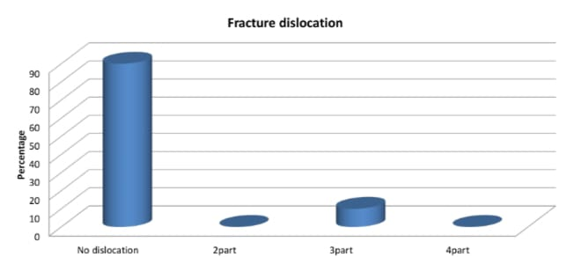
TABLE- III:TYPE OF FRACTURE
S.NO. | NEER’S type | No. of patients | Percentage
1 | 2 part | 12 | 60
2 | 3 part | 7 | 35
3 | 4 part | 1 | 5
TABLE-IV:FRACTURE DISLOCATION
S.NO. | Dislocation | No. of patients | Percentage
1 | No dislocation | 18 | 90
2 | Dislocation
 | 2part | 0 | 0
 | 3part | 2 | 10
 | 4part | 0 | 0

Slide 6
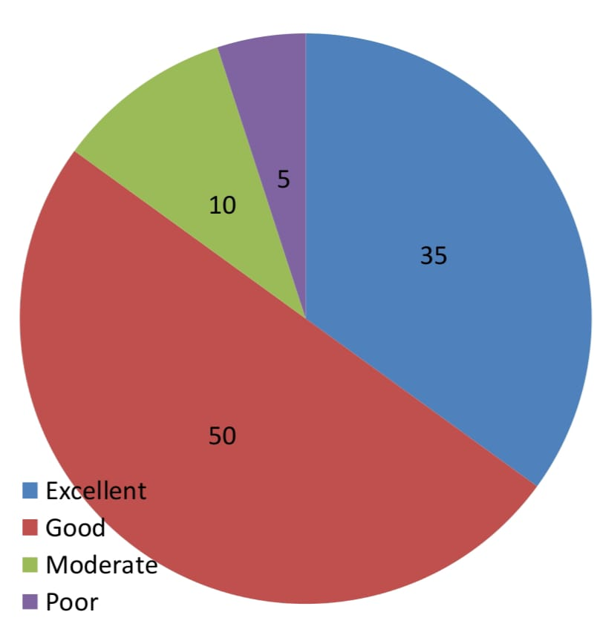
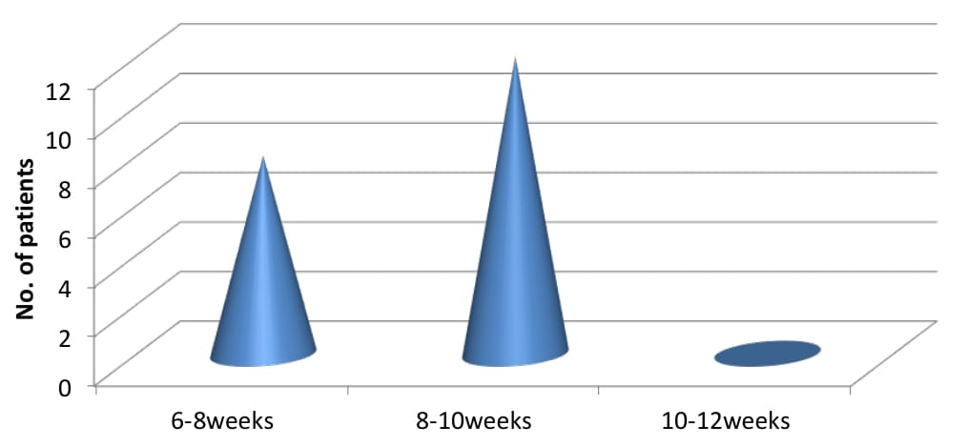
FUNCTIONAL OUTCOME:
was graded according to CONSTANT SHOULDER SCORE.
according to this criteria following results were achieved.
S.NO. | Rating | No. of patients | Percentage
1 | Excellent(86-100) | 7 | 35
2 | Good(71-85) | 10 | 50
3 | Moderate(56-70) | 2 | 10
4 | Poor(0-55) | 1 | 5
RADIOLOGICAL OUTCOME:
S.NO. | Time taken for union (in weeks) | No. of patients | Percentage
1 | 6-8 | 8 | 40
2 | 8-10 | 12 | 60
3 | 10-12 | 0 | 0

Slide 7
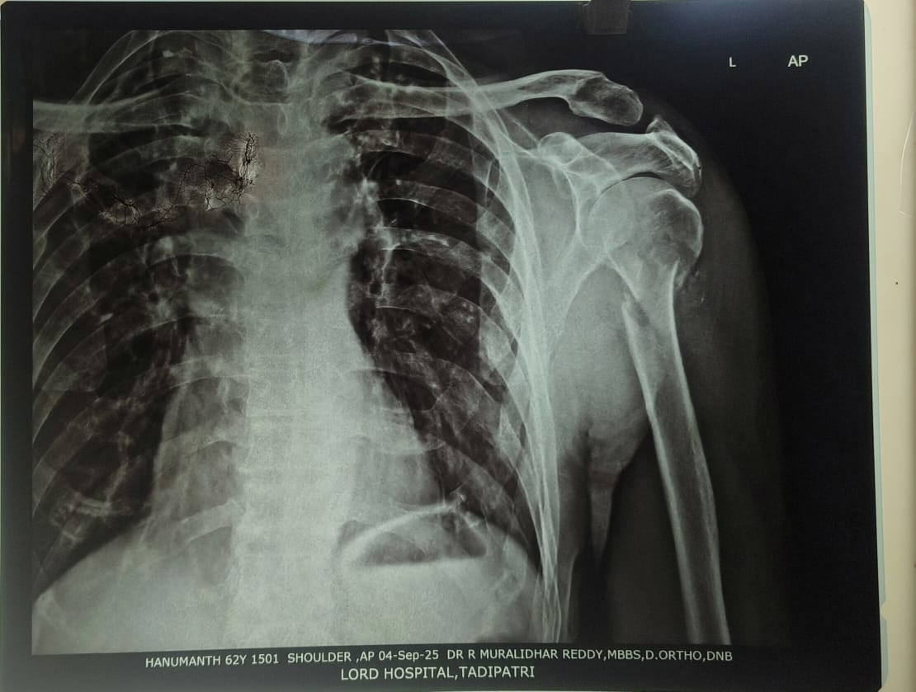
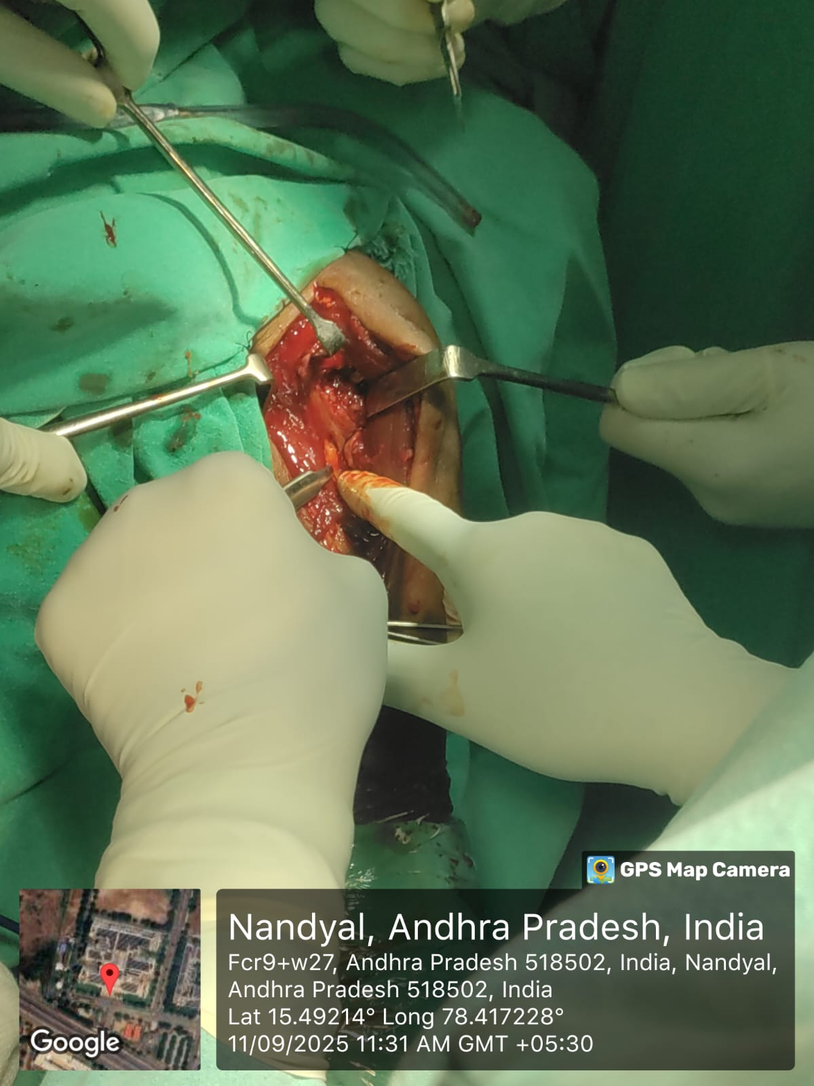
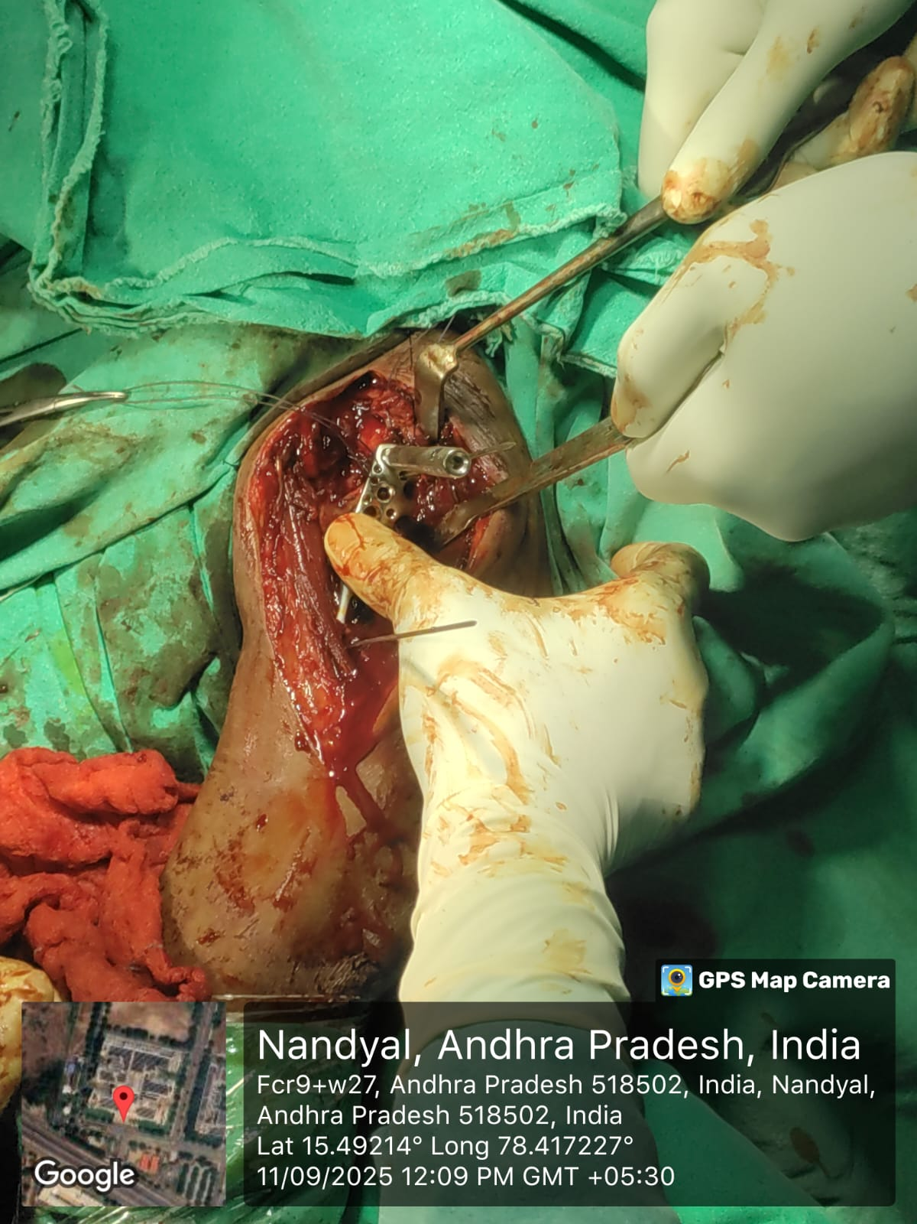
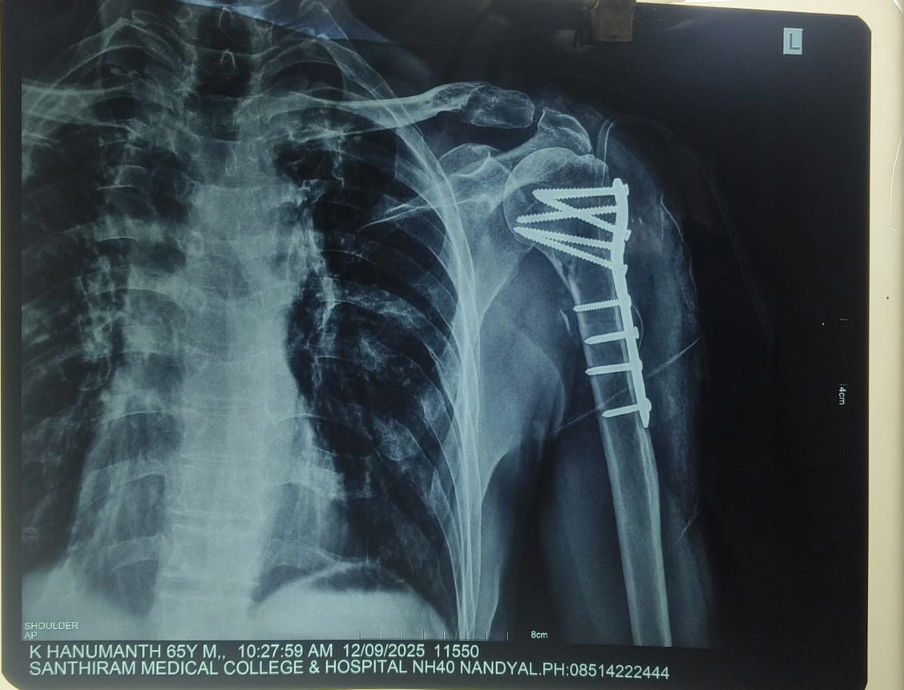
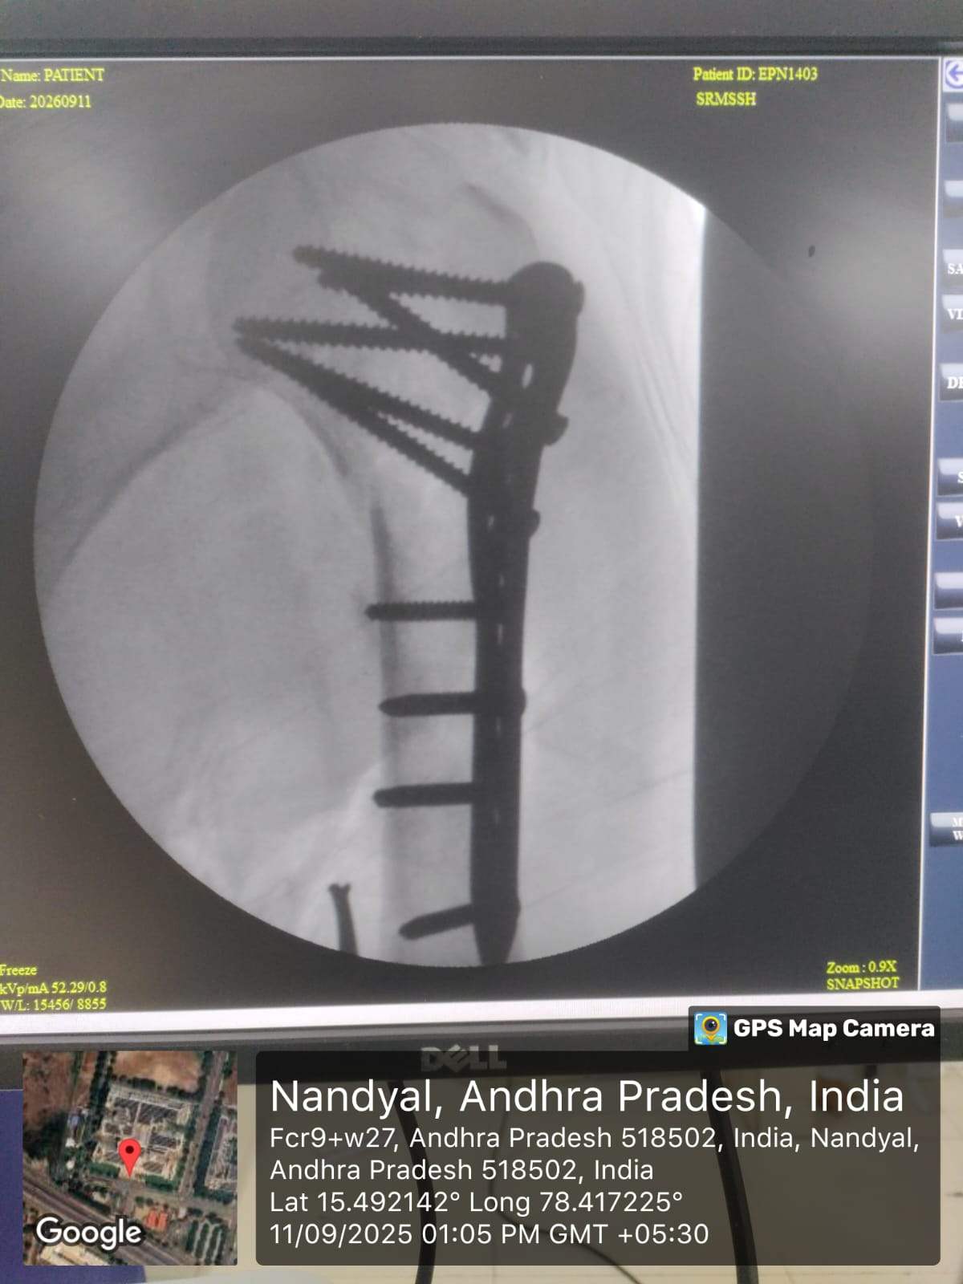
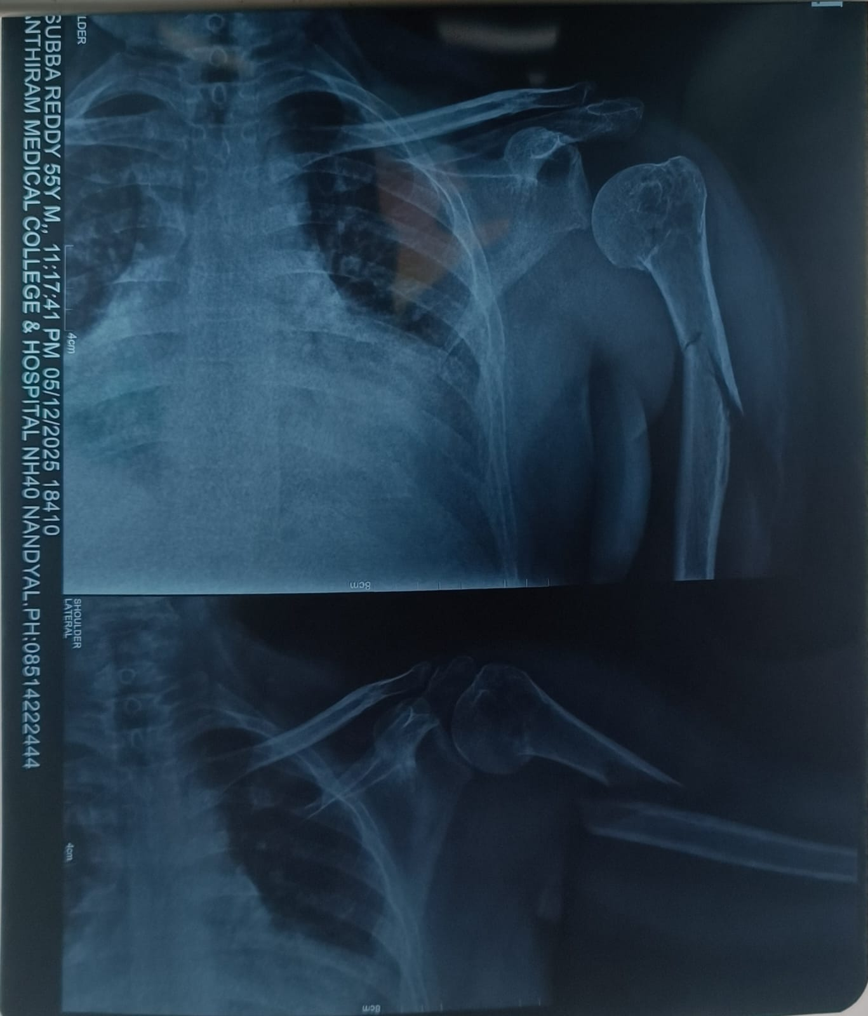
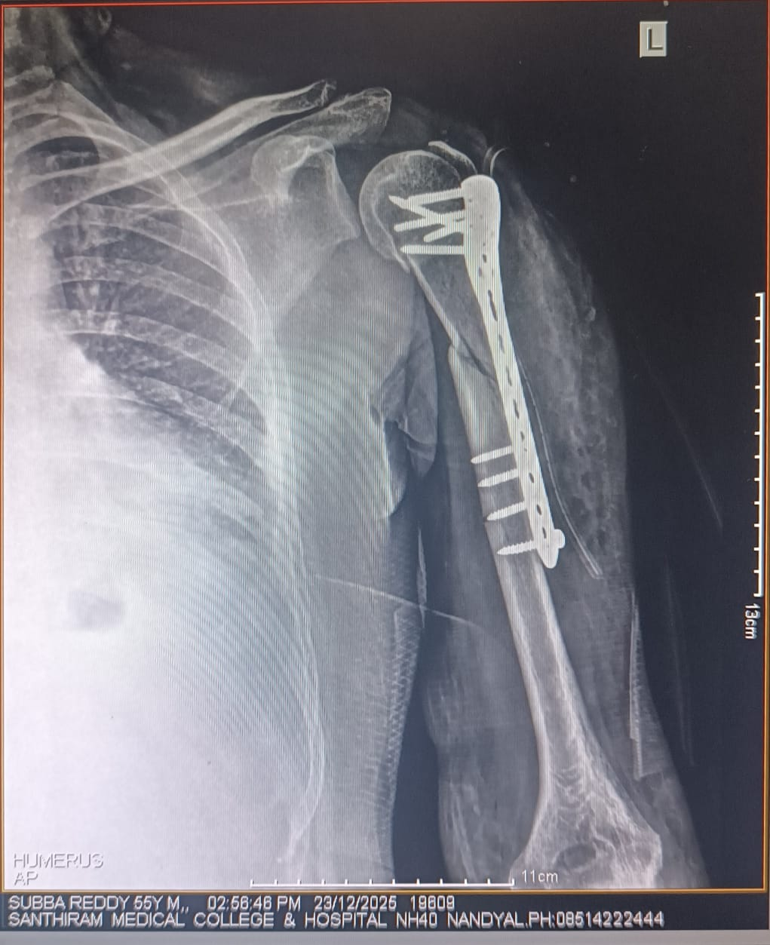
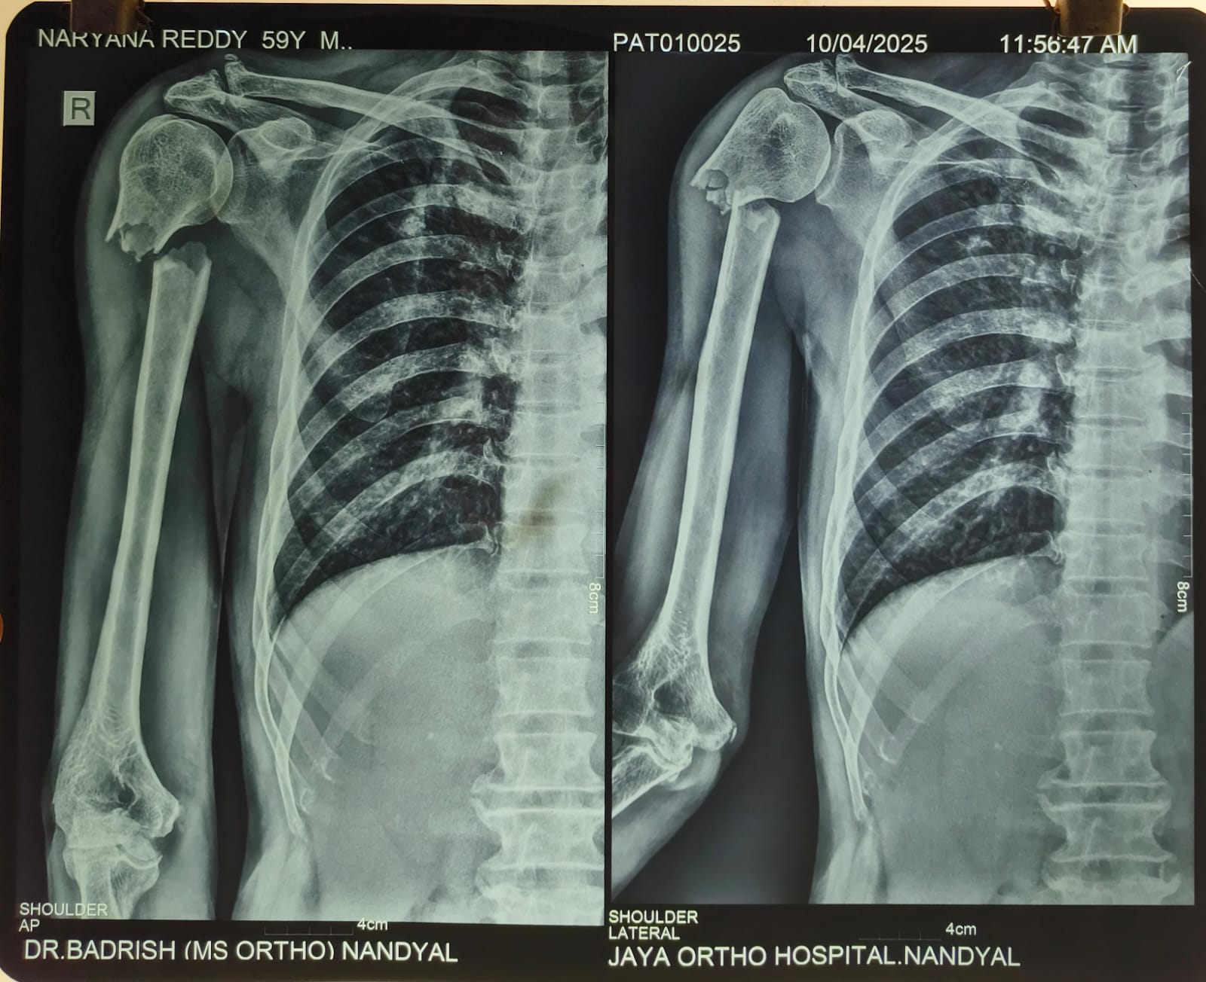
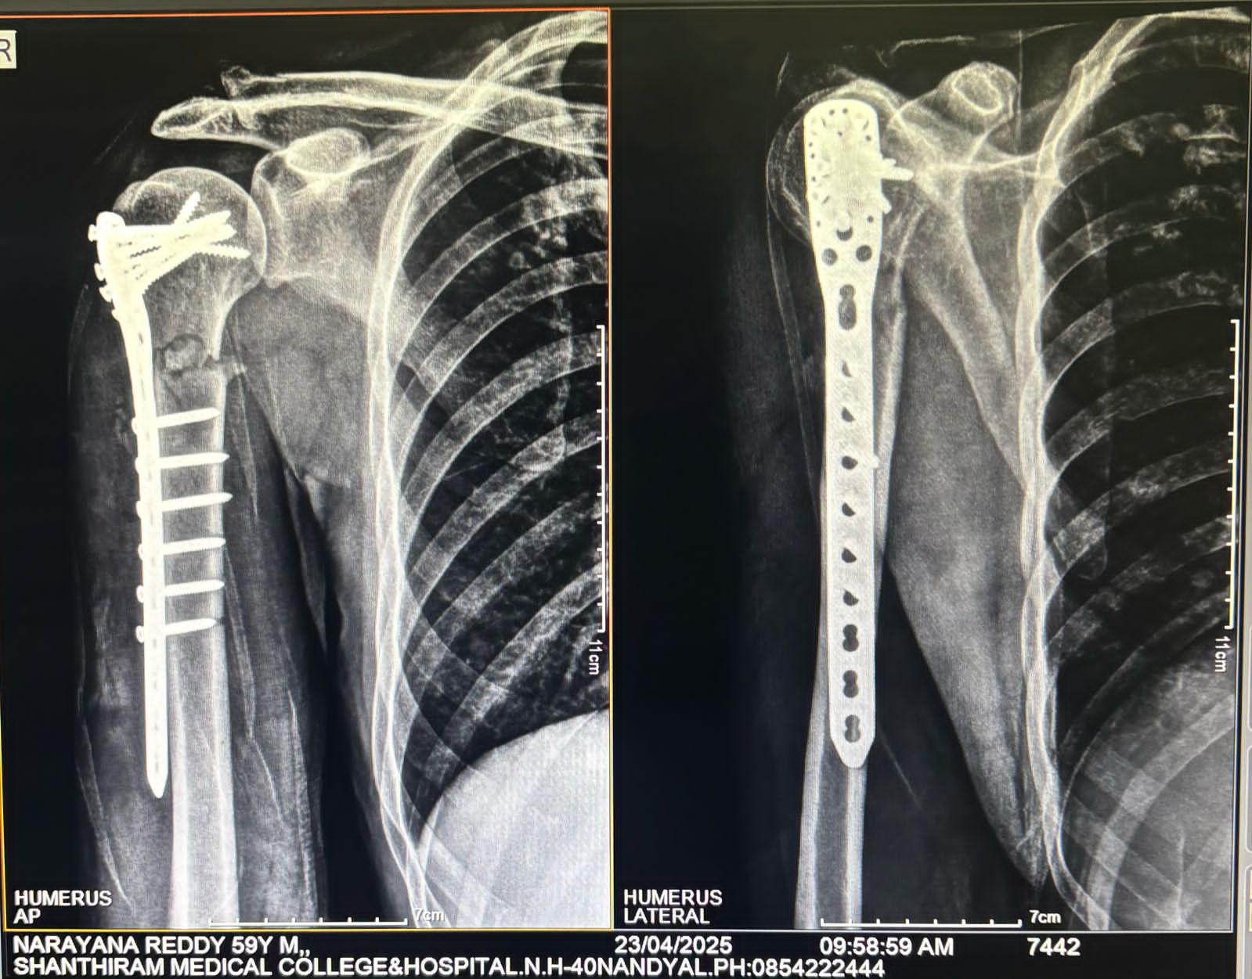
Intra operative photograph showing fracture site
PRE OP XRAY
Intra operative photograph showing fracture reduction with PHILOS plate
Intra operative C-ARM XRAY showing fracture reduction and fixation with PHILOS plate
IMMEDIATE POST OP XRAY
PRE OP XRAY
POST OP XRAY
POST OP XRAY
PRE OP XRAY

Slide 8
CONCLUSION
Locking compression plate fixation for proximal humerus fractures provides reliable fracture union with good functional and radiological outcomes,particularly in displaced Neer type II and III fractures .
Stable angular fixation allows early mobilization , resulting in satisfactory shoulder range of motion and improved functional scores such as Constant-Murley and DASH.
REFERENCES
1.Cheng HY, Liang CW,Wang JH, et al. The effects of augmentation choices for locking plate fixation in proximal humerus fracture osteosynthesis: a systematic review and meta-analysis.J Orthop Traumatol.2025;26:47.
2. Birsel O,et al. Proximal humerus fractures treated with proximal humerus inter locking system: minimum 10-year clinical and radiological outcomes. J Shoulder Elbow Surg.2025.

