Slide 1
CORRELATION OF VITAMIN D LEVELS WITH BONE MINERAL DENSITY IN POST- MENOPAUSAL WOMEN –A ONE YEAR CROSS SECTIONAL STUDY.
AUTHOR : Dr. KANALA MABU HUSSAIN
CO-AUTHOR : Dr. T. RAJASEKHAR

Slide 2
INTRODUCTION:
VITAMIN D levels plays an important role in skeletal development and maintenance.
It is estimated that 1 billion people worldwide have vitamin D deficiency or insufficiency.
Vit D Deficiency is quite common in India as reported by various studies and prevalence was found to be around 64.3%.
Bone loss in postmenopausal women is either by high bone turnover mediated by estrogen loss or by secondary hyperparathyroidism due to impaired vitamin D metabolism , low intestinal calcium absorption.

Slide 3
MATERIALS AND METHODS:
• Study type : cross sectional study
• Study population: All post-menopausal women in the inpatient and outpatient in dept of orthopaedics according to inclusion and exclusion criteria.
• Study period : November 2022 to November 2023.
• Study sample :100
AIMS AND OBJECTIVES:
• To study the prevalence of osteoporosis in postmenopausal women
• To evaluate the prevalence of serum vitamin D deficiency in postmenopausal women. • To analyze the association of serum vitamin D levels with bone mineral density in post menopausal women

Slide 4
INCLUSION CRITERIA
EXCLUSION CRITERIA
Women with malignant diseases.
Women with renal, hepatic endocrine and GI disorders.
Women who are under medication like steroids, diuretics , vit D , estrogen supplements.
Any H/O fractures .
Who were not wiling to participate.
Women who were post menopausal by greater than 2 - 3 years
Women wiling to participate in the study

Slide 5
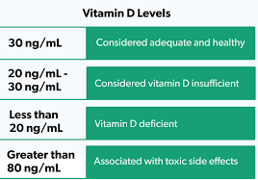
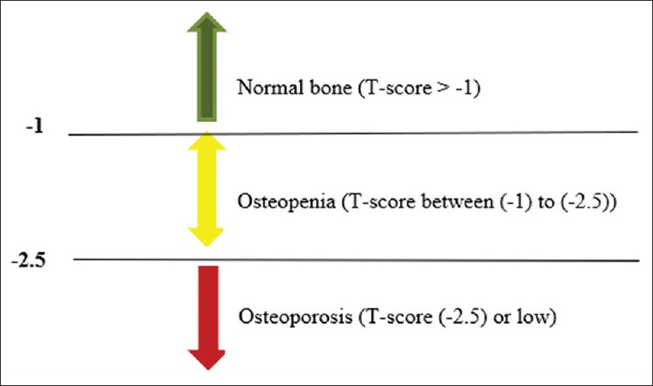

Slide 6
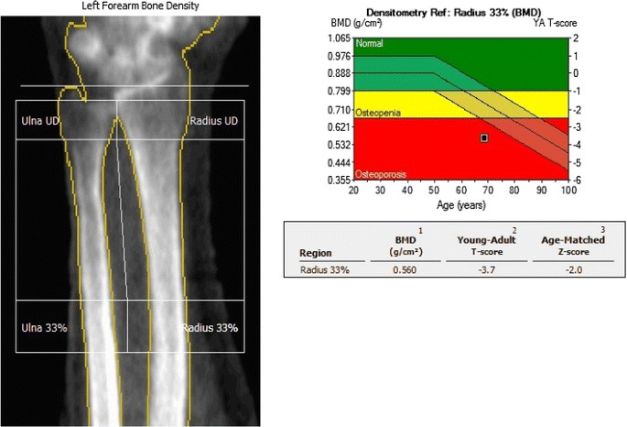

Slide 7
AGE :
Mean age in the study = [58.8 ± 8.42 years]
AGE | POSTMENOPAUSAL WOMEN | PERCENT
41-50 | 15 | 15%
51-60 | 52 | 52%
61-70 | 23 | 23%
71-80 | 8 | 8%
81-90 | 2 | 2%
TOTAL | 100 | 100%

Slide 8
BODY MASS INDEX:
BMI | POST MENOPAUSAL WOMEN | PERCENT
UNDER WEIGHT [<18.5] | 4 | 4%
NORMAL[18.5-24.9] | 58 | 58%
OERWEIGHT[25-29.9] | 22 | 22%
OBESE[>30] | 16 | 16%
TOTAL | 100 | 100%

Slide 9
SERUM VITAMIN D LEVELS:
Mean serum vitamin d level =[18.00 ± 8.07 ng/ml]
SERUM VITAMIN D [ng/ml] | POSTMENOPAUASAL WOMEN | PERCENT
NORMAL [>30 ng/ml] | 8 | 8%
VIT D INSUFFICIENCY [20-30 ng/ml] | 30 | 30%
VIT D DEFICIENCY [<20ng/ml] | 62 | 62%
TOTAL | 100 | 100%

Slide 10
BONE MINERAL DENSITY AT DISTAL RADIUS: Mean BMD [T SCORE]= -2.4 ±1.45
BMD DISTAL RADIUS [SD] | POST MENOPAUSAL WOMEN | PERCENT
NORMAL [>-1 SD] | 18 | 18%
OSTEOPENIA [-1SD TO -2.5 SD] | 28 | 28%
OSTEOPOROSIS [<2.5 SD] | 54 | 54%
TOTAL | 100 | 100%

Slide 11
BONE MINERAL DENSITY AT CALCANEUM: Mean BMD [T SCORE]=-2.10 ±1.35
BMD CALCANEUM | POSTMENOPAUSAL WOMEN | PERCENT
NORMAL [>-1 SD] | 15 | 15%
OSTEOPENIA [-1 TO -2.5 SD] | 36 | 36%
OSTEOPOROSIS [ <2.5 SD] | 49 | 49%
TOTAL | 100 | 100%

Slide 12
Out of 62 postmenopausal women who had vitamin D deficiency 38 [61.3%] had osteoporosis and 16 [25.8%] had osteopenia at Distal Radius . With significant correlation and by pearson”s correlation coefficient it was found that there is a positive correlation between vitamin D level and BMD [r=0.179]
SERUM VITAMIN D | NORMAL | OSTEOPENIA | OSTEOPOROSIS | TOTAL
NORMAL | 6[75.0] | 2[25’0] | 0[0.0] | 8[100.0]
VITAMIN D INSUFFICIENCY | 4[13.3] | 10[33.3] | 16[53.3] | 30[100.0]
VITAMIN D DEFICIENCY | 8[12.9] | 16[25.8] | 38[61.3] | 62[100.0]
TOTAL | 18[18.0] | 28[28.0] | 54[54.0] | 100[100.0]

Slide 13
Out of 62 post menopausal women who had vitamin D deficiency 34 [54.8%] had osteoporosis and 21 [33.9%] had osteopenia at Calcaneum .With significant correlation and by pearson”s correlation coefficient it was found that there is a positive correlation between vitamin D level and BMD [r=0.081]
SERUM VITAMIN D | NORMAL | OSTEOPENIA | OSTEOPOROSIS | TOTAL
NORMAL | 5[62.5] | 3[37.5] | 0[0.0] | 8[100.0]
VITAMIN D INSUFFICIENCY | 3[10.0] | 12[40.4] | 15[50.0] | 30[100.0]
VITAMIN D DEFICIENCY | 7[11.3] | 21[33.9] | 34[54.8] | 62[100.0]
TOTAL | 15[15.0] | 35[35.5] | 50[50.0] | 100[100.0]

Slide 14
CONCLUSION:
We found the prevalence of vitamin D deficiency was 62% and prevalence of osteoporosis was 54% and 49% by measuring BMD at distal radius and calcaneum respectively.
There was significant correlation between AGE , BMI , Sr. VITAMIN D LEVELS AND BONE MINERAL DENSITY .
It is therefore necessary to create awareness among women irrespective of their geographical location , about the risk of osteoporosis and educate those regarding preventive measures to avoid future fractures secondary to osteoporosis.

Slide 15
THANK YOU

