Slide 1


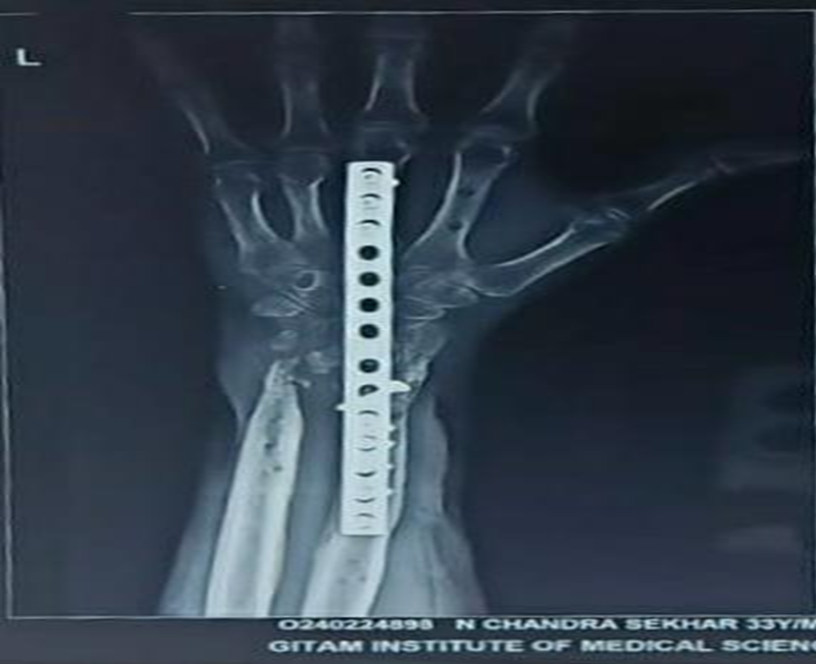
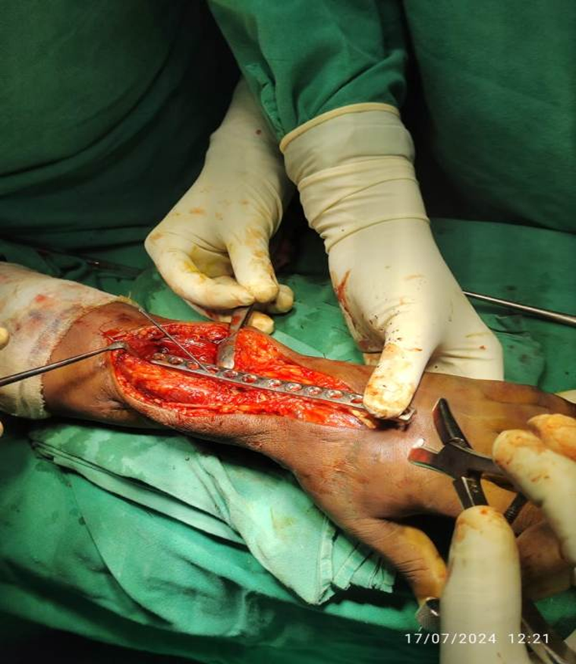
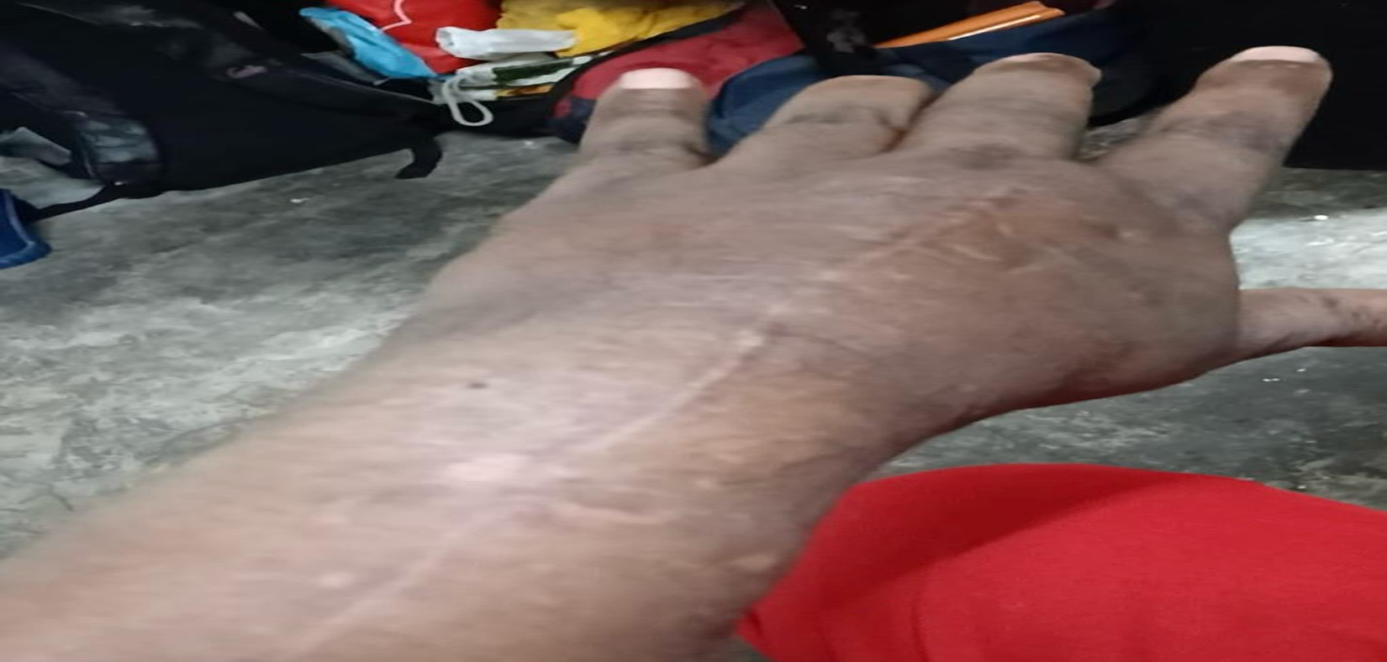
DORSAL BRIDGE PLATING IN MANAGEMENT
OF NON-UNION OF DISTAL RADIUS FRACTURE
AUTHOR: Dr. KANALA MABU HUSSAIN
C0-AUTHOR: Dr. M SAI KRISHNA ( ASSISTANT PROFESSOR) DEPARTMENT OF ORTHOPAEDICS
GITAM INSTITUTE OF MEDICAL SCIENCE AND RESEARCH
INTRODUCTION
OPERATIVE FINDINGS
DISCUSSION
The Dorsal bridge plating include restoring congruity of the radiocarpal and distal radioulnar joint (DRUJ) surfaces and maintaining radial length. We used 14 hole 3.5-mm dynamic compression plate (DCP) in the floor of the fourth dorsal extensor compartment to span from the intact radius diaphysis to the third metacarpal.
SURGICAL APPROACH: We made a longitudinal incision over the dorsum of the wrist and distal forearm. After achieving proper reduction with external fixation and then we used a long dorsal bridge plate that typically spans from the distal third of the metacarpals to the diaphysis of the radius, bypassing the zone of comminution.
Result: Patient had good functional outcome with finger movements. Post operative rehabilitation helped patient to improved quality of life due to pain relief. Patient has not reported with tendon irritation, Neuropraxia, Stiffness of wrist and inter-phalangeal joints, Non union and Malunion.
In Intra articular comminuted DER fractures where plating and external fixation is not possible because of pin-track infection or loosening leading to loss of reduction, stiffness the use of the dorsal bridge plate permitted the soft-tissue envelope to mature while maintaining radial length, allowing retaining congruity of the radiocarpal and radio-ulnar joints.
CONCLUSION
CASE REPORT
This plate provides excellent screw purchase in osteopenic bone because the device is secured to the cortical bone of the long metacarpal & the radius and reduce risk of recurrence
32 years male with non-union of left distal radius fracture with previous failed fixation and did not recover functional arc of motion underwent dorsal bridge plating for distal radius.

