Slide 1
COMPARATIVE STUDY OF CORTICOSTEROID INJECTION
AND PLATELET RICH PLASMA INJECTION IN LATERAL
EPICONDYLITIS
PRASENTER: DR.PANDAVULA PRASHANTH
GUIDE: DR.G.S.MUKHARJEE MS ORTHO(PROFESSOR)
RMC, KAKINADA.

Slide 2
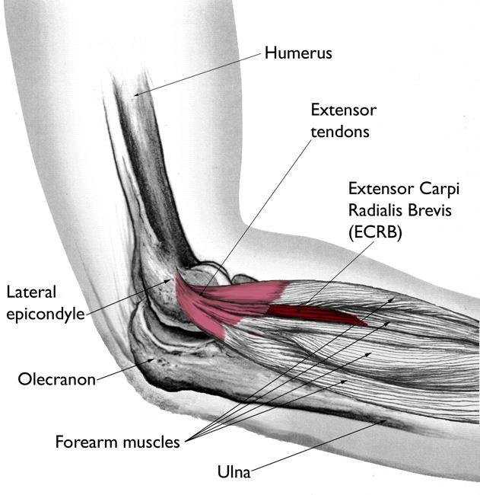
INTRODUCTION:
Lateral epicondylitis is a common cause of elbow pain Involves origin of common extensor tendon
Most commonly affects ECRB tendon
Affects 1–3% of general population
Common in age group 35–50 years
Dominant limb commonly involved
ETIOPATHOGENESIS:
Caused by repetitive overuse
Microvascular changes lead to degeneration
Tendinosis rather than pure inflammation
Primary pathology at ECRB origin
Occasionally involves ECRL and EDC

Slide 3
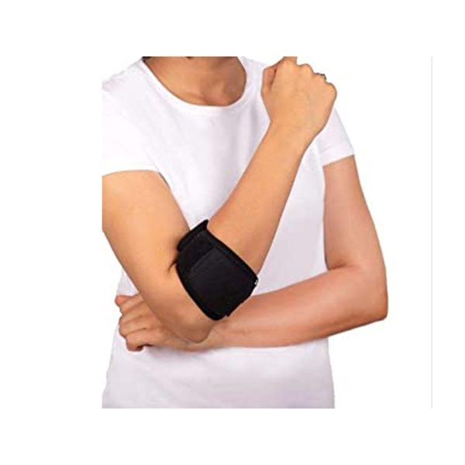
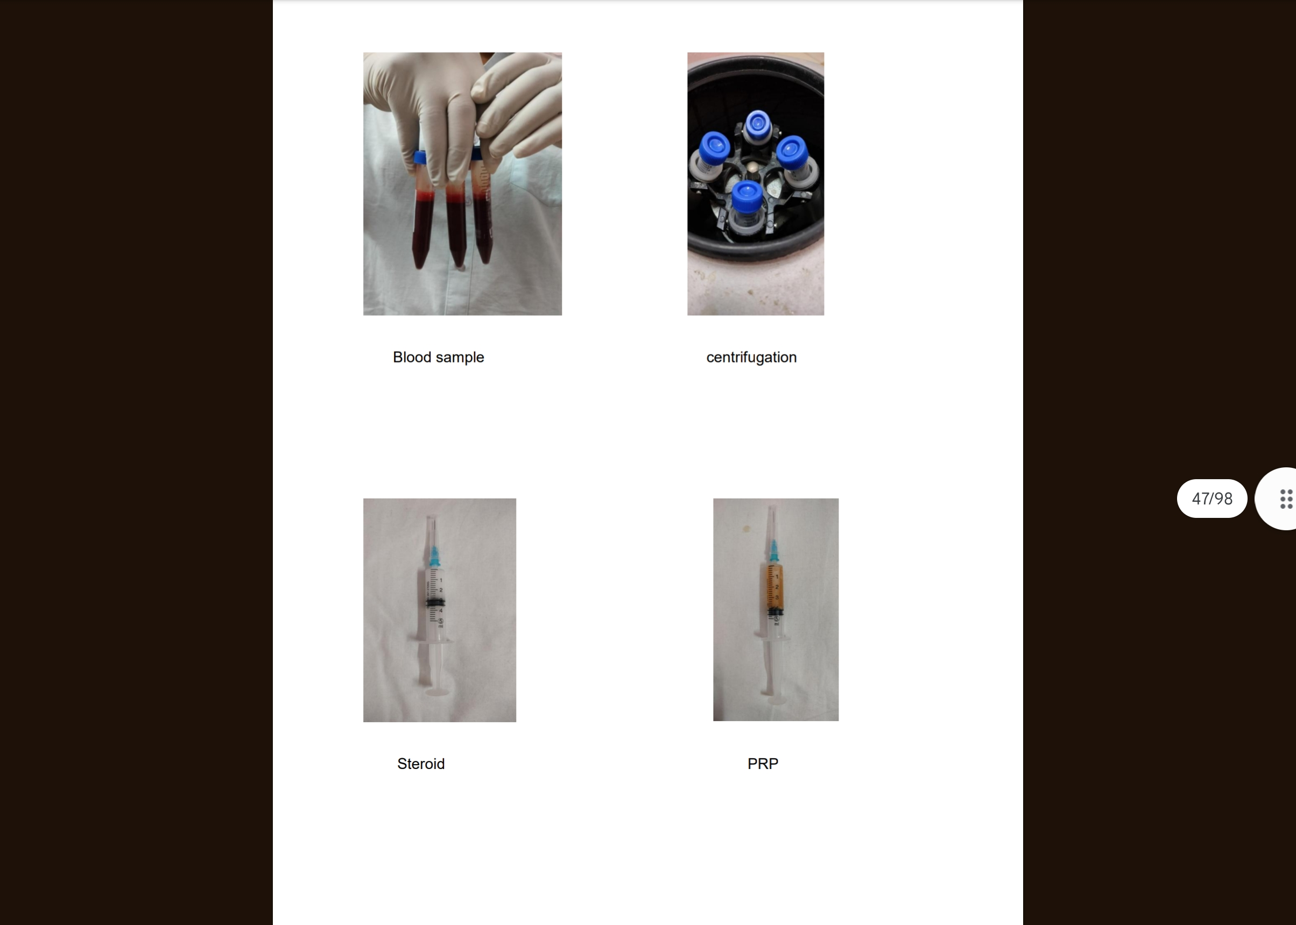
TREATMENT MODALITIES:
Rest and activity modification
NSAIDs
Counterforce braces
Physiotherapy
Ultrasound and shock wave therapy
Corticosteroid injections
PRP injections
Surgical treatment in refractory cases
RATIONALE OF STUDY :
Corticosteroids give rapid pain relief -Poor long-term outcomes and recurrence reported
PRP promotes biological healing -Limited comparative studies
-Need to evaluate short-term effectiveness

Slide 4
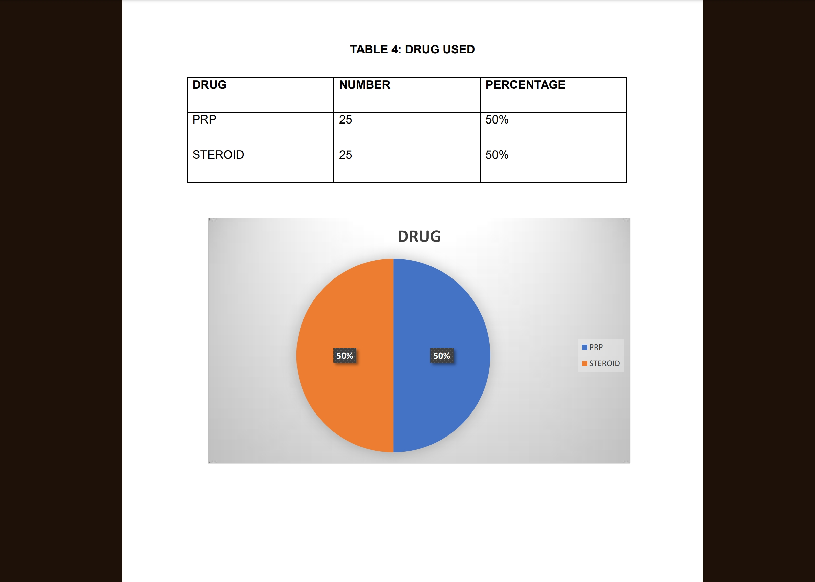
AIM AND OBJECTIVES
Aim:
- To evaluate outcomes of corticosteroid and PRP injections in lateral epicondylitis
Objectives:
-Compare pain relief
-Compare functional improvement
-Assess short-term results
STUDY DESIGN:
Prospective comparative study
Sample size: 50 patients
Diagnosed cases of lateral epicondylitis
Two groups:
-PRP group
-Steroid group

Slide 5
OUTCOME MEASURES:
Visual Analog Scale (VAS) – Pain assessment
DASH Score – Functional assessment
Follow-up periods:
-Baseline
-4 weeks
-8 weeks
-12 weeks
PRP: MECHANISM OF ACTION:
Derived from autologous blood
Releases growth factors:TGF-β,PDGF,FGF,VEGF
Enhances tendon healing
Promotes tissue regeneration
Has antibacterial properties

Slide 6
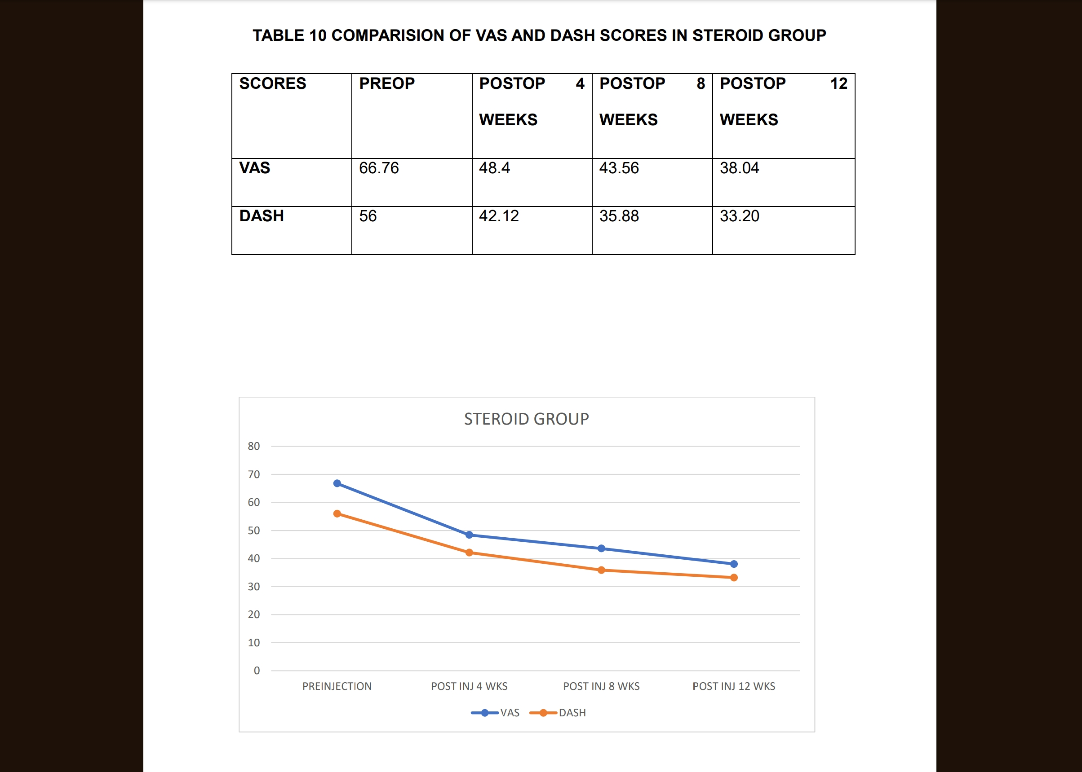
LITERATURE REVIEW (STEROIDS):
Good short-term pain relief
Faster initial improvement
High recurrence rates
Outcomes decline at long-term follow-up
Post-injection discomfort reported
LITERATURE REVIEW (PRP):
Promotes biological tendon healing
Improves long-term outcomes
Better functional recovery
Safe and effective treatment option

Slide 7
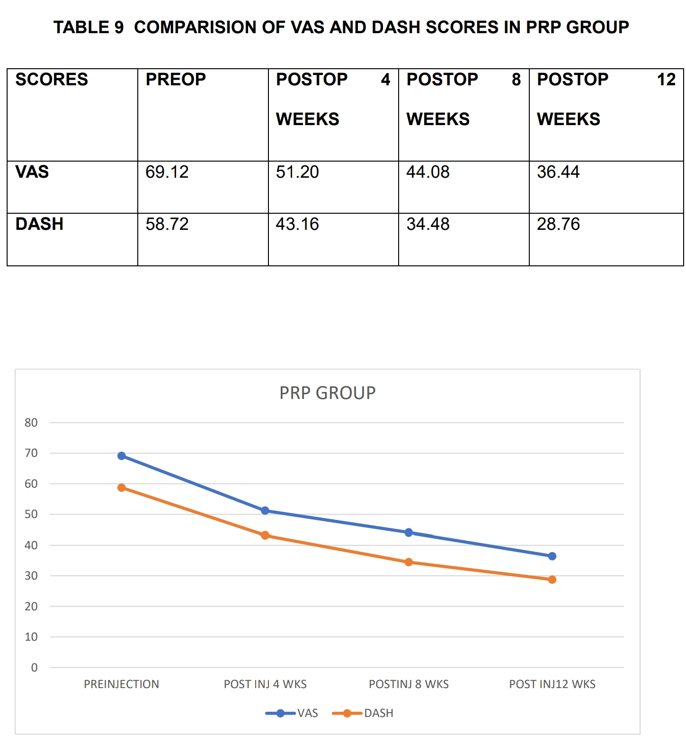
RESULTS (OVERVIEW):
Both groups showed improvement
Steroid group:
-Faster early pain reduction
PRP group:
-Sustained improvement
-Significant improvement in VAS and DASH scores
DISCUSSION:
Steroids effective for short-term symptom relief
PRP offers regenerative benefits
PRP shows better durability of results
Supports shift towards biological therapy

Slide 8
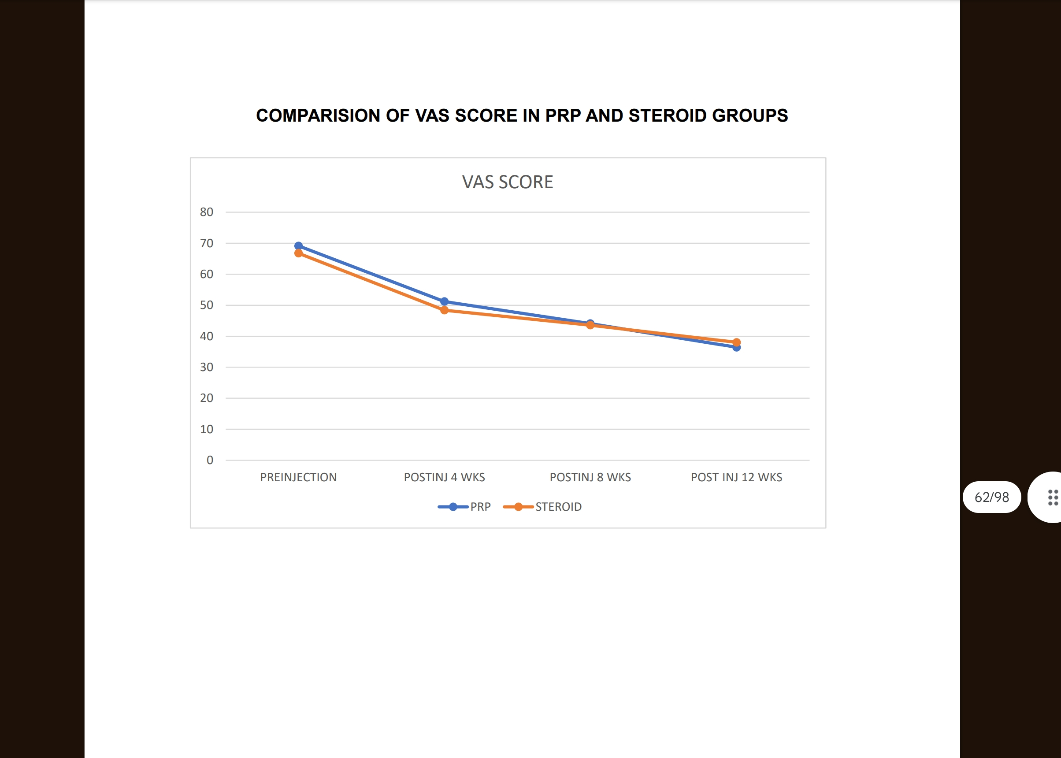
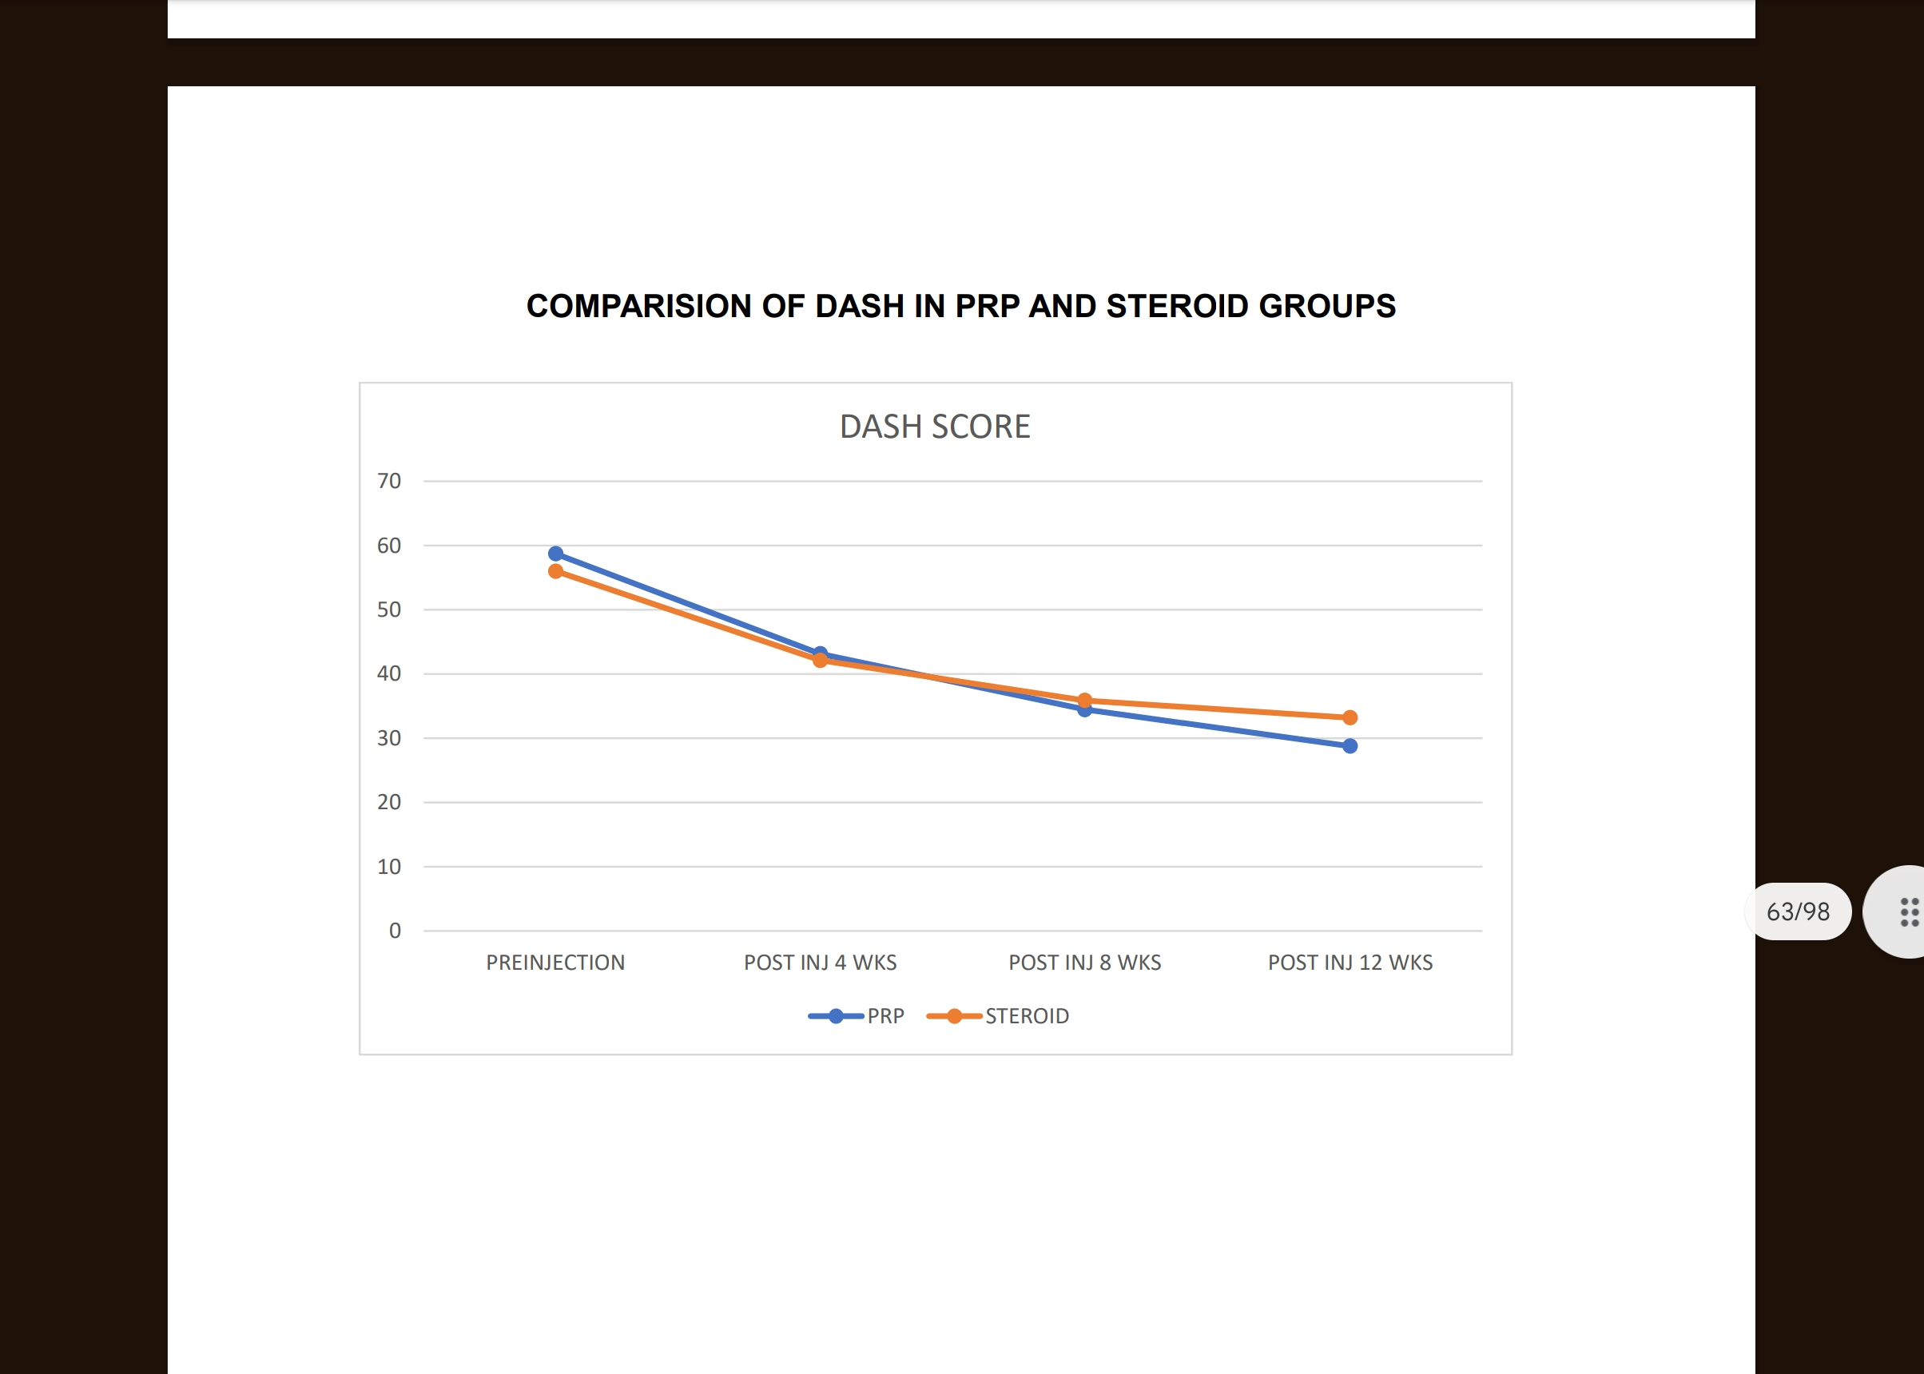
CONCLUSION:
Both PRP and steroid injections are effective
Steroids provide rapid pain relief
PRP provides better sustained functional improvement
PRP is a promising alternative in chronic cases
TAKE HOME MESSAGE
Lateral epicondylitis is degenerative in nature
Steroids → Short-term benefit
PRP → Long-term regenerative benefit
PRP should be considered in recurrent and chronic cases

