Slide 1




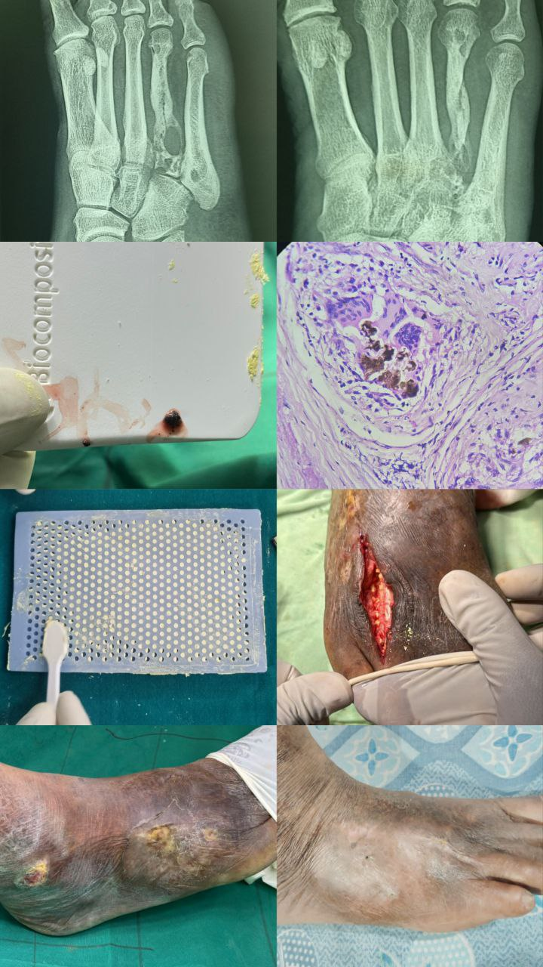
CHRONIC FUNGAL OSTEOMYELITIS OF 4th , 5th METATARSAL DUE TO ASPERGILUS SPECIES IN AN INMMUNOCOMPROMISED PATIENT
PRESENTING AUTHOR:DR.R.SANTHOSH 3RD YR POSTGRADUATE,RMC,KAKINADA
UNDER THE GUIDANCE OF DR.SIVANANDA(HOD),DR.R.G.MADHU(ASSO PROF),DR.RAJA KISHORE(ASST PROF)
INTRODUCTION
OPERATIVE FINDINGS
DISCUSSION
→Fungal infections are usually indolent in immunocompetent individuals but may rapidly disseminate and become fatal in immunocompromised hosts.
→Chronic fungal osteomyelitis is a rare, slowly progressive bone infection that can lead to extensive bone destruction if untreated.
→Infection may occur through direct inoculation following trauma, open wounds or surgery, hematogenous spread, or contiguous extension from adjacent sites.
→A 55-year-old diabetic male presented with multiple draining sinuses of the right foot for one month, with a remote history of thorn prick injury 15 years back and recurrent self-healing sinuses.
→Examination showed three sinuses over the midfoot and hindfoot with preserved neurovascular status; XRAY and MRI revealed chronic osteomyelitis of the 4th & 5th metatarsal with deep soft-tissue infection.
→The patient underwent surgical debridement and curettage with tigecycline(sensitive)-loaded calcium sulphate pellets, and intraoperative samples were sent for microbiology and histopathology.
→Sample reports came as CHRONIC GRANULOMATOUS PIGMENTED FUNGAL OSTEOMYELITIS.
→Postoperatively, he received IV and oral antifungals then advised non–weight bearing for 4 weeks.
CONCLUSION
CASE REPORT
→A 55Y/M k/c/o Diabetes with a remote thorn prick injury presented with multiple draining sinuses of the rt foot, and imaging confirmed chronic osteomyelitis managed by surgical debridement and tigecycline-loaded pellets followed by antifungals.
→ Aspergillus chronic fungal osteomyelitis is a debilitating infection affecting both immunocompromised and immunocompetent patients.
Thus, management optimally includes antifungal therapy and individualized surgery based upon site and local complications to achieve a favourable outcome.
Reference:Fungal Osteomyelitis: A Systematic Review of Reported Cases - https://pmc.ncbi.nlm.nih.gov/articles/PMC10383745/

