Slide 1
A study of intra articular calcaneal fracture treated with cannulated screw fixation.
Author: Dr.Cheetirala venkata siva satya prudhvi
2nd year Post graduate
Co-author: Dr. Sujith deva prasad
HOD&Professor,
Department of orthopaedics
Santhiram medical College, Nandyala.

Slide 2
INTRODUCTION
Calcaneal fracture constitutes above 70% of all tarsal injuries, majority of the calcaneal fractures are treated non operatively.
Open reduction and internal fixation through an extensile lateral approach has been widely accepted but high wound related complication rate has been reported.
Minimally invasive techniques have been reported as effective in wound related operation time, complications and maintaining articular reduction.

Slide 3
AIM
To assess the functional outcome of patients with displaced intra-articular calcaneal fractures treated with percutaneous reduction, cannulated screw fixation
METHODS
14 patients with a DIACFs, underwent percutaneous reduction, cannulated screw fixation.
Functional outcomes were evaluated using the American Orthopaedic Foot and Ankle Society (AOFAS) hind foot scores.
Radiological results were assessed using plain radiographs and computed tomography (CT) scans, and postoperative wound-related complications were also recorded.

Slide 4
SURGICAL TECHNIQUE
Firstly, Steinman pin is inserted in posterior inferior portion of calcaneus. Then in axial view varus, valgus angulation is corrected and provisionally fixed with kirschner wires.
In lateral view joint depression is elevated using bone taps and fixed with kirschner wires.
In tongue depression fractures kirschner wire is inserted lateral to achilles tendon and elevated. All provisionally fixed kirschner wires are replaced with cannulated cancellous screws.

Slide 5
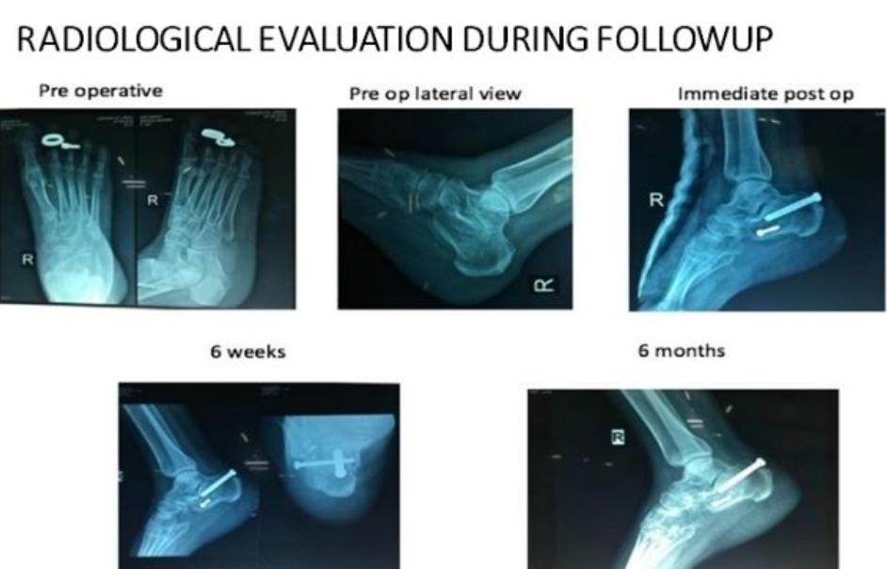

Slide 6
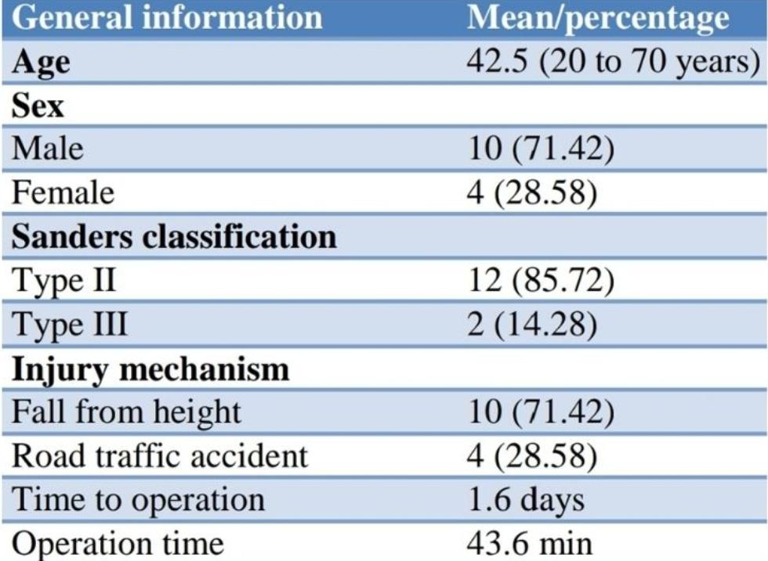
RESULTS
A total of 46 adult patients were assessed in our study. Twenty patients did not meet the inclusion criteria and were excluded.
Twelve patients were excluded due to severe medical ailments (2 patients) and non-adherence to the treatment plan (10 patients).
Therefore, 14 patients with an average age of 42.5 years old (range, 20 to 72 years) including 10 men and 4 women participated in the study.

Slide 7
All patients were followed-up for 6 months averagely (range, 6 to 8 months). Complete articular reduction is achieved in 8 patients, 6 patients had articular depression of posterior facet, 3 patients had heel widening and lateral impingement.
There was no wound complications in any of the patients.
According to the AOFAS scoring 10 excellent; 2 as good; 2 as fair. Good to excellent rate of 84.0%. The mean AOFAS score was 86.6. Time from surgery to partial weight bearing was 6.2 week.
CONCLUSION
Surgical treatment of intra articular calcaneal fractures remains challenging task.
Minimally invasive reductions for intra articular calcaneal fractures with cannulated cancellous screw fixation remains good option to minimize wound complications.

Slide 8
1)Yang H, Zhang S, Zhong Q, et al. Subtalar joint arthroscopic-assisted reduction and cannulated screw fixation versus open reduction and internal fixation for displaced intra-articular calcaneal fractures. Journal of Orthopaedic Surgery and Research. 2025;20:270. DOI:10.1186/s13018-025-05666-7. (Comparative study of cannulated screws vs ORIF with arthroscopic assistance)
2)Bahaeddini MR, Konjkav AR, Aminian A, et al. A simple modified technique for screw fixation of displaced intra-articular calcaneus fractures through a sinus tarsi approach: comparison with plate fixation. BMC Musculoskeletal Disorders. 2024;25:750. DOI:10.1186/s12891-024-07873-5. (Focused on screw fixation in sinus tarsi approach)
3)Kerketta AH, Mittal S, Rahul K, Laik JK. Radiographic and functional outcome of operated closed intra-articular fractures of calcaneum: screws vs plate fixation. International Journal of Research in Orthopaedics. 2023;9(5):975-981. (Shows cannulated screw outcomes vs plate)
4)PubMed: Prospective comparative study – Percutaneous cannulated screws vs K-wires for displaced intra-articular calcaneal fractures. Prospective study showing better functional & radiologic outcomes with screws. (Sohag Univ. Hospital RCT; Sanders II/III)
REFERENCES

