Slide 1


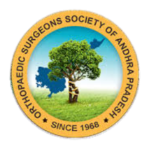
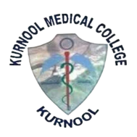
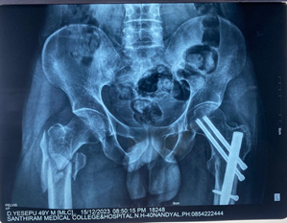
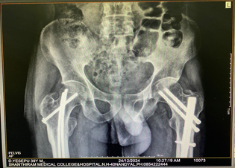
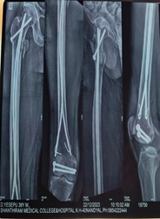
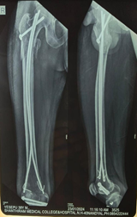
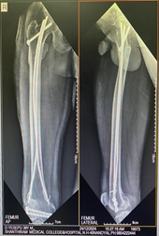
Title: Flexible intramedullary nailing (Ender’s nail) for comminuted intertrochanteric femur fracture in a patient with uncontrolled diabetes.
PRESENTER:DR.CHEETIRALA VENKATA SIVA SATYA PRUDHVI (POST GRADUATE)
GUIDE:DR. P. SUJITH DEVA PRASAD (HOD & PROFESSOR)
DEPARTMENT OF ORTHOPAEDICS, SANTHIRAM MEDICAL COLLEGE, NANDYAL.
INTRODUCTION
OPERATIVE FINDINGS
DISCUSSION
Comminuted intertrochanteric femur fractures are challenging to manage due to their complexity and difficulty in achieving stable fixation, especially in patients with comorbidities like uncontrolled diabetes mellitus.
Multiple treatment options—conservative and surgical with various implants—have been described, each with advantages and limitations.
Since its introduction in 1969, ender’s nail remains in use, particularly in the elderly, with modifications. Its advantages include technical simplicity, shorter operative time, reduced blood loss, and early mobilization
Under Epidural anaesthesia, patient on traction table in supine position, reduction of fracture fragments achieved under C-arm guidance. Two small incisions taken near the knee joint both on medial and lateral sides. Entry made with bone awl and pre bent Enders nails (4.5mm x 40mm) were introduced one from each side allowing them to spread out within the femoral head and neck to stabilize fracture. For achieving additional rotational stability, a 6.5mm x 80mm CC screw along with washer was introduced from the base of the greater trochanter into the femoral neck and head. The nails were secured to the bone at the base by inserting pre bent (U-shaped) K-wires through the eye holes of Enders nails.
Postoperatively, patient was allowed to sit up in the bed immediately. Knee mobilization was started after 2 weeks. Partial Weight bearing was started after 4 weeks post operatively.
The goal of the fracture treatment has shifted from just union of the fracture to the maximal functional recovery of the limb as early as possible.
In diabetic patients, there are several factors that can compromise bone healing, including impaired vascularity, delayed collagen synthesis, and increased susceptibility to infections.
In the case of uncontrolled diabetes, challenges such as poor wound healing, risk of infection, and delayed bone healing are amplified.
A "modified Ender's nailing" in the femur refers to a surgical technique where the standard Ender nails, which are flexible, pre-bent intramedullary nails, are used to fix a femoral fracture, but with additional modifications to improve stability and address potential limitations of the traditional Ender nailing method, often including features like added screws or cerclage wires to enhance rotational control and prevent migration of the nails.
The main advantages of Ender’s nailing method are short operative procedure, minimally traumatic, little blood loss, early mobilization, negligible risk of infection and risk of delayed union or non-union is also reduced.
CASE REPORT
PRE OP XRAY
10 MONTHS F/U XRAY
CONCLUSION
39-year-old male presented with right hip pain for 4 hours following skid-and-fall injury at work. Examination revealed swelling, tenderness, and external rotation of the right lower limb, with restricted and painful hip movements.He has diabetes mellitus for 15 years, on insulin therapy.
Past history includes right knee surgery 5 years ago and left hip PFN fixation 2 years ago following trauma.
Surgical fixation of long bones in patients with severe comorbidities is a challenge as there are chances of heavy blood loss, high infection rates owing to the prolonged surgical time in difficult cases such as comminuted intertrochanteric femur fractures.
So, to avoid such complications closed reduction and modified Ender’s nailing is done in this case to lessen the operative time and minimize the exposure of the surgical sites.
Excellent reduction and alignment are achieved with good functional outcome.
IMMEDIATE POST-OP
1 MONTH F/U
10 MONTHS F/U

