Slide 1




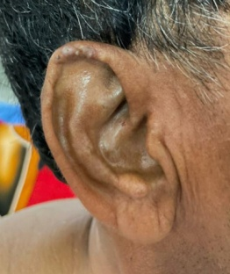
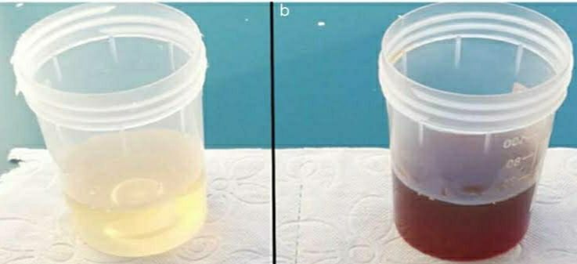
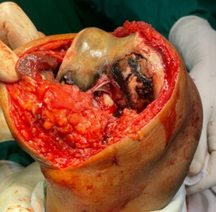
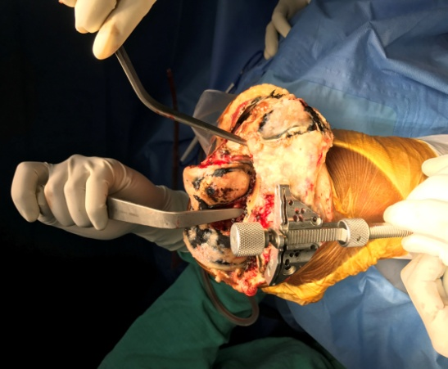
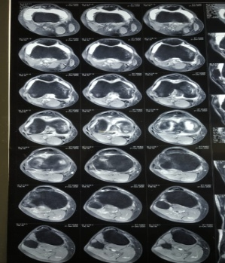
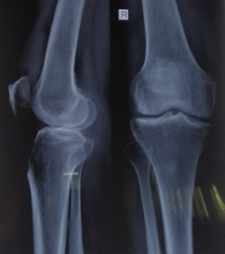
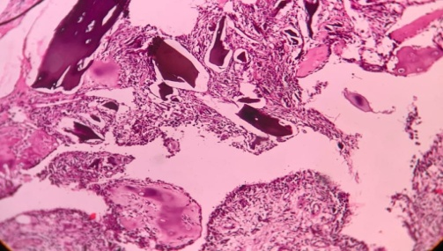
55th Annual Conference of Orthopedic Surgeon Society of Andhra Pradesh
ALKAPTONURIA - A CASE REPORT
Dr. D VENKATESH(PG)
Dr. P ANIL BABU(MS ORTHO) , Dr. HEMA DURGA (MS ORTHO)
INTRODUCTION
OPERATIVE FINDINGS
DISCUSSION
Alkaptonuria is a rare autosomal recessive metabolic disorder caused by deficiency of homogentisate 1,2-dioxygenase, an enzyme involved in tyrosine metabolism. Deficiency leads to accumulation of homogentisic acid (HGA), which oxidizes and polymerizes to form ochronotic pigment. Deposition of this pigment in connective tissues results in ochronosis, causing progressive degenerative arthropathy.
Clinical findings – Black pigmentation is over eyes and ears since many years. Swelling of right Knee is tender, no local rise of temperature
Alkaptonuria, an autosomal recessive disorder, In Alkaptonuria due to absence of homogentisate1,2dioxygenase, homogentisic acid produced in excess. Accumulationof this pigment in various tissues leads to systemic disease. This process is called ochronosis2. As homogentisic acid is oxidized to benzoquinone acetate, which polymerizes to form melanin-like polymers, resulting in widespread deposition in fibrous tissue and cartilage. Ochronosis, homogentisic aciduria, and ochronotic osteoarthropathy are the triad of alkaptonuria.
Patient is planned for Total Knee replacement.
INTRA OPERATIVE FINDINGS
Synovectomy of right knee done –Black coloured tissue identified, removed and
sent for histopathological examination
Movements-fixed flexion Deformity 20deg.
ROM: 20 -90 deg active
RADIOLOGICAL FINDINGS
X- ray shows arthritis changes.
MRI right knee –
shows Grade IV articular cartilage injury invoving lateral compartment of knee joint with involvement of medial femoral condyle with joint effusion and fat deposition.
LABORATORY FINDINGS: Urine turned black on exposure to air. Urine gas chromatography shows homogentisic acid. Catecholamines- Elevated
CASE REPORT
A 53-year-old male presented with swelling of the right knee for 2 years and pain for 6 months. He had a past history of tuberculosis of the knee, treated with anti-tubercular therapy for one year. The patient also underwent surgical repair for bilateral Achilles tendon ruptures in 2014 and 2015. Clinical and intraoperative findings were suggestive of ochronotic arthropathy, leading to the diagnosis of alkaptonuria.
CONCLUSION
Histopathological reported as polypoidal synovial Ochronosis
Final diagnosis –Alkaptonuria.
Alkaptonuric patients may be treated supportively.A low tyrosine and phenylalanine diet, vitamin C or antioxidants, and nitisinone may slow the progression. Joint replacement has excellent outcomes in a patient with significant degenerative arthropathy .

