Slide 1
Evaluation of Functional and Radiological Outcome of Five‑Pin Technique in Management of Distal End Radius Fractures
PRESENTOR: DR. DACHEPALLY VINIL
MODERATOR: DR TATI RAJASHEKHAR (ASSOCIATE PROFESSOR)
DEPARTMENT OF ORTHOPAEDICS, GIMSR

Slide 2
ABSTRACT
Introduction:
Distal end radius fractures are the most common fractures of the upper extremity.
The most common mode of injury is a fall on outstretched hand.
Closed reduction and percutaneous pinning with “the five‑pin technique” improve the reliability of fixation.
The current study aimed to assess the clinical and functional outcome of fixation of distal radius fractures using the five‑pin technique.

Slide 3
Materials and Methods:
20 patients with fracture of distal end radius Frykman type 1 and 2 were subjected to close reduction and K‑wire fixation by five‑pin technique

Slide 4
Results:
Functional outcome‑using Obrien scoring system for functional outcome, there was 90%–100% score in 9 patients, 80%–89% in 9 patients, and < 80% in 2 patient.
Radiological outcome using SARMIENTO MODIFICATION LINDSTROM CRITERIA. 9 patient had excellent results, and 9 had good results and 2 had fair result.

Slide 5
Conclusion :
“The five- pin technique” is a versatile tool which provides optimum functional and radiological outcome better than conventional k wire fixation

Slide 6
Introduction
Fracture of the distal radius is the most common of all orthopedic injuries accounting 16%–20% of all fractures presenting to the emergency department.
Road traffic accident plays a major role sustain these trauma while older person has house fall with trivial insults.
Pathoanatomy and biomechanics of radiocarpal and radioulnar joints have pivotal role in maintaining wrist functions and movement.
Problems associated with these fracture hamper strength of grip and early arthritis with carpal instability.

Slide 7
Close reduction with cast application is the most common modality of treatment for distal radius fracture.
But complications such as fracture malunion and subluxation of distal radioulnar joint is a common complication associated with close reduction with cast application.
Although many treatment modalities are available, there is no consensus on the optimum treatment of these injuries.

Slide 8
Aims and objective
Evaluation of functional and radiological outcome of five‑pin technique in management of distal radius fracture and to study the complication associated with this technique.

Slide 9
Materials and Methods
Inclusion criteria:
  Age above 50 years
  All extra‑articular fractures which are reduced by close method or joystick method
  Patient presenting within 7 days of fracture.

Slide 10
Exclusion criteria
  Patients with intra‑articular fracture of distal radius
  Pathological fracture
  Patients with compound fracture
  Patients with associated ipsilateral upper limb trauma
  Uncontrolled diabetes mellitus

Slide 11
Closed reduction performed using Charnley’s method and checked under image intensifier to confirm acceptable reduction and proceed with K‑wire fixation in the following order:
Radial styloid pin in lateral to medial direction
Medial corner pin in dorsal to volar and medial to lateral direction
Lister tubercle pin in dorsal to volar direction
Distal and proximal radio ulnar pins

Slide 12
Patient was given below‑elbow plaster of Paris Slab and prescribed analgesic and antibiotic drugs.
Regular pin tract dressing was explained.
Patient was followed up for 1, 3, 6, and 12 weeks.
At 3 weeks, below‑elbow slab was removed and proximal and distal radioulnar wire was removed.
At the end of 6 weeks, remaining K‑wire and below‑elbow slab were removed, and physiotherapy was started .

Slide 13
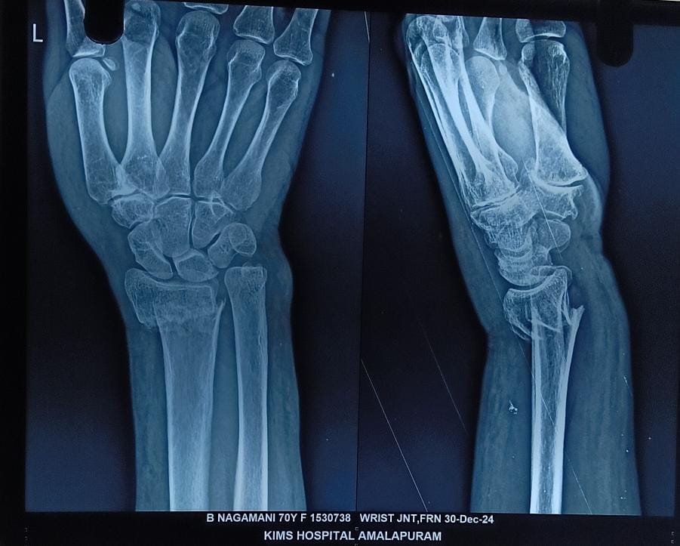
PRE OP XRAY

Slide 14
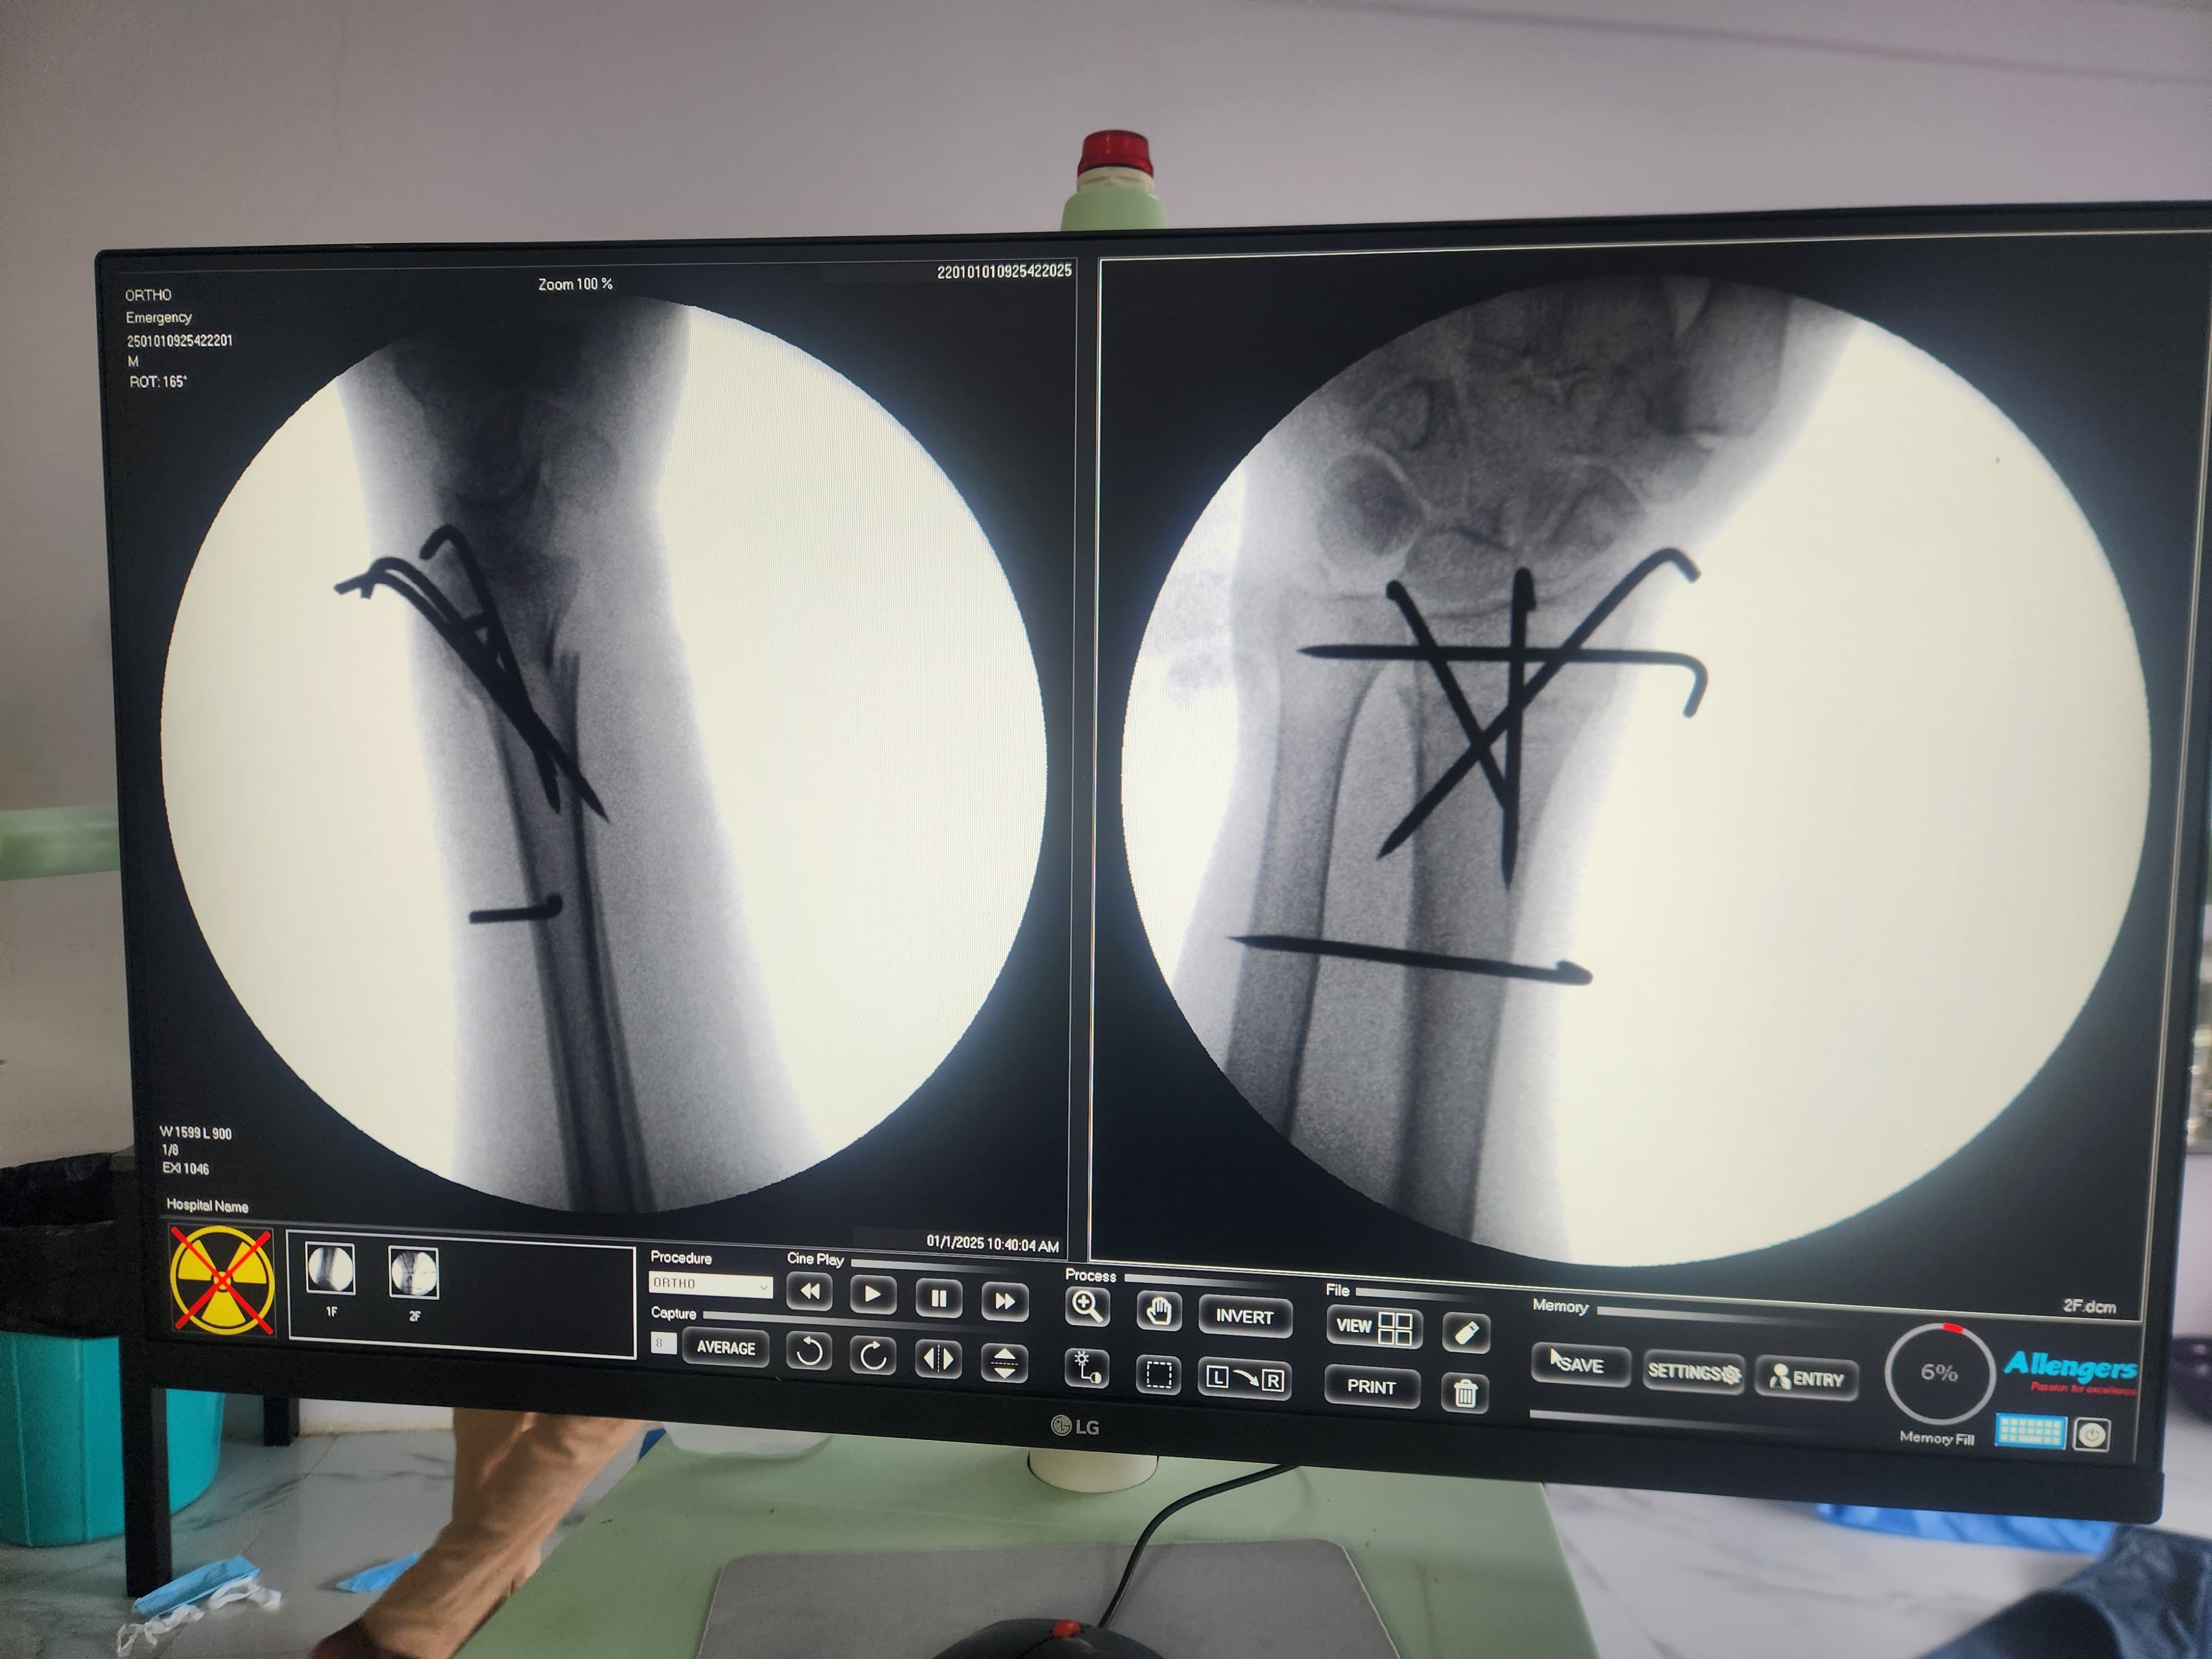
INTRA-OP

Slide 15
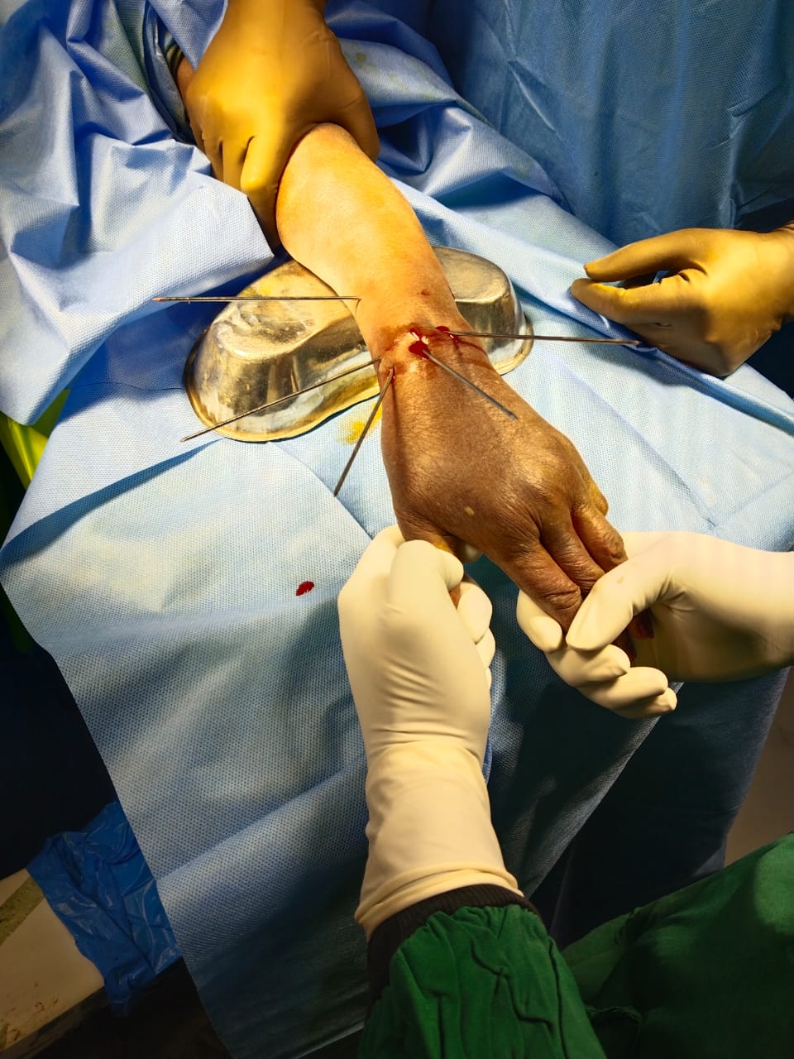
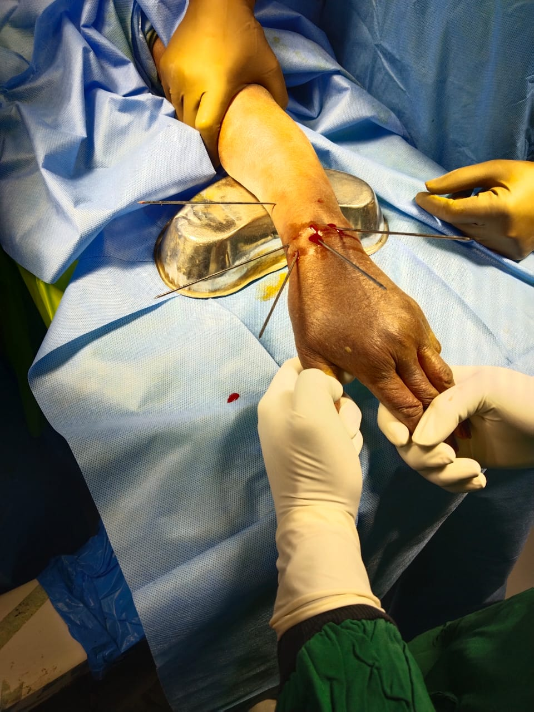

Slide 16
Results
20 patient with fracture of distal radius were studied prospectively at gitam institute of medical science and research centre, Visakhapatnam, from January 2023 to September 2024. the sex distribution and fracture type has been mentioned in table.
The mean age of the patients included in the study was 50 years with youngest patient being 45 years and the oldest patient being 80 years.
All patients were operated within 5 days of trauma.
Complication‑superficial pin track infection was reported by one patient that was treated with antibiotics, dressing, and repinning.

Slide 17
Sex distribution
SEX | NO. OF PATIENTS
MALE | 12
FEMALE | 8

Slide 18
FRACTURE TYPE DISTRIBUTION
FRACTURE TYPE | NO. OF PATIENTS
FRYKMAN TYPE 1 | 16
FRYKMAN TYPE 2 | 4

Slide 19
FUNCTIONAL OUTCOME USING OBRIEN SCORING
OBRIEN SCORE | NO. OF PATINET
90-100 | 9
80-89 | 9
<80 | 2

Slide 20
RADIOLOGICAL OUTCOME-USING SARMIENTO MODIFICATION LINDSTROM CRITERIA
GRADE | NO. OF PATIENT
EXCELLENT | 9
GOOD | 9
FAIR | 2

Slide 21
Conclusion
Five‑pin technique of K‑wire fixation is a novel technique that provides effective means of treating distal end radius fractures. It is a versatile tool which provides optimum functional and radiological outcomes.

Slide 22
THANK YOU

