Slide 1

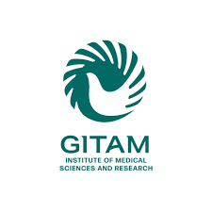
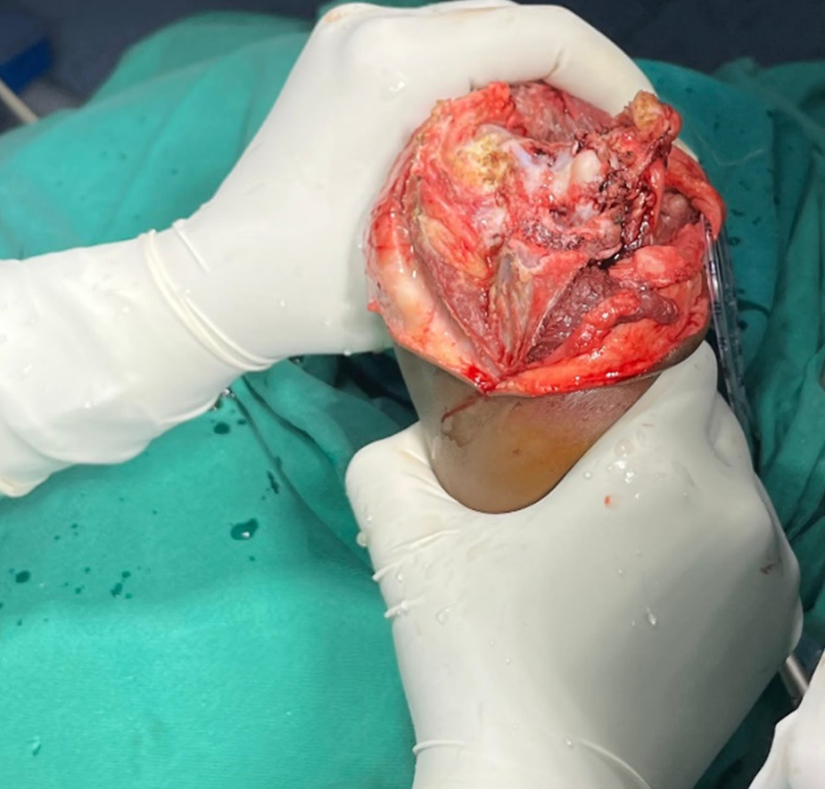
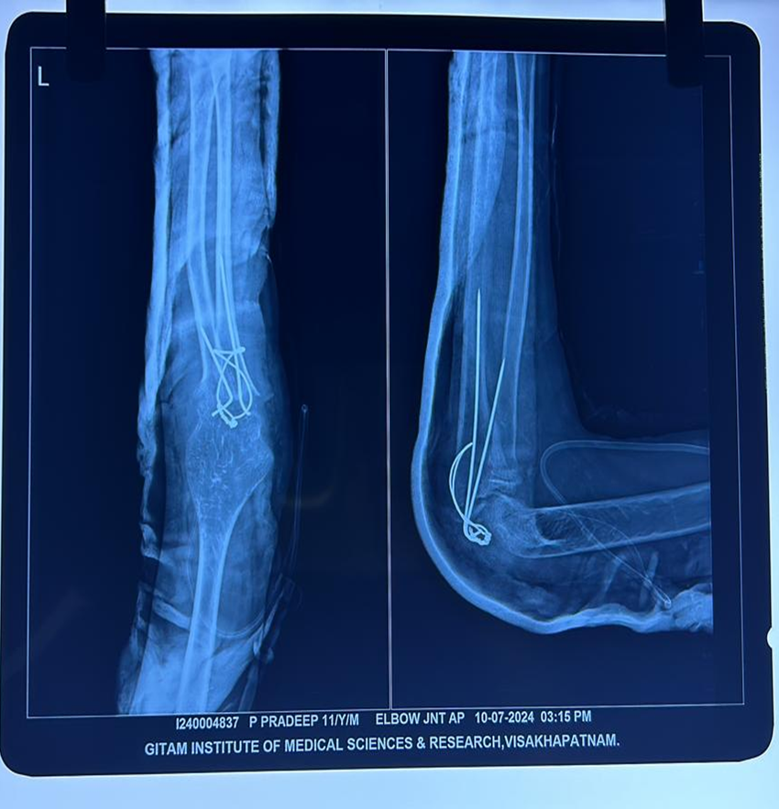
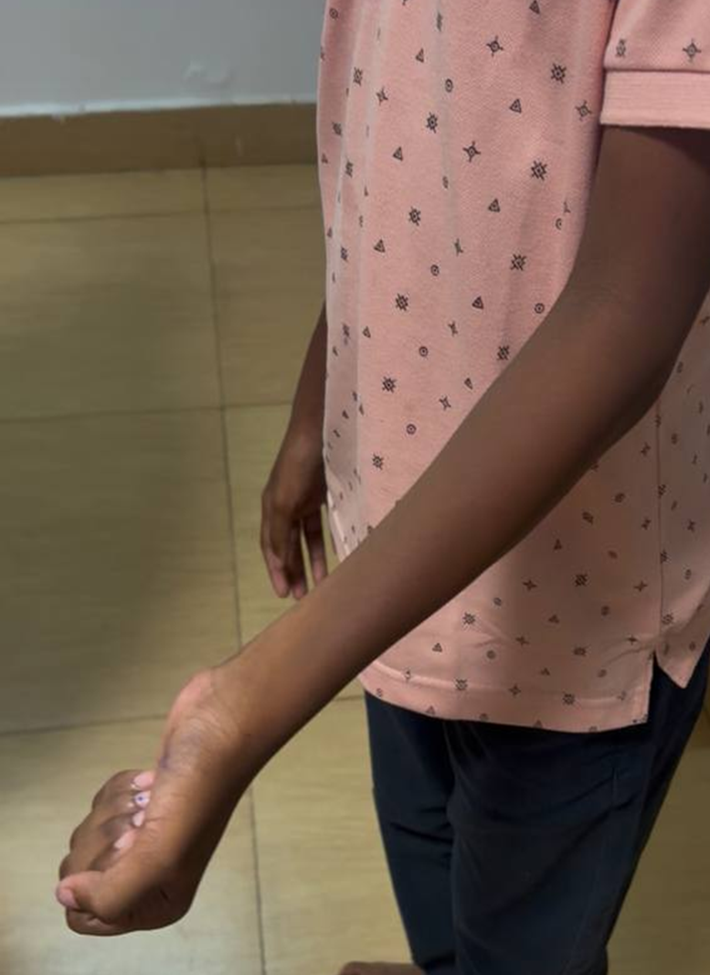
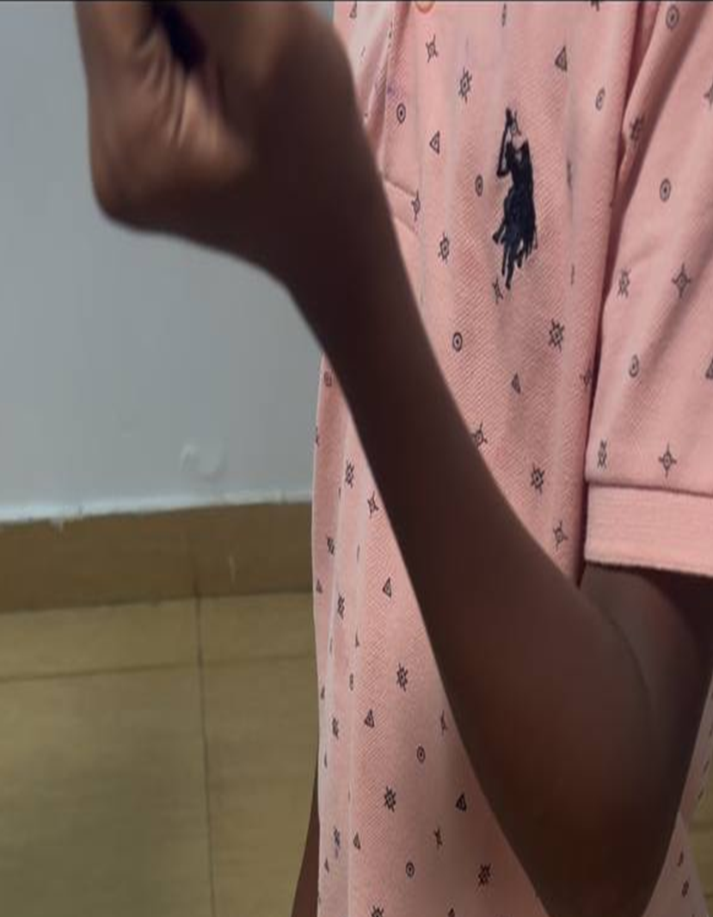
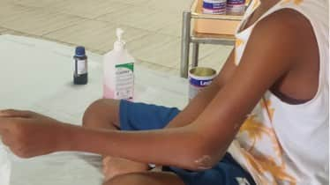
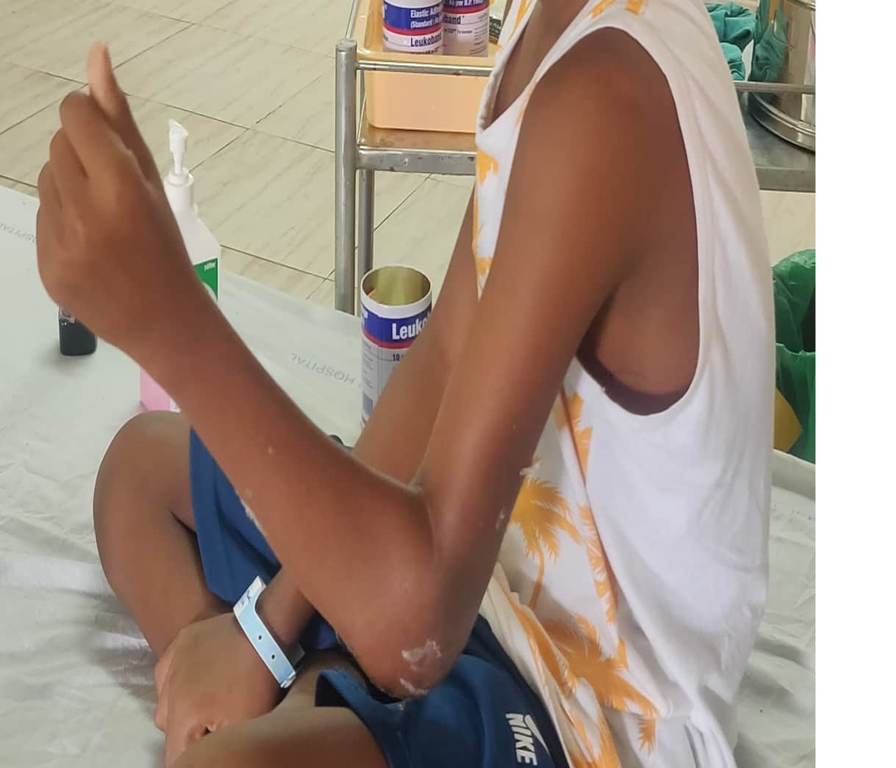
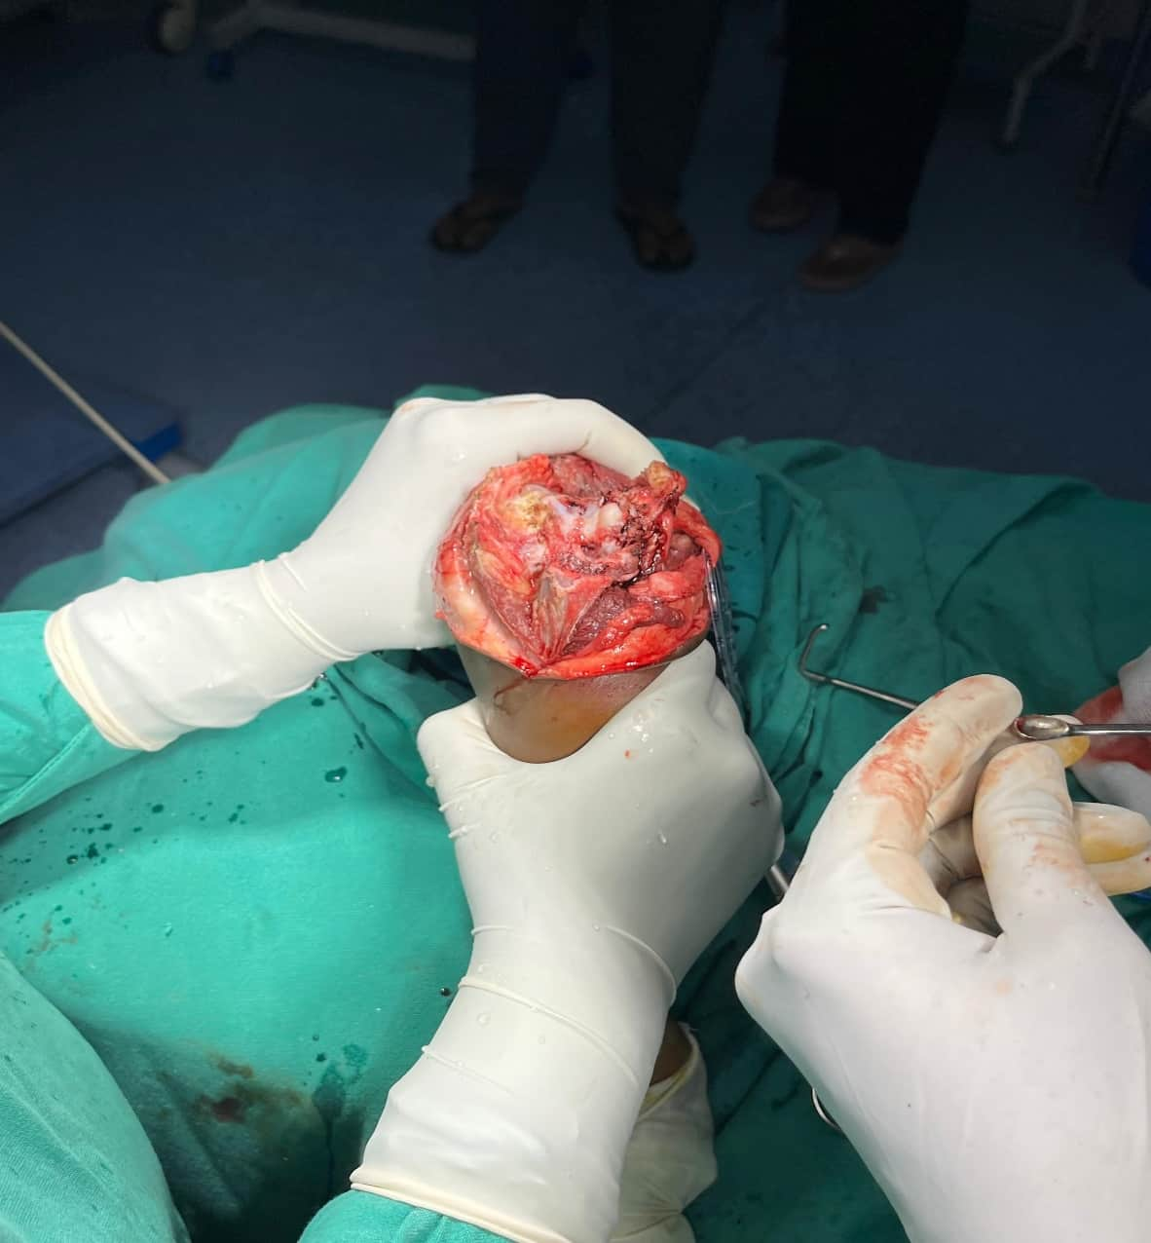
Olecranon osteotomy Facilitated Elbow Release(OFER)
AUTHOR: Dr. Dachepally Vinil
CO-AUTHOR: Dr. Karanam Vamsi (Assistant Professor)
Department Of Orthopedics, GIMSR
INTRODUCTION
OPERATIVE FINDINGS
DISCUSSION
Post-traumatic elbow contracture is a challenging condition that significantly limits function and quality of life. Although both open and arthroscopic release techniques are available, each has limitations related to soft-tissue morbidity, technical difficulty, and restricted indications.
Olecranon Osteotomy Facilitated Elbow Release (OFER) provides excellent circumferential exposure of the elbow joint, allowing effective release of both intrinsic and extrinsic contractures with controlled soft-tissue handling. This poster highlights the surgical technique and functional outcome of OFER in a long-standing post-traumatic elbow stiffness.
Intraoperatively, there was marked thickening and fibrosis of both the anterior and posterior elbow capsule with dense post-traumatic adhesions severely restricting joint motion. Heterotopic ossification was noted, contributing to the extrinsic component of the contracture, along with a tight medial collateral ligament limiting elbow extension. Following olecranon osteotomy, excellent exposure of the elbow joint was achieved, allowing complete visualization of both anterior and posterior compartments. This facilitated thorough capsular release and excision of heterotopic bone with minimal soft-tissue dissection. The articular surfaces were well preserved with no significant cartilage degeneration, and a significant improvement in elbow range of motion was noted intraoperatively after completion of the release.
Post-traumatic elbow contracture remains a difficult condition to manage, In long-standing cases with extrinsic pathology such as heterotopic ossification. While arthroscopic release offers minimal soft-tissue disruption and limited utility in complex contractures. Open release techniques provide wider exposure but may be associated with increased morbidity.
OFER offers excellent circumferential exposure of the elbow joint, enabling effective release of both intrinsic and extrinsic components. In our case, OFER resulted in a substantial and sustained improvement in range of motion and functional outcome. This supports OFER as a safe and reliable alternative in severe post-traumatic elbow stiffness.
CONCLUSION
CASE REPORT
OFER is a safe and effective technique for long-standing post-traumatic elbow contractures. It provides excellent joint exposure, allows comprehensive release of both intrinsic and extrinsic pathology, and results in significant functional improvement with acceptable morbidity. OFER should be considered a reliable alternative to conventional open and arthroscopic release in selected cases.
A 14-year-old male with post-traumatic elbow stiffness of 5-year duration presented with a severely restricted motion arc of 15° despite failed conservative treatment. He underwent OFER, resulting in improvement of the flexion–extension arc to 100° at 6 months, with significant functional and pain score improvement and no complications.
OFER) is a safe and effective technique for the management of long-standing post-traumatic elbow contractures. It provides excellent circumferential joint exposure, allows comprehensive release of both intrinsic and extrinsic pathology, and results in significant functional improvement with acceptable morbidity. OFER should be considered a reliable alternative to conventional open and arthroscopic release in selected cases.

