Slide 1




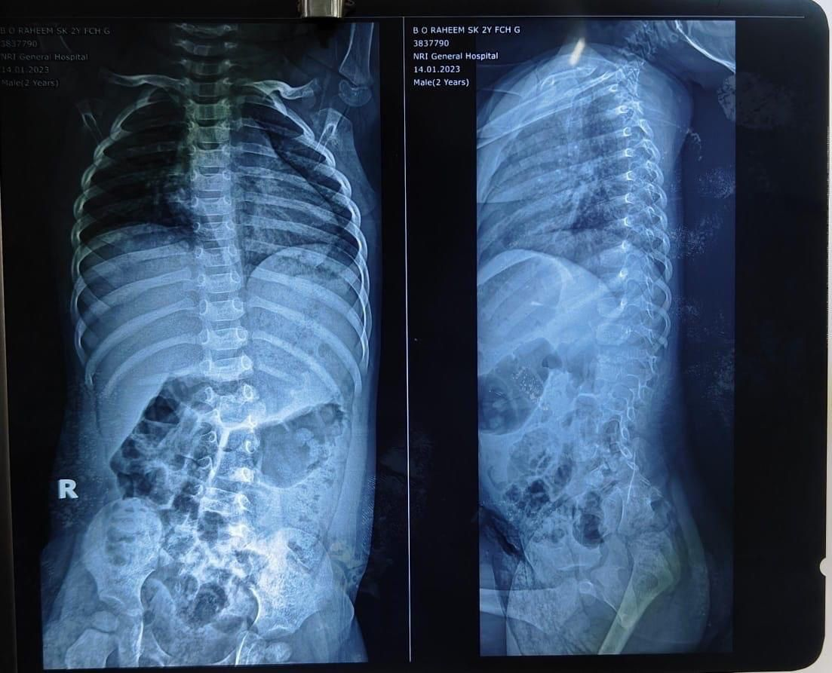
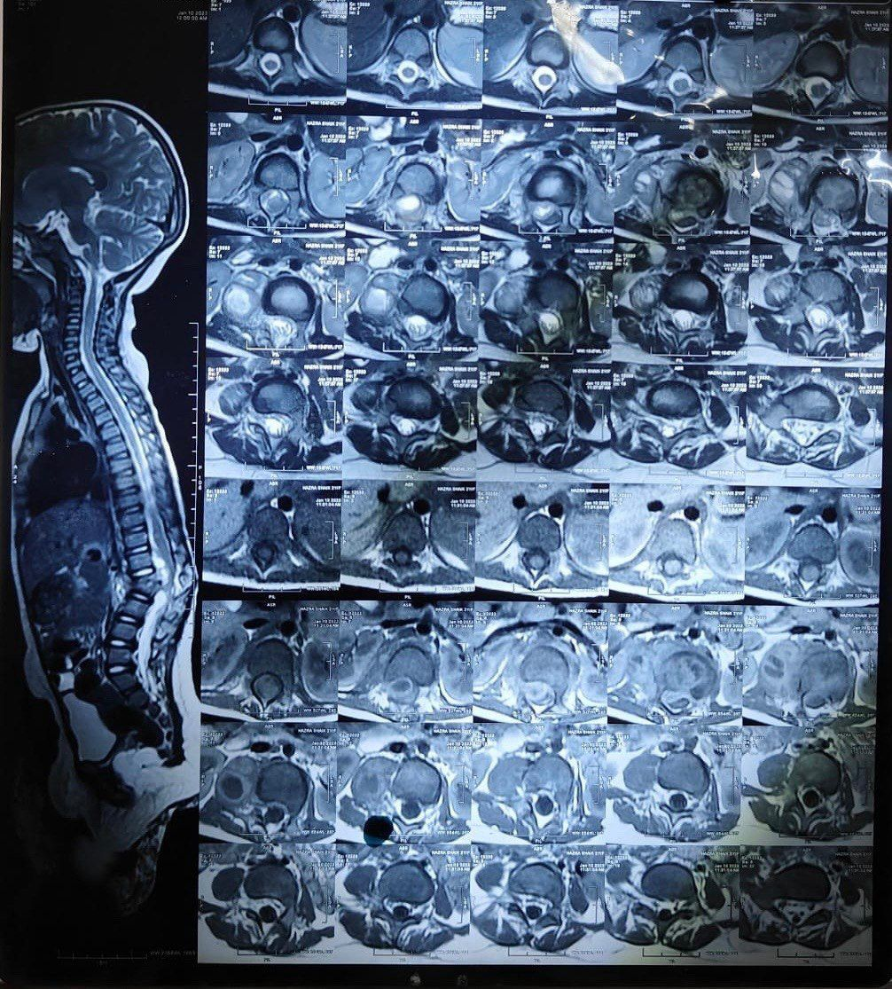
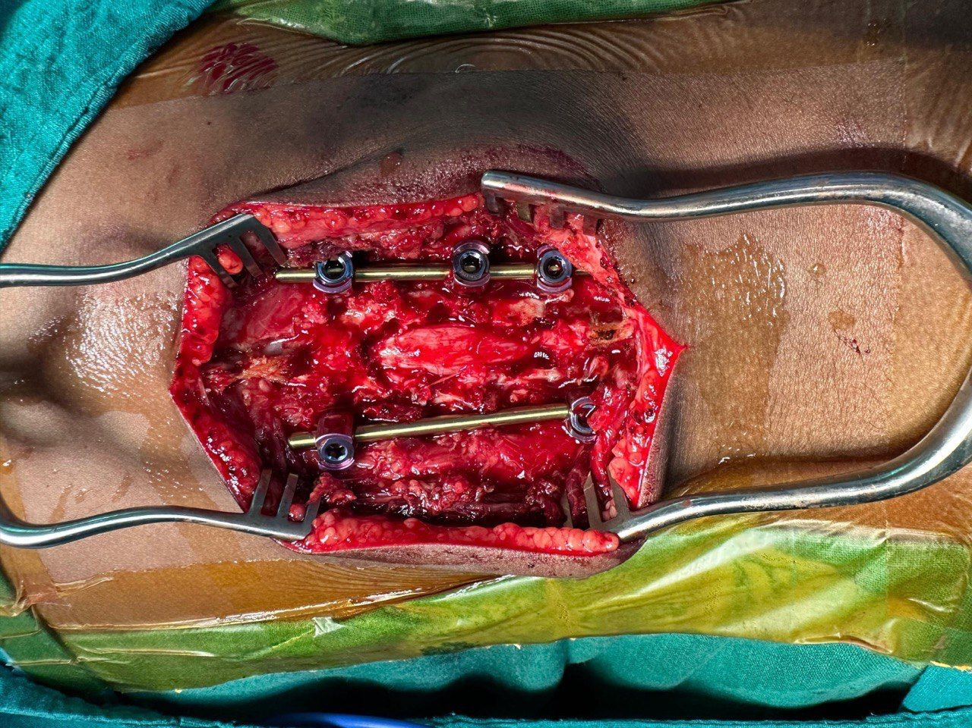
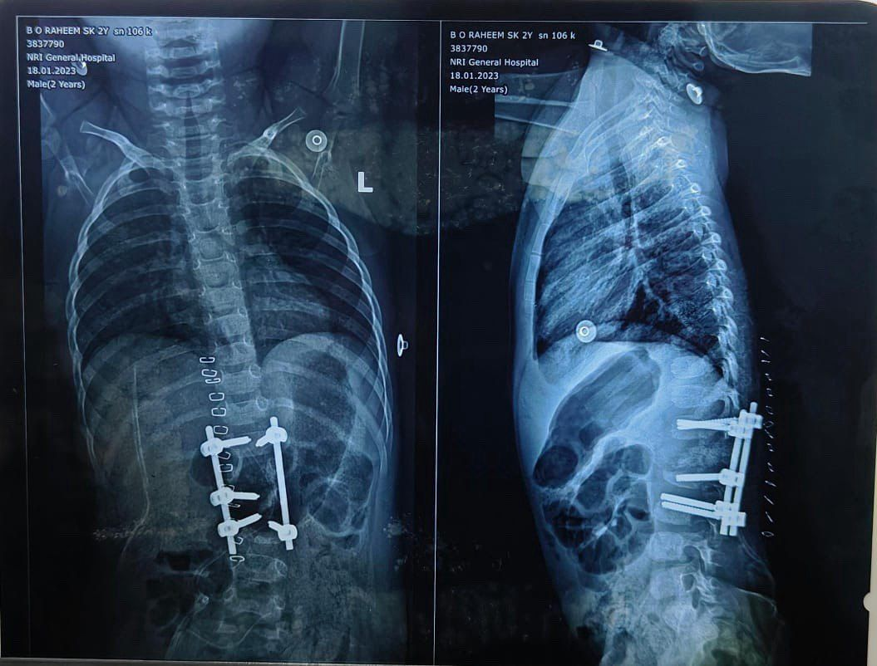
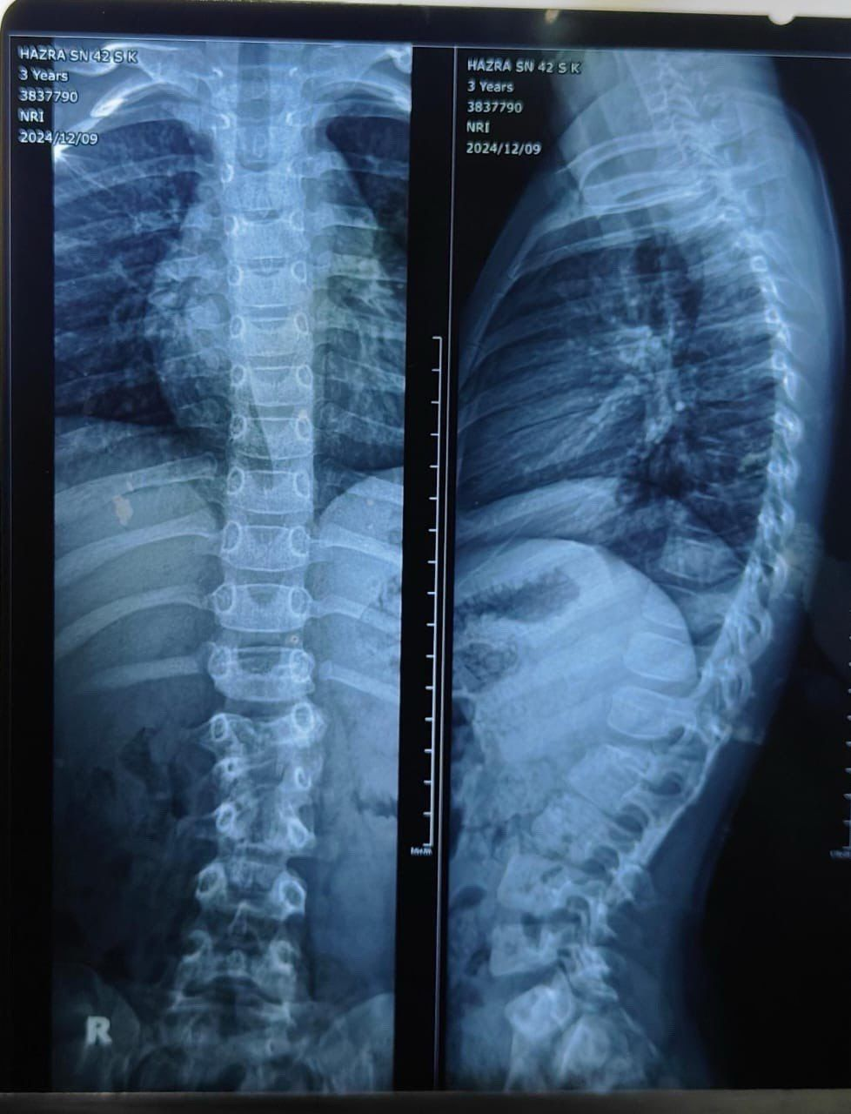
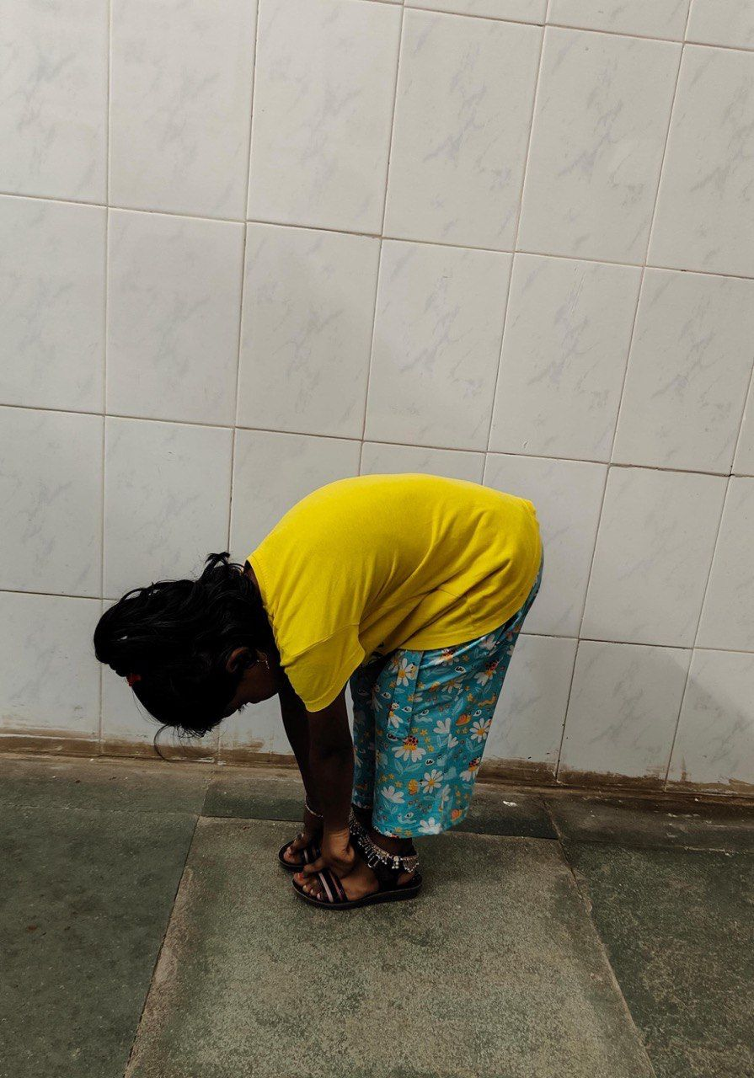
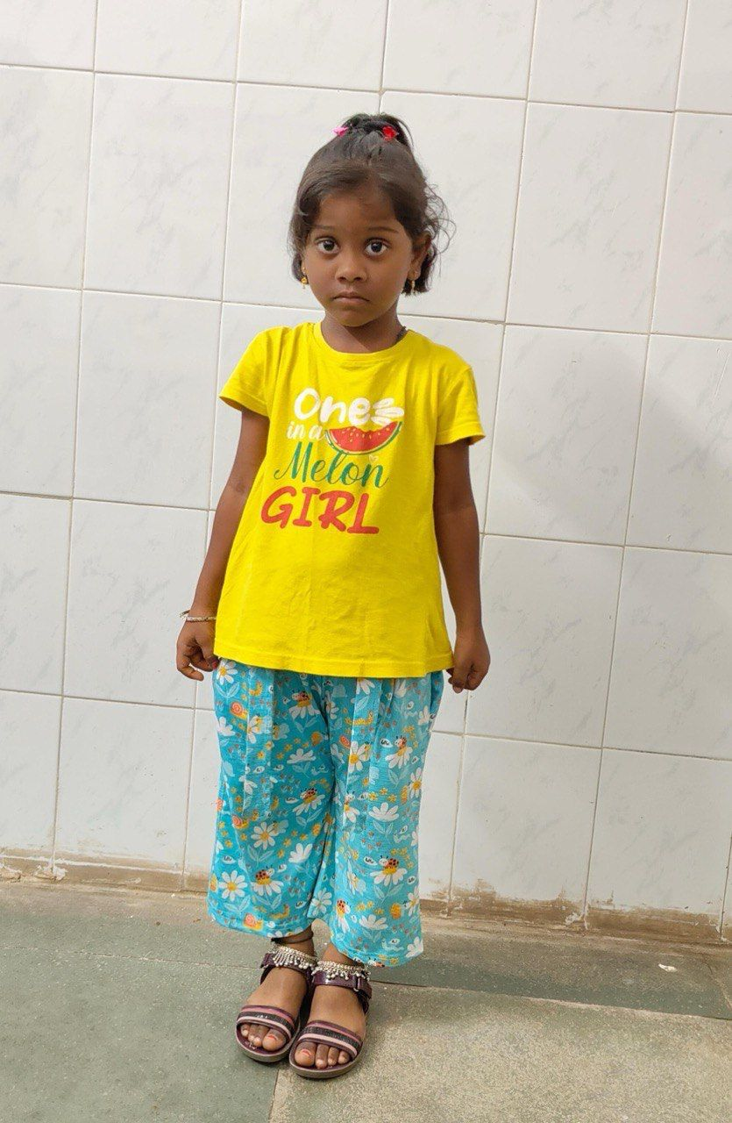
A RARE CASE OF SPINAL TUBERCULOSIS IN A 2yr OLD CHILD WITH FAVOURABLE SURGICAL OUTCOME
PRESENTED BY: DR. AGADALA VENKATARAMANA
GUIDE:DR BALAKRISHNA BATHINA
CONSULTANT SPINE SURGEON,
ASSOCIATE PROFESSOR,DEPARTMENT OF ORTHOPAEDICS ,NRIMC, CHINAKAKANI
OSSAP-177
INTRODUCTION
OPERATIVE FINDINGS
DISCUSSION
Spinal tuberculosis is the commonest form of skeletal TB in children and often presents with nonspecific symptoms such as fever, irritability, refusal to walk and spinal deformity, causing delayed diagnosis. Due to immature vertebrae, soft bone, and a flexible spine, children are at higher risk of rapid deformity progression and neurological compromise. The thoracolumbar junction is most frequently involved. Early diagnosis with timely medical therapy and appropriate surgical intervention is essential to prevent kyphosis, spinal instability and long-term disability.
Posterior spinal fixation and fusion from T12-L3 was done followed by T12-L2 cord decompression and L1-L2 disc space was debrided through left sided L2 transpedicular approach. The disc material,pus and infected tissue was collected and sent for biopsy, gram stain,AFB stain,culture and sensitivity and geneXpert.
Spinal TB in children under 5 years is uncommon but aggressive due to high vertebral vascularity . In this case child presented with fever, irritability, refusal to walk and progressive thoracolumbar swelling—typical but often overlooked features of infantile spinal TB. Household contact with active pulmonary TB supported the diagnosis. Kyphotic deformity with raised inflammatory markers and radiological investigations favoured Pott’s spine. Surgery was indicated for progressive deformity and impending neurological deficit. Posterior spinal fixation and fusion with decompression provided stability, deformity correction and neurological deficit improvement. Biopsy showing non-necrotizing granulomatous inflammation supported tubercular pathology. Early mobilization with customised thoracolumbar brace with support of appropriate ATT aided recovery .Implant failure noted at 18 months , was managed by timely removal after solid fusion was noted on X-rays. At 2 years postoperative, child had good clinical, functional and neurological outcomes, emphasizing long-term follow-up.
CASE REPORT
A 2-year-old child presented with fever, irritability, refusal to walk and progressive thoracolumbar swelling causing difficulty in sitting and standing since 2 months. Patient had history of close household contact with a pulmonary TB patient.
Examinations:
Babinski : positive
Gibbus noted over thoracolumbar region.
CONCLUSION
Paediatric spinal TB can be devastating because of bone destruction, spinal deformity leading to permanent paraplegia. Early diagnosis and timely surgical intervention in case of severe deformity with neurological deficits is the key to good clinical , functional and neurological outcomes.

