Slide 1
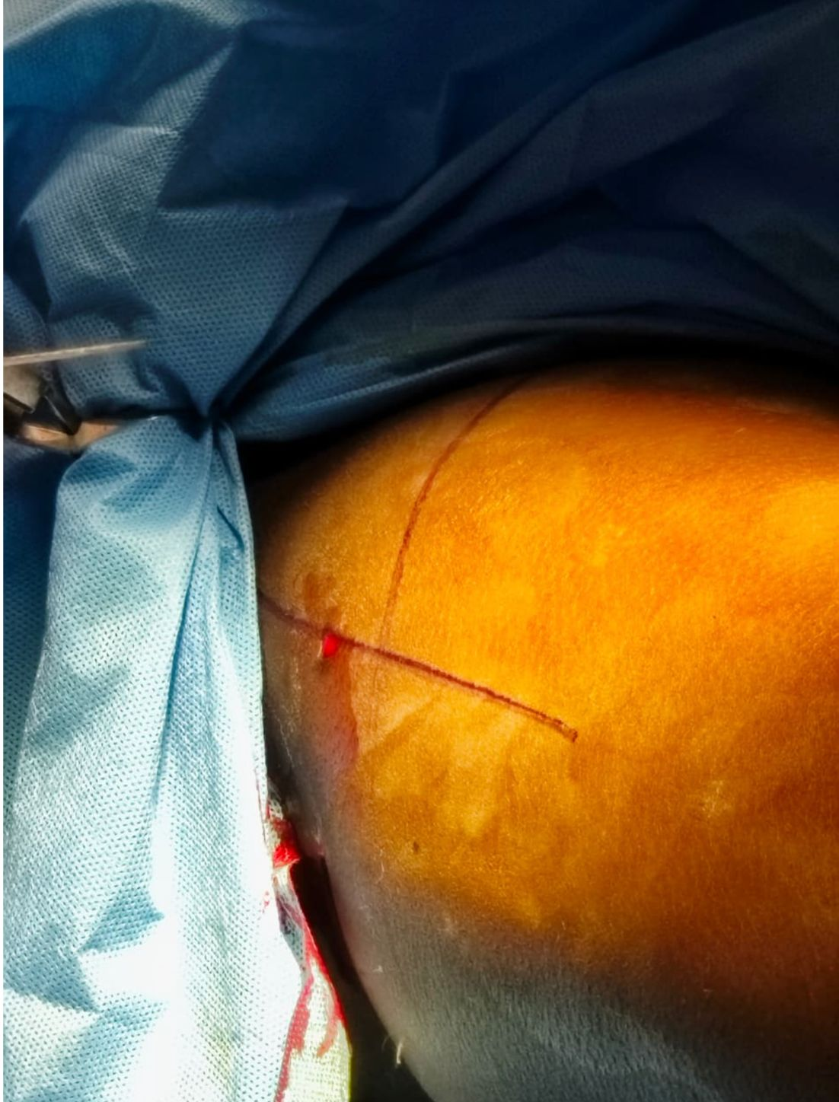
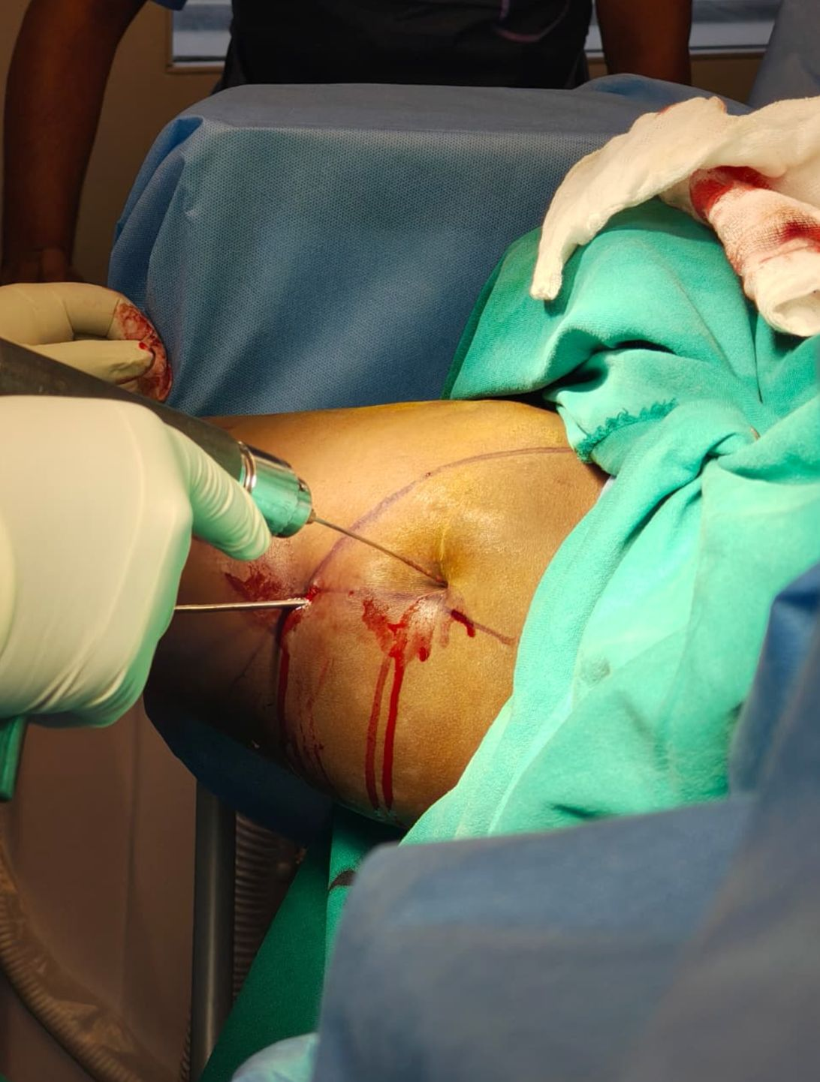
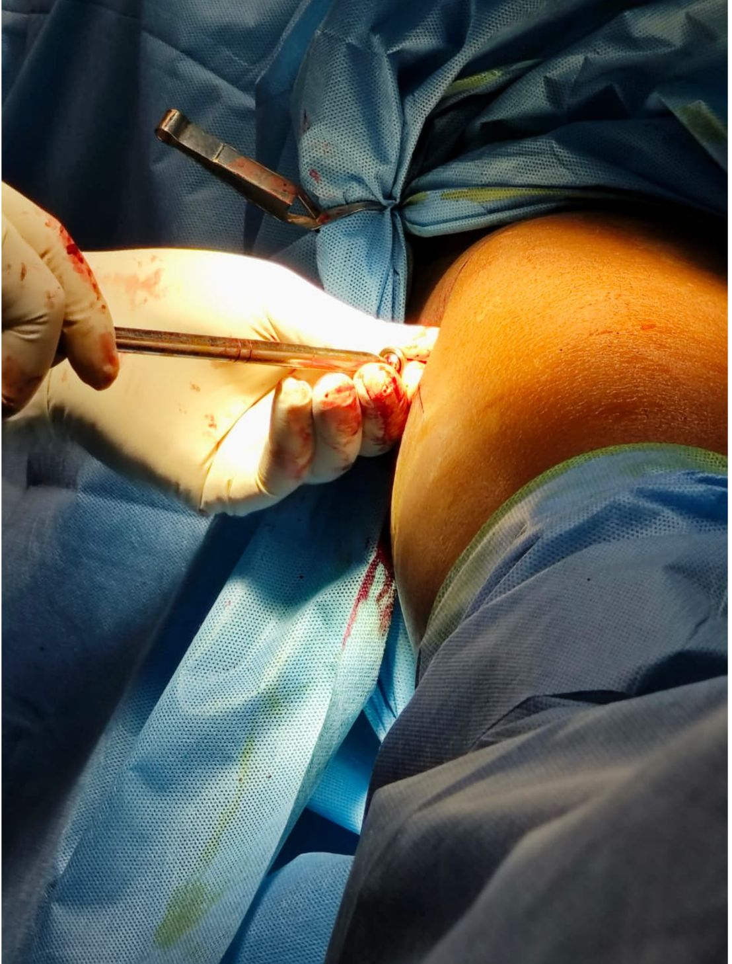
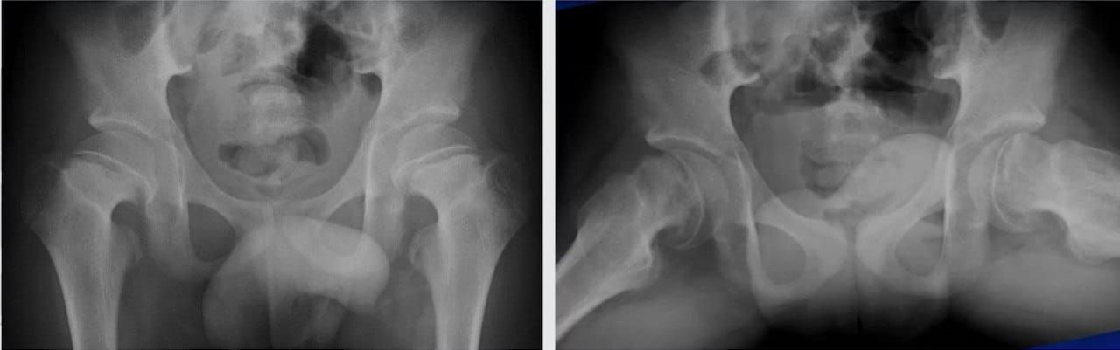
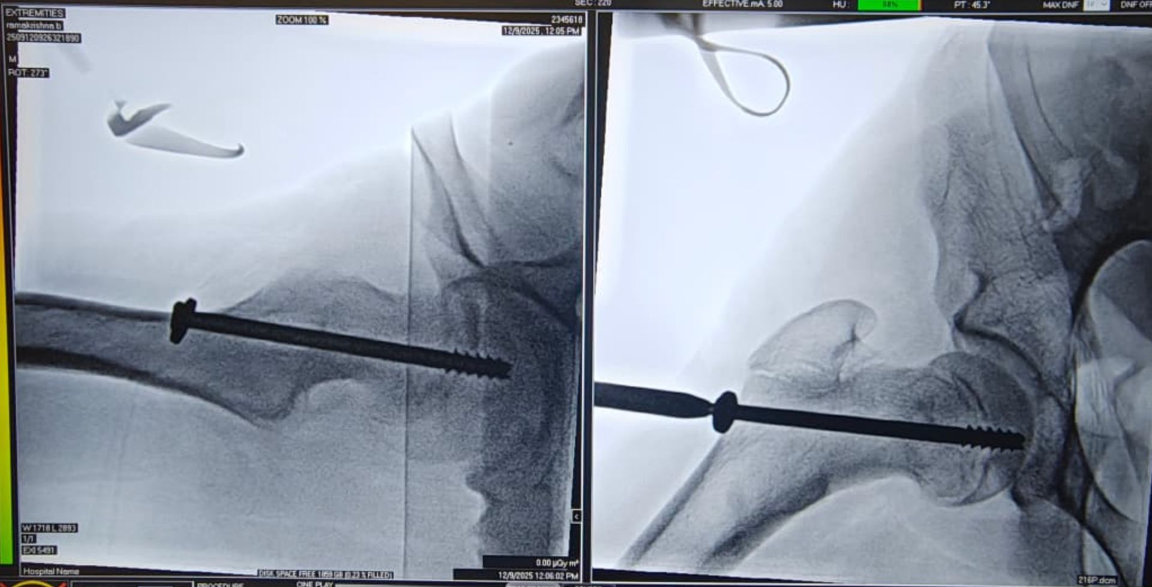
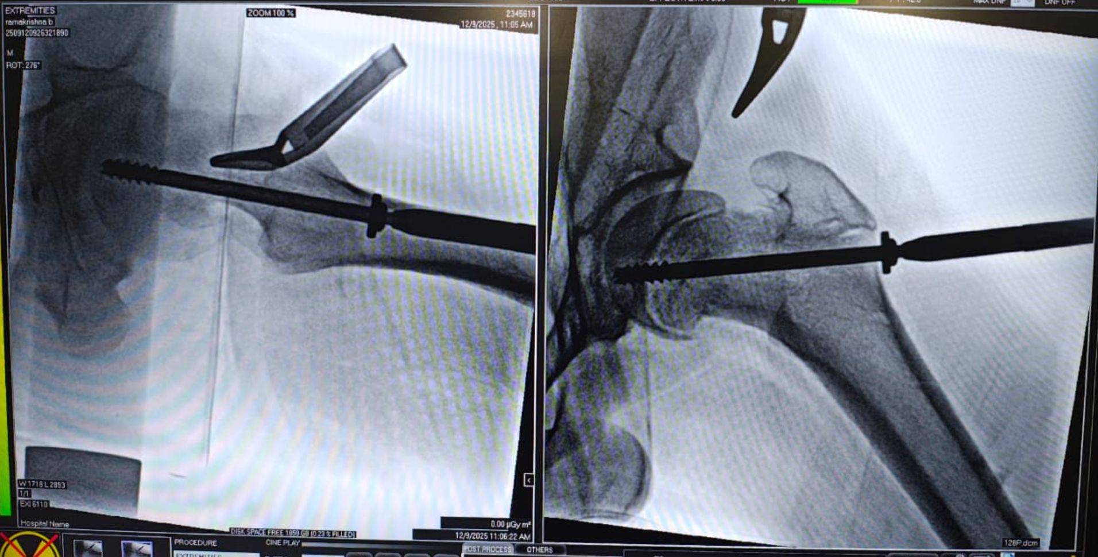
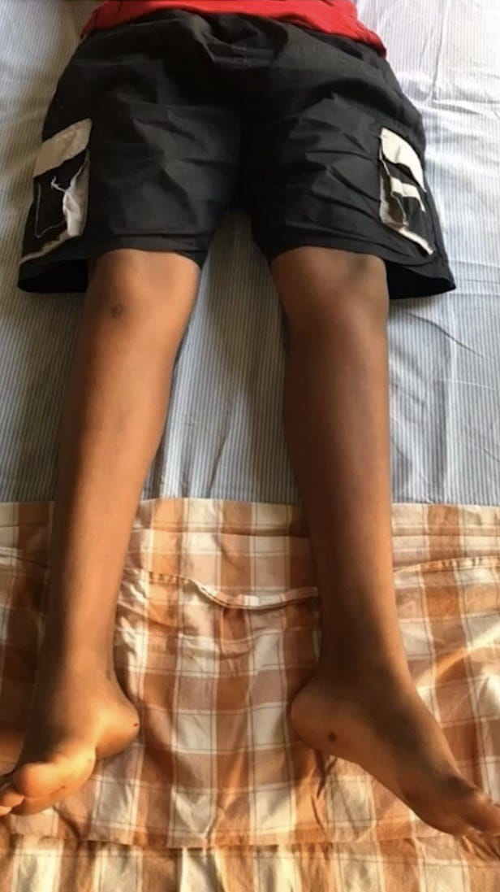
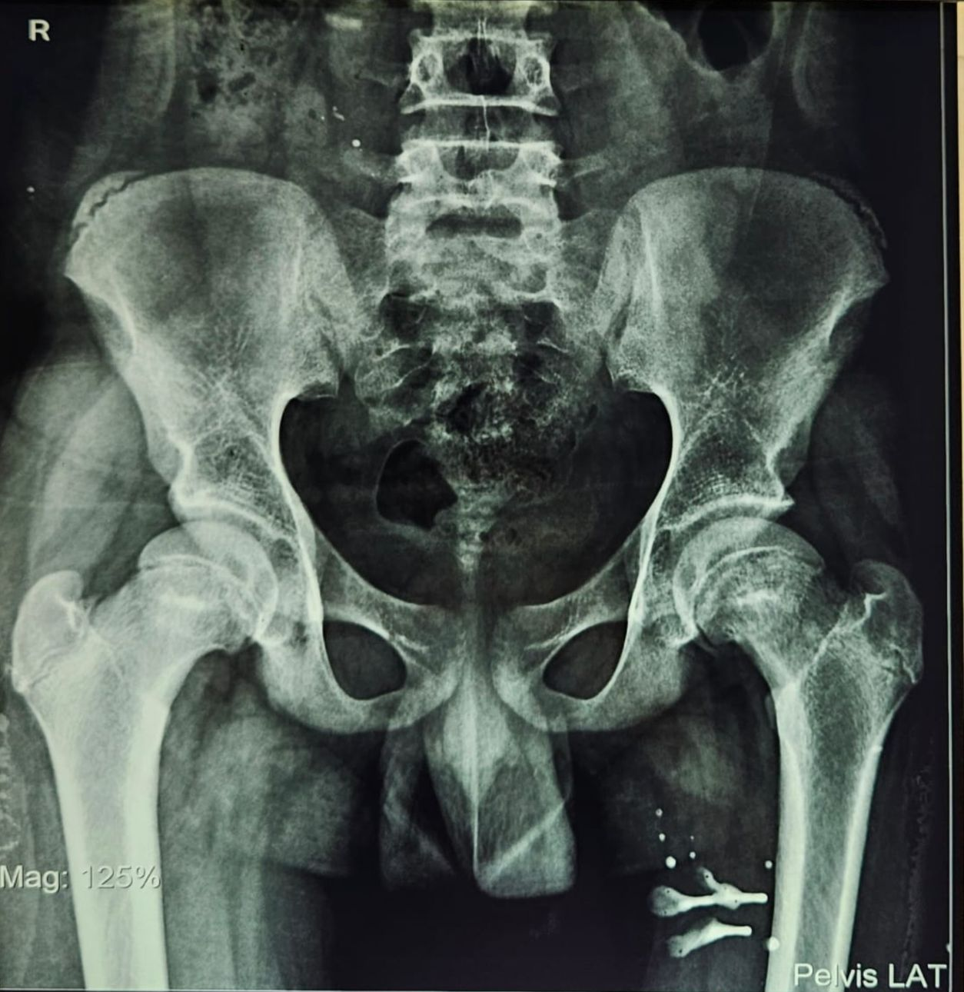
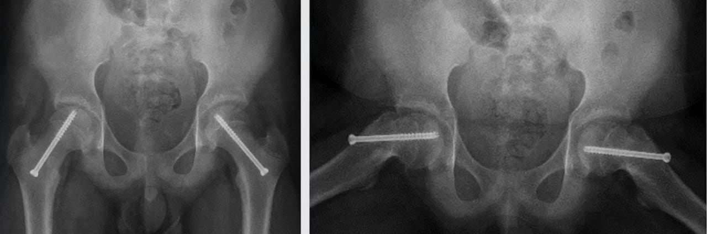
Introduction:
Slipped Capital Femoral Epiphysis (SCFE) is one of the most common hip disorders in adolescents, characterized by posterior and inferior displacement of the femoral head relative to the femoral neck through the physis. It commonly affects adolescent males during periods of rapid growth. Bilateral involvement is frequently reported, either simultaneously or sequentially. Early diagnosis and timely surgical stabilization are crucial to prevent progression, complications, and long-term disability. Prophylactic fixation of the contralateral hip remains a widely accepted strategy to prevent future slip.
Abstract:
Background: Slipped Capital Femoral Epiphysis is a potentially debilitating adolescent hip disorder. Bilateral slips carry a higher risk of complications if not managed appropriately.
Case Summary: We present a case of a 16-year-old male with bilateral SCFE, more pronounced on the left side, managed successfully with bilateral in-situ fixation using cannulated cancellous screws.
METHODOLOGY
Left Hip
Under C-arm guidance:
  6.5 mm, 16-threaded, 75 mm cannulated cancellous screw with washer inserted
Screw threads crossed perpendicular to the physis into the epiphysis
Position confirmed under image intensifier
Right Hip (Prophylactic Fixation)
6.5 mm, 16-threaded, 80 mm cannulated cancellous screw with washer inserted
Threads ensured to crossed perpendicular to the physis into epiphysis
Final position confirmed under C-arm guidance
RESULTS
Successful bilateral in-situ fixation achieved
No intraoperative complications
Postoperative period uneventful
Pain significantly reduced
Improved gait on follow-up
No evidence of further slip or hardware failure
DISCUSSION
SCFE commonly affects adolescent males and may present bilaterally
Bilateral involvement occurs in up to 20–40% of cases
Prophylactic fixation of the contralateral hip reduces the risk of subsequent slip
In-situ screw fixation is the treatment of choice for stable SCFE
MRI helps in early diagnosis and assessment of stability
Early surgical intervention prevents complications such as avascular necrosis and chondrolysis
Intra op pics
MATERIAL & METHODS
Case Presentation
16-year-old male apparently normal 3 months prior developed pain in bilateral hip region while walking, pain which is insidious onset gradually progressive dull aching in nature non-radiating no diurnal variation partially relieved with rest and medication
CLINICAL & RADIOLOGICAL FINDINGS
Clinical Examination
Antalgic gait ,Restricted internal rotation of hip ,Limb length discrepancy: minimal
Radiological Evaluation
X-ray pelvis with both hips: Bilateral Slipped Capital Femoral Epiphysis ,Left side more severe than right , sectoral sign
MRI Hip Joint: Confirmed bilateral SCFE
Pre op x ray
CONCLUSION
Bilateral SCFE should always be considered in adolescent hip pain
Early diagnosis with appropriate imaging is essential
In-situ fixation using cannulated cancellous screws is safe and effective
Prophylactic fixation of the contralateral hip prevents future slips and improves outcomes
Right side
Southwick angle Left hip 23’ , Right hip 11’
REFERENCES
Loder RT, et al. Slipped capital femoral epiphysis. J Bone Joint Surg Am. 2000;82(8):1170–1188.
Aronsson DD, et al. Slipped capital femoral epiphysis: current concepts. J Am Acad Orthop Surg. 2006;14(12):666–679.
Kocher MS, et al. Prophylactic pinning of the contralateral hip in SCFE. Clin Orthop Relat Res. 2004;427:157–164.
Weinstein SL. Lovell and Winter’s Pediatric Orthopaedics. 7th ed. Lippincott Williams & Wilkins; 2014.
Left side
Post op x ray
ACKNOWLEDGEMENT
I express my gratitude to HOD and faculty from department of orthopaedics,I sincerely thank the Radiology,GSL Medical College & General Hospital, for their guidance and support.

