Slide 1
FUNCTIONAL OUTCOME FOLLOWING DORSAL PLATING IN INTRA-ARTICULAR DISTAL RADIUS FRACTURE
PRESENTER : DR POTHURAJU DURGA SAI PRASAD
GUIDE : DR I ROHIT (PROFESSOR)
DEPARTMENT OF ORTHOPAEDICS
ASRAM MEDICAL COLLEGE

Slide 2
INTRODUCTION
Distal radius fractures account for ~17.5% of all orthopaedic fractures
Nearly 50% are intra‑articular with risk of poor functional outcome
Dorsal plating allows direct articular visualization and stable fixation
Inadequate reduction can result in stiffness, chronic pain, and post-traumatic arthritis
Restoration of articular congruity and radiological parameters is essential for good outcome

Slide 3
Aim :
To analyse the functional outcome of intra‑articular distal radius fractures treated with dorsal plating
Objectives:
To evaluate functional outcome of intraarticular fracture of distal radius by open reduction and internal fixation by dorsal plating.
To assess intra operative and post operative complications of dorsal plating of distal radius

Slide 4
Methods :
Prospective interventional study (n = 25)
Adult patients with intra‑articular distal radius fractures
Treated by open reduction and internal fixation using dorsal plating
Functional outcome assessed using DASH score
Inclusion criteria : Adult age groups (more than 18 years ) , Post traumatic cases, Dorsal subluxation and dislocation of distal radius
Exclusion criteria: Pathological fractures, Neglected fractures are excluded

Slide 5
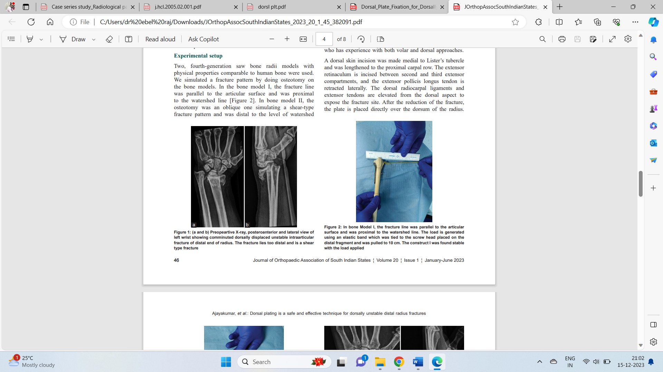
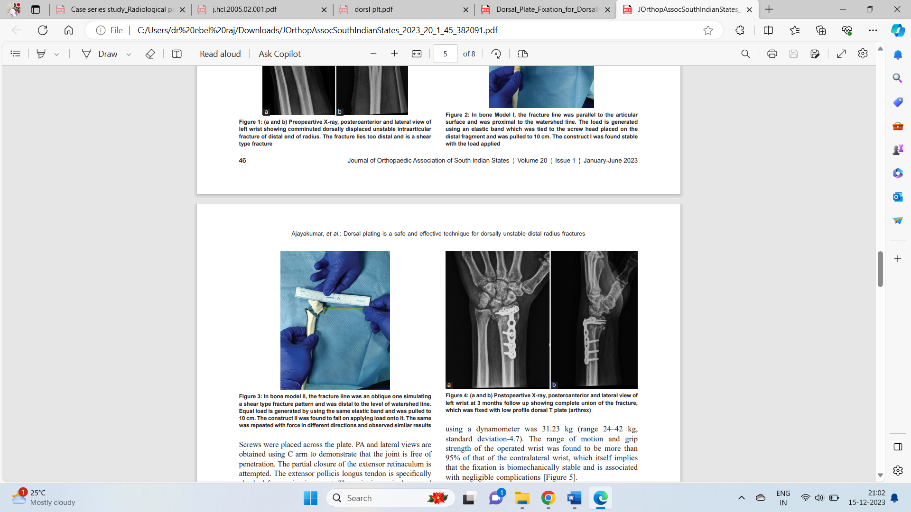
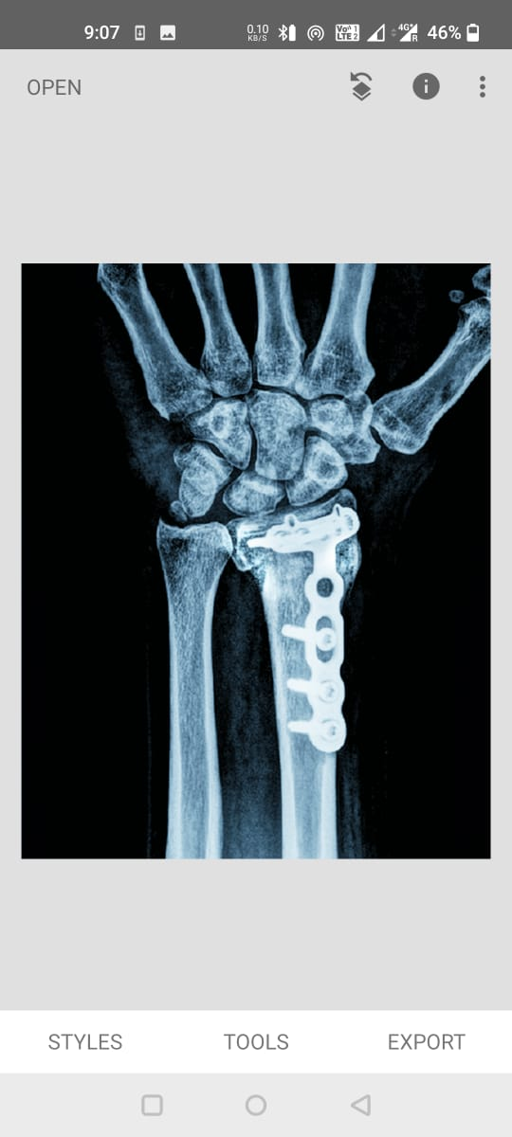
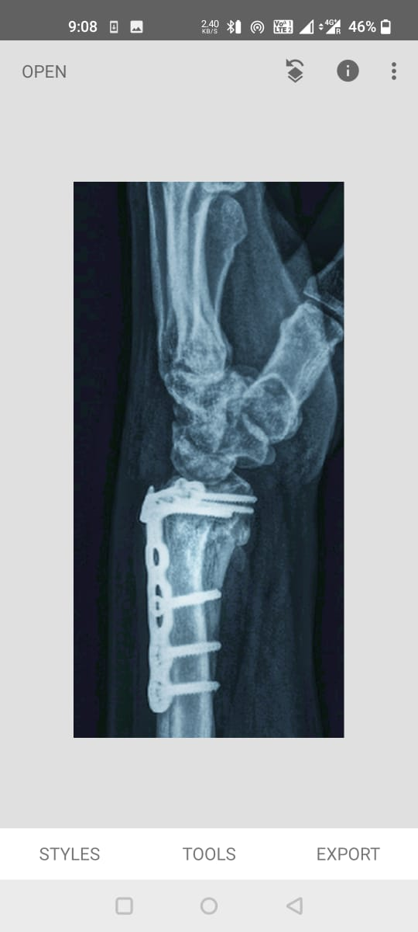
Pre op x rays post op x rays
Follow up x rays

Slide 6
Results :
GRADE | NO OF CASES | PERCENTAGE
EXCELLENT | 8 | 32%
GOOD | 14 | 56%
FAIR | 3 | 12%
POOR | 0 | 0%
Mean age: 41 years; Male:Female = 64%:36%
Excellent to good outcomes in 88% of patients
Complications: extensor tendon irritation (8%), CRPS (4%)
Majority regained >75% ROM and grip strength
Functional outcome assessment by DASH Scoring System

Slide 7
Conclusion :
Dorsal plating provides stable fixation and good functional outcomes
Allows early mobilization and satisfactory range of motion
It enables accurate articular reconstruction and stable fixation
Early mobilization leads to improved range of motion and grip strength
Low complication rates with modern low‑profile plates

Slide 8
References
Herron M, Faraj A, Craigen MA. Dorsal plating for displaced intra-articular fractures of the distal radius. Injury. 2003 Jul;34(7):497-502. doi: 10.1016/s0020-1383(02)00190-0. PMID: 12832175.
Kamath AF, Zurakowski D, Day CS. Low-profile dorsal plating for dorsally angulated distal radius fractures: an outcomes study. J Hand Surg Am. 2006 Sep;31(7):1061-7. doi: 10.1016/j.jhsa.2006.05.008. PMID: 16945704.
Lutsky K, McKeon K, Goldfarb C, Boyer M. Dorsal fixation of intra-articular distal radius fractures using 2.4-mm locking plates. Tech Hand Up Extrem Surg. 2009 Dec;13(4):187-96. doi: 10.1097/BTH.0b013e3181c15de2. PMID: 19956044.

