Slide 1




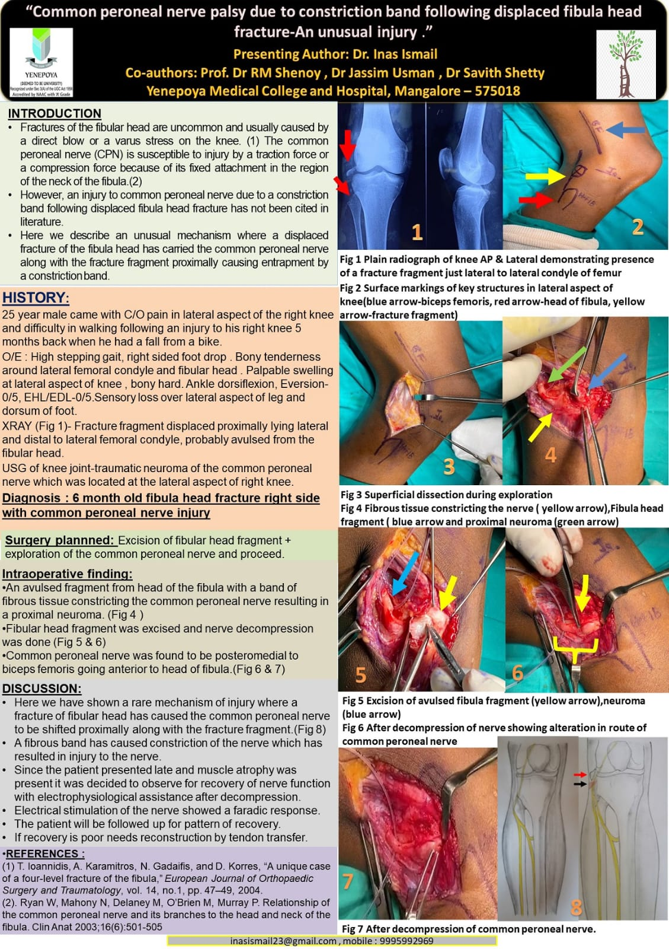
55th Annual Conference of Orthopedic Surgeon Society of Andhra Pradesh
Title : Common peroneal nerve palsy due to constriction band following displaced fibular head fracture
Authors : Dr Pothuraju Durga Sai Prasad , Dr I Rohit
INTRODUCTION
OPERATIVE FINDINGS
DISCUSSION
Fractures of the fibular head are uncommon and usually caused by a direct blow or a varus stress on the knee.The common peroneal nerve is susceptible to injury by a traction force or a compression force because of its fixed attachment in the region of the neck of fibula⁽¹⁾.
Here we describe an unusual mechanism where a displaced fracture of fibula head has carried the common peroneal nerve along with the fracture fragment proximally causing entrapment by a constriction band.
USG of knee joint-traumatic neuroma of the common peroneal nerve which was located at the lateral aspect of right knee. Diagnosis: 6 month old fibula head fracture right side with common peroneal nerve injury
Surgery planned: Excision of fibular head fragment + exploration of the common peroneal nerve and proceed. Intraoperative finding:
•An avulsed fragment from head of the fibula with a band of fibrous tissue constricting the common peroneal nerve resulting in a proximal neuroma.
•Fibular head fragment was excised and nerve decompression was done.
•Common peroneal nerve was found to be posteromedial to biceps femoris going anterior to head of fibula.
• Here we have shown a rare mechanism of injury where a fracture of fibular head has caused the common peroneal nerve to be shifted proximally along with the fracture fragment. A fibrous band has caused constriction of the nerve which has resulted in injury to the nerve.
• Since the patient presented late and muscle atrophy was present it was decided to observe for recovery of nerve function with electrophysiological assistance after decompression. Electrical stimulation of the nerve showed a faradic response.
• The patient will be followed up for pattern of recovery. If recovery is poor needs reconstruction by tendon transfer
CASE REPORT
25 year male came with C/O pain in lateral aspect of the right knee and difficulty in walking following an injury to his right knee 5 months back when he had a fall from a bike.
O/E: High stepping gait, right sided foot drop. Bony tenderness around lateral femoral condyle and fibular head. Palpable swelling at lateral aspect of knee, bony hard. Ankle dorsiflexion, Eversion- 0/5, EHL/EDL-0/5.Sensory loss over lateral aspect of leg and dorsum of foot.
CONCLUSION
Displaced fractures of the fibular head can rarely result in delayed common peroneal nerve palsy due to nerve entrapment by a constricting fibrous band. A high index of suspicion, careful clinical evaluation and imaging are essential for early diagnosis.Timely surgical exploration with excision of the fracture fragment and decompression of nerve can prevent irreversible neurological damage and improve functional outcomes. References :
(1)Ryan W, Mahony N, Delaney M, O'Brien M, Murray P. Relationship of the common peroneal nerve and its branches to the head and neck of the fibula. Clin Anat 2003;16(6):501-505

