Slide 1
Comparative Evaluation of Autologous Platelet Rich Plasma and Corticosteroid Injection in Chronic Plantar Fasciitis
Presenter : Dr R Shravya Chandana
Moderator : Dr R M Mallikarjuna Reddy (Professor)
Department of Orthopaedics
Asram medical college and hospital

Slide 2
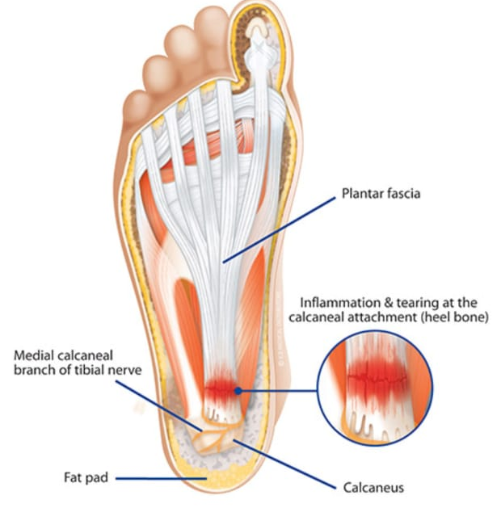
Introduction
Chronic plantar fasciitis is a degenerative fasciosis, not purely inflammatory.
It is a common cause of chronic heel pain affecting daily activities.
Most cases respond to conservative treatment; recalcitrant cases need injections.
Corticosteroids give rapid short-term relief but have limited long-term benefit and risk of complications.
PRP is an autologous therapy promoting tissue healing and regeneration

Slide 3
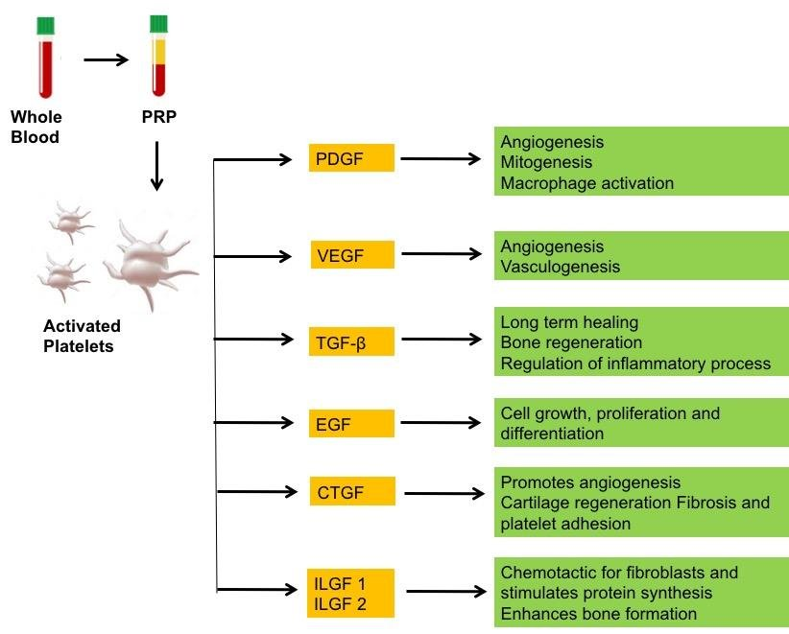
Rationale : PRP vs Corticosteroid
Corticosteroid injections, although effective in reducing pain rapidly, primarily address inflammation and do not reverse the underlying degenerative pathology. Repeated use may predispose to complications such as plantar fascia rupture and fat pad atrophy, limiting their long-term utility.
Platelet-rich plasma (PRP) is an autologous biological treatment rich in growth factors (PDGF, TGF-β, VEGF) that stimulate fibroblast proliferation, angiogenesis, and collagen remodeling, directly targeting the degenerative process

Slide 4
Aim
To compare the effectiveness of a single-dose autologous platelet-rich plasma (PRP) injection with a single-dose corticosteroid injection in patients with chronic plantar fasciitis.
To evaluate and compare pain relief and functional outcomes at 4, 8, 12, and 24 weeks of follow-up.

Slide 5
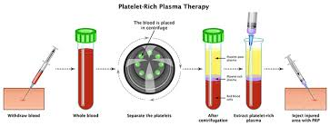
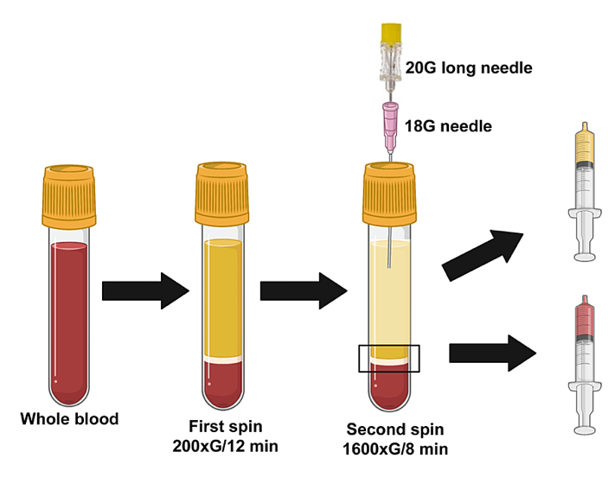
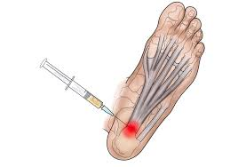
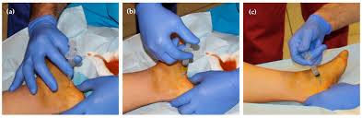
Materials and Methods
Design: Prospective randomized controlled study (Oct 2023–Jan 2026)
Sample: 180 patients
PRP: 90 | Steroid: 90
Inclusion: Age >20 yrs, symptoms >6 months, failed conservative care
Intervention:
PRP: 2 ml autologous PRP (double-spin)
Steroid: 2 ml Triamcinolone (40 mg/ml)
Peppering technique at maximal tenderness
Assessment: VAS & Nirschl scores at 4, 8, 12, 24 weeks

Slide 6
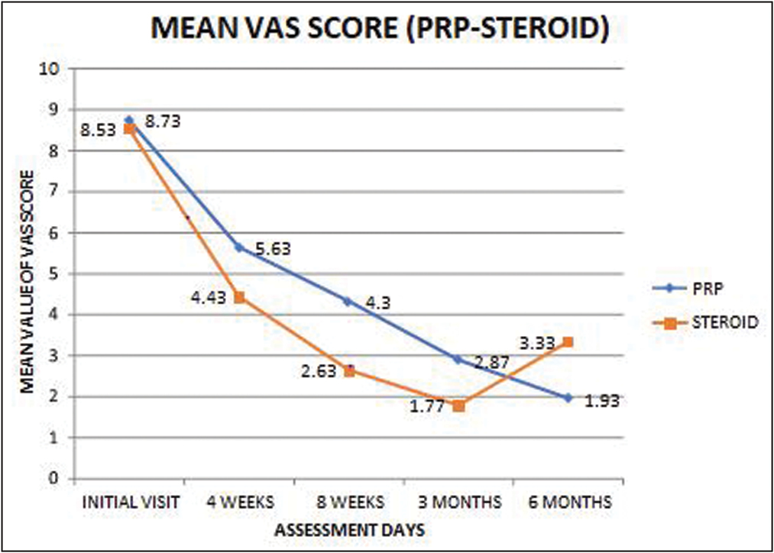
Results
Baseline pain scores: Comparable in both groups
4 weeks: Corticosteroid group showed better early pain relief
12 & 24 weeks: PRP group had significantly lower VAS and Nirschl scores
Outcome: PRP showed sustained improvement (p < 0.001 at 24 weeks)
Complications:
Steroid: 1 case of transient paraesthesia
PRP: No significant complications

Slide 7
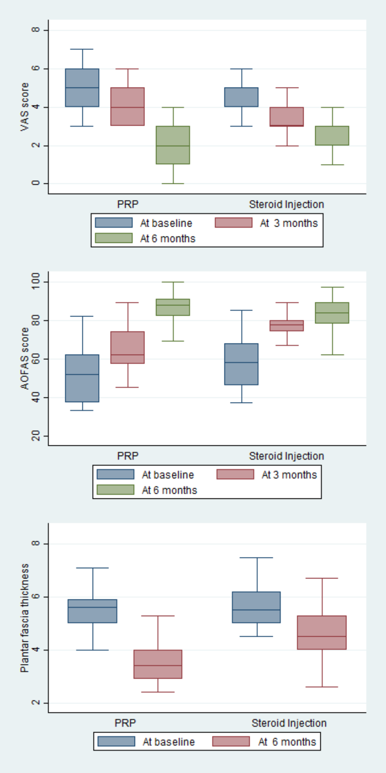
Conclusion
Both PRP and corticosteroid injections are effective in managing chronic plantar fasciitis.
Corticosteroids provide early symptomatic relief.
PRP offers better long-term pain relief and functional improvement with minimal complications.
Clinical Implication:
PRP should be considered a preferred biological option for chronic plantar fasciitis, especially in recalcitrant cases

Slide 8
References
Lemont H, Ammirati KM, Usen N. Plantar fasciitis: a degenerative process (fasciosis) without inflammation. J Am Podiatr Med Assoc, 2003;93:234–237.
Monto RR. Platelet-rich plasma efficacy versus corticosteroid injection treatment for chronic severe plantar fasciitis. Foot Ankle Int, 2014;35:313–318.
Mahindra P, Yamin M, Selhi HS, Singla S, Soni A. Chronic plantar fasciitis: Effect of platelet-rich plasma, corticosteroid, and placebo. Orthopedics, 2016;39:e285–e289.
Peerbooms JC, Sluimer J, Bruijn DJ, Gosens T. Positive effect of an autologous platelet concentrate in chronic tendinopathies. Am J Sports Med, 2009;37:255–262

