Slide 1

₅₅th
Annual Conference of
Orthopedic Surgeon Society of Andhra Pradesh
Date 6 – 8 February,2026, Venue : Kurnool Medical College
Organized by : Department of Orthopaedics, Kurnool Medical College Kurnool
Functional Outcome of Extra-Articular Distal Tibia Fractures Treated with Intramedullary Nail and Locking Plate: A Prospective Comparative Study
Presenter : Dr Shaik Sikander Mohsin
Moderator : Dr N Naga Rama Krishna (Assistant Professor) Department of Orthopaedics
Asram medical college and hospital

Slide 2
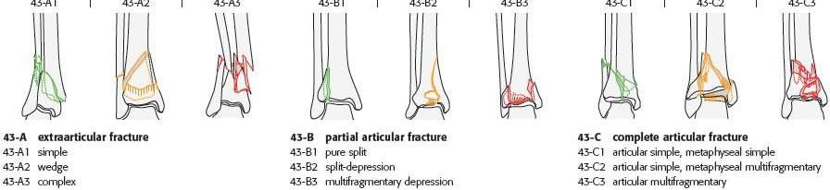
₅₅th
Annual Conference of
Orthopedic Surgeon Society of Andhra Pradesh
Date 6 – 8 February,2026, Venue : Kurnool Medical College
Organized by : Department of Orthopaedics, Kurnool Medical College Kurnool
Introduction
Distal tibia fractures account for less than 7% of tibial fractures and are commonly seen in males aged 25–50 years. These injuries result from low- to high-energy trauma, most frequently due to road traffic accidents, falls from height, and twisting ankle injuries.
Management options include conservative treatment, intramedullary nailing, external fixation, and plate osteosynthesis. The goals of treatment are to restore the mechanical axis, maintain joint stability, and achieve optimal functional recovery. However, management is challenging due to poor soft-tissue envelope, variable bone quality, and fracture comminution, with outcomes largely influenced by injury severity, soft-tissue status, and quality of reduction

Slide 3
₅₅th
Annual Conference of
Orthopedic Surgeon Society of Andhra Pradesh
Date 6 – 8 February,2026, Venue : Kurnool Medical College
Organized by : Department of Orthopaedics, Kurnool Medical College Kurnool
Aim of the Study
The aim of this study was to compare the functional outcome of extra-articular distal tibia fractures managed by intramedullary interlocking nailing versus locking plate fixation

Slide 4
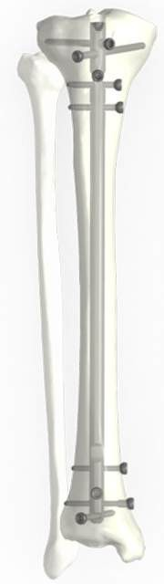

₅₅th
Annual Conference of
Orthopedic Surgeon Society of Andhra Pradesh
Date 6 – 8 February,2026, Venue : Kurnool Medical College
Organized by : Department of Orthopaedics, Kurnool Medical College Kurnool
Materials and Methods
This prospective study was conducted in the Department of Orthopaedics , Asram Medical College and Hospital, Eluru, from December 2024 to December 2025. A total of 10 patients with extra- articular distal tibia fractures were included and divided into two groups: Group A (IMIL nailing, n=5) and Group B (locking plate fixation, n=5). Functional and radiological outcomes were assessed using the AOFAS score.
Inclusion criteria were closed extra-articular fractures (AO 43-A1 to A3), age 18–60 years, and fracture line 4–8 cm from the tibial plafond. Exclusion criteria included open or intra-articular fractures, pathological fractures, age >60 years, and neurovascular injury.
All patients underwent standard clinical and radiological evaluation, followed by definitive fixation. Postoperatively, early mobilization was initiated, and patients were followed up at 2, 6, 12, and 26 weeks until clinical and radiological union

Slide 5
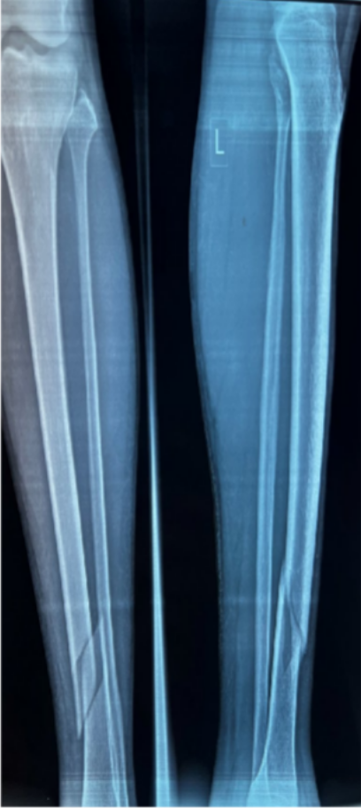
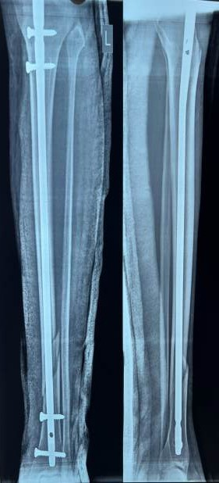
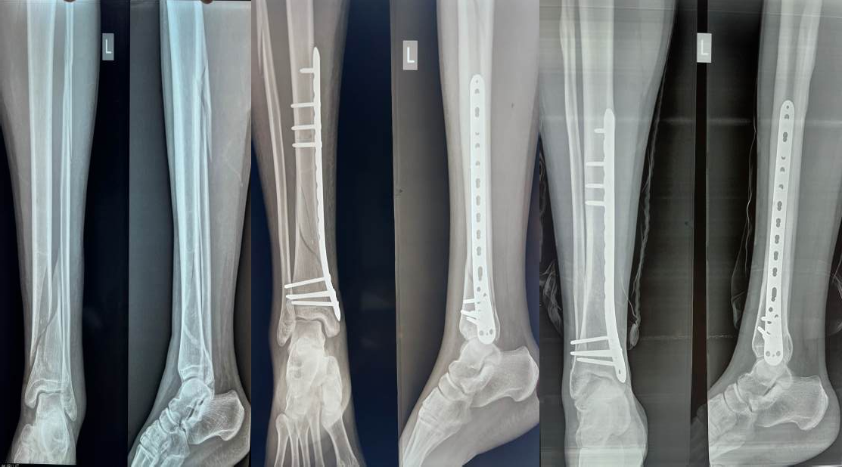
₅₅th
Annual Conference of
Orthopedic Surgeon Society of Andhra Pradesh
Date 6 – 8 February,2026, Venue : Kurnool Medical College
Organized by : Department of Orthopaedics, Kurnool Medical College Kurnool
Preop x-ray
Postop x-ray Nailing
Preop x-ray
Postop x-ray Plating

Slide 6
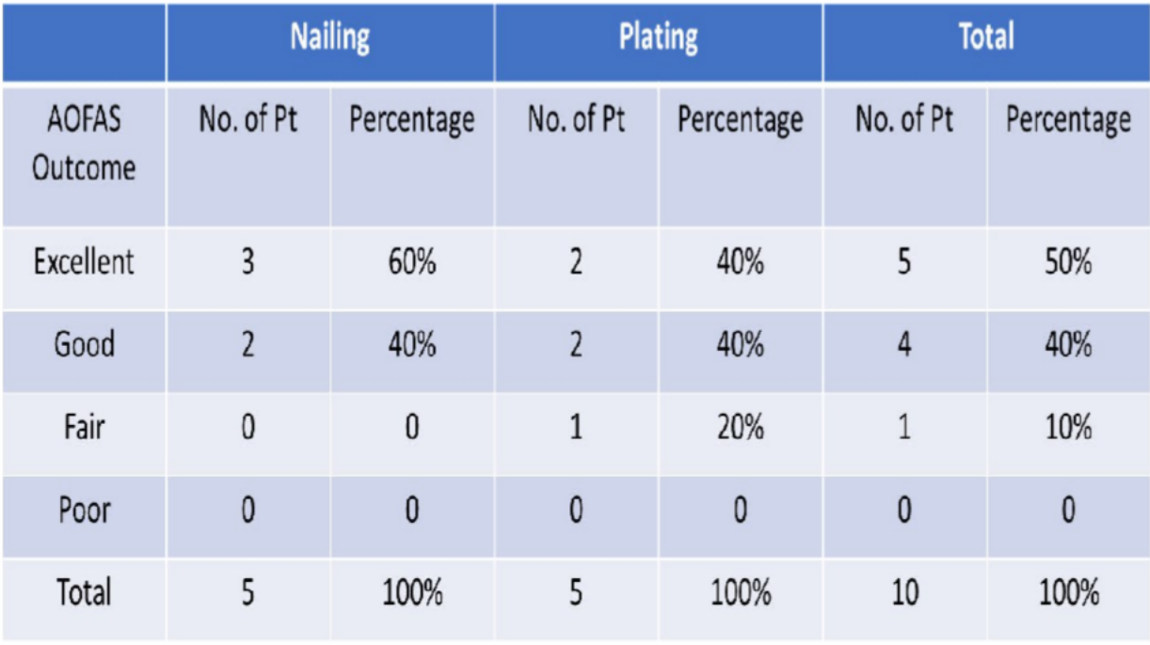
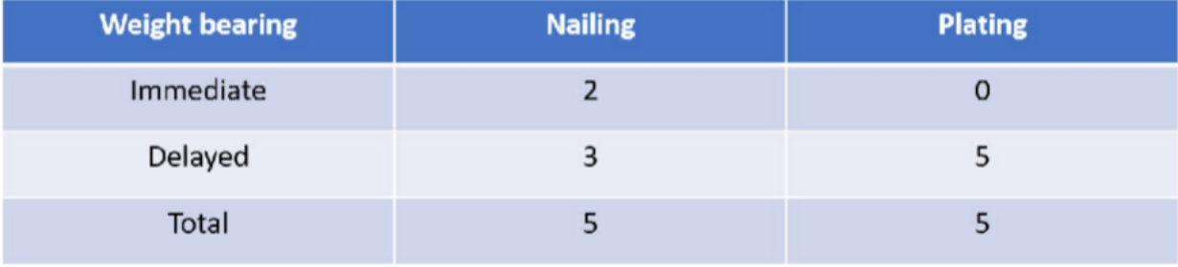
₅₅th
Annual Conference of
Orthopedic Surgeon Society of Andhra Pradesh
Date 6 – 8 February,2026, Venue : Kurnool Medical College
Organized by : Department of Orthopaedics, Kurnool Medical College Kurnool
Results
Most patients (85%) were aged 18–45 years, consistent with higher incidence of road traffic and occupational injuries. Outcomes assessed included AOFAS score, time to weight bearing, and complications.
The mean radiological union time was
15.43 weeks in the nailing group and
17.30 weeks in the plating group. Anterior knee pain occurred in three nailing cases, while one plating case developed a superficial infection, managed successfully with antibiotics and wound care

Slide 7
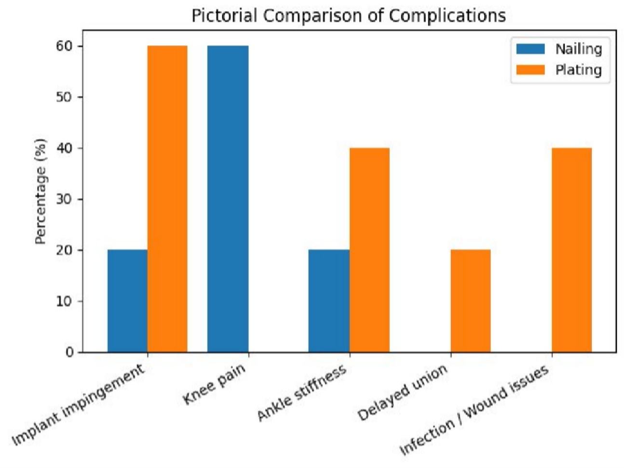
₅₅th
Annual Conference of
Orthopedic Surgeon Society of Andhra Pradesh
Date 6 – 8 February,2026, Venue : Kurnool Medical College
Organized by : Department of Orthopaedics, Kurnool Medical College Kurnool
Conclusion
Intramedullary interlocking nailing is a safe and effective option for extra- articular distal tibia (AO 43-A) fractures, offering earlier union, better ankle mobility, and fewer complications.
Nailing: Early union, better ROM, early mobilization
Plating: Higher infection risk, implant impingement, delayed weight bearing

Slide 8
₅₅th
Annual Conference of
Orthopedic Surgeon Society of Andhra Pradesh
Date 6 – 8 February,2026, Venue : Kurnool Medical College
Organized by : Department of Orthopaedics, Kurnool Medical College Kurnool
References
•Janssen KW, Biert J, van Kampen A. Treatment of distal tibial fractures: plate versus nail. International Orthopaedics (SICOT). 2007;31:709-714.
•Mohammed A, Saravanan R, Zammit J et al. Intramedullary tibial nailing in distal third tibial fractures. Int Orthop. 2008;32(4):547-549.
•Väistö O, Toivanen J, Kannus P, Järvinen M. Anterior knee pain after intramedullary nailing of tibial shaft fractures. J Trauma. 2008;64:1511- 1516.
•Soni K, Patel J. Comparative study of distal tibia fractures managed by nailing vs plating. National Journal of Clinical Orthopaedics.
2018;2(3):106-112

