Slide 1






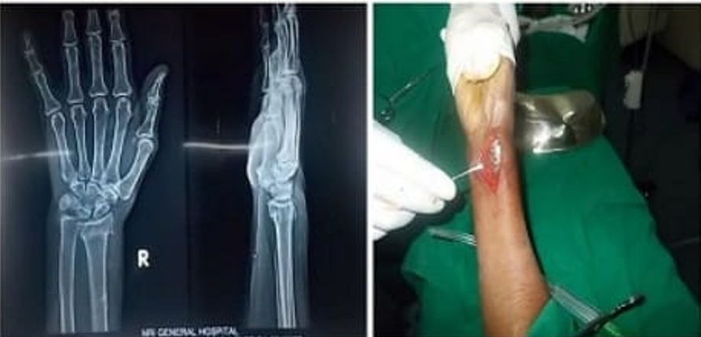
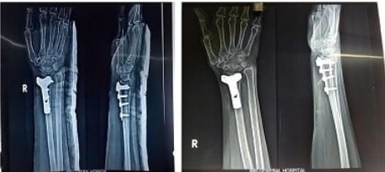
55th Annual Conference of Orthopedic Surgeon Society of Andhra Pradesh
Volar Locking Plate Fixation in Elderly Distal Radius Fractures : A Prospective Study
Dr SHAIK SIKANDER MOHSIN JUNIOR RESIDENT ; Dr N NAGA RAMA KRISHNA (ASSISTANT PROFESSOR)
ASRAM MEDICAL COLLEGE AND HOSPITAL
INTRODUCTION
OPERATIVE FINDINGS
DISCUSSION
Distal radius fractures account for approximately 15% of all upper extremity fractures and are particularly common in the elderly due to osteoporotic bone, making management challenging. Volar locking plate fixation is now widely accepted for unstable fractures as it provides anatomical reduction, stable fixation, and allows early wrist mobilization, leading to improved functional outcomes and reduced stiffness in elderly patients.
All patients were treated with open reduction and internal fixation using a volar locking plate and screws via the Volar Henry approach, achieving adequate reduction and stable fixation, which allowed early mobilization. Post-operative radiographs showed good implant positioning, and six-month follow-up X-rays confirmed fracture union with maintained alignment. Functional assessment using the DASH score revealed excellent results in 62.5%, good in 25%, and fair in 12.5% of cases. Complications included reflex sympathetic dystrophy (7.5%) and malunion (20%).
Comminuted distal radius fractures in the elderly are challenging due to osteoporosis and fracture instability, with conservative or K-wire fixation often leading to loss of reduction and malunion. Volar locking plate fixation provides a stable construct even in osteoporotic bone, functions as an internal fixator, and permits early wrist mobilization. This study demonstrates excellent to good functional outcomes in most patients, with acceptable complication rates
CASE REPORT
CONCLUSION
This prospective study included 40 elderly patients (>60 years) with osteoporotic isolated distal radius fractures, comprising 30% males and 70% females. The right wrist was involved in 75% and the left in 25% of cases. Patients with vascular injuries or associated ulna fractures were excluded.
Internal fixation of distal radius fractures in elderly patients using volar locking plates and screws provides excellent functional and radiological outcomes with good fracture reduction and early return of wrist motion.
Although K-wire fixation is a simpler and less invasive technique, it carries a higher risk of malunion, particularly in osteoporotic bone. Therefore, volar locking plate fixation is a reliable and effective treatment option for unstable distal radius fractures in the elderly.

